Slide 1

Guide Sign Design
June 17-18, 2015
Shoreview, MN

Slide 2
Sign Components
Topics
  Panels → Sizes, Radii, Borders, Margins
  Colors
  Fonts → Styles, Sizes, and Spacings
  Horizontal and Vertical Spacing
  Horizontal and Vertical Lines
  Route Markers
  Arrows
  Fractions
  Abbreviations

Slide 3
Sign Components
Panel Size
  Panels for guide signs are sized in 6" increments in all cases. Sign panel sizes are always listed with the horizontal dimension first; e.g., a 96" x 48" sign is 96" wide by 48” high.

Slide 4
Sign Components
Panel Size
  Panel size is typically determined as a function of the components and their required spacings
  For retrofits, new signs may be limited by existing mounting configuration

Slide 5
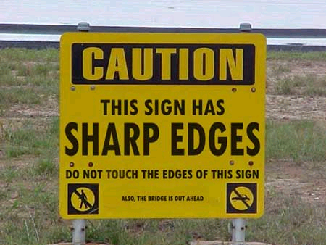


Sign Components
Panel Corners
  Generally, guide signs do not have radiused corners. The border will be radiused, but the panel corner will not be. If there is a concern that a pedestrian may be injured by a sharp corner, then the corner should be radiused.
  Non-guide sign corners shall be rounded, except for stop signs.
  Yield No Parking Warning Stop

Slide 6
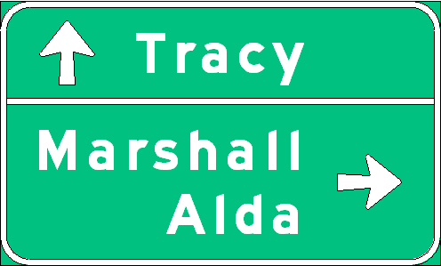
Sign Components
Borders
  Unless specifically stated otherwise, each sign illustrated herein shall have a border of the same color as the legend, at or just inside the edge

Slide 7
Sign Components
Margins
  Area between the sign edge and the border

Slide 8

Sign Components
Margins
  A dark border on a light background should have a margin, while a light border on a dark background should extend to the edge of the panel and have no margin.
White border
(Light on Darker)
Margin? No
Black border
(Dark on Lighter)
Margin? Yes
White background
(Darker on Lightest)
Margin? Yes

Slide 9
Sign Components
Page 3-2
Radii, Borders, & Margins
  Radius, Border width, and Margins are determined by the panel size, which again, is generally determined by the components.

Slide 10
Sign Components
Radii, Borders, & Margins
  Exhibit 3-1: Standard Corner Radii, Margin, & Border Width for Non-Guide Signs

Slide 11
Sign Components
Radii, Borders, & Margins
  Exhibit 3-2: Border Width and Radius for Guide Signs
    Exceptions
    1. A sign having 20” legend shall use a 3” border width and a border radius based on the above table.
    2. 16”-12” or 13.3”-10” legend on Type “A” or Type “OH” signs shall use a 2” border width and a border radius based on the above table.

Slide 12
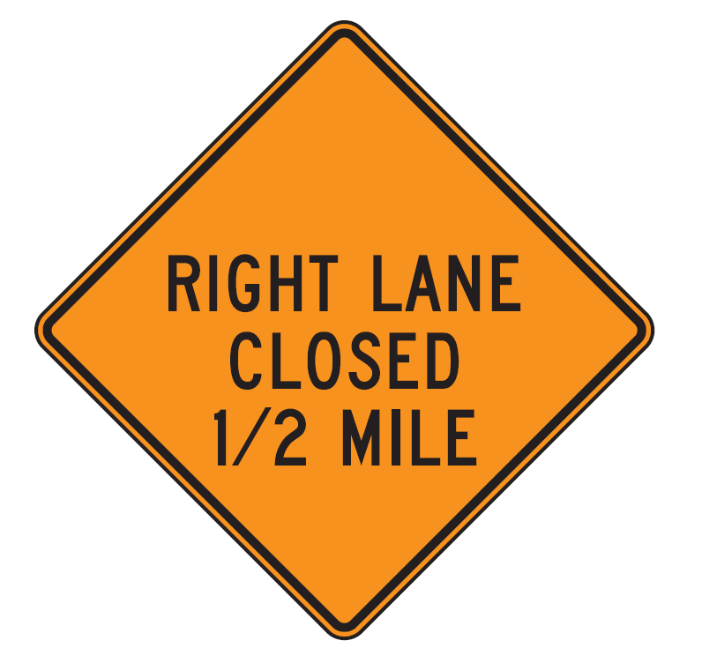

Sign Components
Colors
  Black: Used as legend color for signs with orange, white or yellow backgrounds. Black also is used as the background color for some regulatory signs.
    Legend
    Background

Slide 13
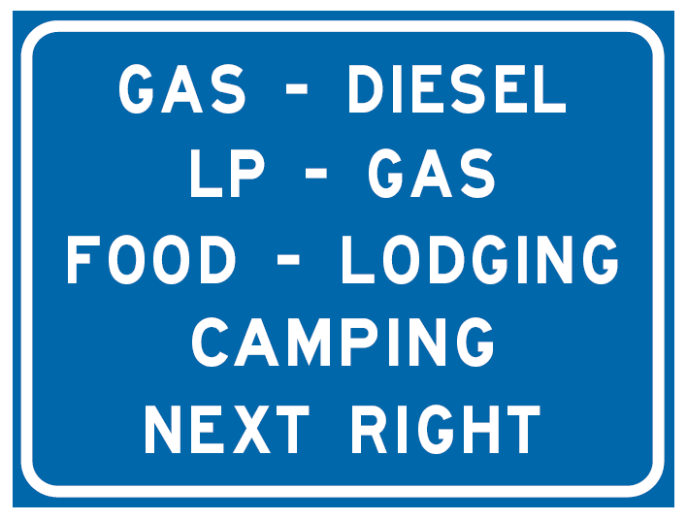
Sign Components
Colors
  Blue: Indicates services available to road users. It is used as the background color in motorist information signs, interstate, Minnesota, and county route markers, and auxiliary markers. Blue is not used as a legend color except on Adopt-a-Highway signing.
    Background
    Legend

Slide 14
Sign Components
Colors
  Brown: Indicates recreational and cultural facilities. It is used only as the background color in recreational and cultural interest signs. It is not used as a legend color.
    Background
    Legend
      None

Slide 15
Sign Components
Colors
  Green: Indicates movement permitted or gives directional guidance. It is used as the background color in guide signs and as the legend color in permissive parking signs.
    Background
    Legend

Slide 16
Sign Components
Colors
  Orange: Warns of temporary traffic conditions with a higher than normal potential hazard level. It is used as the background color in temporary traffic control signs and is most commonly seen in construction zones. It is not used as a legend color.
    Background

Slide 17

Sign Components
Colors
  Red: Indicates right-of-way control, prohibition or exclusion. It is used as the background color for STOP, DO NOT ENTER, WRONG WAY, and interstate route marker signs and as the legend color for YIELD, parking prohibition and prohibitory (circular with slash) signs.
    Background
    Legend

Slide 18
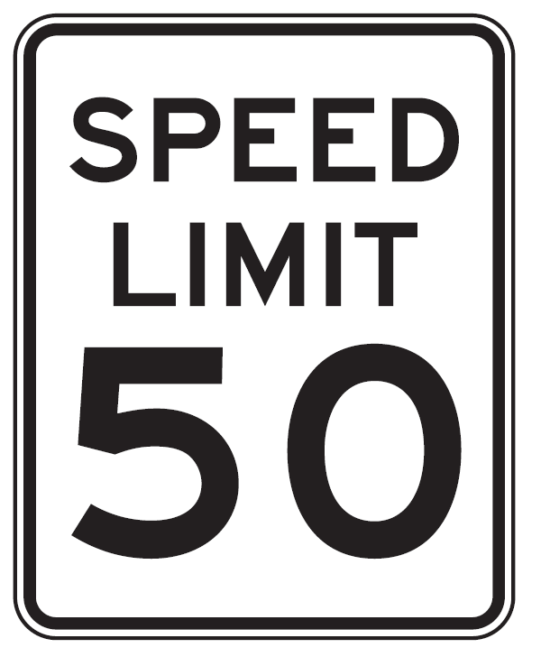

Sign Components
Colors
  White: White either indicates a law, regulation or legal requirement in effect at or near the sign or provides directional guidance. It is used as the background color for regulatory signs, route markers and route marker auxiliaries. It also is used as the legend color for signs with a black, blue, brown, green or red background.
    Background
    Legend

Slide 19
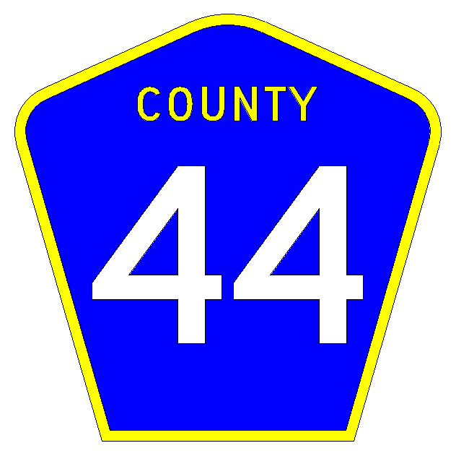
Sign Components
Colors
  Yellow: Warns of a potential hazard. It is used as the background color for warning signs and as the legend color for county route marker signs.
    Background
    Legend

Slide 20
Sign Components
Colors
  Fluorescent Yellow-Green: Designated for use as background color for warning signs and their supplemental plaques associated with pedestrians, bicyclists, playgrounds and schools. SCHOOL plaque is also included.

Slide 21

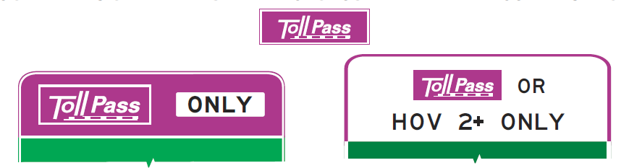
Sign Components
Colors
  Fluorescent Pink: Incident Management
  Purple: Electronic Toll Accounts (ETC) such as Minnesota’s MnPASS lanes.

Slide 22
Sign Components
Word Messages
  Except as provided in Section 2A.6 of the MN MUTCD, all word messages shall use standard wording and letters as shown in this Manual, the MnDOT “Standard Signs Manual”, and the Federal "Standard Highway Signs and Markings" book
  Word messages should be as brief as possible
  Lettering should be large enough to provide the necessary legibility distance

Slide 23
Sign Components
Word Messages
  Abbreviations should be kept to a minimum
  Word messages should not contain
    Periods
    Apostrophes
    question marks
    other punctuation or characters that are not letters, numerals, or hyphens unless necessary to avoid confusion

Slide 24
Sign Components
Word Messages
  The solidus (slanted line or forward slash) is intended to be used for fractions only
  Should not be used to separate words on the same line of legend
  A hyphen should be used for this purpose, such as "TRUCKS - BUSES

Slide 25
Sign Components
Word Messages
  Fractions shall be displayed with the numerator and denominator diagonally arranged about the solidus
  More Later….

Slide 26
Sign Components
Fonts → Type
  MnDOT uses highway gothic font styles on all MnDOT highway signs
  These range from B to F Series
  As you progress alphabetically through the font series the letters widen and the stroke widths thicken
  Two of the series have lower-case lettering - D and E Modified Series
  D Series lower-case should be used only on temporary or unique interest signing (Adopt-A-Highway signing, for example)

Slide 27
Sign Components
Fonts → Type

Slide 28
Sign Components
Fonts → Case
  All sign lettering shall be in upper-case letters as provided in
    MnDOT "Standard Signs Manual"
    Federal "Standard Highway Signs and Markings" book
    Unless otherwise provided in the MN MUTCD for a particular sign or type of message
  The sign lettering for names of places, streets, and highways shall be composed of a combination of lower-case letters with initial upper-case letters

Slide 29
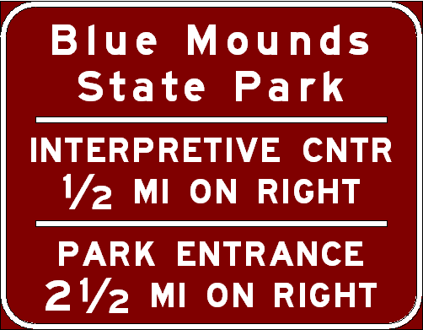
Sign Components
Fonts → Case

Slide 30

Sign Components
Fonts → Case
  The E-Modified font type has a lower-case height which is ¾ of the upper-case height.
    For example, if the upper-case height is 8” the lower-case will be 6” (8 * ¾ = 6).
    This size is referred to as 8”-6” E Modified.
Approved Letter Heights for Guide Signs (inches)
4-3 | 12 (Upper)
6-4.5 | 13.33-10
8-6 | 16-12
10 (Upper) | 18 (Upper)
10.67-8 | 20-15
h
0.75h

Slide 31
Sign Components
Fonts → Spacing between letters
  As a guide to choice of alphabets, tests have shown that, for any given legend, better legibility can be obtained by using a relatively wide spacing between letters than by using wider and taller letters with a cramped space.
  See Appendix 5.1 for spacing charts.
    Major advantage of software!

Slide 32
Sign Components
Fonts → Spacing between letters
  Font: E Mod
  Size: 10
  Spacing: Normal
  Font: E Mod
  Size: 13.3
  Spacing: -80%
  ← word width approx. same →

Slide 33
Sign Components
Fonts → Spacing between letters
  See Appendix 5.1 for spacing charts.
    Width of Letters and Numerals (for each size)
    Width of Space between Letters and Numerals
    Width of Stroke
    Repeated for lower-case letters
  Major advantage of software!

Slide 34
Example
Find the spacing for the word “EXIT”

Slide 35
Example

Slide 36
Example

Slide 37
Example
10.7
+5.94
+2.06
18.7
18.7
+6.94
+2.06
27.7
27.7
+1.60
+2.06
31.4
10.7

Slide 38

Sign Components
Fonts → Text Base Line
  With all fonts it should be noted that all characters rounded at the top, bottom, or both top and bottom, are slightly taller than the straight characters. This becomes important when fabricating a sign to correctly position the text base line.
Top of Letter
Text Base Line
Text Base Line
Bottom of Letter

Slide 39
Sign Components
Fonts → Size
  Font size is measured in terms of inches of letter height.

Slide 40
Sign Components
Fonts → Size
  Lettering sizes for specific signs are based on the characteristics of the roadway: facility type, speed, and number of lanes and desired mounting configuration.
  To determine proper MnDOT font sizes, use the following tables from the course manual:
    Exhibit 3-4 – Non-freeways (Page 3-6)
    Exhibit 3-5 – Freeways (Page 3-8)

Slide 41
Sign Components
Fonts → Size
  What size font should be used for a Distance sign on the following facility:
    Non-Freeway / Conventional Road
    55 mph
    Multilane

Slide 42
Sign Components

Slide 43
Sign Components
Exhibit 3-4 - Continued

Slide 44
Sign Components

Slide 45
Sign Components
Abbreviations

Slide 46
Sign Components

Slide 47
Sign Components

Slide 48
Sign Components
Horizontal Spacing
  Horizontal spacing between objects is typically equal to the font size
  An exception is with city names such as La Crosse or Le Roy, where 60% of the font size is used between the two parts of the name
  This 60% spacing has been programmed into SignCAD®, so no special spacing need be created

Slide 49
Sign Components
Horizontal Spacing
  Spacing between objects and borders is between ½ and ¾ of the font size
    Distance signs, where the spacing between objects and borders is 13” (constant value)
  When designing freeway distance signs, a minimum of 21” space is required between a destination and its corresponding mileage, while a minimum of 18” horizontal space is maintained between the longest destination line and the longest mileage

Slide 50
Sign Components
Vertical Spacing
  Special vertical spacing for Freeway Distance Signs has been developed by MnDOT and is summarized in Exhibit 3-9.

Slide 51
Sign Components
Vertical Spacing

Slide 52
Sign Components
Vertical Spacing

Slide 53
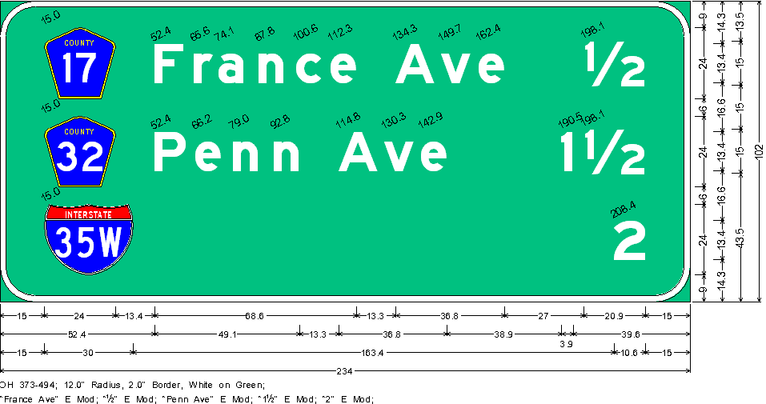
Sign Components
Vertical Spacing
  Example
    Three overlays control vertical spacing, use Combo #1

Slide 54
Sign Components
Horizontal and Vertical Lines
  Horizontal lines, border to border, are used to separate independent subjects on a single sign panel
  Horizontal lines are used primarily on destination signing
  The examples below are the only instances where a horizontal line is needed on a two-destination sign panel

Slide 55
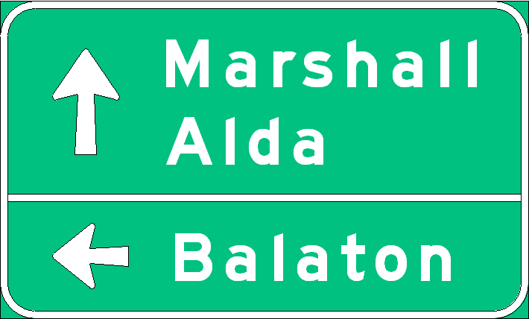
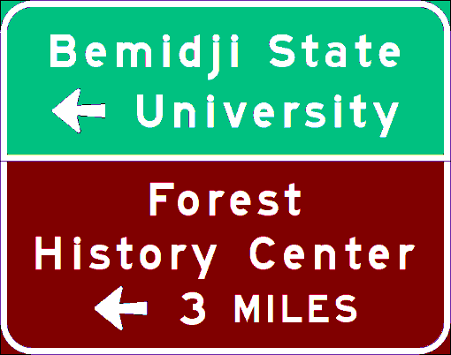
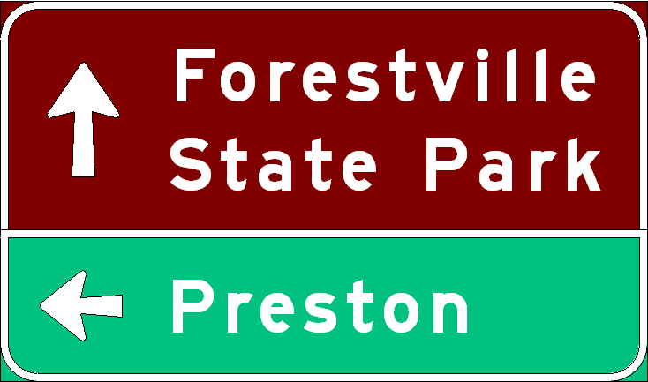
Sign Components
Horizontal and Vertical Lines
  On destination signs with three or more lines of legend a horizontal line is needed if two lines share an arrow
  The line is border to border

Slide 56
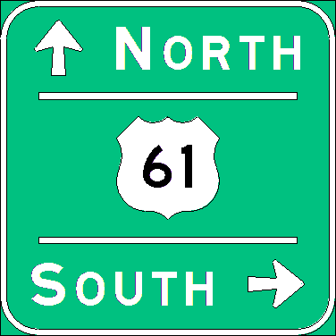
Sign Components
Horizontal and Vertical Lines
  Indented horizontal lines are used on panels with more than one message about a single subject. They may act as a form of punctuation, separating phrases to avoid confusion.

Slide 57
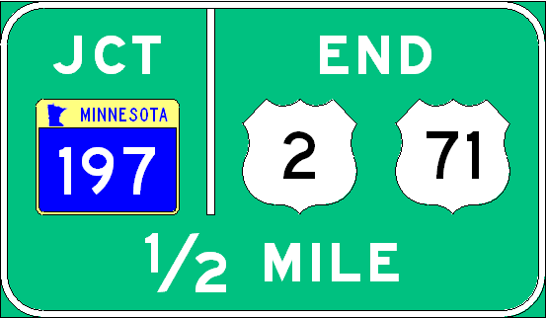
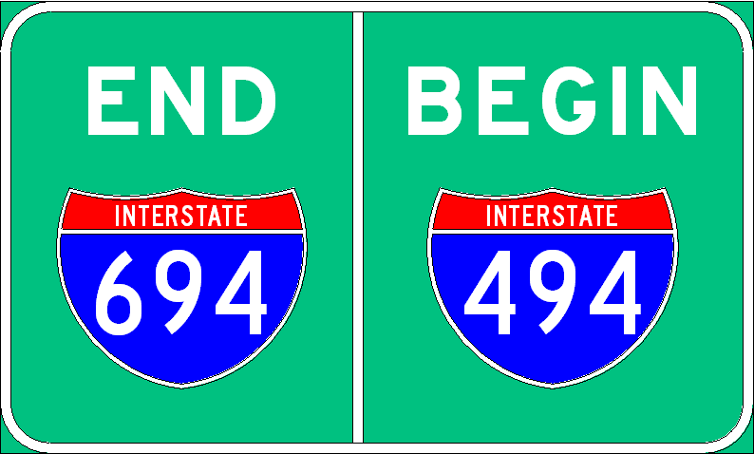
Sign Components
Horizontal and Vertical Lines
  Vertical lines separate different directional movements and subjects to prevent confusion.

Slide 58
Sign Components
Route Markers
  The route markers are listed in the M series of the Standard Signs Manual and the Standard Signs Summary
  One or two digit route markers will have the same width and height dimensions, but three digit markers have a width that is 25 percent greater than their height
  Route markers attached to the surface of a guide sign panel are referred to as overlays

Slide 59
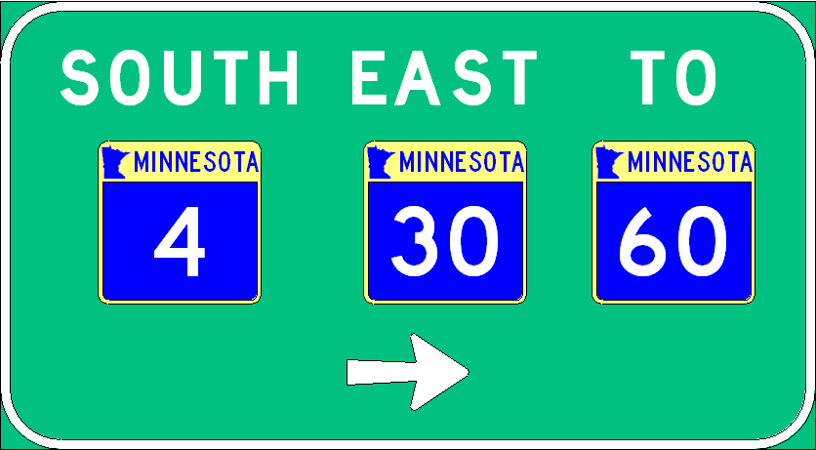
Sign Components
Route Markers → Layout
  Sign panels containing two or more route marker overlays are laid out in the following way:
    Group overlays by arrow direction
    Group by functional class
    Group same functional classes from low to high

Slide 60
Sign Components
Route Markers → Layout
  On signs with one route marker, cardinal directions are always located to the right of route markers and top-justified, except on distance signs.
  On Distance signs, cardinal directions are middle justified.

Slide 61
Sign Components
Route Markers → Layout
  On signs with more than one route marker, cardinal directions are always centered above the route markers.

Slide 62
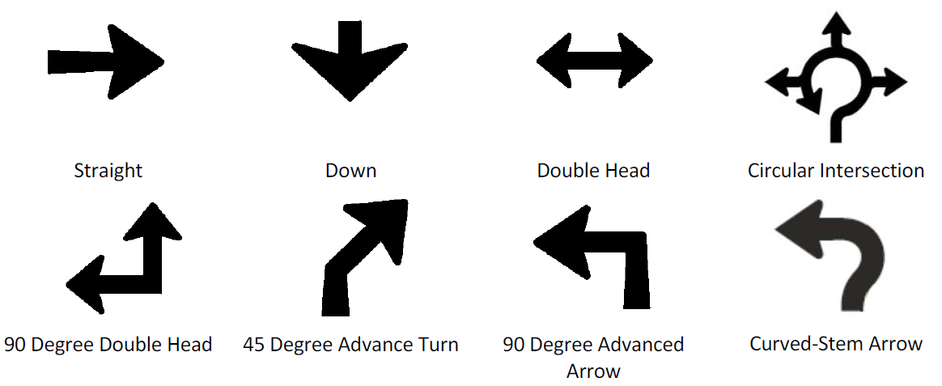
Sign Components
Arrows
  Arrows for guide signs are divided into several types

Slide 63
Sign Components
Arrows
  Straight arrows can be installed at different angles, from 0 to 180 degrees, with 0 degrees designated right, 90 degrees straight up, and 180 degrees left.
  Straight arrows can have a long or short shaft, depending on the angle and adjacent text
  Specifically, 60 degree arrows are used for exit ramps, and 45 degree arrows for exit loops.
90º
180º
0º

Slide 64
Sign Components
Arrows
  Down arrows shall be used only on overhead guide signs that restrict the use of specific lanes to traffic bound for the destination(s) and/or route(s) indicated by these arrows
  Down arrows shall not be used unless an arrow can be located over and pointed to the approximate center of each lane that can be used to reach the destination displayed on the sign

Slide 65
Sign Components
Arrows
  If down arrows are used, having more than one down arrow pointing to the same lane on a single overhead sign (or on multiple signs on the same overhead sign structure) shall not be permitted

Slide 66
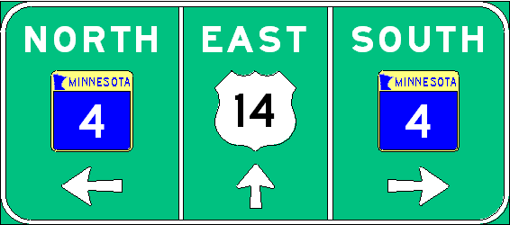
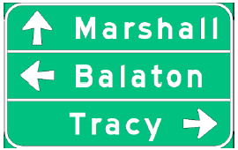
Sign Components
Arrows
  When more than one arrow is used on a sign, the arrows, with corresponding legends, are to be placed in the order specified below:

Slide 67
Sign Components
  Arrows are referenced by head number – length
  5-13

Slide 68
Sign Components
Fractions
  A fraction is always 1.5 times the height of the numerals used in it
  When using a whole number with a fraction the height of the number should be close to, or the same as, the overall height of the fraction, without being greater

Slide 69
Sign Components
Fractions
  If a fraction is used on a line with additional legend (as in “1/2 MILE ON RIGHT”) the fraction numerals should be the same height as the legend letter height, as shown below

Slide 70
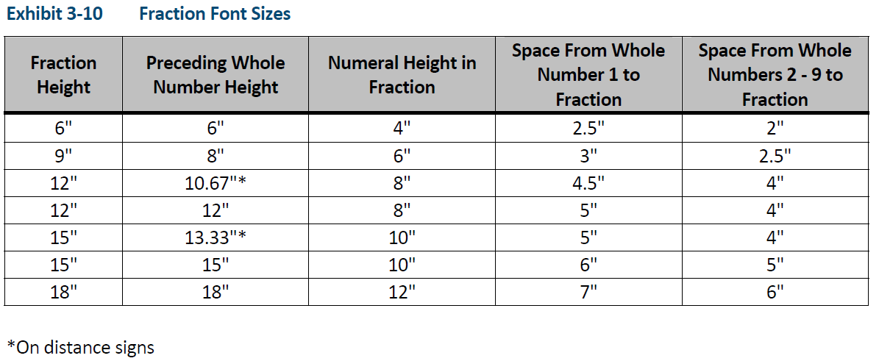
Sign Components
Fractions

Slide 71
Sign Components
Legend/Layout Justifications
  Along with Arrow placements (Section 3.8) the wording on a panel is aligned (or justified) left, center, or right
  Various suggested layouts are illustrated on the following slides

Slide 72
Sign Components
Legend/Layout Justifications

Slide 73
Sign Components
Legend/Layout Justifications

Slide 74
Sign Components
Legend/Layout Justifications

Slide 75
Sign Components
Legend/Layout Justifications

Slide 76
Sign Components
Legend/Layout Justifications

Slide 77
Sign Components
Legend/Layout Justifications

Slide 78
Sign Components
Legend/Layout Justifications

Slide 79
Sign Components
Typical Freeway Guide Signs
  Advanced Guide Type A
    There are two formats to this classification, one or two city names
    The border shall be three (3) inches wide due to the use of 20-15” legend. The spacing is standardized, as follows:

Slide 80
Sign Components
Typical Freeway Guide Signs
  Advanced Guide Type A
    One City

Slide 81
Sign Components
Typical Freeway Guide Signs
  Advanced Guide Type A
    Two Cities

Slide 82
Sign Components
Typical Freeway Guide Signs
  Exit Direction Type A
    There are two formats to this classification, one or two city names. The border shall be three (3) inches wide due to the use of 20-15” legend. The spacing is standardized, as follows:

Slide 83
Sign Components
Typical Freeway Guide Signs
  Exit Direction Type A
    One City

Slide 84
Sign Components
Typical Freeway Guide Signs
  Exit Direction Type A
    Two Cities

Slide 85
Sign Components
Sign Posts
  The following chart (page 3-25) determine the number of posts and knee braces needed to erect a sign panel so the sign and structure can adequately resist wind loads
  Note the Type “A” sign areas that require I-beam sign posts which are installed under contract

Slide 86
Sign Components

Slide 87
Sign Components
Sign Posts → U-Post Charts
  Determine Sign Post Structure
    U-Post Structure Charts - Ground-Mounted Signs
    Desirable to stay within U-post area for cost considerations
    Enter table based on panel width and height
      66” wide by 30” tall

Slide 89
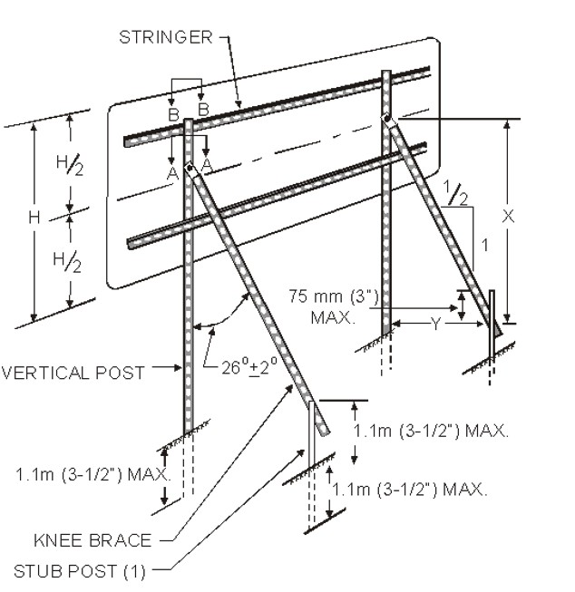
Sign Components

Slide 90
Sign Components
Sign Posts → U-Post Charts
  While adhering to the required letter height for a sign panel, it is desirable to stay within the U-post area of the tables due to cost and ease of installation and maintenance
  In some cases, it is possible to change design
    For example, on the 3 pound/ft chart:
      a 102” x 84” sign panel, can be installed on U-posts
      a 90” x 84” sign panel, however, must be installed on I-beam posts

Slide 91
102”x84”
U-post check satisfactory
90”x84”
U-post check UNsatisfactory

Slide 92
Sign Components
Sign Posts → Post Spacing
  Proper U-post spacing is essential for sign structures to meet FHWA breakaway requirements
  It is also important when redesigning a sign panel if the existing U-post sign structure will be reused
    For example, an existing 2 post (54” spacing) sign structure with an 84” x 48” sign panel could accommodate a 78”, 84”, 90” or 96” sign panel that is 48 inches high on the existing sign structure without moving the vertical posts (chart on page 3-23)

Slide 93
Sign Components
Sign Posts → Post Spacing
  Conclusion: We can resize the panel without changing the structure

Slide 94
Sign Components
84”
48”
54”

Slide 95
Sign Components
SignCAD Demonstration

