Slide 1

Guide Sign Design
June 17-18, 2015
Arden Hills, MN

Slide 2
Basic Information/Background
Signs
  Several basic provisions for regulating, warning, and guiding traffic
    Fulfill a need
    Command attention
    Convey a clear, simple meaning
    Command respect of road users
    Give adequate time for proper response

Slide 3
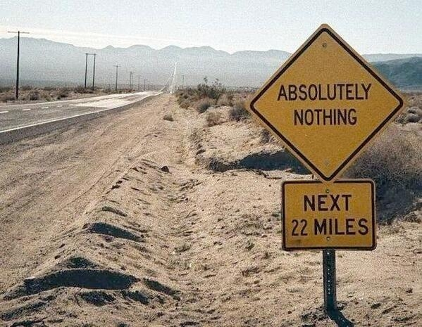
Basic Information/Background
Fulfilling a need?

Slide 4

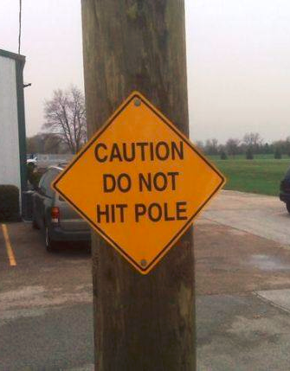
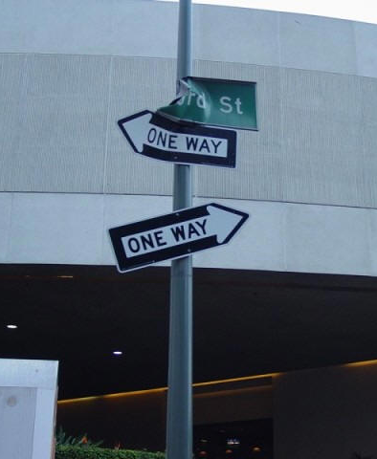
Basic Information/Background
Commanding Attention?

Slide 5
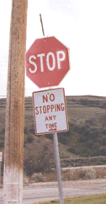
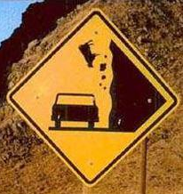
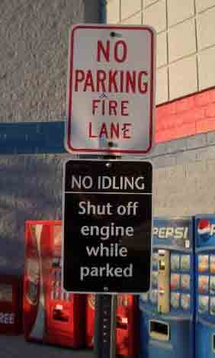
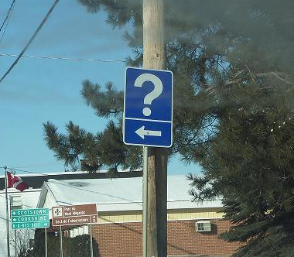
Basic Information/Background
Conveying a clear, simple meaning?

Slide 6
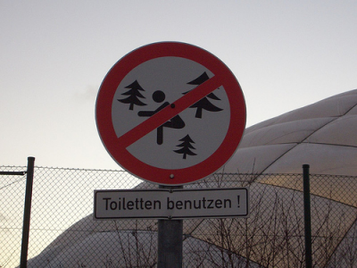
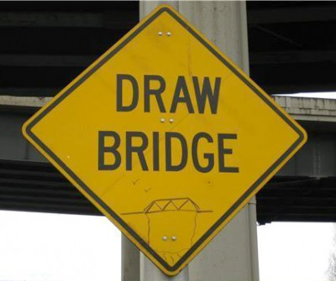
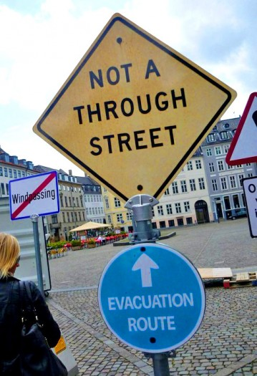


Basic Information/Background
Commanding Respect of Road Users?

Slide 7
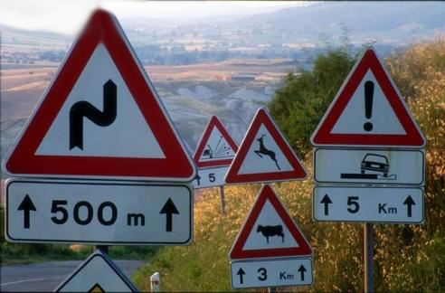
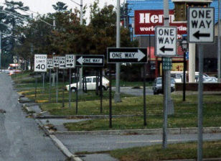
Basic Information/Background
Giving Adequate Time for Proper Response?

Slide 8

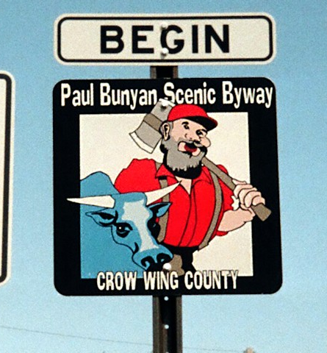
Basic Information/Background
Historical Perspectives
  Guide Signs
    MnDOT has over 90 years of experience in signing and is a national leader in signing
    Consistency in signing was key from beginning
  Lettering Style and Size
    Various styles have been developed over the years:
      A (no longer used), B, C, D, E, F, E modified, & D modified
      Research will continue to improve signing
    National (minimum) standards set by FHWA

Slide 9
Basic Information/Background
Sign Design Variables
  Guide signs compete for the drivers attention like all traffic control devices
  Need to get the message across in a clear, simple, and efficient manner
    Consistency with readability is key
  Human Factors Exercise
    Volunteer? (Rick)

Slide 10
Basic Information/Background
Say the COLOR of the text as fast as possible
Yellow
Red
Blue
Orange
Green
Grey
Pink
Black
Brown

Slide 11
Basic Information/Background
Say the COLOR of the text as fast as possible
Green
Grey
Orange
Black
Brown
Pink
Grey
Green
Black

Slide 12
Basic Information/Background
Human Factors Exercise
  We are visual readers
  As designers, we sometimes unknowingly ‘trick’ the road user
  Major implications to the science of signing
  What can we do?
    Consistency with readability is key

Slide 13
Basic Information/Background
Page 2-4
MnDOT Specific Guidance for Traffic Signs
  Basic Considerations for Installation of Traffic Signs
    Design: size, color, shape
    Placement: physical location
    Operation: application of the device, readability
    Maintenance: upkeep and removal
    Uniformity: same message for similar situations

Slide 14
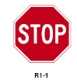
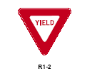

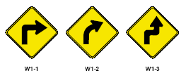
Basic Information/Background
  Functional Classifications of Traffic Signs from the MN MUTCD:
    Regulatory signs
    Warning signs
    Guide signs
      Focus of this class

Slide 15
Basic Information/Background
  Guide signs for expressways and freeways have two (2) sub-classifications:
    Primary guide signs
      Advance junction signs, exit directional signs, exit gore signs, destination signs, freeway exit numbers, distance signs
    Supplemental guide signs
      Provide further geographic orientation and secondary destinations at interchanges
      Destinations include cities, motorist services, or traffic generators.

Slide 16
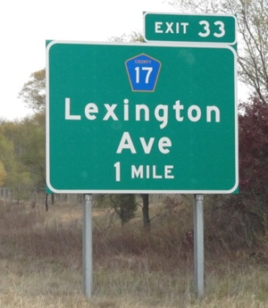
Basic Information/Background
  Department Classification by Sign Design Type
    Type A signs are large breakaway guide, directional, or informational signs normally installed on mainline freeways, expressways, and occasionally on conventional roads

Slide 17
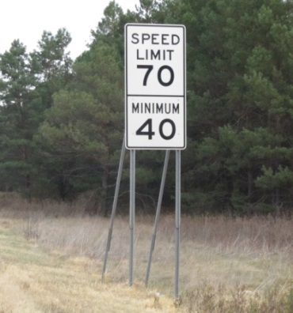
Basic Information/Background
  Department Classification by Sign Design Type
    Type C signs are primarily regulatory, warning, route marker assemblies, and auxiliaries, as found in the Standard Signs Manual
    They are the most common sign type and typically installed on driven U posts or square tube posts

Slide 18
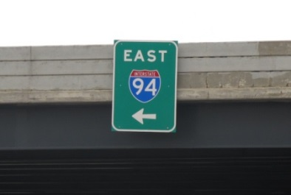
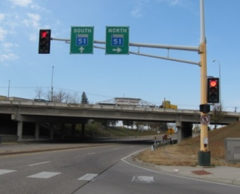
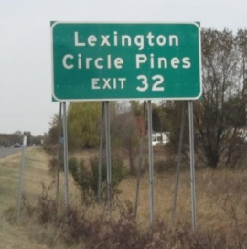
Basic Information/Background
  Department Classification by Sign Design Type
    Type D signs are the smaller guide, destination, or informational signs.

Slide 19
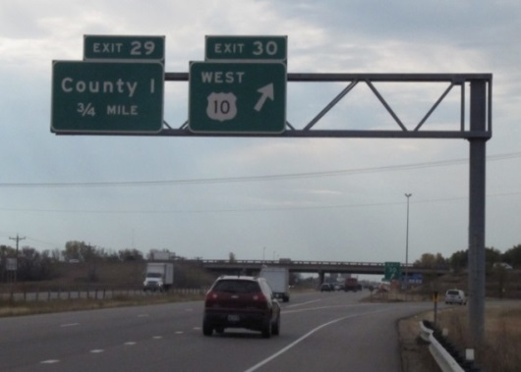
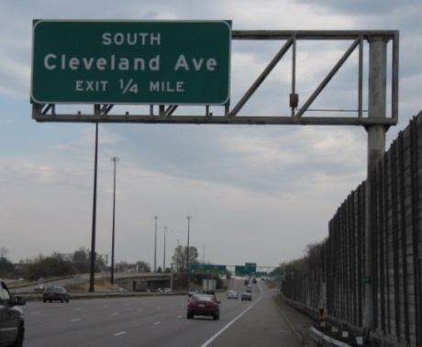
Basic Information/Background
  Department Classification by Sign Design Type
    Type OH – mounted overhead
      sign support (no walkway or sign lighting)

Slide 20
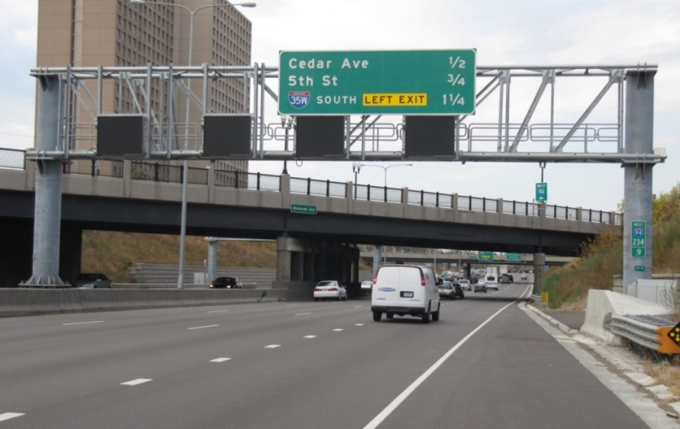
Basic Information/Background
  Department Classification by Sign Design Type
    OH
      truss (may or may not include walkway and sign lighting) and

Slide 21
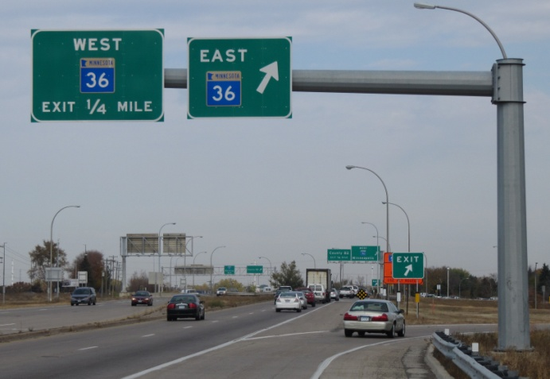
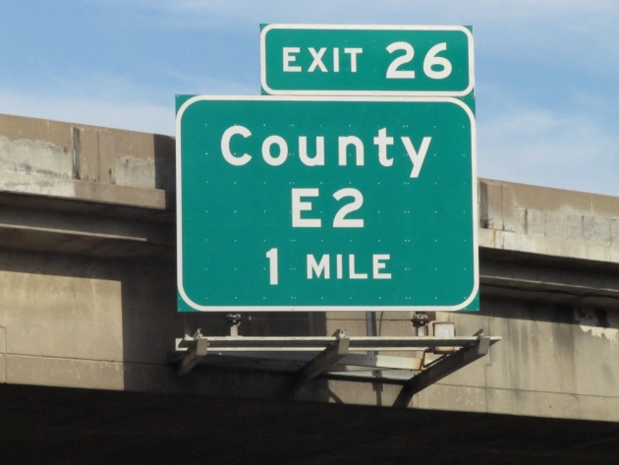
Basic Information/Background
  Department Classification by Sign Design Type
    OH

Slide 22
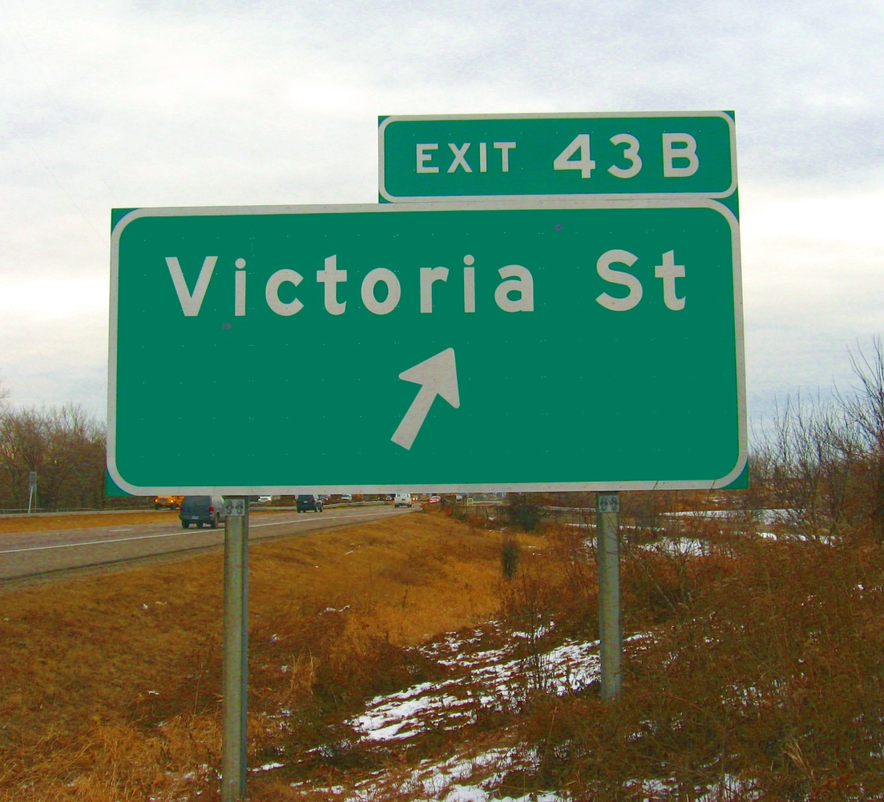
Basic Information/Background
    Type EA signs are exit number panels attached with U-posts to Type A sign panels.

Slide 23
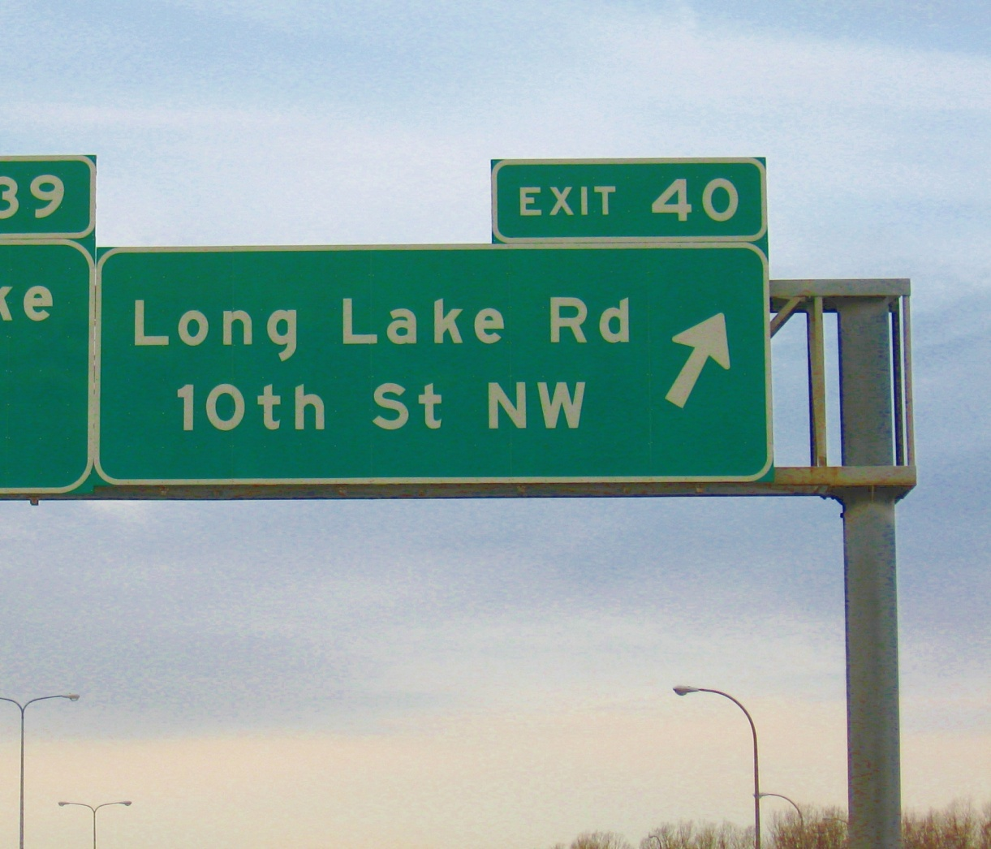
Basic Information/Background
    Type EO signs are exit number panels attached with U-posts to Type OH sign panels.

Slide 24
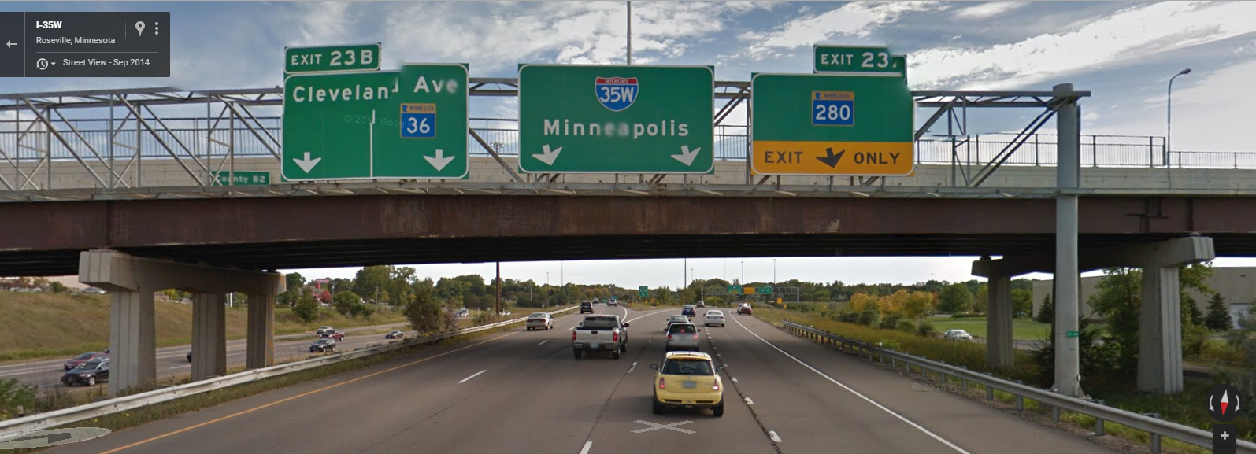
Basic Information/Background

Slide 25
Basic Information/Background
  Conventional Road (Single Lane)
    A two-lane, two-way roadway
  Conventional Road (Multilane)
    An undivided highway with more than one lane in each direction of travel and having a posted speed equal to or less than 60 mph or a divided highway with more than one lane in each direction of travel and having a posted speed equal to or less than 55 mph

Slide 26
Basic Information/Background
  Expressway
    A high speed, divided, multi-lane highway which is generally an arterial road with a posted speed of 55 mph and greater
    Most intersections are at grade, although grade separated interchanges may exist

Slide 27

Basic Information/Background
  MnDOT Conventional Roads Guide Sign Types
    Destination signs typically have a destination(s) with an accompanying arrow(s) indicating direction. No more than three city names should be on a sign. A few exceptions have been made where multiple routes intersect.

Slide 28
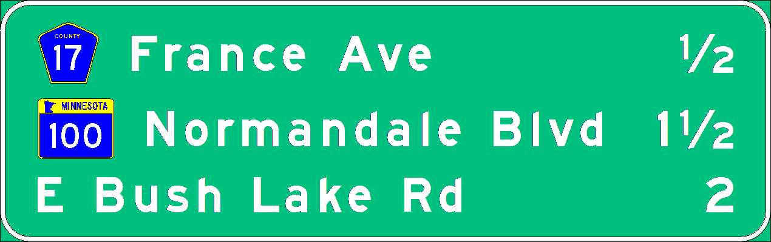
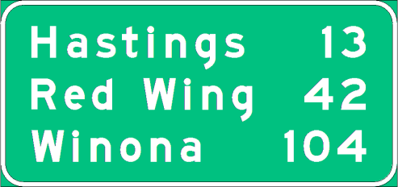
Basic Information/Background
  MnDOT Conventional Roads Guide Sign Types
    Distance signs typically have a destination(s) with mileage(s) indicating the distance from the sign location. No more than three city names should be on a sign. A few exceptions have been made where multiple routes intersect at junctions.

Slide 29
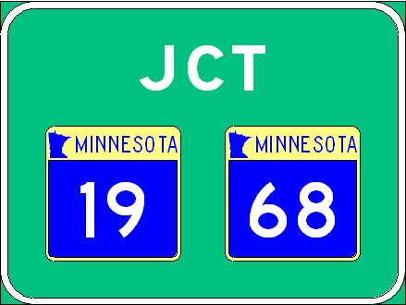
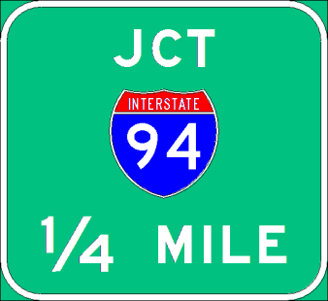
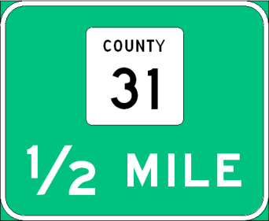
Basic Information/Background
  MnDOT Conventional Roads Guide Sign Types
    Junction signs indicate the intersection of two or more routes.

Slide 30
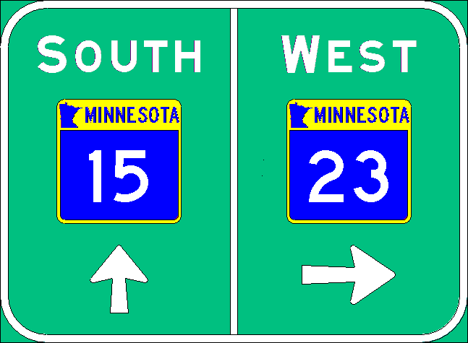
Basic Information/Background
  MnDOT Conventional Roads Guide Sign Types
    Directional signs typically have a route marker(s), possibly city or street names, and an arrow(s) indicating turning direction.

Slide 31
Basic Information/Background
  MnDOT Conventional Roads Guide Sign Types
    Supplemental signs show secondary destinations such as airports or tourist attractions. Under MnDOT policy supplemental signs may be provided for the following:
      National Parks
      National monuments
      State parks, with certain amenities
      Airports
      Educational institutions
      Traffic generator signing

Slide 32
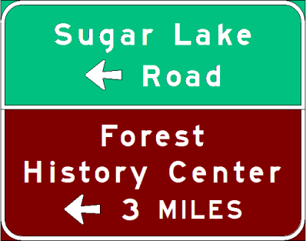

Basic Information/Background
  MnDOT Conventional Roads Guide Sign Types
    Supplemental signs show secondary destinations such as airports or tourist attractions. Under MnDOT policy supplemental signs may be provided for the following:

Slide 33

Basic Information/Background
  MnDOT Conventional Roads Guide Sign Types
    Street name signs are normally mounted only on mast arms.
    Specific service signs

Slide 34
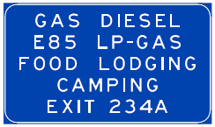
Basic Information/Background
  Supplemental and Motorist Services Signs
    Numbered Interchanges
    Unnumbered Interchanges

Slide 35

Basic Information/Background
  MnDOT Freeway Guide Sign Types
    Distance (Sign Type A or OH)
    Advanced Guide

Slide 36








Basic Information/Background
  MnDOT Freeway Guide Sign Types
    Exit Directional Guide
    Exit Panel (Sign Type EA or EO)

Slide 37
Basic Information/Background
  MnDOT Freeway Guide Sign Types
    Supplemental Guide (Sign Type A or OH)

Slide 38
Basic Information/Background
  REVIEW

Slide 39
Basic Information/Background
  REVIEW
    What is the MnDOT Design Type classification of this sign?
    A
    C
    D
    OH
    EA
    EO

Slide 40
Basic Information/Background
REVIEW
  What Type of Guide Sign is this sign?
    Advance Guide
    Distance
    Exit Directional
    Supplemental Guide
    Exit Panel

Slide 41

Overhead Sign

