Slide 1

Indian Country Lunch and Learn
Learning about Government and Lands
Mary Otto - Levi Brown | Tribal Liaison Manager
Presented by: Government Affairs
Date: October 15, 2019

Slide 2
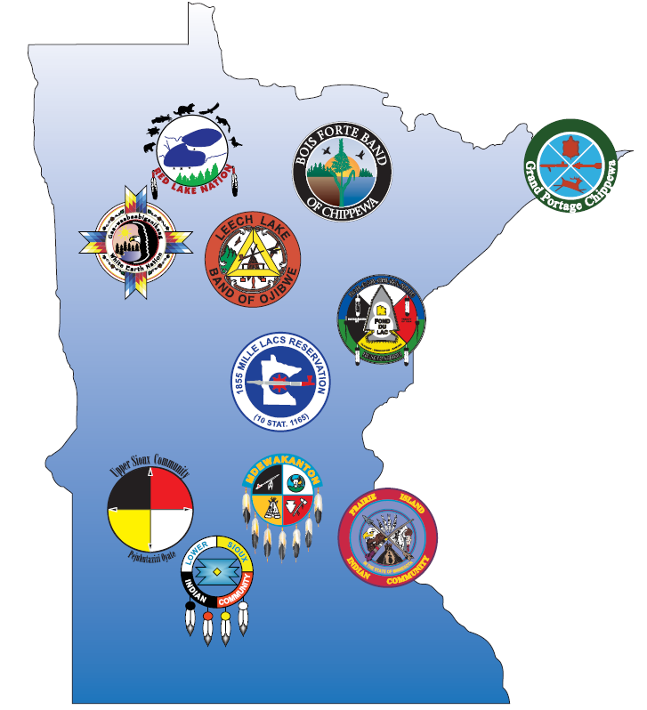
Tribal Governments in Minnesota
MnDOT District | Reservations/Tribal Lands
1 | Bois Forte, Leech Lake, Fond du Lac, Grand Portage, Mille Lacs
2 | Leech Lake, Red Lake, White Earth
3 | Leech Lake, Mille Lacs
4 | White Earth
6 | Prairie Island, Ho-Chunk
7 | None (Dakota 38 Memorial Ride)
8 | Lower Sioux, Upper Sioux
Metro | Shakopee Mdewakanton
Notes:
Levi
7 Ojibwe Tribes: Red Lake, Bois Forte, Grand Portage, White Earth, Leech Lake, Fond du Lac and Mille lacs
4 Dakota Tribes: Upper Sioux, Shakopee Mdewakanton, Prairie Island, and Lower Sioux

Slide 3
Tribal Membership
Dual Citizenship
Prairie Island: 1100
Red Lake: 10,000
Shakopee Mdewakanton Sioux: 480
Upper Sioux: 600
White Earth: 18,500
Bois Forte: 3500
Fond du Lac: 4200
Grand Portage: 1100
Leech Lake: 9400
Lower Sioux: 1100
Mille Lacs: 4300

Slide 4
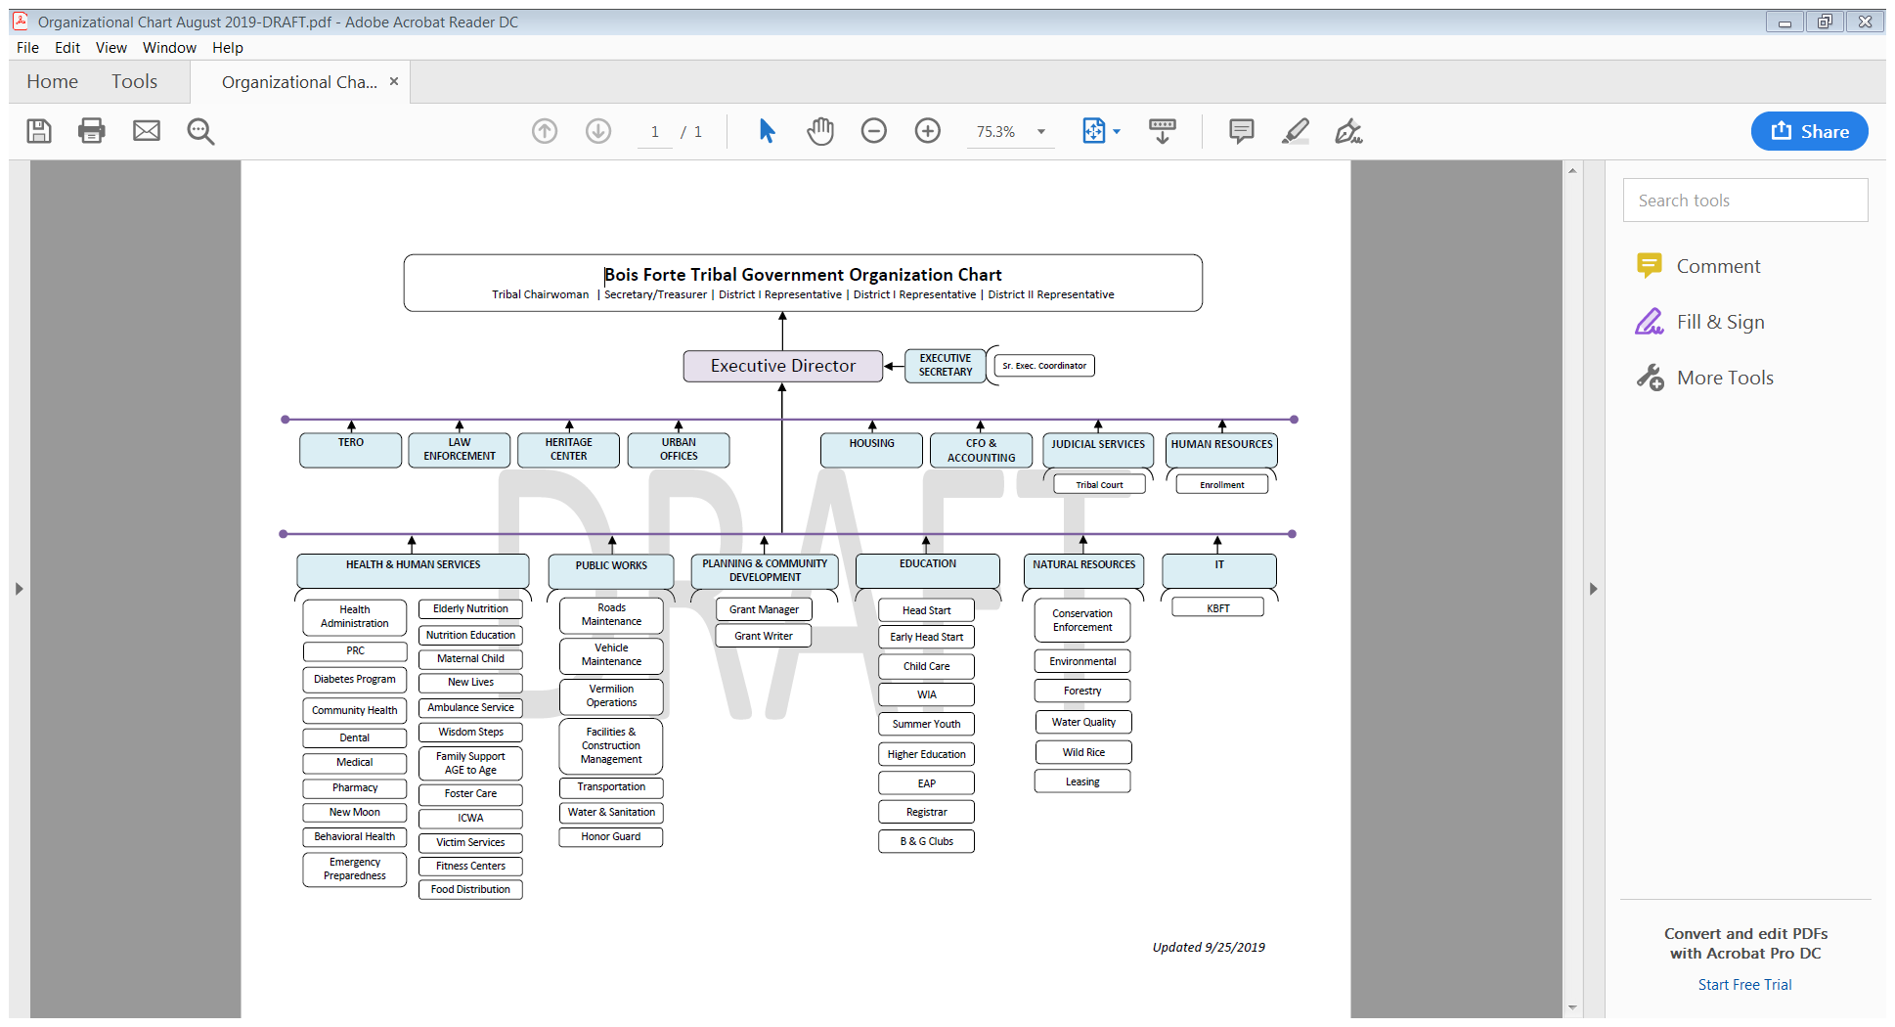
Tribal Government Structure

Slide 5
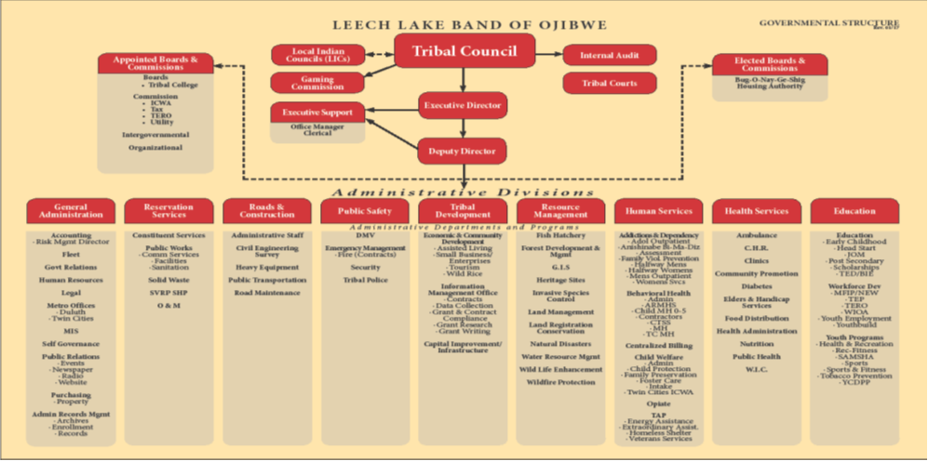
Tribal Government Structure

Slide 6
State Counterpart
Utilize your liaison to discover who your counterpart is at the Tribal level
Recognize the government to government relationship between the state agency and the tribe
Tribes are not programs, non-profits or organizations that we contract with, Tribes are sovereign nations and need to be recognized as such

Slide 7
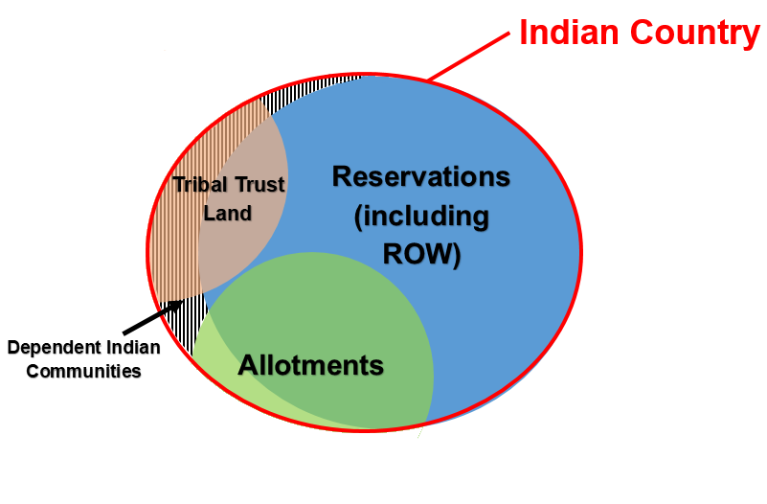
Indian country
Indian country is the area where questions about jurisdiction between state and tribal governments arise.
As shown on the left, Indian Country is:
Reservations including right-of-way going through reservations;
Some allotments (allotments the Indian title to which has not been extinguished); and
Dependent Indian Communities (usually found on tribal trust land).
Notes:
Lindsey

Slide 8
Land Ownership
Trust Land
Tribal Trust Land – 11
Allotted Trust Land - 6
Unrestricted Fee Land
Fee simple land owned by a tribe - 11
Fee simple land owned by an individual Indian - 6
Fee simple land owned by a non-Indian – 6
Notes:
Levi

Slide 9
Trust Land
Land held by the United States Government in Trust for a Tribe.
This creates an actual fiduciary trust responsibility.
The Unites States is the legal owner, the Tribal Government is beneficial owner. (Example MCT Lands)
The land is a Federal/Tribal jurisdiction rather than a Federal/State/Tribal Jurisdiction
It does not matter if the Fee Land is within the exterior boundary of a Reservation, rights are the same.
Trust land is Indian Country and treated as Reservation for most, if not all, purposes.
It is effectively not part of the State surrounding it. State law does not apply subject to Public Law 280.
States may not exercise eminent domain actions against trust land.

Slide 10
Reservations
Reservation –
  Open (10) vs. Closed (1)
    Checker boarded – A pattern of Indian and non-Indian ownership within the exterior boundary of a Reservation
  Non Public Law 280 (2)
    Red Lake and Bois Forte

Slide 11
Ceded Territory
This is a treaty created situation.
When Indian Nations granted land to the U:nited States in treaties they reserved land for themselves and also reserved Usufructuary Rights (the rights to hunt, fish, gather, pass through and use for certain purposes).
These rights continue to exist and are exercised by the various Bands in Minnesota and Wisconsin.
Since these were created by Treaty they are fundamental Federal law.
This creates a complex jurisdictional situation regarding those rights.
The four (4) Dakota Communities in Minnesota have not pursued ceded territory Usufructuary rights. Their treaty situation is complicated.

Slide 12
Tribes & the Economy
Tribes are Minnesota’s 14th largest employer
Tribes pay their gaming and government employees more than $500 million in wages and benefits annually
Tribal casinos pay more than $64 million annually toward employee health and dental insurance benefits
Tribes purchase more than $717 million in goods and services annually, including more than $482 million from Minnesota businesses
Tribal casinos attract almost 23 million visitors annually, second only to Mall of America
*Data from August 2016

Slide 13
Maps & Resources
iHUB “Tribal Lands” site:
    A to Z, “T” for “Tribal Lands”
    Guidance for MnDOT’s Work in Indian Country
Tri-Party Map: Map comparing federal, state, and tribal data on boundaries
Two-party Map: Map comparing federal and state data on reservation boundaries
MnDOT CHIP: Includes reservation boundaries
Notes:
Levi

Slide 14
Thank you again!
Levi Brown – Mary Otto
Levi.Brown@state.mn.us – Mary.otto@state.mn.us
651-236-7048

