Slide 1


2018 Pavement Workshop
May 23-24, 2018
Maintaining Poor Pavements
NRRA Preventive Maintenance Team
Long Term Research Project
Joe Korzilius
Senior Associate
SRF Consulting Group, Inc
+ 46 Associate Members

Slide 2
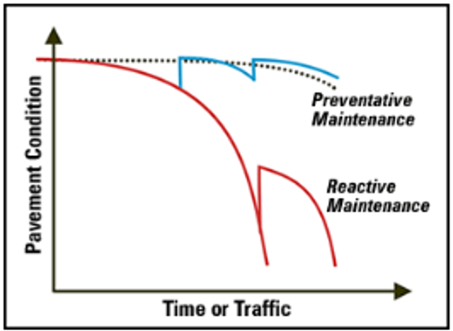
Project Objective
To identify performance improvement and durability that can be expected for Hot Mix Asphalt (HMA) pavement in poor condition from the application of a thin pavement rehabilitation treatment.

Slide 3
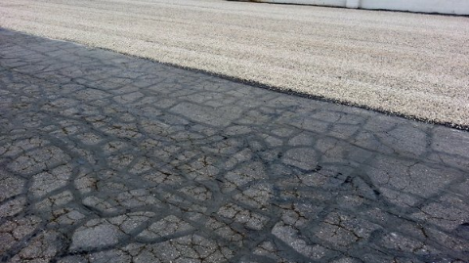
Project Goal
What are the Practices
What are the Results
To summarize practices being performed and collect performance and cost data from NRRA states to then provide guidance to consider for extending service life of lower volume roadways

Slide 4
Project Tasks
Literature Review
Collect Data from NRRA States
Analysis of Data
Draft Final Report
Final Report
We are here!

Slide 5
Literature Review
Completed in May 2018
Reviewed existing literature
  relative to management of pavements in poor condition
  use of thin surface treatments as stop gap measures to improve ride and prolong useful life
Established definitions of applied treatments
  Limited to those that are considered
  “Thin” = less than a 2" depth.
General Treatments Considered in the Study
Thin Overlay (with or without milling) | 10. Fibermat Chip Seal
2. Thinlay (with or without milling) | 11. Scrub Seal
3. Hot in-place recycling (HIR) | 12. Cape Seal
Open Graded Friction Courses (OGFC)/Plan Mix Seal Courses | 13. Fog Seal
5. Texas Under Seal | 14. Rejuvenating Fog Seal
Ultra Thin Bonded Wearing Course/ Paver Placed Surface Seal/Nova Chip | 15. Bio Fog Seal
Microsurfacing | 16. Otta Seal
8. Slurry Seal | 17. Scratch Course
9. Chip Seal | Mastic Surface or Crack Treatment

Slide 6
“Development of Holding Strategies for Deteriorated Low Volume Roads and Evaluation of Performance of Iowa Test Sections”
Iowa Department of Transportation and Iowa State University, Ames.
The study found that a holding strategy can be successfully employed by selecting treatments that use a combination of thin hot mix overlays, surface treatments and in-place recycling.

Slide 7
(2014 - MnDOT)
National Center for Freight and Infrastructure Research
“Cost Effective Means of Managing Pavements in Poor Condition” Univ. of Wis. Madison, Dept of Civil and Environmental Engineering.
Goal: Identify treatments or materials that could be used to extend the service life of pavements in poor condition.
Objectives:
  Establish a basis for evaluating end-of-life pavement treatments using user needs, cost-effectiveness, and environmental impact.
  Create tools for selecting and analyzing strategies
  Suggest design strategies in resurrecting roads in poor condition.

Slide 8
Collect Data from NRRA States
Questions for Data Gathering: May 2018
Compiling performance and cost data from NRRA Member States.
Data is intended to identify
  performance improvements
  durability to be expected from the application of a thin surface treatment to an HMA pavement in poor condition

Slide 9
Questions 1-5 for Case Studies
1
Please provide a listing of pavement segments in poor condition that received a thin surface treatment.
2
3
Collect IRI
4
5
What surface treatment(s) was performed. Refer to Definitions.
Collect SR
(Before/after application of thin surface treatment; After year 1 and successive years where data is available; Any before/after photos?)
If the treatment performed does not fit into any of the definitions provided, describe.
(Before/after application of thin surface treatment; After year 1 and successive years where data is available; Any before/after phots?)
Cost of surface treatment
(Total project cost with material/installation; Area covered; Cost per lane mile)

Slide 10
Questions 6-10 for Case Studies
6
When was the next rehabilitation performed?
7
8
Case Studies from NRRA member States.
9
10
What is the basic structure and construction of history of the roadway segment?
Please describe the most significant distress(s) being addressed.
Description of roads that were in poor condition and a treatment was applied to extend life.
Please describe the methodology or decision making process followed to select the rehabilitation application.

Slide 11
Analysis of Data
Data analysis will focus on
  Effectiveness
    Initial improvement to ride quality after application of various thin rehabilitation treatments
  Performance
    Rate of loss of ride quality after treatment application
  Comparison of Treatment Performance
    Do multiple passes or patching improve durability
  Cost of Treatment
    Cost Benefit Analysis
    Life Cycle Cost Assessment

Slide 12
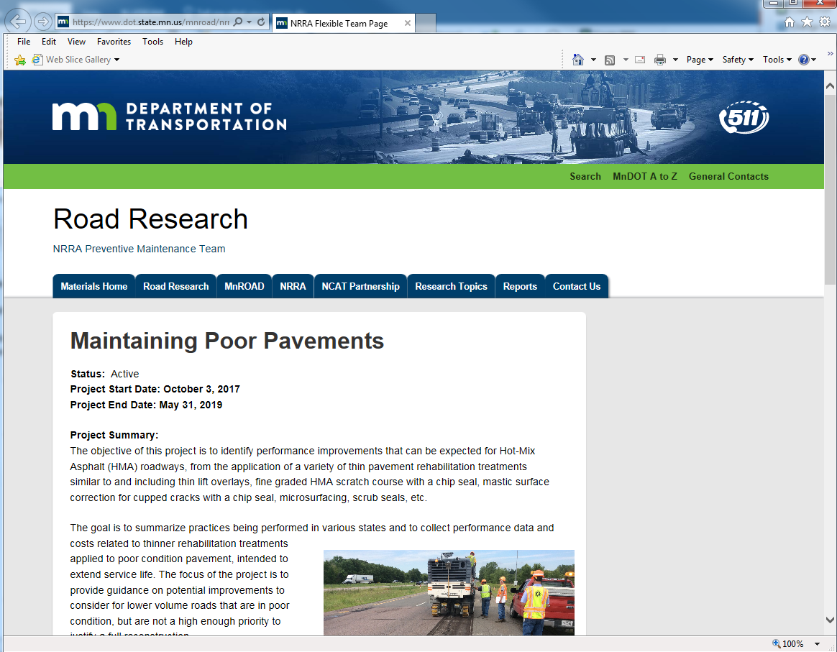
Final Report
Final Report
  Expected May 2019
  Will provide member State’s with information related to the cost and performance of various treatments intended to help make planned decisions for maintaining pavements in poor condition.
The project’s NRRA Study web page:
https://www.dot.state.mn.us/mnroad/nrra/structureandteams/preventivemaintenance/longterm1.html

Slide 13
Questions?
Joe Korzilius
Jkorzilius@srfconsulting.com

Slide 14


















































Thank You

