Slide 1
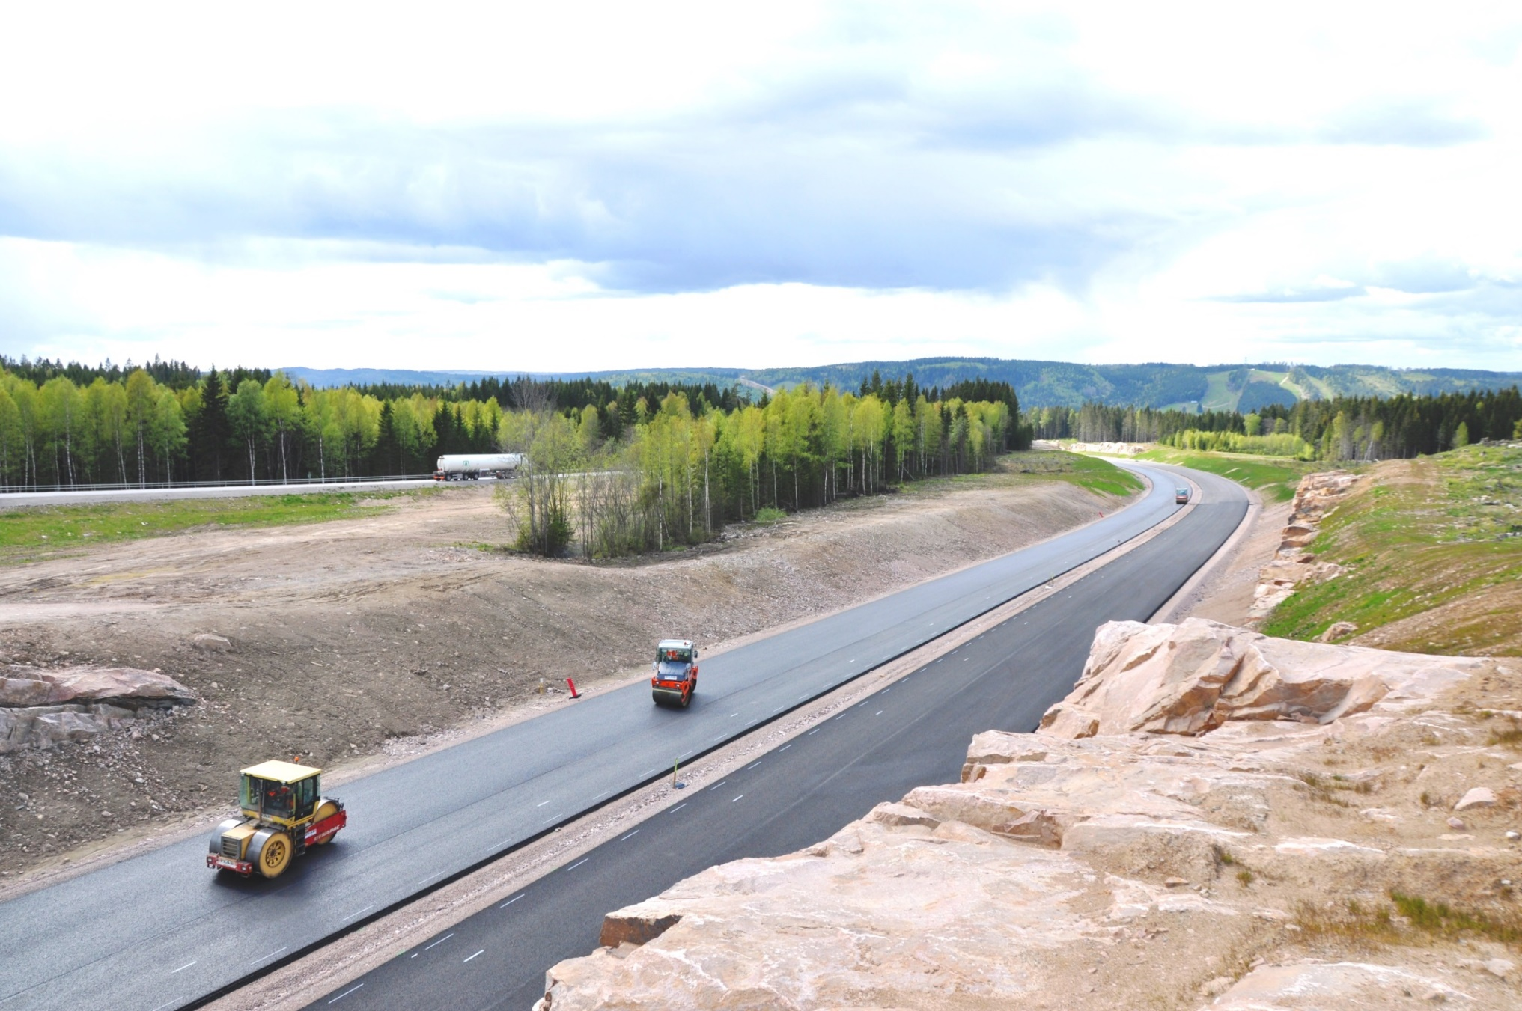

Seismic Approach to Quality Management of HMA
Principal Investigator: Choon Park, Park Seismic LLC, Shelton, Connecticut, USA
Co-Investigators: Nils Ryden and Josefin Starkhammar, Norfee Tech, Lund, Sweden
Administrative Staff: Jin Park, Park Seismic LLC, Shelton, Connecticut, USA
Presented By
Choon Park, Ph.D.
Park Seismic LLC

Slide 2

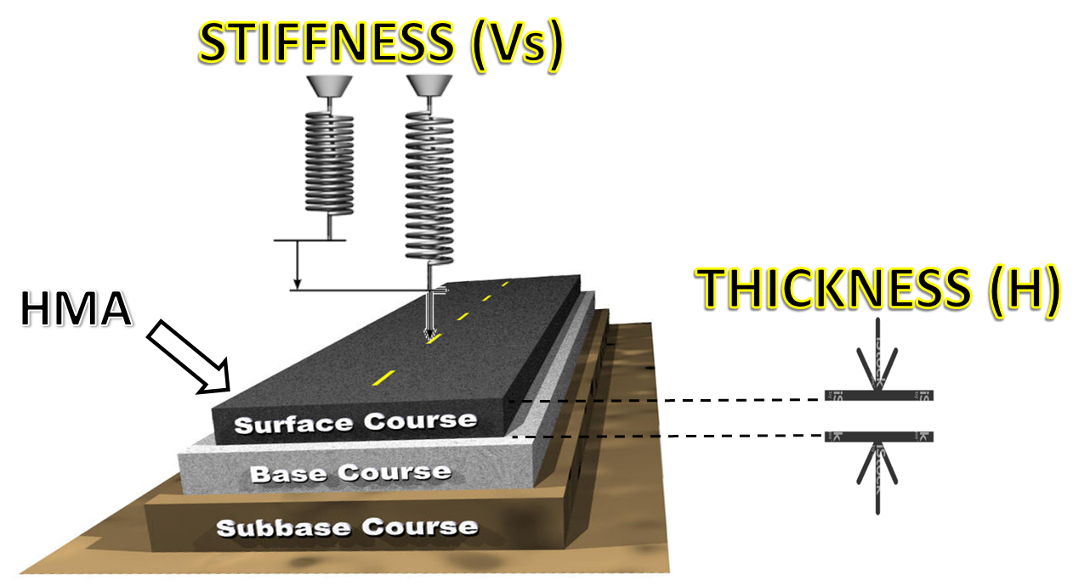
Hot Mix Asphalt (HMA) Pavement
Stiffness (e.g., Vs) and Thickness (H)
Construction and Maintenance

Slide 3
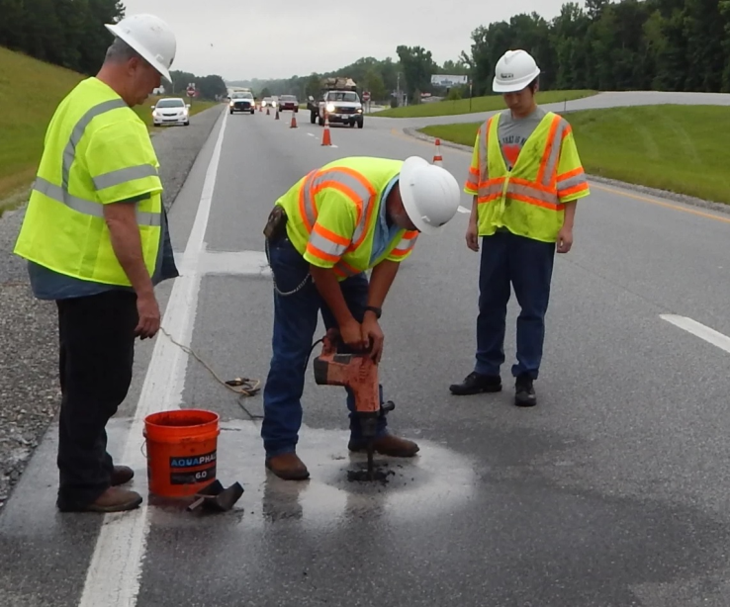
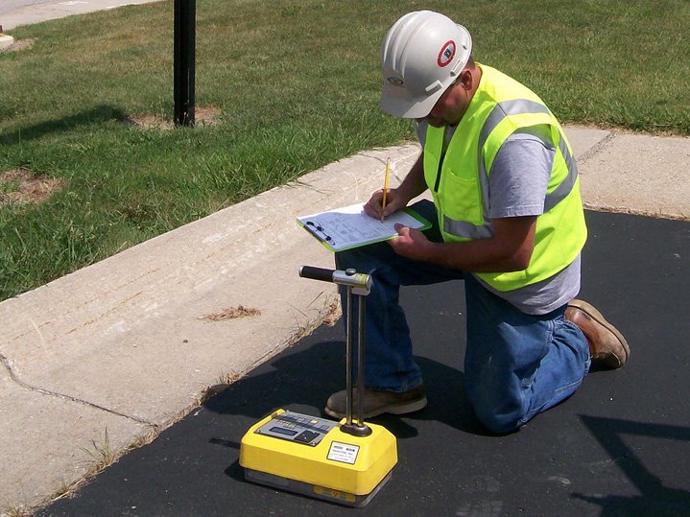
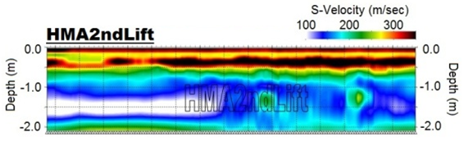
HMA − How to Measure Vs and H
  Conventional (Coring, Density, Gravity, etc.)
  Indirect stiffness
  Spot checking
  Destructive
Seismic (Elastic) Wave Approach
  Direct stiffness (“Elasticity”)
  Non-destructive
  Continuous 2D & 3D
Conventional
Seismic

Slide 4
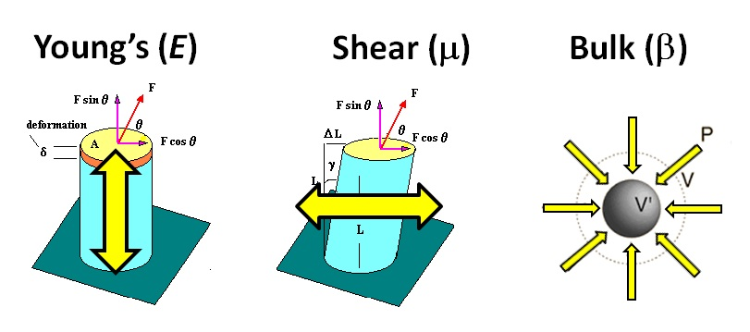
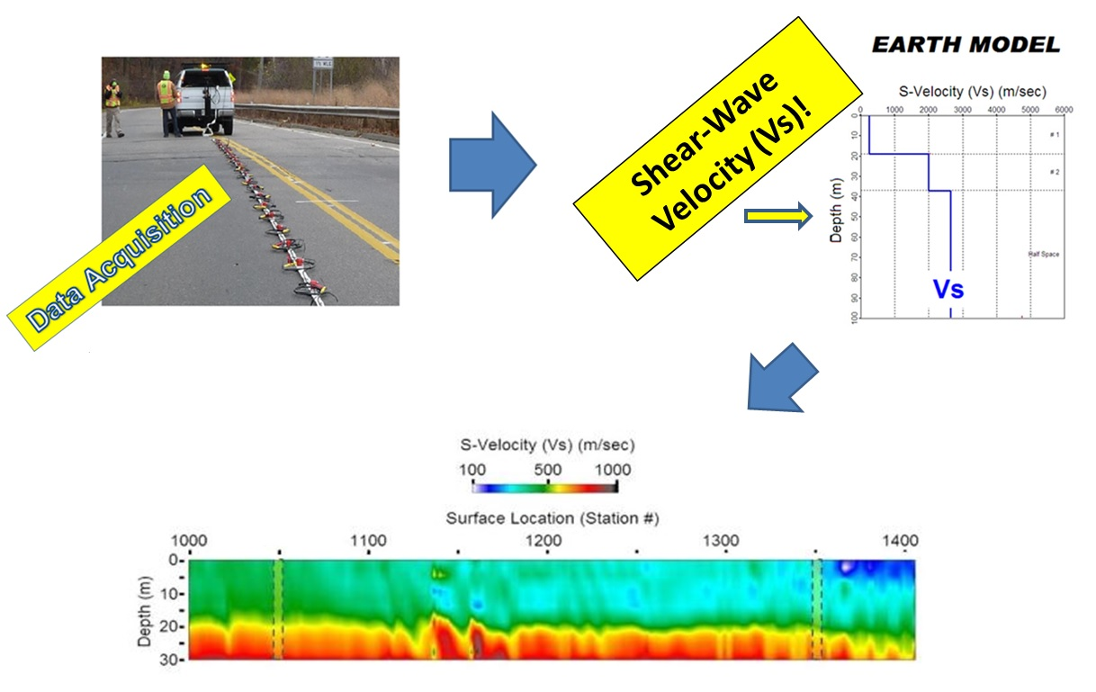
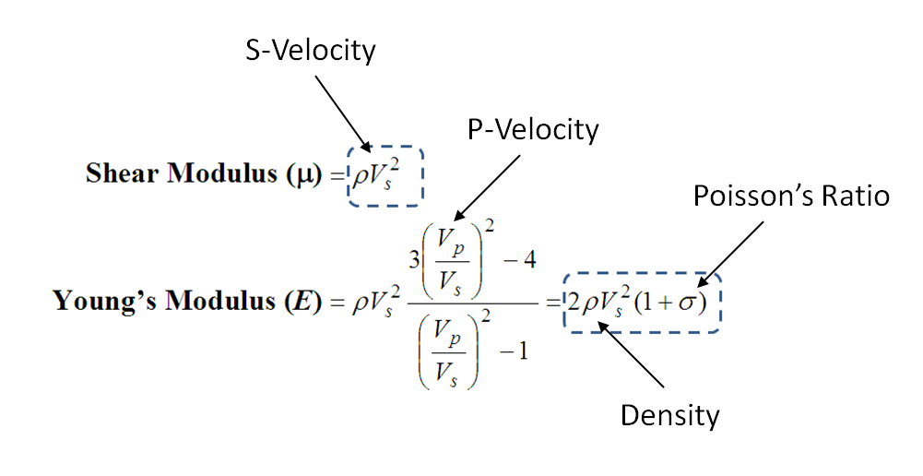
Seismic Approach − MASW
  Multichannel Analysis of Surface Waves (MASW) (Park et al., 1999)
  Shear-wave velocity (Vs) (1D, 2D, and 3D)
  Vs − Direct indicator of “stiffness” [e.g., Young’s (E) and shear (μ)]
MASW

Slide 5
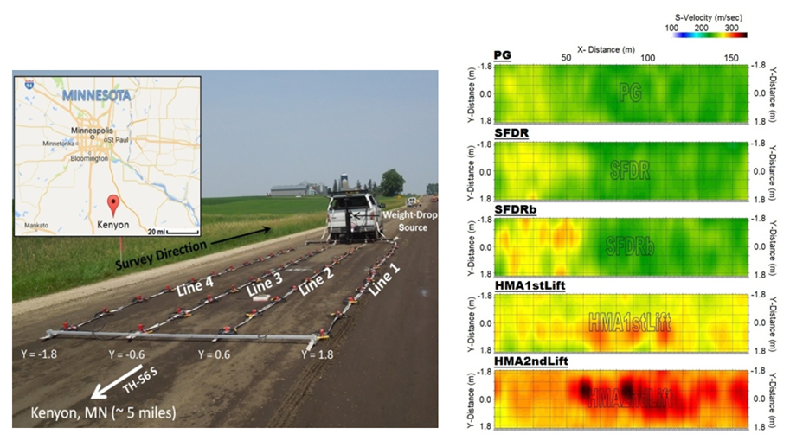
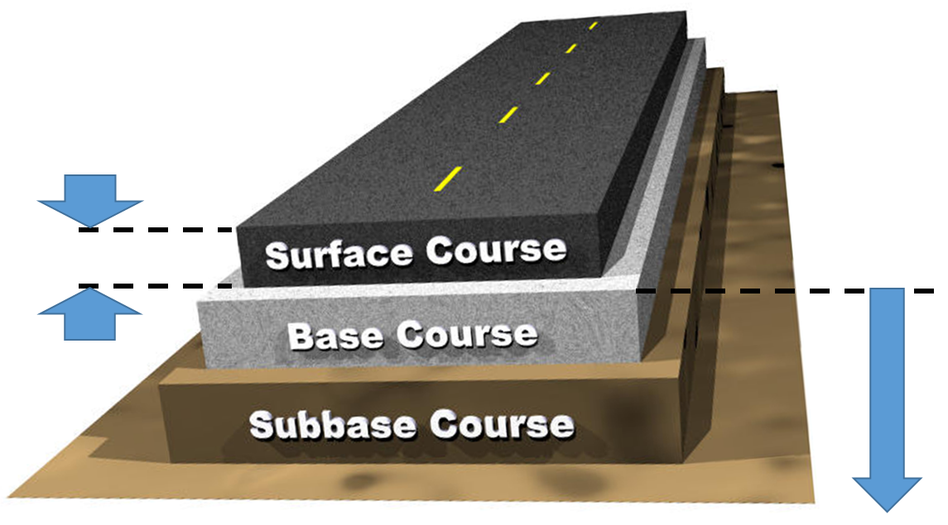
Previous Project at MnDOT − CEMS
(Park and Richter, 2017)
  Geophone approach (50 – 1000 Hz) with target depths ≥ 0.5 m
  This (HMA) project − target depths ≤ 0.3 m (1-25 Khz)
Compaction Evaluation by MASW Surveys (CEMS)
THIS
Project
Previous (CEMS)

Slide 6
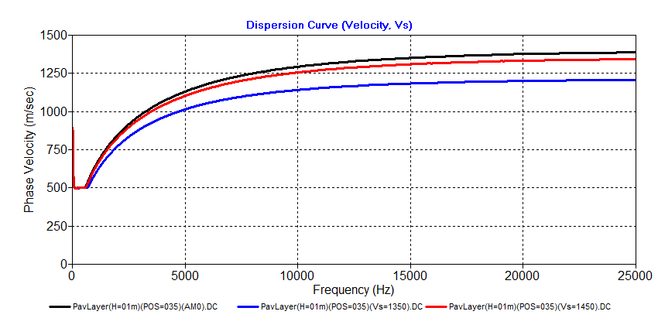
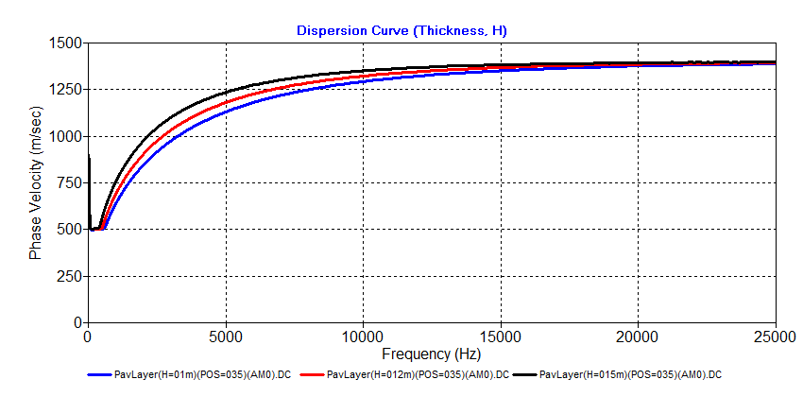
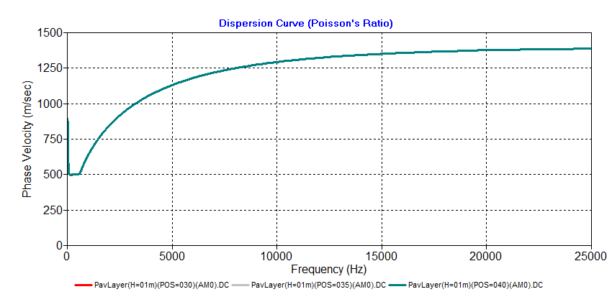
HMA and Dispersion Curve − How
HMA Stiffness (Vs)
HMA Thickness (H)
Vs = 1500 m/s
H = 0.15 m
Vs = 1450 m/s
Vs = 1350 m/s
H = 0.12 m
H = 0.10 m
Accuracy ≥ 98%
(H = 0.1 m)
Accuracy ≥ 95%
(Vs = 1500 m/s)
HMA Poisson’s Ratio (POS)
POS = 0.35
POS = 0.40
POS = 0.30
(H = 0.1 m, Vs = 1500 m/s)

Slide 7
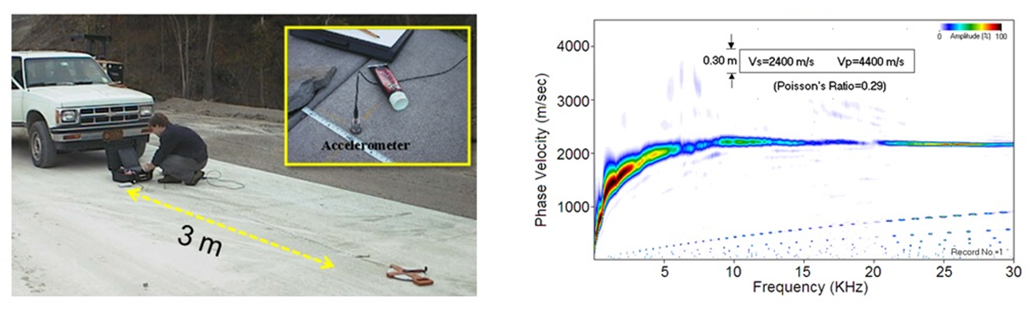
Pavement MASW (Ryden et al., 2004)
Contact measurements with accelerometer and a small hammer.
I-70 (Manhattan, KS)
Lamb wave (A0)

Slide 8
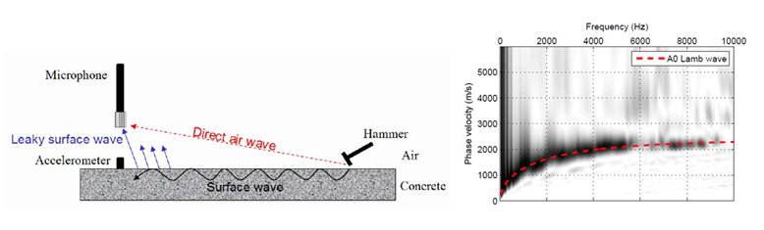
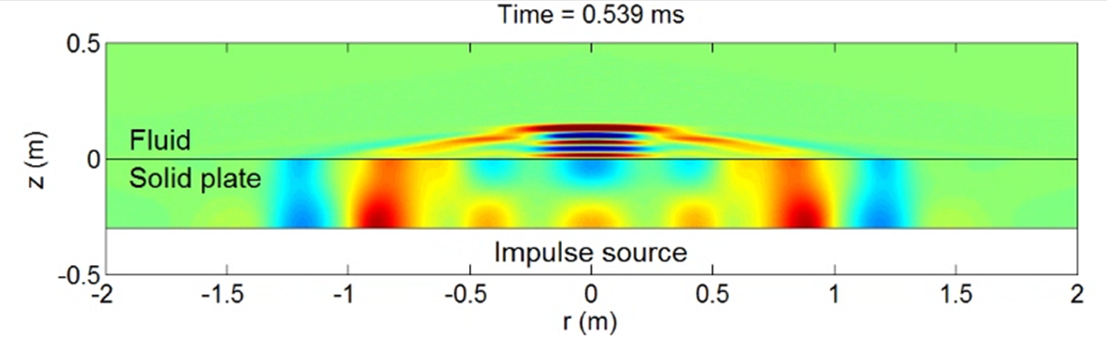
Non-Contact Pavement MASW
(Ryden et al., 2006)
Leaky
surface wave
Surface wave
Surface wave

Slide 9
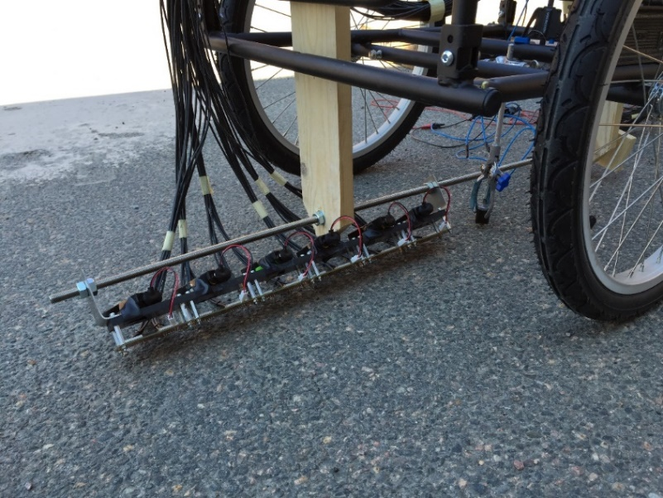
Non-Contact-Rolling Pavement MASW
(Bjurström and Ryden, 2017)
Solenoid impact source
Shear wave velocity (m/s)
48 MEMS microphone array (1-cm spacing)
Test line 4.0 m

Slide 10
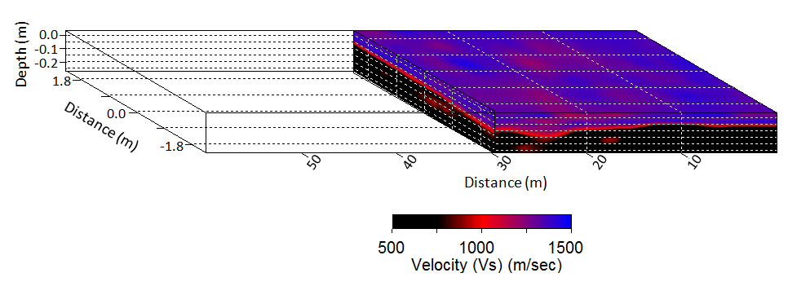
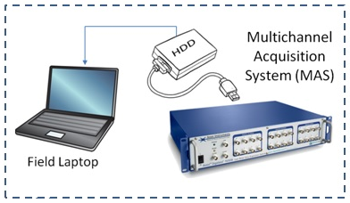
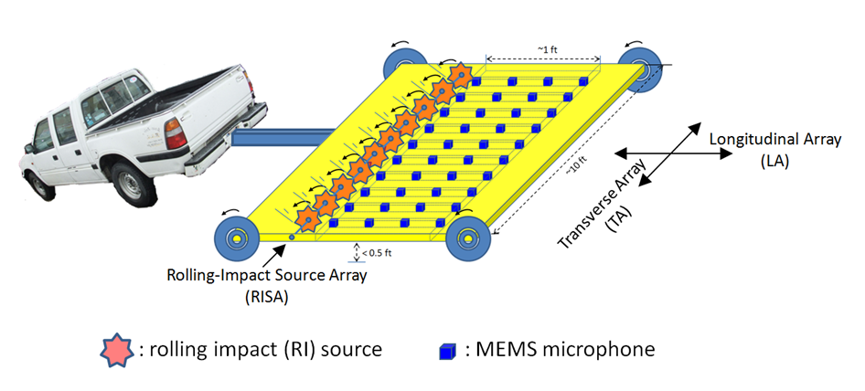
THIS PROJECT
On-Board Real Time Display
~2 ft
10 – 30 MPH
~6 ft

Slide 11
PROPOSERS

Slide 12
WORK PLAN & DELIVERABLES
Hardware (Dr. Starkhammar & Dr. Ryden)
  Multichannel Acquisition Device (MAD) (e.g., 60 channels)
  MEMS Microphone Arrays (MMA) (e.g., 3-6 linear arrays with 10-channel/array)
  Rolling Impact Source (RIS) (e.g., one or an array of flying steel balls)
  Frame (MAD + MMA) + RIS
Software and General Oversight (Dr. Park)
  Acquisition Control Module (Pseudo AUTO)
  QA/QC Module (Full AUTO)
  On-Board Real-Time Analysis/Display Module (Full AUTO)
  Post-Acquisition Extended Analysis Module (Manul-AUTO)
Administration (Dr. Jin Park)
  Monthly Conference (Skype)
  Managing Dedicated Secure Website
  Travel and Joint Field Test Arrangement
  Financial Management
  Quarterly and Final Report

Slide 13
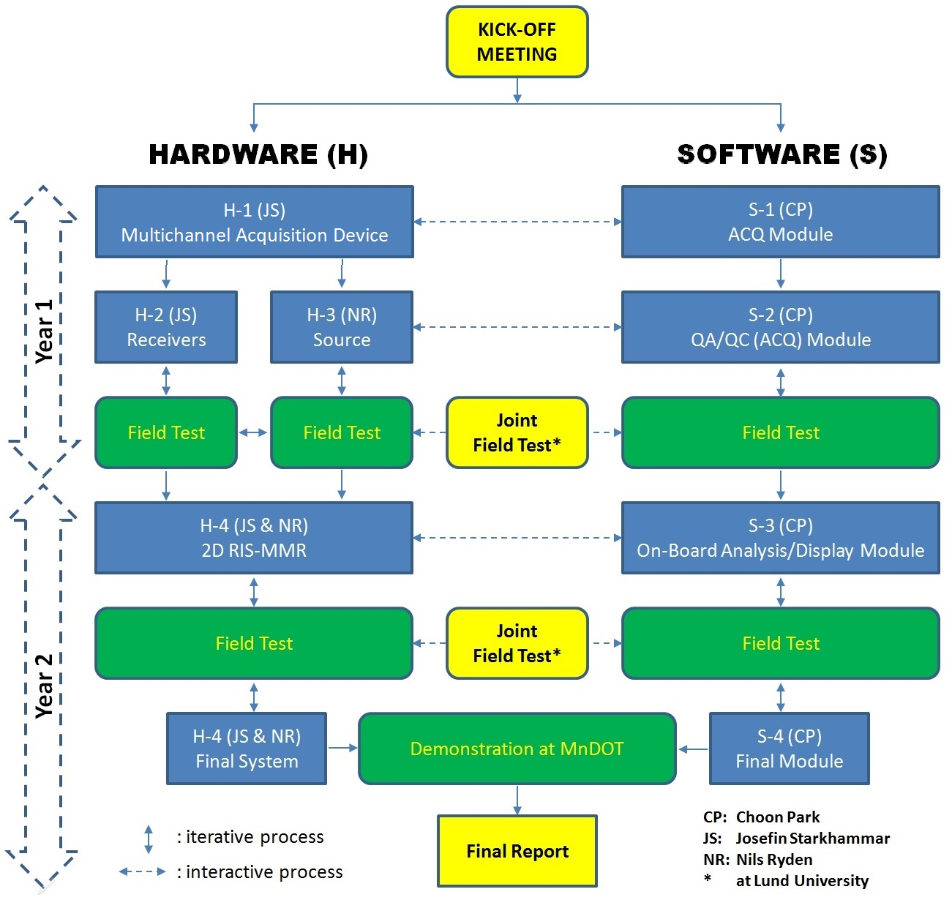
WORK PLAN AND SCHEDULE
May, 2022

Slide 14
PROJECT BUDGET
DETAILS
SUMMARY
Category | Amount ($)
Direct Labor Costs: | 134,504.00
Direct Expense Costs: | 12,940.00
Subcontractor Costs: (Norrfee Tech, AB) | 152,442.00
Totals: | 299,886.00

Slide 15
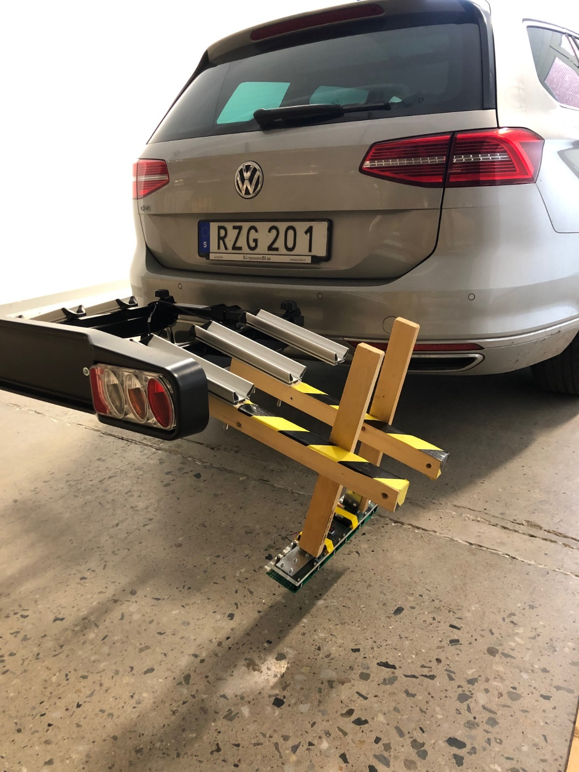
RECENT DEVELOPMENTS AND PROJECTION
(Rest of hardware
kept in trunk)
(Modified car bicycle rack)
Microphone array
(MEMS*)
*Micro-Electro-Mechanical Sensor

Slide 16
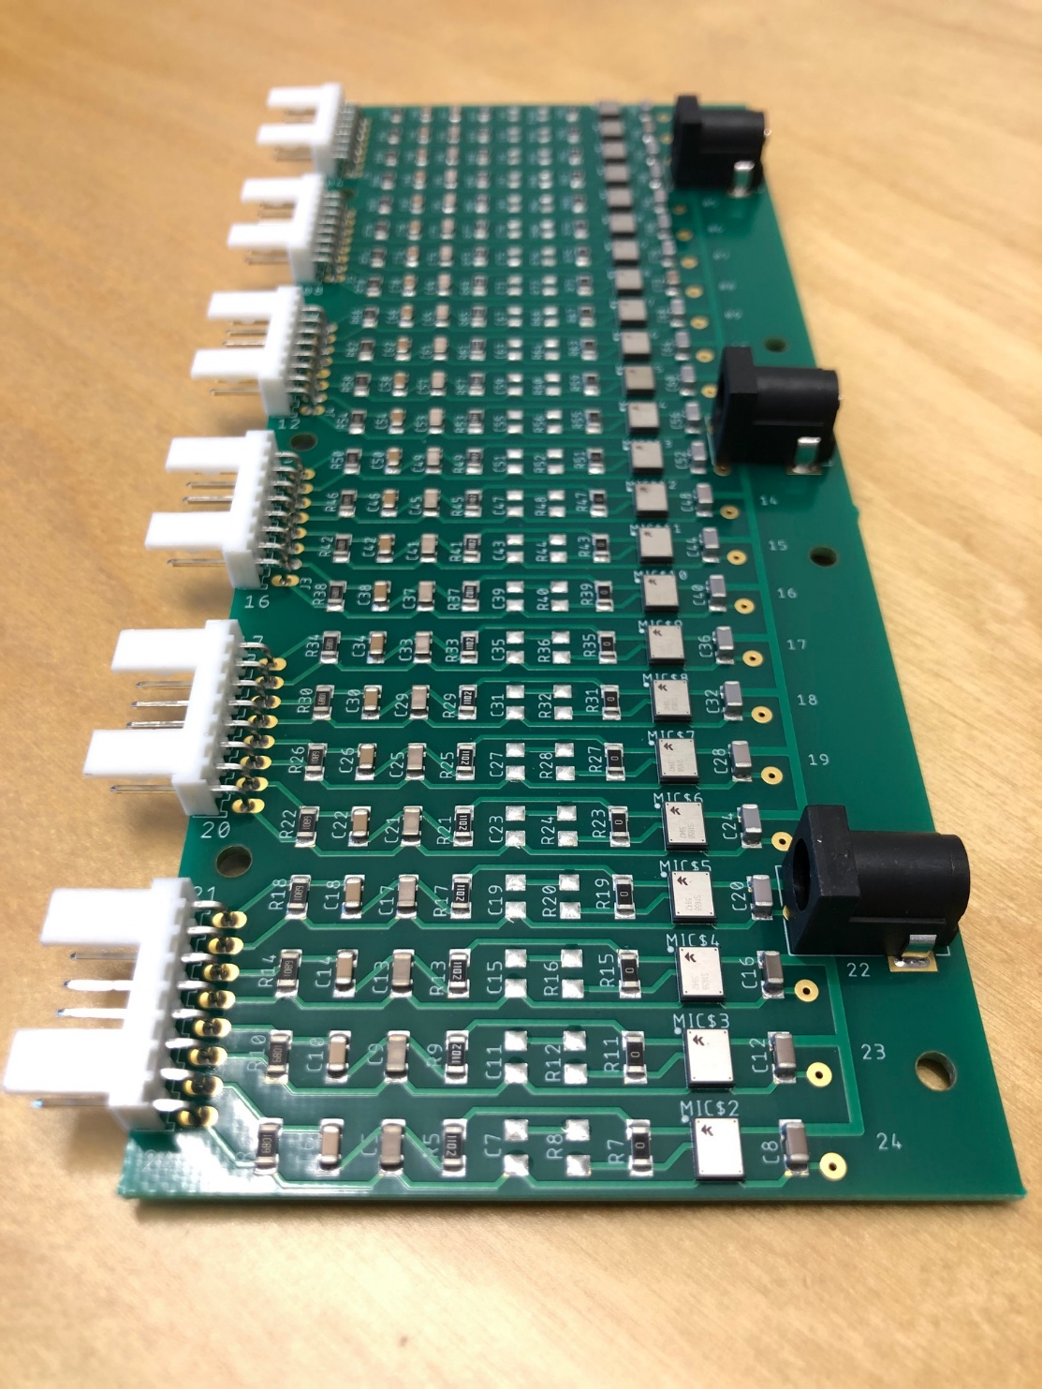
Microphone array close-up (Top)
Connectors to for cables
leading the analogue signal to
A/D converting hardware
Connectors for batteries supplying the microphones with power
Each of these are
microphones
48 channels → “super stereo recording”

Slide 17
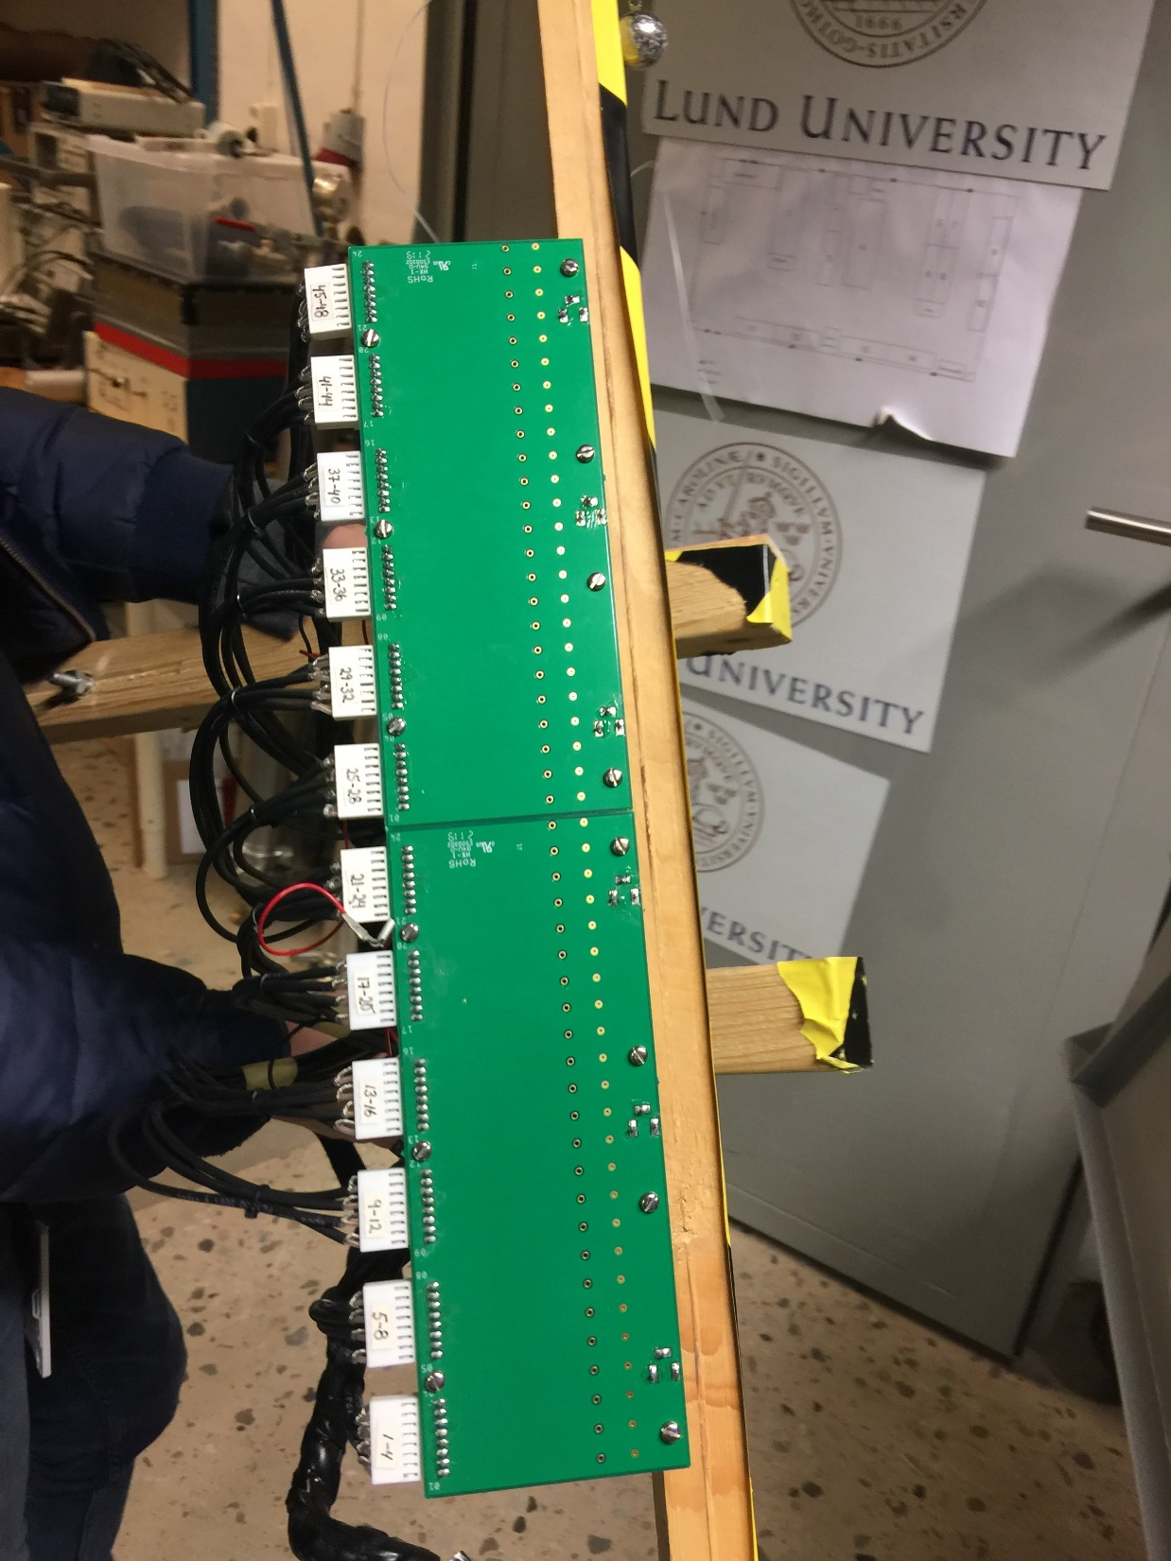
Microphone array close-up (Bottom)
The 48 microphone acoustic
ducts face the pavement during
recordings
0.75 cm

Slide 18
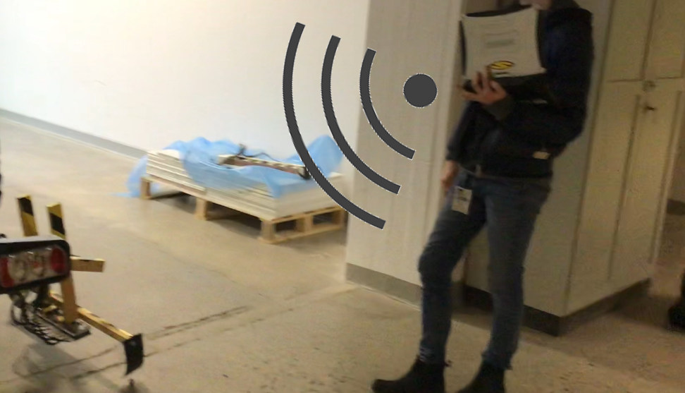
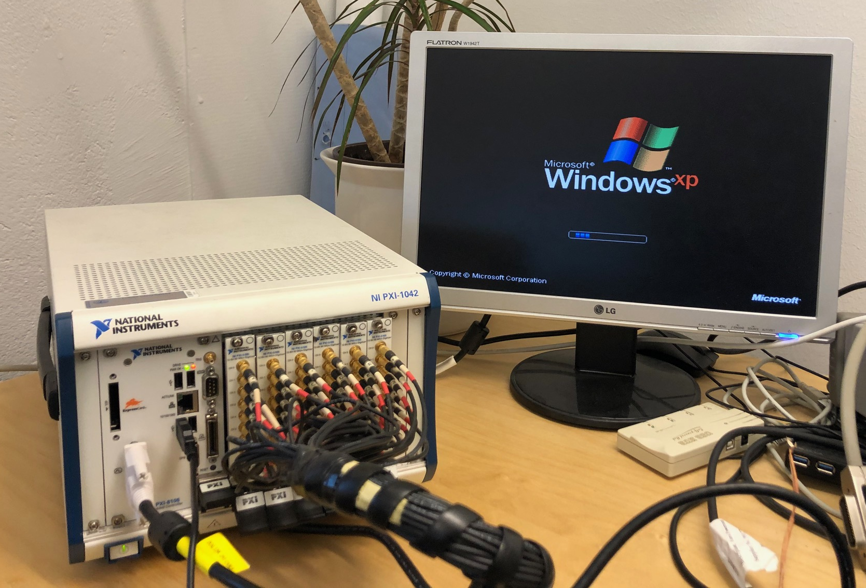
Entire A/D System
PC screen monitor. In field measurements, this monitor is replaced by a rugged laptop with wireless connection to the PXI rack
PXI rack holding digitizer cards
(A/D conversion) and controller
(PC in rack format)
48 parallel A/D converters from National Instruments
Data acquisition controlled though LabVIEW-program on regular PC in rack form, from National Instruments

Slide 19
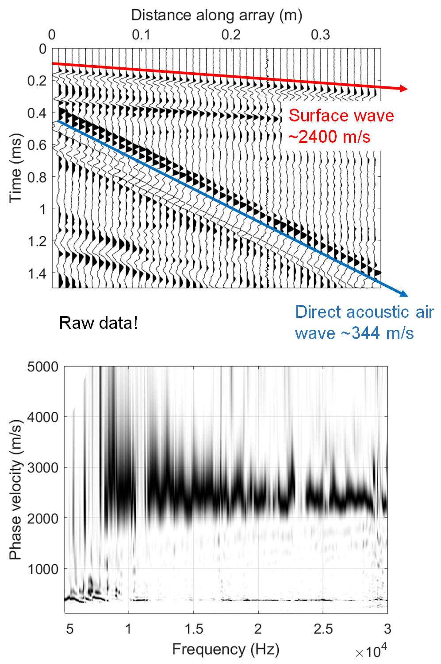
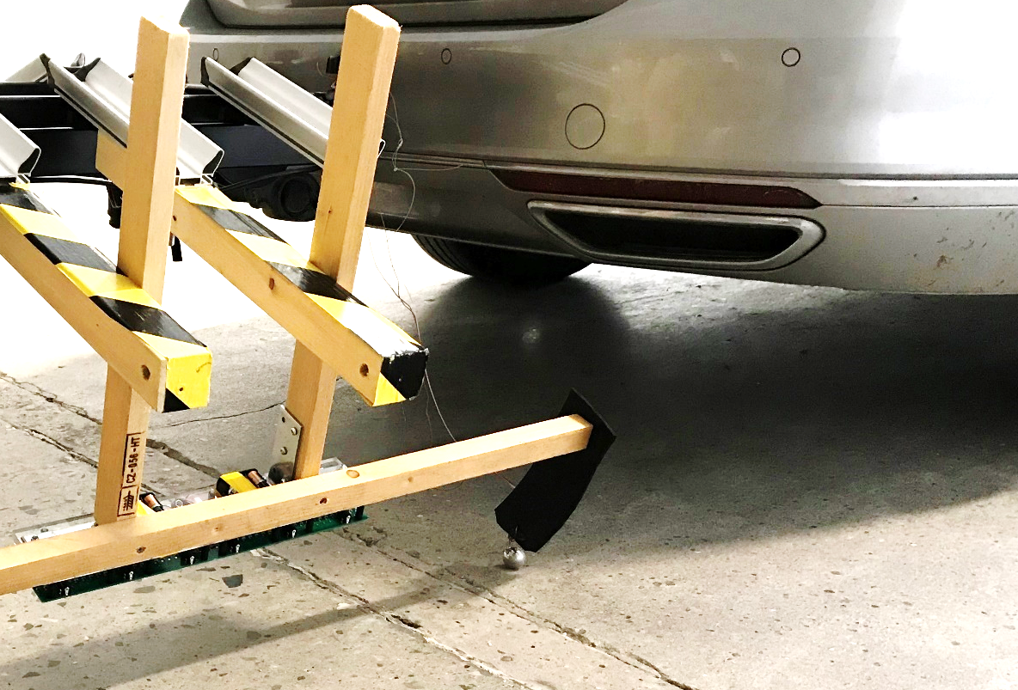
Rolling-Impact Source − “Bouncing Steel Ball”!
Bouncing ball source!

Slide 20

Rolling-Impact Source − “Bouncing Steel Ball”!

Slide 21
