Slide 1

NRRA Flexible Team Subcommitee #3
Rehabilitation of SFDR Cells at MnROAD
March 30, 2021

Slide 2
Meeting objectives:
Develop research/construction project that provides valuable research and a safe ride for the next 5 years. Write 2-pager
Reminder:
This meeting is a discussion of idea for MnROAD construction in 2022. RFPs will be developed at a later date.

Slide 3
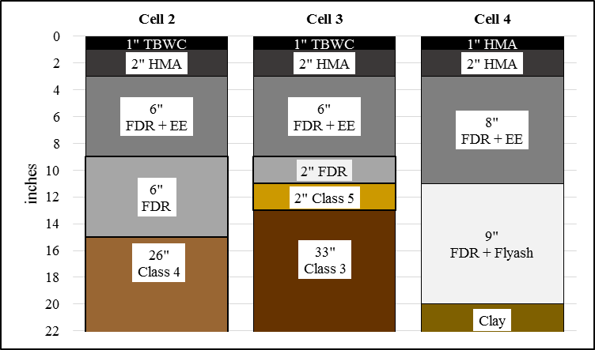
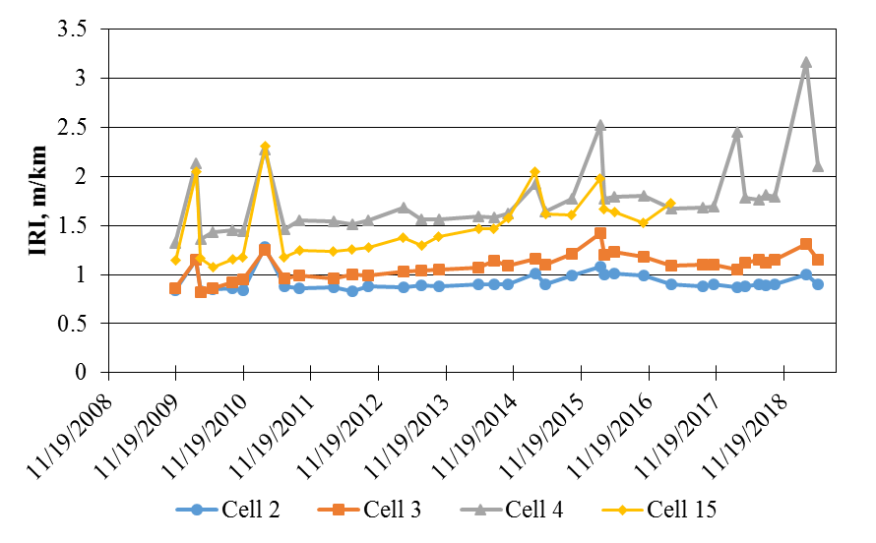
Cross Section & Ride
Ride collected in March and May 2019
March spikes have returned
Cell 4 IRI > 2 (m /km)
→Mainly due to patched area
Cell 2 and 3 still very good ride

Slide 4
Summary
Cell 2 & 3– cores taken in low severity fatigue area.
Surface cracks only
Cell 4 – HMA layer and EE layer separated in 3 out of 4
cores. EE layer removed in pieces in 3 out of 4 cores.
HMA layer had little cracking throughout even
in locations were EE layer was removed in
pieces. Unable to determine if EE was previously
deteriorated or damaged during coring.Likely
a combination of the two

Slide 5
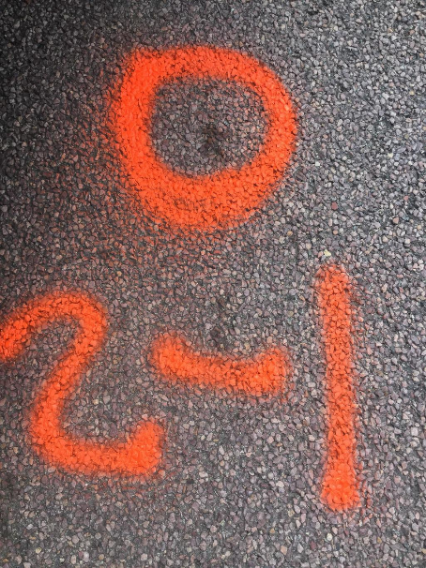
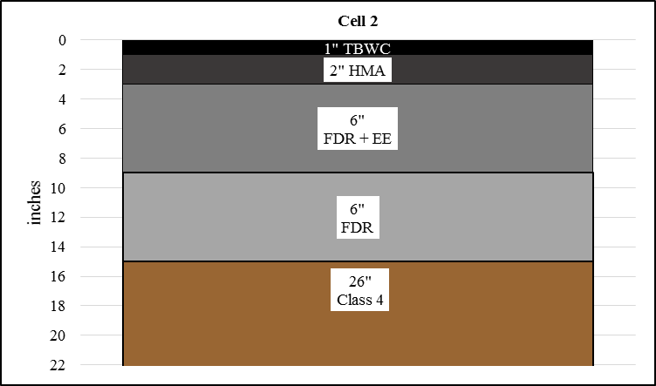
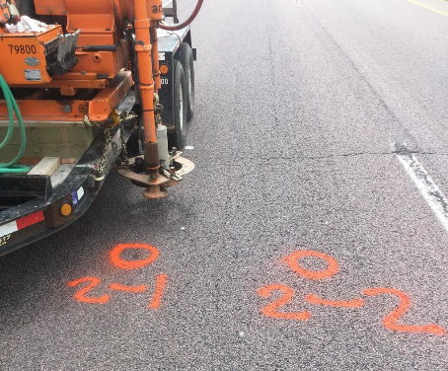
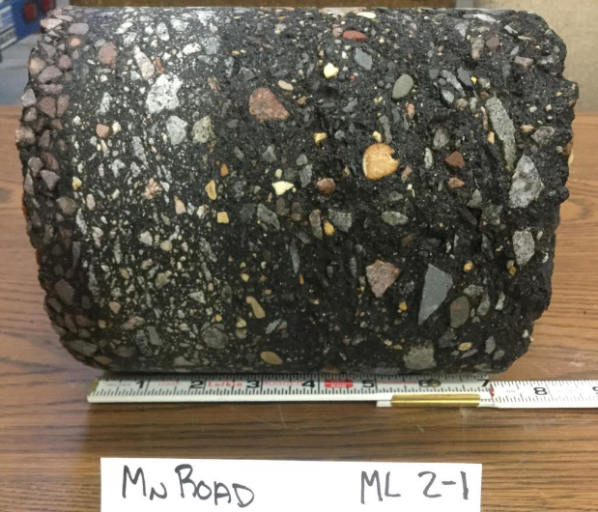
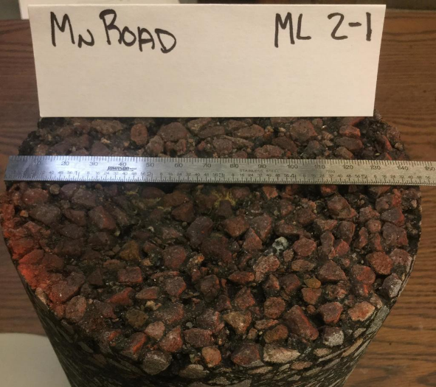
Cell 2-1
Driving lane IWP
Area classified as low severity fatigue
Cracks do not extend beyond surface

Slide 6
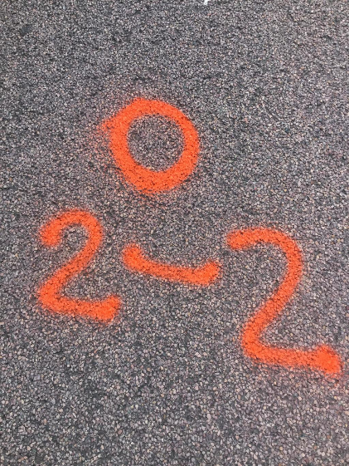
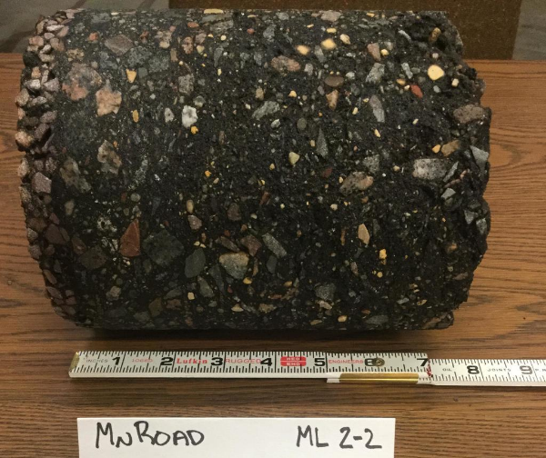
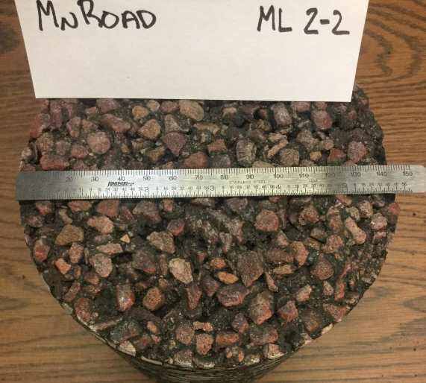
Cell 2-2
Driving lane IWP
Area classified as low severity fatigue
Cracks do not extend beyond surface

Slide 7
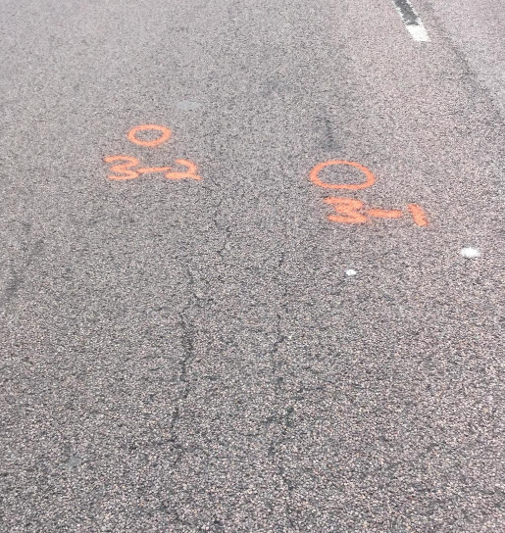
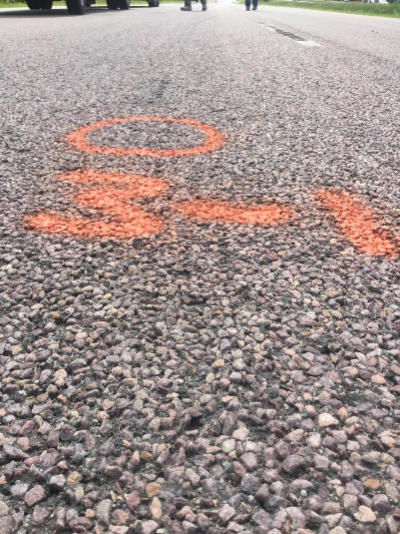
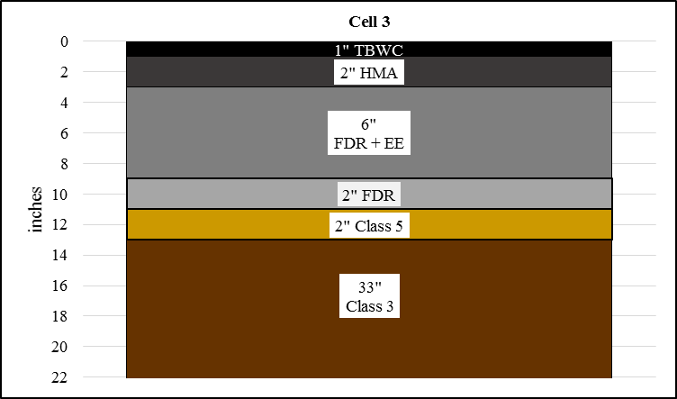
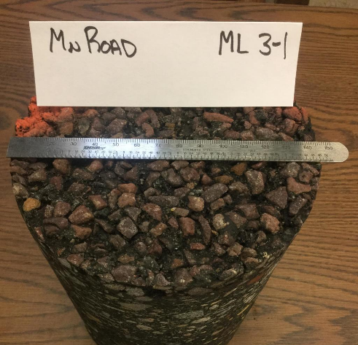
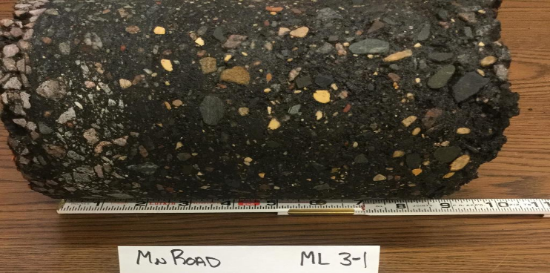
Cell 3-1
Driving lane IWP
Area classified as low severity fatigue
Cracks do not extend beyond surface

Slide 8
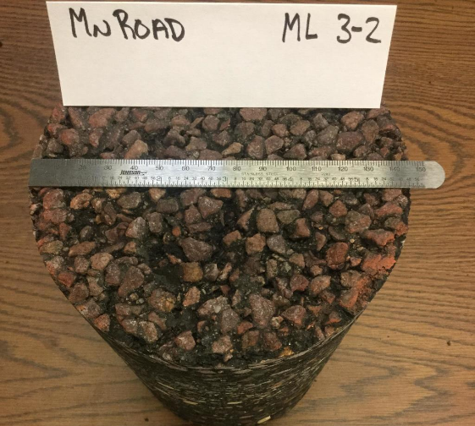
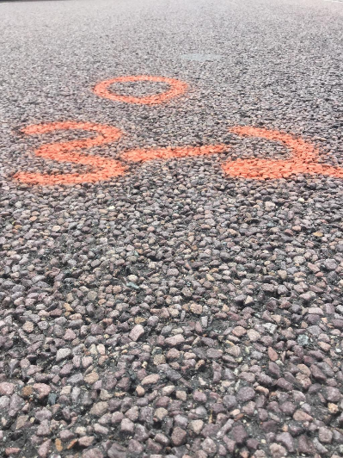
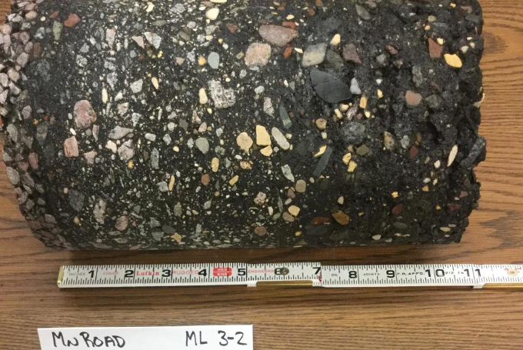
Cell 3-2
Driving lane IWP
Area classified as low severity fatigue
Cracks do not extend beyond surface

Slide 9
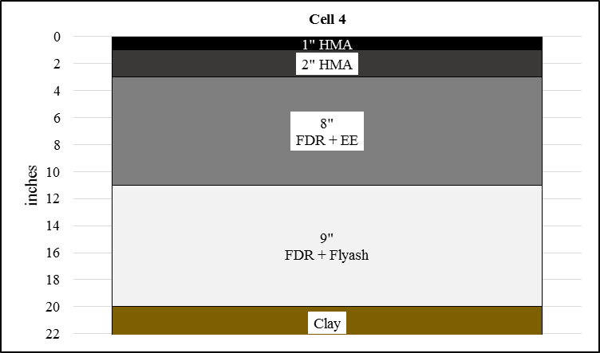
Cell 4
Able to feel rigid Flyash layer during coring/ removal of loose EE layer
but decided to leave FA layer in-place

Slide 10
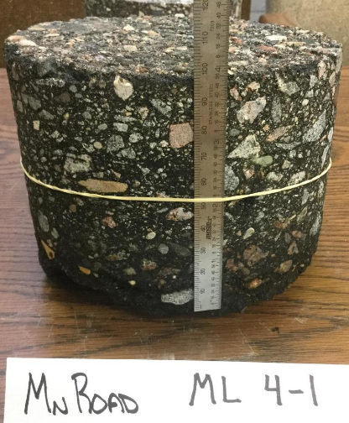
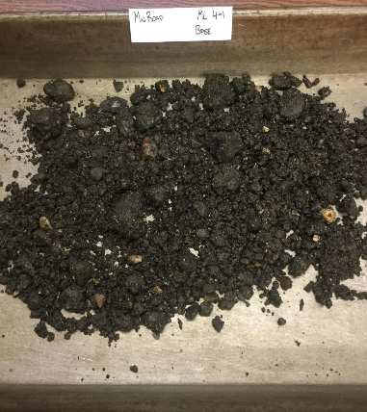
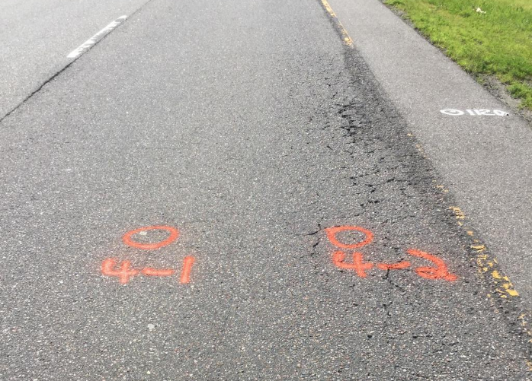
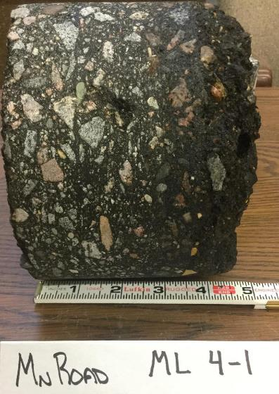
Cell 4-1
4-1
No cracking
Passing lane in transition BWP

Slide 11
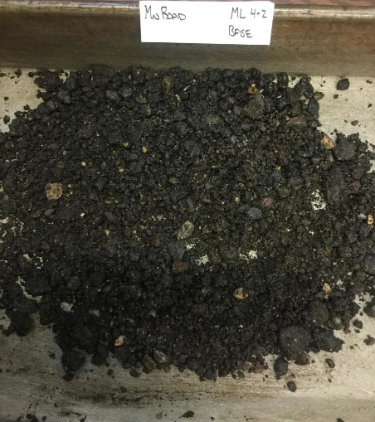
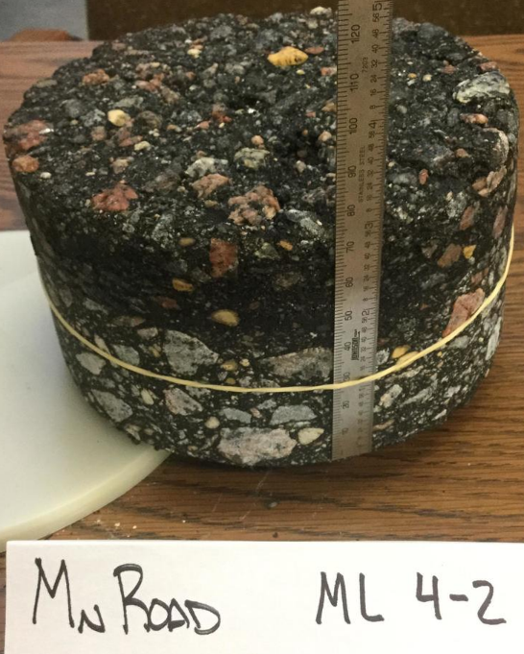
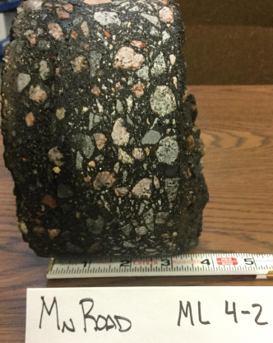
Cell 4-2
4-2
Cracks only in surface
Passing lane in transition OWP

Slide 12
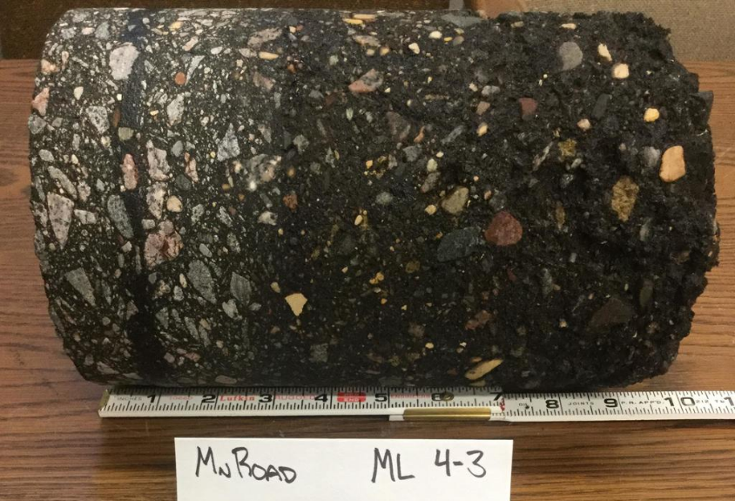
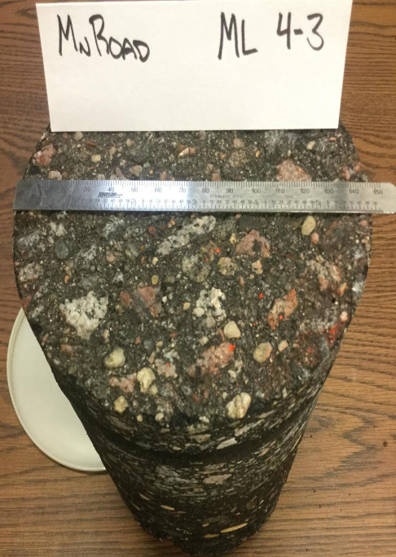
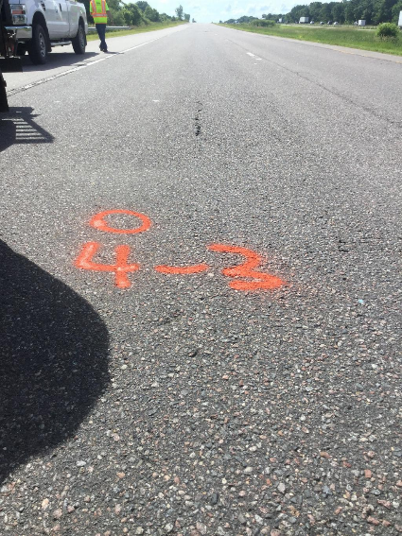
Cell 4-3
Driving lane BWP
No surface distress

Slide 13
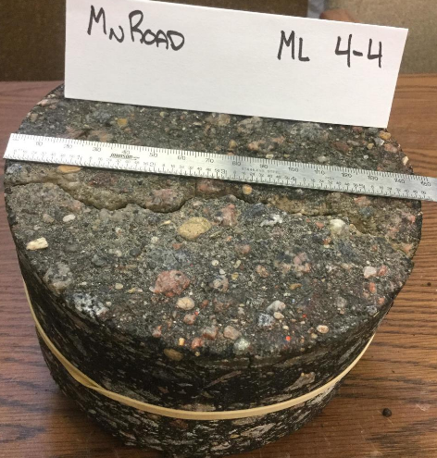
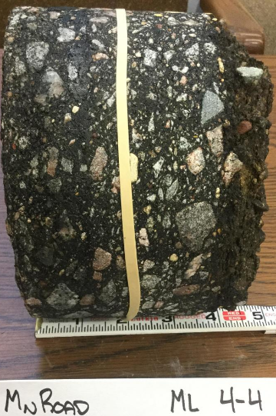
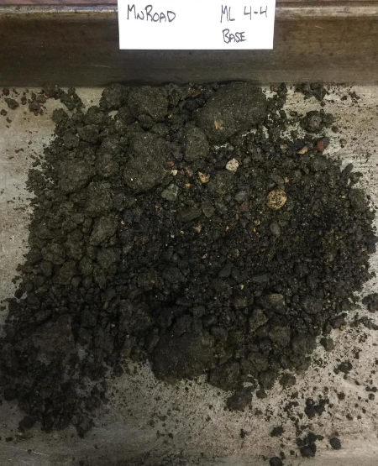
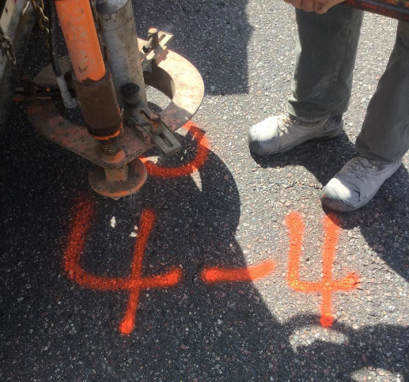
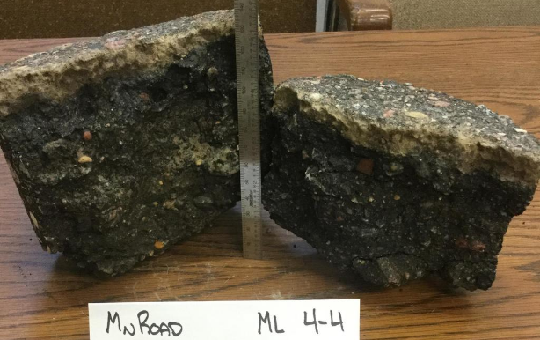
Cell 4-4
Driving lane OWP
surface cracking = low severity fatigue

Slide 14
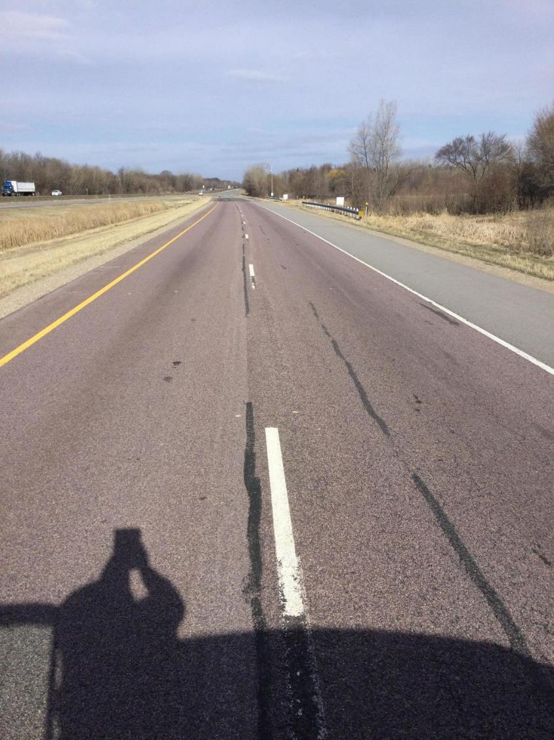
Cell 2

Slide 15
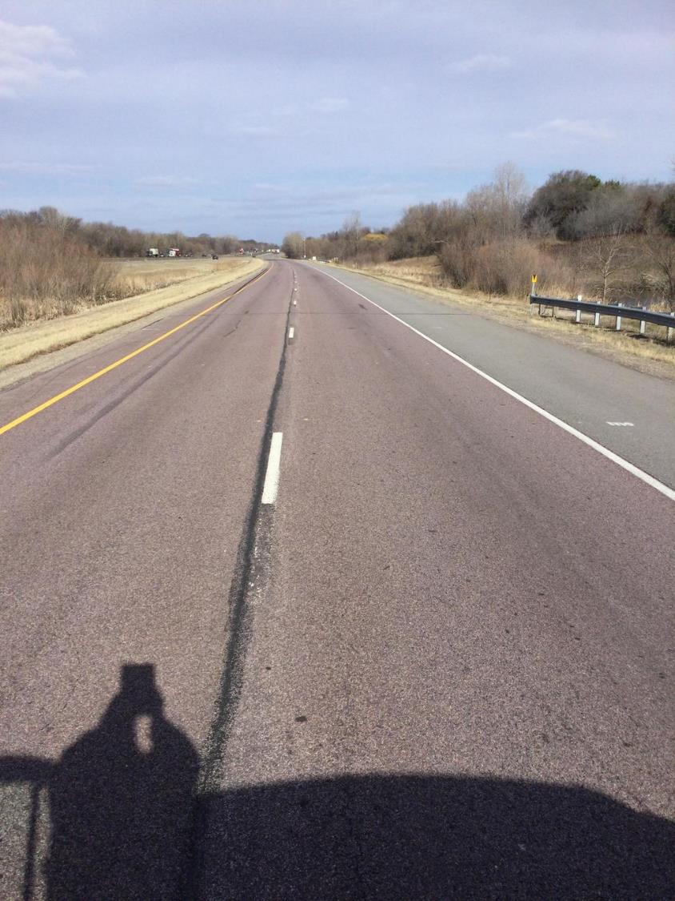
Cell 3

Slide 16
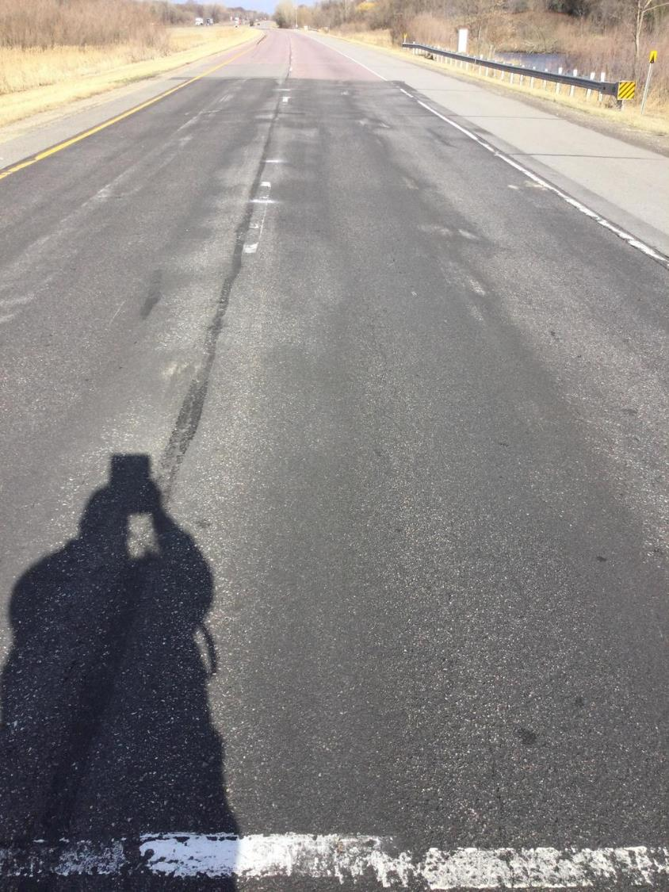
Cell 4
Microsurface applied in October 2020

Slide 17
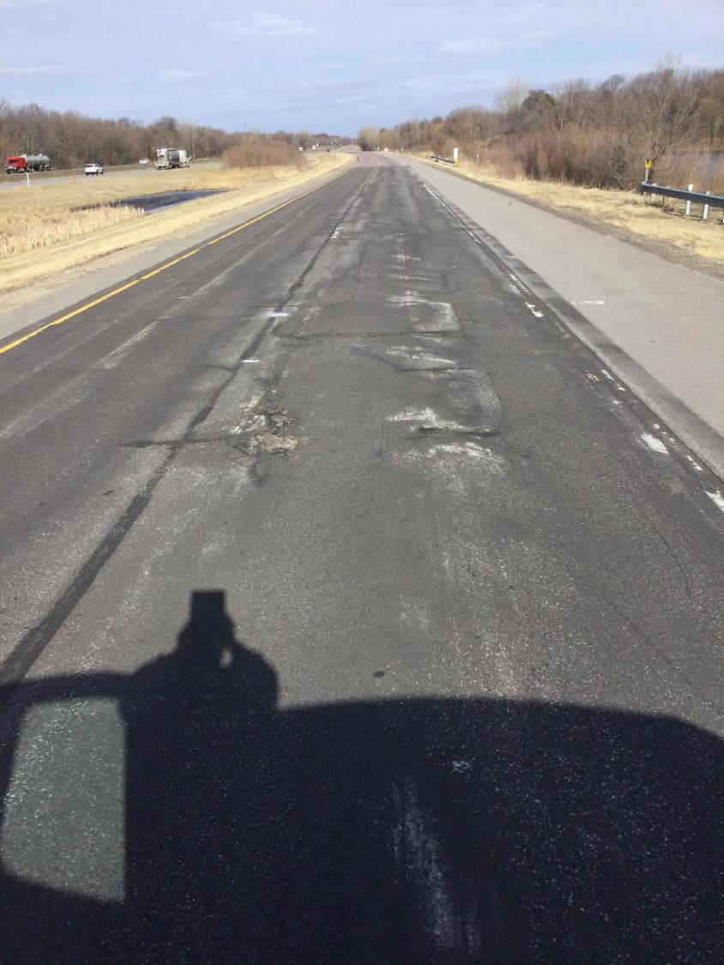
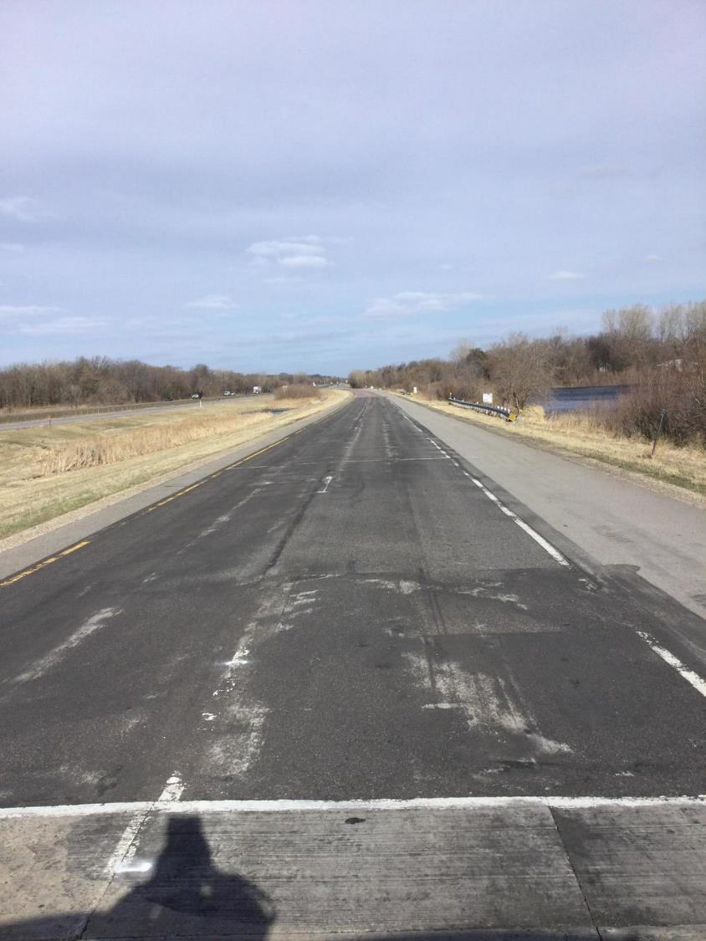
Cell 4

Slide 18
NRRA Subcommittee #3
Recommend:
  Cells 2-3 = 1-2” mill + overlay
    Could use UTBWC or thin SMA idea
  Cell 4 needs full depth fix? How deep?
OPEN DISCUSSION / MEETING NOTES WILL GO HERE

Slide 19
NRRA Subcommittee #3
Meeting notes:
Ben W. – Research beyond construction?
Dan Wegman – recommend microsurface on 2 and 3 since ride is still good. Micro over UTBWC will create a cape seal.
  Cell 4 – want to look at salvaging with restabilizing options
    Mill 6-8” and fix FDR + flyash
    Terry B agrees
    Ben W agrees on 2-3
      Cell 15 has full depth HMA and could be redo of Cell 4
    Joel U. likes UTBWC on 2-3.
      Is micro-mill an option?
      Cell 4 opportunity to do something deeper with materials
    Steve H – cell 2/3 is cracking only in surface or through HMA should determine mill or slurry
      Cell 4 – Can this fix be applied to network situations?

Slide 20
Notes
Dan W. – D3 uses micro on similar type applications
John G. – agrees with UTBWC. Micromill 3/8” to ½”
Jerry – 1 microsurface; 1 micro mill + UTBWC wants microsurface on 2 or 3 with additional emulsion. Micromill and ultrathin could be huge ride improvement
Dan W – not all microsurfaces are the same. Need high quality application and materials
Jenna – likes Jerry’s idea of splitting 2/3 . Need to have micro dialed in
  Cell 4 – like using inplace materials to rehab
Ben W split individual cells
  What is research goal???
    2-3 Joel “what do we do to keep extending pavement life with limited work”
    4 how to fix?

