Slide 1

NRRA Flexible Team Subcommittee #2
Perpetual Pavement Test Sections on I-94 in Wisconsin and Minnesota
March 31, 2021

Slide 2
Meeting objectives:
Develop research construction project for I-94 in Wisconsin and MnROAD
Reminder:
This meeting is a discussion of idea for MnROAD construction in 2022. RFPs will be developed at a later date.

Slide 3
Meeting Format
Introductions
Background and Motivation
NRRA Flex Subcommittee #3 Perpetual SFDR Test sections at MnROAD
Other ideas to consider???
General Discussion

Slide 4
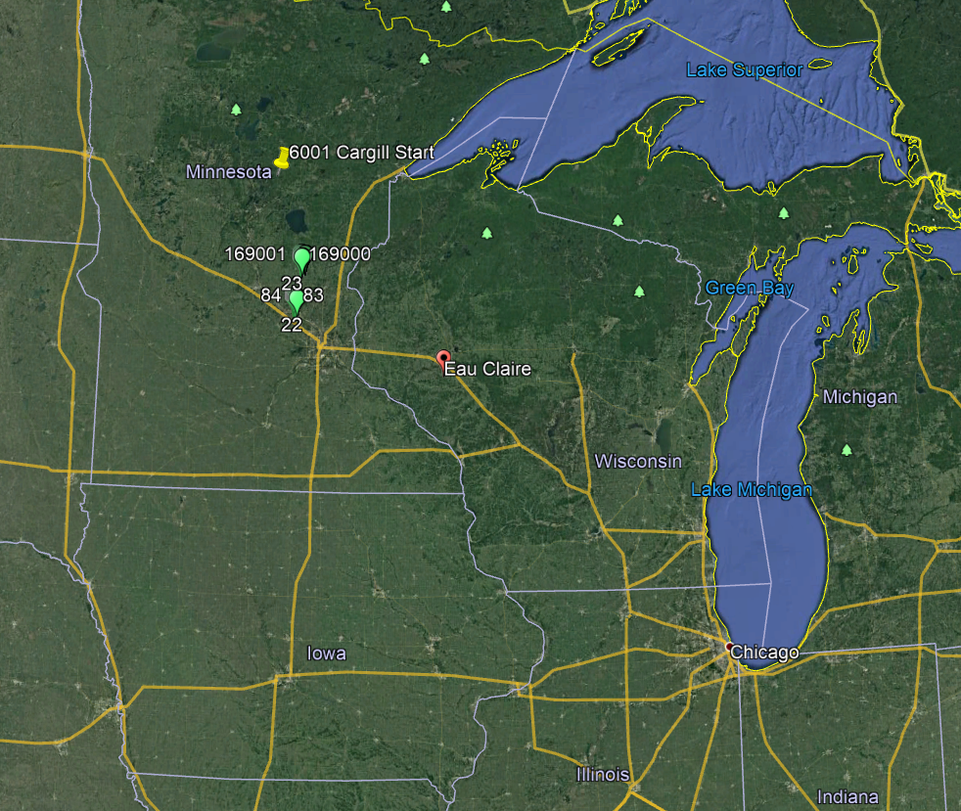
Background
WisDOT is interested in instrumenting this pavement to develop a fatigue transfer function that can be used in the PerRoad software for perpetual pavement design.
There is a pavement section in Trempealeau county, Wisconsin where a deep strength Hot Mix Asphalt (HMA) pavement is going to be placed (Figure 1).

Slide 5
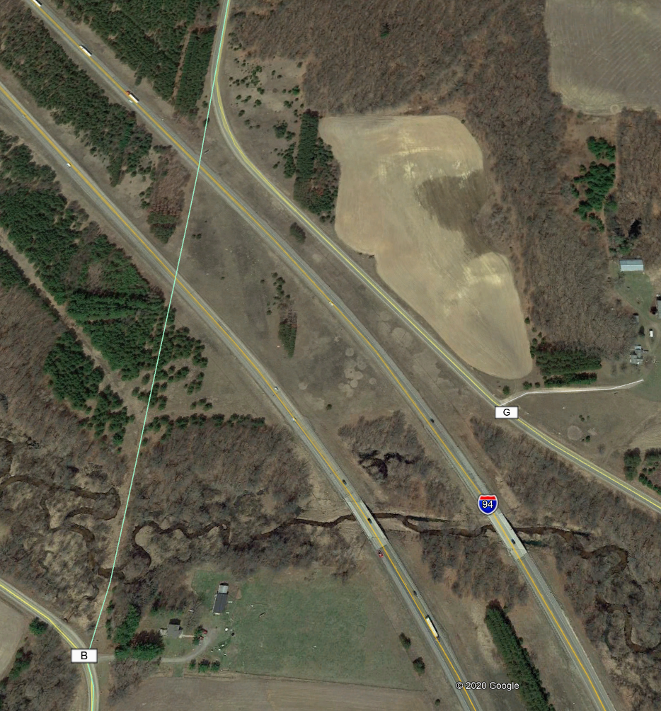
Background
Looking at instrumenting both sides of I-94 with the same array
Instrumentation Measuring:
Temperature (Enviro)
Moisture (Enviro)
Strain at bottom of HMA
Pressure at top of base
Pressure at top of subgrade
Deflection at top of base (MDD or SCG)
Offset?
910 feet
500 feet

Slide 6
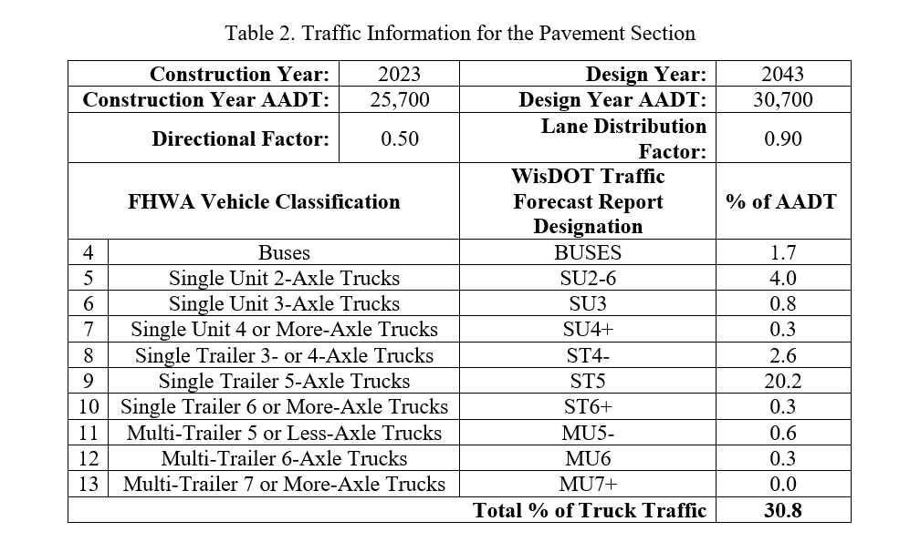
Traffic
High Truck Traffic!!!

Slide 7
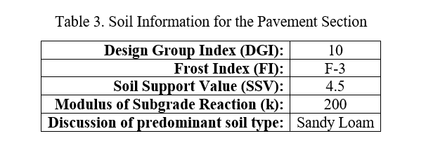
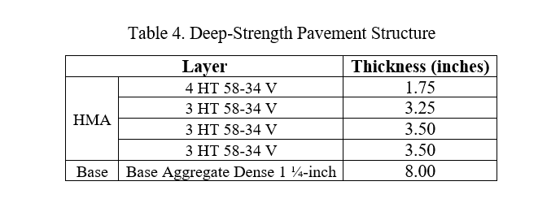
Structure
The 4 HT 58-34 V designates Gradation - Traffic Level - Binder Grade - Binder Designation (https://wisconsindot.gov/rdwy/fdm/fd-14-10.pdf#fd14-10-10.7). More information regarding the aggregate gradation can be found in Table 460-1, page 177 (https://wisconsindot.gov/rdwy/stndspec/ss-04-60.pdf

Slide 8
Objective
Objective to directly measure critical responses (strain, pressure, vert disp.,) from interstate traffic loading for use in developing a perpetual pavement (deep strength) design parameters
Want to capture
  Pavement response to heaviest vehicles at full range of temperature
  Pavement response to “Known Truck”. Used as verification of live data (X4?)
2 cabinets- power on both sides
Datalink- cellular for static- no problem; dynamic?
  Flexlogger
  Ben contacted intercomp. Meeting Thursday morning
Outstanding questions:
  Offset? Can we live without it?
  Triggering
  Nearest WIM?

Slide 9
Centerline
Plan View
Alt #2 (reduced MnROAD array)
PGx6= $7,200
ASGx9= $7,200
Total dynamic= $14,400
Traffic
Could remove inside wheelpath row to save third of cost
PG202
LE209
TE204
LE204
PG205
PG203
LE208
TE205
LE205
PG201
PG204
LE207
TE206
LE206
PG206
3’
Shoulder
Not to scale

Slide 10
Temperature throughout pavement structure
12” HMA
8” Base
Subgrade
Two thermal couple “trees” – (depth from surface)
8 Channel tree TC 8a- .5”, 1”, 2”, 4”, 6”, 8”, 10”, 11”
8 Channel tree TC 8b-– 72”, 60”, 48”, 36”, 24”, 16”, 12”, 11”

Slide 11
12” HMA
Moisture content
in unbound material
8” Base
Subgrade
Moisture unbound
Depth from surface EC
-13”, 19”, 21”, 24”

Slide 12
12” HMA
Pressure
under dynamic loading
8” Base
Subgrade
Pressure Gauge (Depth not affected by array selected)
-13”, 20”

Slide 13
12” HMA
Vertical displacement (SCG)
under dynamic loading
8” Base
Subgrade
Soil Compression Gauge ($600)
Need to order!!!
-20” (x6) 2 per wheelpath

Slide 14
12” HMA
Strain
Under dynamic loading
8” Base
Subgrade
ASG (Depth not affected by array selected)
-12”

Slide 15
HOW?
Want to capture
  Pavement response to heaviest vehicles at full range of temperature
  Need remote activation
Propose to collect 5-15 minutes twice per week
  One morning; one afternoon

Slide 16
WESLEA Simulation
12” HMA
8” Base
Using default WESLEA inputs for moduli
18 kip dual axel load
@12”
    µε_{xy}= -89
    σ_{v}= 3.8
    disp_{v}= 10.7 mill-in
@20”
    µε_{xy}= -78
    σ_{v}= 2.44
    disp_{v}= 9.38 mill-in
Subgrade

Slide 17
Meeting notes
Ben
  Other states could have companion sections?
  Consider tie with Perpetual SFDR project
  EC wants collaboration between states and teams
Richard
  Stress opportunity to have different designs on each side. Richard can help with those conversations
Ben
  Only need 200’ length for MnROAD sections
Fujie
  Haven’t done PP for a while. Recently, designed for midland tx 100 mesals = 13” (3 mix types to reduce cost, 4 lifts)
John G
  MnDOT hasn’t designed intentionally but there are numerous in MN
  Looked at perpetual design in past with Coke materials but never got constructed

Slide 18
Meeting notes
Ben
Richard provided link to French EME design http://eng.auburn.edu/research/centers/ncat/files/technical-reports/rep17-04.pdf
  Texas, California, and Iowa have recently done PP. Key is how you communicate with contractor. Present as opportunity
  Future highway legislation likely have more emphasis on life cycle and cost
Fujie – competition with CRCP for high-volume urban applications

Slide 19
Meeting notes
Ben
Fujie
  Texas SFDR performed well with foam to open to traffic
Richard
  https://www.fhwa.dot.gov/pavement/sustainability/case_studies/hif19080.pdf
  https://member.asphaltpavement.org/Shop/Product-Catalog/Product-Details?productid=%7BC45DA814-BFCD-EA11-A812-000D3A4DF1CD%7D

