Slide 1

NRRA Flexible Team Subcommittee #1
MnROAD Reflective Cracking Challenge
March 31, 2021

Slide 2
Meeting objectives:
Develop research construction project for MnROAD
Reminder:
This meeting is a discussion of idea for MnROAD construction in 2022. RFPs will be developed at a later date.

Slide 3
Meeting Format
Present each Idea submitted (<5 minute per idea)
  MnROAD real estate available and Reflective Cracking Challenge– Michael and Ben presented
  NCAT Additive Group – Randy West presented; slides included
  Reflective and Thermal Crack Control – Curt Dunn briefly presented; 2-pager attached to email
  HMA/HMA overlay research needs- Eshan Dave presented; slides included
  Superpave 5.0 Test Section – John Garrity idea briefly explained
  Superpave 5.0 Test Section with graphene – Mihai M unable to attend but idea briefly explained
  SMA as a thinlay (3/4 to 1") option for preventative maintenance. - John Senger and Phil Rufus
    unable to attend but idea briefly explained; better fit for subcom #3 that is using UTBWC
  Other ideas to consider???

Slide 4
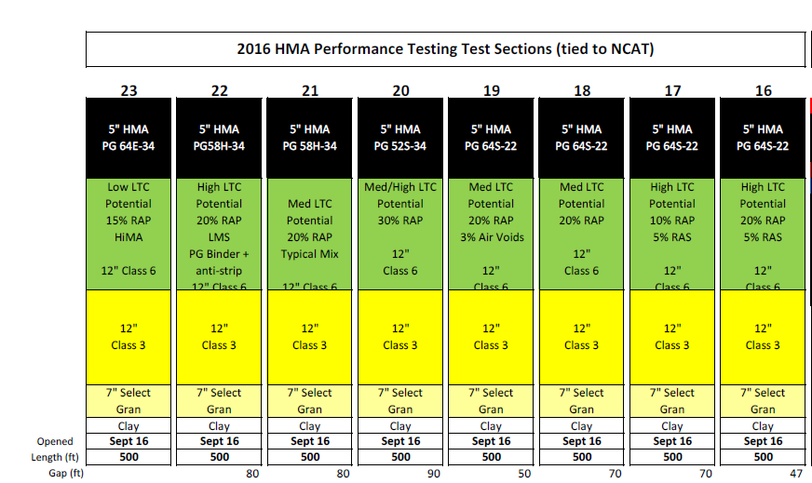
MnROAD Real Estate Available
4500’ total

Slide 5
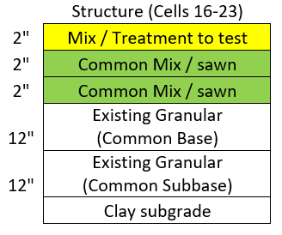
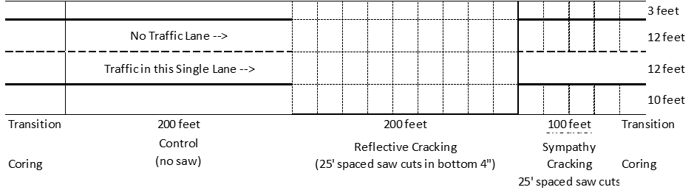
Additive Group Study – Northern Perspective
Reflective Cracking (HMA/HMA) Challenge
Northern Section Layout
  8-10 Test Sections
  ~450’ or 550’ of paving per material
  Discussion on 3 approaches below
    Reduce to only have 400 feet for 10 sections?
Passing Lane Traffic
Driving Lane Traffic

Slide 6
Additive Group Study – Northern Perspective
Reflective Cracking (HMA/HMA) Challenge
Comments:
Eshan- keep in mind with overlay performance, it is a combo of material and structure
Eyoab – important variables to watch saw cut depth
Randy – likes overall experiment idea; doesn’t have problem if some sections have different structure. Reflective cracking strain not the same as other distress. Still have conventional mnroad section and analysis with uncut portion
Fujie- shared slide over overlay thickness/material simulation. Used Texas overlay design program. UC program also showed longer life (non-linear) for 4” overlay
Should thickness be a variable???
Eshan – 2017 NRRA HMA/PCC overlay. Good data for comparison. Move forward with 6” structure and

Slide 7
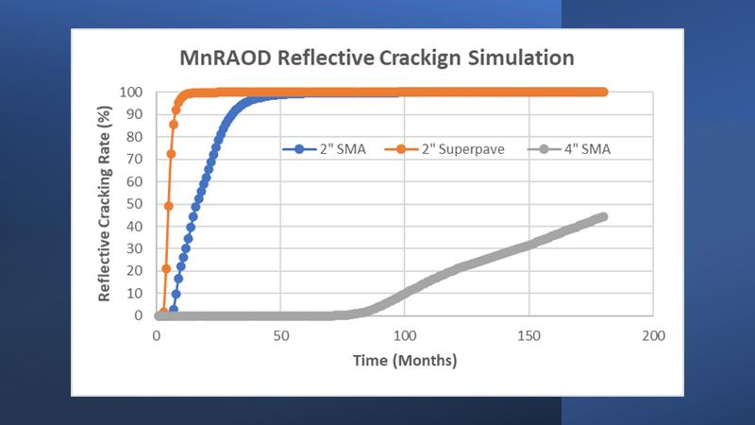
Fujie’s Slide

Slide 8
Additive Group Study – Northern Perspective
Reflective Cracking (HMA/HMA) Challenge
Possible Test Section Mixes
  B Oil – Control 1 (Base Oil) PG 58S-28
  C Oil – Base Oil (Polymer Modified) PG 58H-34
  PG52-34 binder – 2016 MnROAD Cold regions best performer
  Superpave 5 (Using mix 1 or 2 as a basis)
  Superpave 5 (Graphene Nanoplatelets from mix 4 or mix 1)
  NCAT/NRRA Member 1 (Base Oil - Plastic)
  NCAT/NRRA Member 2 (Base Oil - Rubber)
  NCAT/NRRA Member 3 (Base Oil - Fibers)
  NCAT/NRRA Member 4 (Base Oil - ?)
  NCAT/NRRA Member 5 (Base Oil - ?)
  Cost Neutral vs Cost Value Added needs to be discussed
  (are you looking to minimize the cost or increased performance)

Slide 9
Additive/Reflective Cracking Challenge
Internal Partnership Relationships (NCAT/MnROAD)
NRRA – Pooled Fund
TPF-5(466)
NCAT Test Track
Pooled Fund TPF-5(466)
Executive Committee
NRRA Flex Team Study
Northern States
MN – $1,200,000
NY – $750,000
Southern States
AL, B, C, D, E
$4M MnDOT Construction Funding
MnDOT Contribution to TPF-5 (466)
MnROAD / NCAT Partnership
(Shared Tasks using the $750K)
See Next Page
Phase-1
Lab Additive Selection
NCAT Additive Study
NCAT Test Sections
Construction
(MnROAD Collaboration)
NRRA Reflective Cracking
/ Additive Study
MnROAD Test Sections
Construction
(NCAT Collaboration)

Slide 10
Shared Products to be Developed
NRRA Deliverables (Flex Team to Discuss)
  Low Temperature Binder Grade Reflective Cracking Potential
  Pavement Life Impact of Included Additives
    Layer Coefficient or Calibrated ME Model
  Better Understanding of Reflective Cracking Mechanisms with HMA/HMA
    Improved Modeling
NCAT Deliverables
  Pavement Life Impact of Included Additives
    Layer Coefficient or Calibrated ME Model
  Validated Methodology for Evaluating Additives
    Climatic Effects with Additives between North and Southern Mixes
Shared Tasks ~ $750K
  Phase-1 Additive Selection = paid by vendors
  Initial Mix Designs for Northern Test Sections
  NCAT Construction Support on site
  Lab Testing Plant Placed Materials
  Travel Sponsor and Communications Meetings
  Rejuvenator NY sections MnROAD = Discuss with NY
  (No money transfer to MnDOT)
  Is NCAT in the ~5 additive sections or all ~10 reflective cracking test sections at MnROAD?

Slide 11
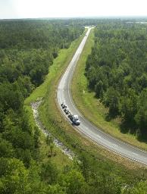

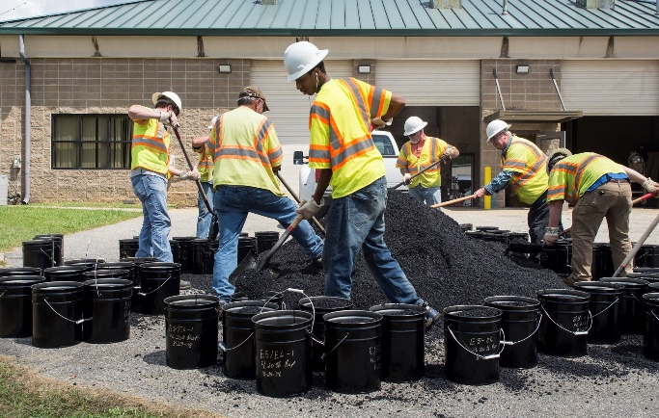
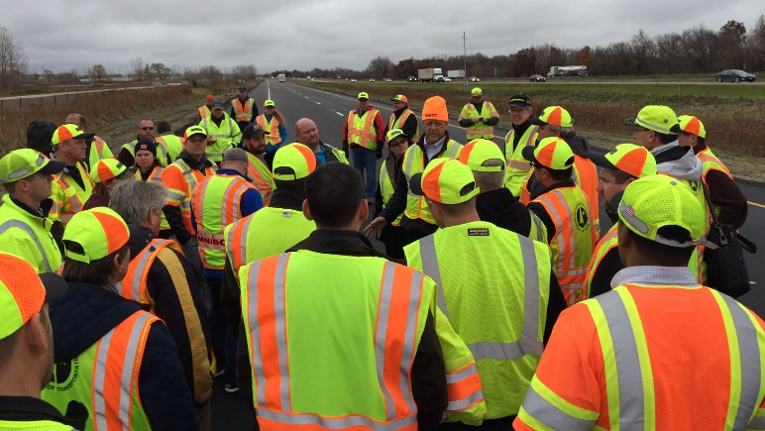

Additive Group Experiment
A continuation of the partnership between NCAT and MnROAD to address national needs
Establishing a simplified process for evaluating the impacts of asphalt mixture additives using BMD and validated Mechanistic-Empirical pavement modeling
NCAT Test Track
MnROAD
Notes:
As you know the cracking group experiment contains a southern experiment looking at top down cracking. I will talk about that. Michael Vrtis will talk about the experiment in Minnesota looking at thermal cracking.

Slide 12





Overall Additive Group Plan
State DOTs commit to sponsoring the AG experiment
Phase I lab study to evaluate potential additive products
Phase I results shared with state DOTs
Repeat process for MnROAD
Evaluate performance of Test Sections; Calibrate models
Construct AG test sections on Test Track
Sponsors select additives for the AG experiment

Slide 13
Phases, Sponsors, and Costs
Phase 1 – BMD & Pavement ME Evaluation
  Funded by additive suppliers
  Evaluate fundamental and BMD index tests as well as a theoretical structural pavement analysis.
  $20,000 per additive
Phase 2 – Build & Evaluate Test Sections
  Funded by AG sponsors
  Comprehensive accelerated pavement evaluation

Slide 14












Phase 1 Additive Technologies
Recycled Tire Rubber
Recycled Plastics
Fibers

Slide 15

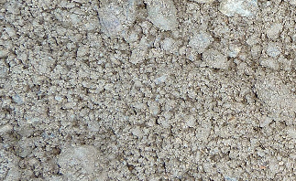
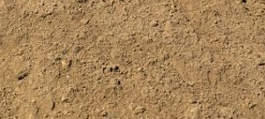
NCAT Additive Group Experiment Design
Control
Additive 1
Additive 2
…
Additive N
5”
6”
Bottom-up fatigue cracking is the designed mode of failure
15

Slide 16
MnROAD Additive Group Experiment
Reflective Cracking (HMA/HMA) Challenge
Northern Sections Layout
  Six to eight Test Sections
  550’ of paving per material
  Partner with NCAT for Instrumentation, Testing and Analysis

Slide 17
Timeline
Phase 1 work
  started in Oct. 2020
  Complete in April 2021
  share results with AG sponsors in May 2021
Phase 2: Build & evaluate AG test sections 2021-2024
  NCAT section to be built in July-Aug, 2021
  MnROAD cells to be built in Summer 2022
  Complete evaluations in 2025

Slide 18
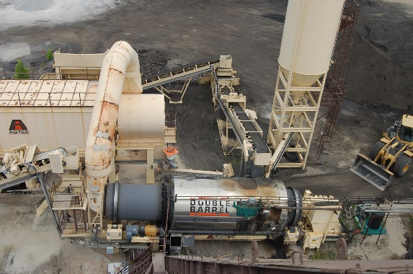
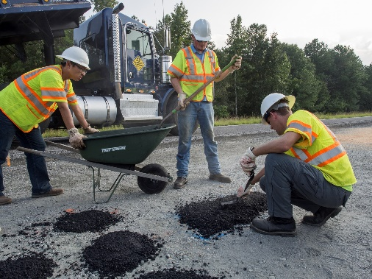
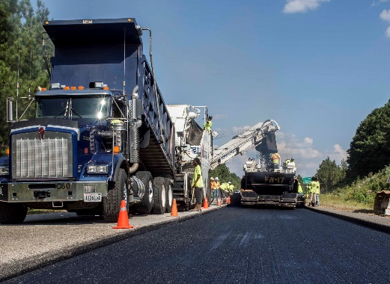
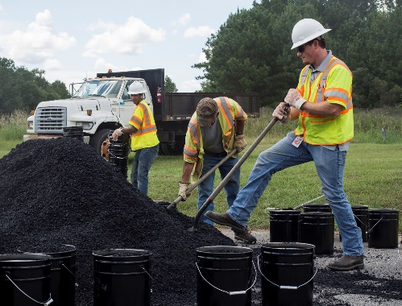
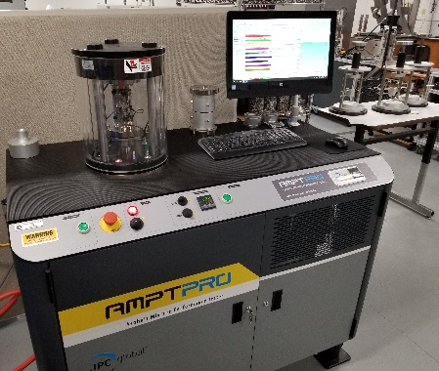
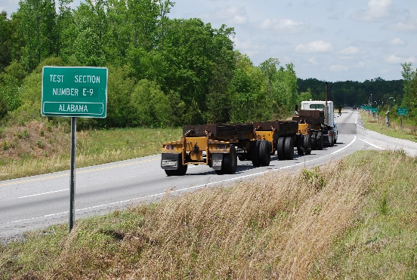
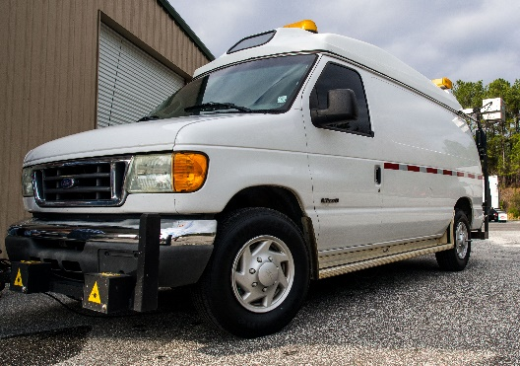
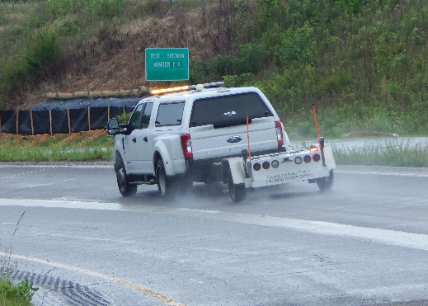
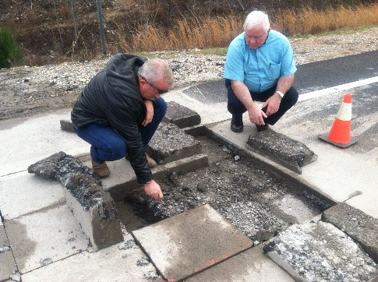
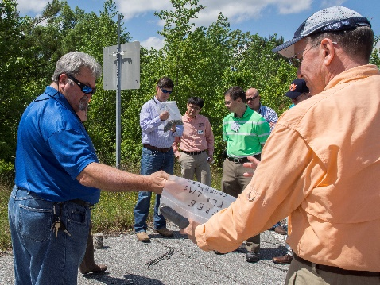
Build & Evaluate AG Test Sections

Slide 19
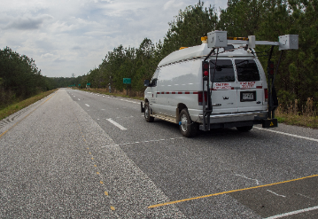
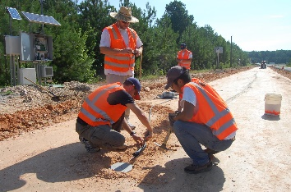
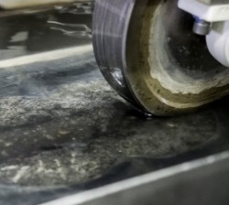

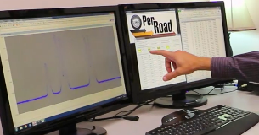
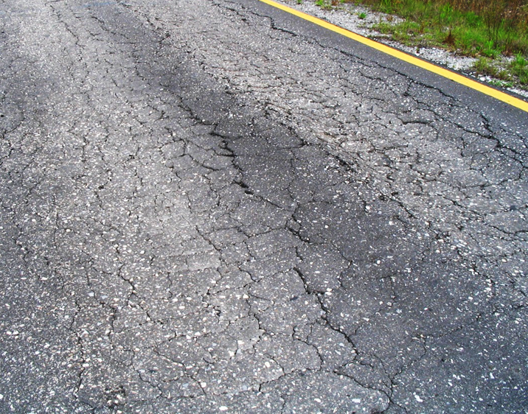
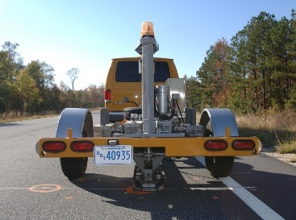
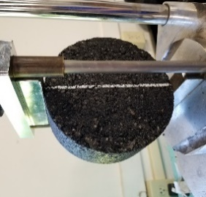

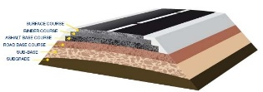
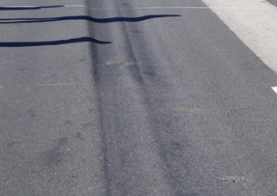
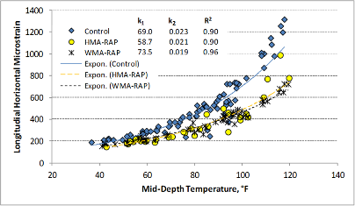
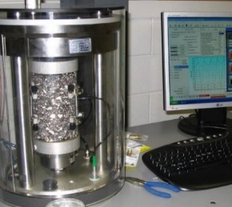
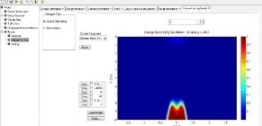
Additive Group Experimental Scope
Performance Data
Structural Response
Materials Characterization
Pavement
Design
FlexPAVETM

Slide 20


Asphalt Concrete Overlays on Asphalt Pavements
Katie Haslett, Eshan Dave and Jo Sias
University of New Hampshire
NRRA Phase-II Idea
Flexible Pavements Team Meeting
March 3rd, 2021

Slide 21
Why, What and How?
  Substantial development and practical outcomes have come out of current NRRA effort:
    Treatment that works, treatments that do not work, effects of asphalt mix design approaches, decision tool…
  Things that can add significant value to current effort:
    Asphalt on asphalt overlays
    Life cycle assessment with sustainability benchmarking
  Build on current project and leverage on-going efforts
    Innovative mixtures/additives/recycled products/existing cells
    Ensure that outcome includes decision tool for practitioners
      Field data + Modelling + Performance Testing

Slide 22
Lessons learned from current NRRA Reflective Cracking study
Both mixture and overlay thickness is important!
Cold temperatures is really what is driving cracking (at least at MnROAD)!

Slide 23
THANK YOU!

Slide 24
Additive Group Study – Northern Perspective
Reflective Cracking (HMA/HMA) Challenge
Group Discussion-
Starting Point for Meeting 2
Possible Test Section Mixes
  B Oil – Control 1 (Base Oil) PG 58S-28
  C Oil – Base Oil (Polymer Modified) PG 58H-34
  PG52-34 binder – 2016 MnROAD Cold regions best performer
  Superpave 5 (Using mix 1 or 2 as a basis)
  Superpave 5 (Graphene Nanoplatelets from mix 4 or mix 1)
  NCAT/NRRA Member 1 (Base Oil - Plastic)
  NCAT/NRRA Member 2 (Base Oil - Rubber)
  NCAT/NRRA Member 3 (Base Oil - Fibers)
  NCAT/NRRA Member 4 (Base Oil - ?)
  NCAT/NRRA Member 5 (Base Oil - ?)
  Cost Neutral vs Cost Value Added needs to be discussed
  (are you looking to minimize the cost or increased performance)

