Slide 1

Industry Outreach Report
January 22nd, 2013
John Bale, PB
Peter Davich, MnDOT

Slide 2
Purpose
MnDOT at intervals evaluates the innovative contracting program.
Legislation authorization in 2001.
2006, an industry forum was conducted to improve the delivery of design-build projects.
A continued improvement Industry Outreach was performed in 2012.

Slide 3
Method for Outreach
Circulated a questionnaire /survey
Holding one on one meetings with industry to solicit open feedback
Facilitate non-restricted comments and feedback
Report prepared:
  To present results
  Recommend modifications to program

Slide 4
Timeline and Participants
Questionnaire circulated in February 2012.
One-on-one meetings were conducted between March 19 and May 4, 2012.
Participants represented a cross section of industry involved in large and small design-build projects.
Participants of the one-on-one meetings included individuals from
  10 contactor firms;
  10 engineering firms;
  14 individuals representing MnDOT District/Offices and FHWA.
Names of the participants have been kept confidential.

Slide 5
General Findings
MnDOT innovative contracting program
  Is well established (experienced industry)
  Generally accepted and supported throughout the industry.
The comments and recommendations represent
  a fine tuning of the program to improve
  are intended to help drive the Program to continue to be leader in industry

Slide 6
Findings
Three Themes 1. Consistency
Consistency throughout the design-build process was important to both industry and Owner individuals. Primary areas stated requiring more consistency:
  Procurement documents –
    clear the documents have evolved
    time to bring them back to a consistent standard.
  Inconsistent Project Management (both in OCIC and MnDOT District project manager)
    Turnover in the OCIC has made it difficult for the office to follow a consistent process during procurement.
    District Project Managers do not have the experience or depth to consistently manage design-build during construction.
  Oversight services are viewed to not follow established guidelines and procedures during design and construction. This leads to varied expectations for the level of design and quality assurance for the contractor.

Slide 7
Findings
Three Themes 2. Training
Training was commonly mentioned as a solution to the consistency theme and other concerns.
Training opportunities requested include:
  Improve contractor understanding of alternative contracting methods
  Clarify the role each office or organization has in the Design-build process. (e.g. the role of OCIC, Districts and Consultants). Apply consistently across all projects.
  Develop consistency with all Project managers.
  Provide consistent application of design and construction verification.

Slide 8
Findings
Three Themes – 3. Project Selection
In recent history several procurements have been delayed , rejected or changed delivery method . Solutions or concerns raised included:
  Pick the right delivery method for a project, select consistent criteria
  Delaying Notice to Proceed or accelerating the procurement process makes it difficult for:
    Industry to prepare proposals
    Industry to maintain key staff

Slide 9
Recommendations
The current Program is well received by most participants of the outreach process
There are areas that lend themselves for improvement.
There are 9 primary areas of recommendations to MnDOT

Slide 10
Recommendation 1 - Template Documents
Develop an RFP template for Book 1, Book 2, Book 3, and RID to
  Providing more complete and consistent RFP documents
Areas of emphasis should include:
  personnel experience,
  Technical requirements,
  Consistent quality requirements,
  Risk transfer and
  Avoiding more stringent requirements than traditional delivery.

Slide 11
Recommendation 1 -Template Documents
The template should provide for the following:
  Clear contract language for consistent implementation by project managers
  Establishing a known and consistent quality control and quality assurance program
  Internal guidance for vetting information to include in contract versus including in RID
  Internal guidance for vetting assigning project risks
  Internal guidance on design-build team personnel requirements
  Internal guidance for selecting a procurement and oversight team

Slide 12
Response 1 - Consistent RFPs
Book 1 and ITP Templates created
Book 2 Template being developed
Book 3 will be reviewed
RID standard structure being developed for both DB and DBB projects
Creating formalized RFP preparation training
RFP sections are being reviewed by OCIC for “gold plating”

Slide 13
Recommendation 2 - Project Selection Process
Work with the Enterprise Risk Management Program to develop a project selection tool that will be used for vetting project delivery and procurement methods.
The vetting process should establish a systematic risk based approach to selecting alternative delivery types.
The risk analysis will consider:
  Risks associated with scope, stakeholders, timing, and budget
  Methods for estimating projects and assigning contingency to the project to avoid under funding
  Guidance for risk based progress of design
This process will also assist in overall consistency of documents

Slide 14
Response 2 - Project Selection Tool
Why are projects programmed DB?
  Funding constraints/speed of delivery
  Innovation
  Streamlining of project delivery (e.g. Alt Bid)
MnDOT is developing a project selection risk and goal based approach
  OCIC/program managers lead discussion
  Largest risks discussed i.e. earthwork, soils, permitting, R/W, etc

Slide 15
Example - CDOT Method
PROJECT DELIVERY METHOD OPPORTUNITY/OBSTACLE SUMMARY
 | DBB | DB | CMGC
Primary Evaluation Factors
1. Delivery Schedule | X | ++ | -
2. Project Complexity & Innovation | NA | + | +
3. Level of Design | NA | ++ | +
4. Cost | NA | ++ | +
5. Perform Initial Risk Assessment | NA | Risks can be properly allocated | NA
Secondary Evaluation Factors
6. Staff Experience/Availability (Owner) | NA | Pass | NA
7.Level of Oversight and Control | NA | Pass | NA
8. Competition and Contractor Experience | NA | Pass | NA

Slide 16
Response 2 - Project Estimating and Risk
TH 14 Letting
Increased OCIC “risk check” of RFP versus estimate
Beginning a “risk based” estimating study through Iowa State University
  Examine how other states estimate DB
  Look for tools to help us improve estimating

Slide 17
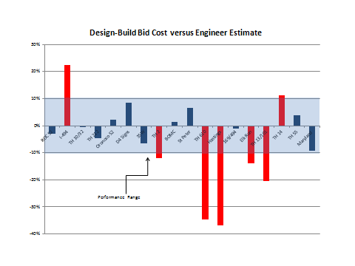
Project Estimating and Risk Allocation

Slide 18
Project Estimate Template
Design-Build | Standard Items | Items Used on SP: INPUT |  | Design-Build | Standard Items | Items Used on SP: INPUT
Item No. | Item |  |  | Item No. | Item
2016.601 | Contract Management |  |  | 2503.601 | Pipe Sewers
2016.601 | Quality Management |  |  | 2506.601 | Drainage Structures
2016.601 | Human Resources Management |  |  | 2511.601 | Riprap
2016.601 | Safety Management |  |  | 2572.601 | Gabions and Revet Mattresses
2016.601 | Public Information Management |  |  | 2514.601 | Slope Paving
2021.601 | Mobilization |  |  | 2520.601 | Lean Mix Backfill
2021.601 | Insurance |  |  | 2521.601 | Walks
2011.601 | Design Services |  |  | 2531.601 | Concrete Curbing
2011.601 | Sanitary Design - A |  |  | 2533.601 | Concrete Median Barriers
2011.601 | Sanitary Design- B |  |  | 2535.601 | Bituminous Curb
2011.601 | Watermain Design -A |  |  | 2545.501 | Electric Lighting Systems
2011.601 | Watermain Design -B |  |  | 2550.501 | Traffic Management System
2013.601 | Environmental Compliance |  |  | 2554.601 | Traffic Barriers
2013.601 | Geotechnical Investigation |  |  | 2557.601 | Fencing
2011.601 | Design Surveying |  |  | 2560.501 | Highway-Railroad Grade Crossing Signals
2011.601 | Construction Surveying |  |  | 2564.601 | Traffic Signs and Devices
2011.601 | R/W - Construction Easements |  |  | 2565.601 | Traffic Control Signals
2105.601 | Grading |  |  | 2571.601 | Plant Installation
2200.601 | Base Construction |  |  | 2572.601 | Protection and Restoration of Vegetation
2301.601 | Concrete Pavement |  |  | 2573.601 | Storm Water Management
2360.601 | Bituminous Pavement |  |  | 2575.601 | Controlling Erosion and Establishing Vegetation
2400.601 | Bridge - A |  |  | 2577.601 | Soil Bioengineered Systems
2400.601 | Bridge - B |  |  | 2581.601 | Removable Preformed Plastic Pavement Marking
2400.601 | Bridge - C |  |  | 2582.601 | Permanent Pavement Markings
2411.601 | Retaining Walls |  |  | 2503.601 | Sanitary Construction - A
2422.601 | NoiseWalls |  |  | 2503.601 | Sanitary Construction - B
2411.601 | Minor Structures |  |  | 2504.601 | Watermain Construction -A
2501.601 | Pipe Culverts |  |  | 2504.601 | Watermain Construction -B
2502.601 | Subsurface Drains |  |  | 2563.601 | Traffic Control

Slide 19
Recommendation 3 - Vet ATC process
Review the ATC process for consistencies and inconsistencies
Evaluate MnDOT willingness to accept innovation
Draft an ATC White Paper to:
  Address protocols for developing, submitting and evaluating ATCs.
  Address a training program

Slide 20
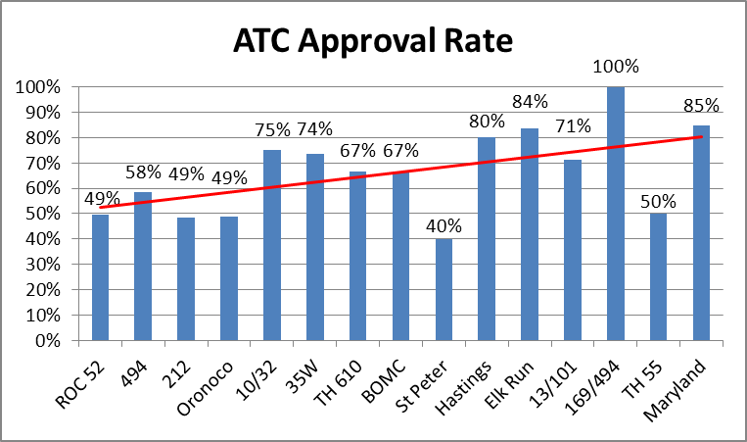
Response 3 - Improve Consistency of ATC Process

Slide 21
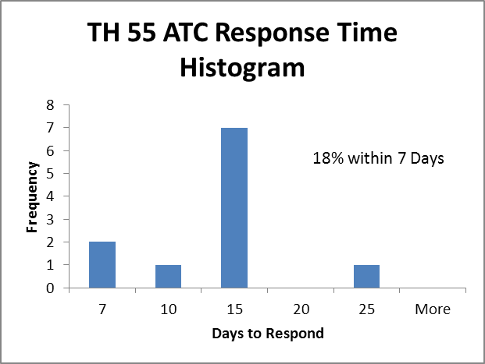
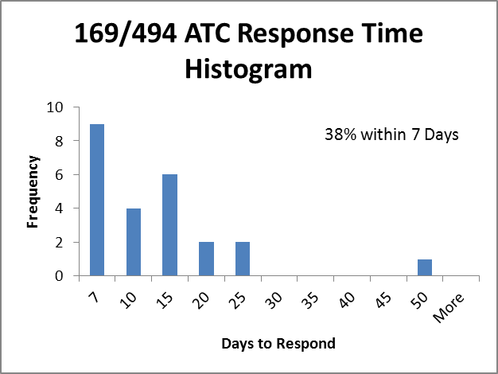
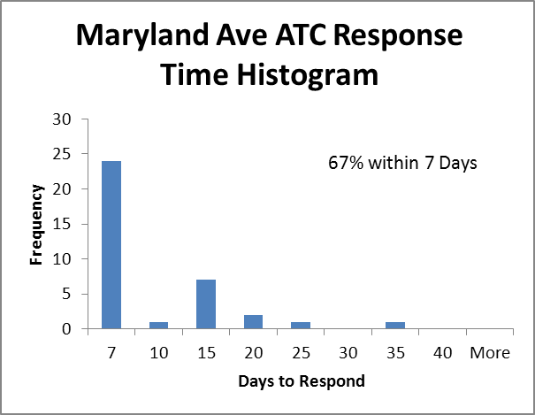
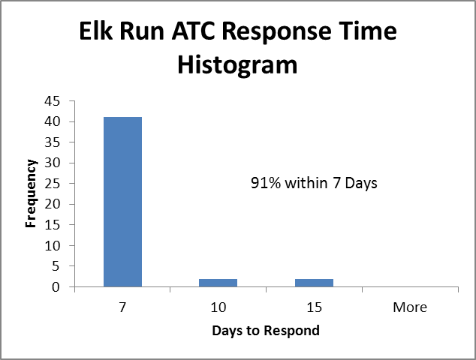
Response 3 - Improve Consistency of ATC Process

Slide 22
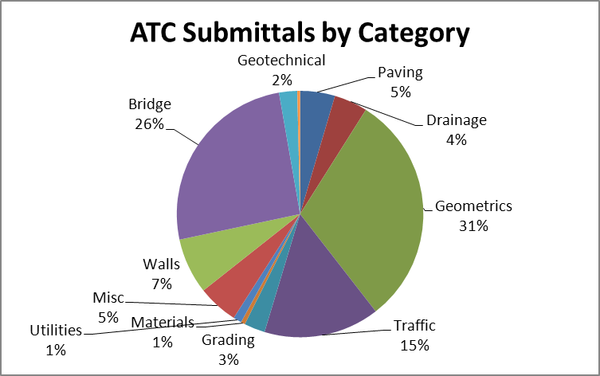
Response 3 - Improve Consistency of ATC Process

Slide 23
Response 3 - Improve Consistency of ATC Process
Develop “just in time” training for PMs
OCIC continue to review all ATCs for consistency
Continue use of ATC log to track performance and trends
Developed new Response Time Performance Targets
  70% Response within 7 Days
  90% Response within 14 Days
Continue to educate Contractors on ATC Success
  “Equal or Better” relates to the design alone.
  Additional explanation will be included on response form/debriefing

Slide 24
Recommendation 4 – Training Program(s)
Establish a simple training program in preparing proposals
    An initial 2 to 4 hour workshop
    Quarterly or bi-annual lunch hour training updates.
    Benefits include continued industry interaction
  This training should cover:
    Contents of the RFP and location of the material on the provided electronic copy and web based site
    Guidance on MnDOT’s web site and applicable internet links
    Guidance on the appropriate information to be contained in given forms and associated proposal paperwork
    Format and content of technical proposals and SOQs
    Guidance on electronic bid submittals
    Guidance on RID and it’s use

Slide 25
Recommendation 4 – Training Program(s)
Develop a training program administered by OCIC for MnDOT personnel and oversight consultants.
Training program to be robust and include topics such as:
  Methods and objectives of oversight
  Required qualifications for oversight team members
  Methods for determining key personnel and qualifications requirements for design-build teams
  Project manager training regarding contractual interpretation and role
  Training for executing the time period between notice of award and NPT1

Slide 26
Response 4 - Training Needs (Contracting Teams)
Develop DB 101 Training for contractors/consultants
  Youtube.com
  Likely held after kick-off meetings
Continue to provide timely and open debriefing sessions
“Open door” policy for OCIC contact
Industry meetings as per Recommendation #6.

Slide 27
Response 4 - Training Needs (MnDOT Oversight)
OCIC to provide input or participate in consultant oversight selection
Develop DB Contract Administration Manual
Develop formal DB Contract Administration training
  Understand role as verification versus designer
  Cover basics, address consistency issues
Qualification requirements unlikely to change. (Recommendation #9)

Slide 28
Recommendation 5 – Scoring Process
Evaluate the debate of objective versus subjective scoring
  Is selection and scoring method driving low bid and not best value
  Should the 50 points awarded for responsive proposal be re-evaluated with industry
  Should most probable cost be included in evaluation
  Should benefits and drawbacks of adjectival scoring be reviewed with industry
Prepare White Paper for industry

Slide 29
Response 5 - Scoring Criteria
Looking for industry input
Option 1: Do Nothing
Option 2: Modify “responsive” points depending on project risk. Rough example:
  70 pts responsive, 30 pts scoring on a simple project
  30 pts responsive, 70 pts scoring on a complex project
Option 3: New Formula, consider national experience

Slide 30
Recommendation 6 – Continued Industry Outreach
Establish an industry (AGC/ACEC) outreach process that:
  incorporates regularly scheduled meetings:
    bi-annual
  Discusses salient issues in the alternative contracting program.

Slide 31
Response 6 - Outreach
Need more regular meetings. Bi-annual just right or too much?
Industry needs to help shape the agenda
Accomplishments from last meeting
  Modified design 140% mark-up
  5% design retaining for RFC eliminated
  Modified warranty requirements; more balanced risk
OCIC ‘open door’ policy

Slide 32
Recommendation 7 –Mission Statement
Provide a clear mission statement that details:
Lines of authority for OCIC and District personnel with regard to innovative contracting
Define OCIC staffing level

Slide 33
Response 7 - OCIC Involvement
Current process:
  District does bulk of development and oversight work
  OCIC oversees process for consistency and programmatic needs during procurement. They are on-call for oversight.
Continued review of process and staffing as DB matures. Should be less OCIC involvement on individual projects in long run.
In short run, new CMGC Manager has some capability to assist with DB during heavy workload periods.

Slide 34
Recommendation 8 – Vet Other Contracting Methods
Evaluate the use of design-build low bid, CMGC and ID/IQ alternative delivery.
  Review the goals of each delivery type
  If goals were met disseminate to the industry the stated goals and how the program is achieving the goals
If the program will introduce CMGC and ID/IQ articulate the goals of each delivery type to industry

Slide 35
Response 8 - DB Low-Bid, CMGC, ID/IQ
Develop lessons learned on each project
Developing project selection matrix (#2)
Constructability reviews when applicable for new project types (e.g. ID/IQ)
Low-Bid DB
  Use on small / simple projects
  May use more one step DB (no short-list) on simple alt bid pavement rehab projects
  TH 5 Bridge Redeck
  May reduce scoring component (#5)

Slide 36
Recommendation 9 – Industry discussion forums
Initial Salient topics include:
  Quality –design-build benefits include placing quality verification on the design-build team. Should more emphasis be placed on this aspect.?
    Contractor bears burden of quality proof
    The Owner performs oversight of the process.
  Staff qualifications Should the Owner have the same level of experience that the design-build team is required to provide?
    In many fields of design-build the Owner is not knowledgeable of the design or construction methods.
  Quantity risk is inherent in design-build discuss how, why and when this risk is transferred to the contractor within the constraints of the contract.

Slide 37
Response 9 - Best-Practices
No major changes for Quality Management planned
  Will formalize QM training
Staff Qualifications
  Most highly qualified available staff or consultants for verification; there is always competition.
  Emphasizing “verification” in training; do not always need qualifications equal to Designer.
  Added emphasis on ‘right-sizing’ experience requirements for DB teams.
Additional risk review by OCIC as per Recommendation #2

Slide 38
Any Questions?
Coming Projects:
35E MnPASS: RFQ in mid-February, RFP in April, Aug let
TH 5 Bridge Redeck: RFQ in mid-February, RFP in April, June let
      56 week procurement
      Low Bid with Stipends/ATCs
TH 35W/4th Street: RFQ released, RFP this summer, Nov let
MAP21?
Alternate Bid?

