Slide 1

Chapter 9
New Technologies
Traffic Signs 101
June 2020

Slide 2
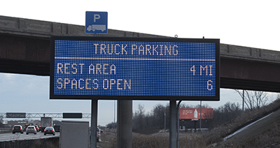
Traffic Signs 101
New Technologies
  Truck Parking and Management System
    Reduce the time searching for parking and provide safe truck parking alternative
    Monitor truck parking availability at selected sites and provide real-time information to truck drivers

Slide 3
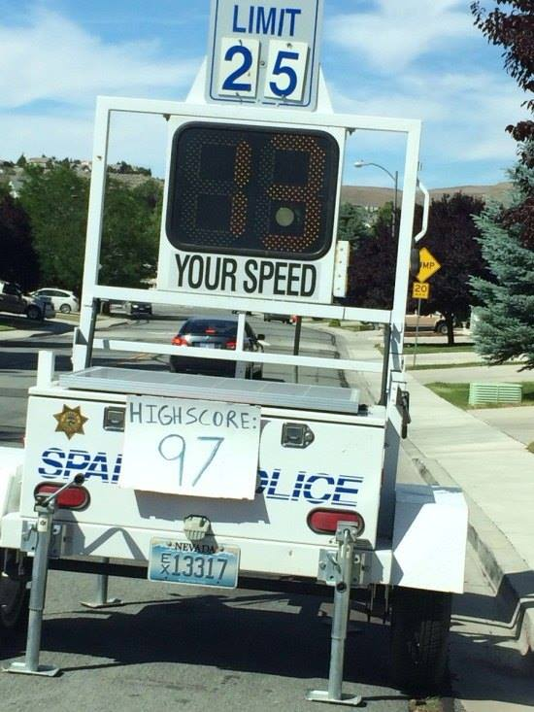
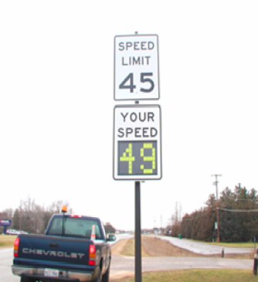
Traffic Signs 101
Dynamic Speed Display Signs
  A device that detects and display a vehicle’s current speed back to the driver
  Have been shown to have a significant speed‐reducing effect in temporary applications such as work zones or neighborhood speed watch programs

Slide 4
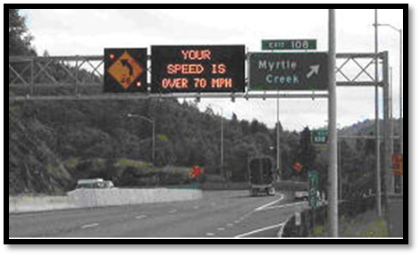
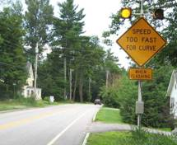
Traffic Signs 101
Curve Warning System
  The Curve Warning System provides a programmable active warning based on the speed of the vehicle as it approaches the curve and provides a warning message to the driver to reduce speed if it is excessive

Slide 5
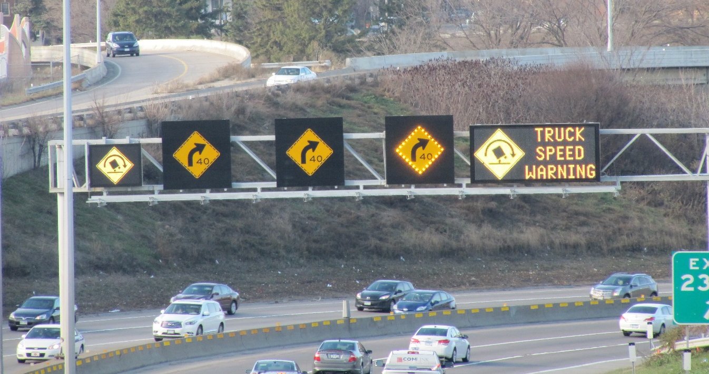
Traffic Signs 101
Truck Rollover Warning System (TROWS)
  TROWS uses use a 3 beam sensor mounted over each lane to determine the vehicle speed and height and if the vehicle has slowed down at that location
  Example on I-94 WB in Minneapolis prior to the tunnel west of I-35W
  A vehicle exceeding the speed and height, the system turns on the appropriate lane signs, and activates the ILCS and DMS at the same time

Slide 6
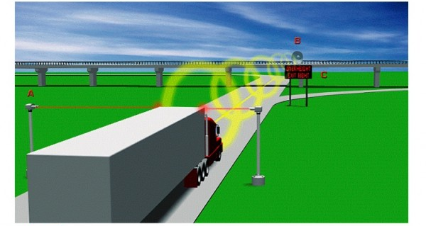
Traffic Signs 101
Over Height Warning System
  Detects over height vehicles moving toward overhead obstacles
  Sign is activated when an over height vehicle is detected by the system

Slide 7
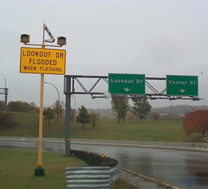
Traffic Signs 101
Water on Road System
  Highway sensor that measures the presence of water on the roadway
  Linked to traveler information systems

Slide 8
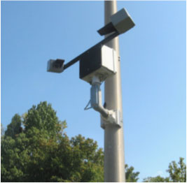
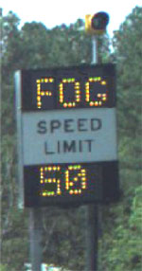
Traffic Signs 101
Fog Warning System
  Visibility sensor that measures the density of roadway fog
  Linked to traveler information systems

Slide 9

Traffic Signs 101
Comments/Questions?
Course Wrap-up

