Slide 1
Supplemental Signs & Costs
Heather Lott, PE
State Signing Engineer
Minnesota Department of Transportation

Slide 2
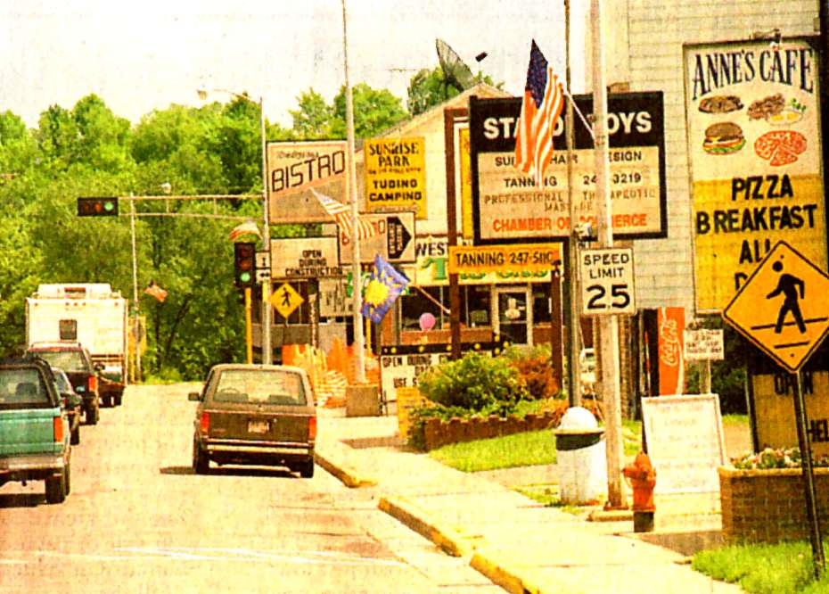
Sign Clutter
Notes:
Sign Clutter
There is tremendous demand for signing along our highway system; many businesses, organizations and agencies feel that they need and deserve signing to advertise, inform and/or aid the motorist in locating their establishment. As discussed under engineering standards, it is necessary to limit all signing to only that which is sufficient to aid drivers in safely arriving at their destination. As such, MnDOT policy and state law set out criteria that a facility must meet in order to be eligible for signing.

Slide 3

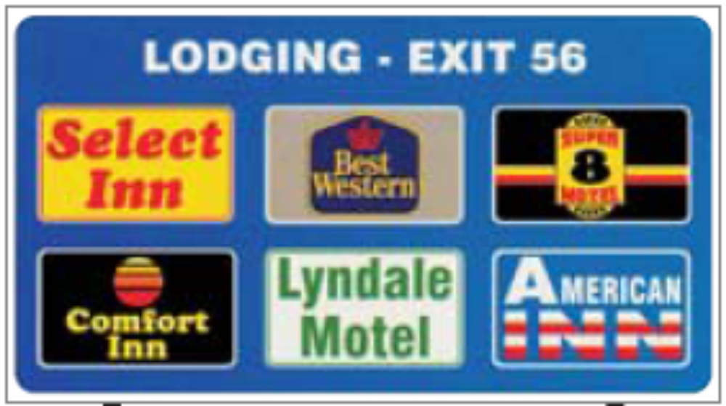

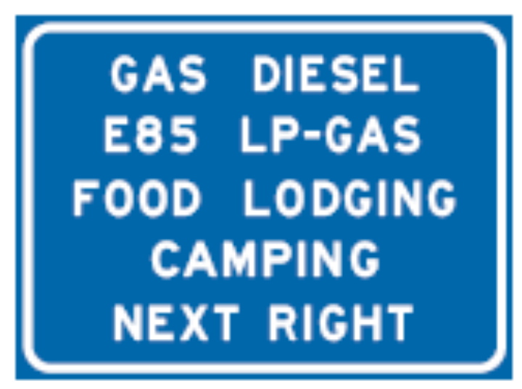

Supplemental
Notes:
Supplemental guide signs, include signs for facilities such as motorist services (gas, food lodging, camping, 24HR pharmacies) amusement, recreation, historic, etc.
We recognize there is importance of signing for facilities and businesses for a variety of reasons.
Signing for places in which drivers expect signing for. For example, motorist services such as gas food and lodging.
Larger traffic generators such as large sports arenas that we have up in the cities (Metrodome/National Sports Center) need signing because they attract thousands of people that are unfamiliar with the area for one event.
Minor Traffic Generators (parks, golf courses, historic resources) usually attract less traffic than larger generators, but they still hold a broad motorist appeal and attract non-local drivers. Although they may be classified as “minor” only because they have less visitors at one time, they are no less important to our state tourism. We need to show people how to get to our state resources such as our state parks and historic places.

Slide 4
Supplemental Guide Signing Programs
Requester pays:
  Airports
  Casino
  Educational Institutions (post-secondary)
  LOGO Sign Franchise Program
  Major Traffic Generators
  Minor Traffic Generators
  National Monuments
  National Parks
  Regional Shopping Centers
  Specific Services
  State Parks
  Tourist Information
  Trail Access
MnDOT pays:
  General Motorist Service
  Hospital
Fabrication & Installation Costs
  One fee paid for by requester covers the life of the sign (~15 yr)
  Logo signs have a monthly cost
Notes:
The MN MUTCD,
Minnesota statutes,
& MnDOT policy
allow supplemental guide signs to be installed on trunk highways for a variety of public and private facilities.

Slide 5
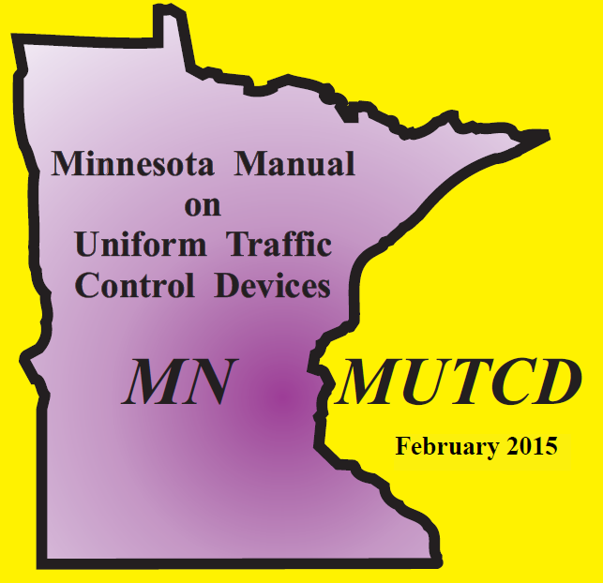
Signing Manuals
Minnesota Manual on Uniform Traffic Control Devices (MN MUTCD)
AASHTO Guidelines for Selection of Supplemental Signs - Freeways
Traffic Engineering Manual (TEM)
MnDOT Standard Signs Manual
MnDOT Standard Signs Summary
Guide Design Manual
At-Grade Signing Manual
Freeway Signing Manual
Notes:
So because we have so many things to sign for…we do have to have guidelines to limit sign clutter and we have to abide by state and federal regulations.
The guidelines, standards and laws that MnDOT staff use to evaluate sign requests come from a variety of manuals and laws.
So this is our pecking order so to speak:
A. State Laws- there are many state laws that govern signs. When we have a request which violates a state law, our hands are tied.
B. The Federal Highway Administration publishes a Manual on Uniform Traffic Control Devices which each states needs to adopt and be substantially compliant with. Minnesota adopts our own MUTCD (substantially compliant of course) which is approved by FHWA. This manual tells us what types of signs we can use and how we need to design those signs. Within many sections the manual states that each State develop a policy based on a set of suggested guidelines and includes the following: B2. AASHTO Guidelines
C. Then, the Traffic Engineering Manual houses the guidelines which supplement the MN MUTCD. Much of the signing guidelines have already been developed but any new ones or changes are discussed and approved by a the state wide signing committee and recommended to the Traffic Engineering Organization Executive Committee for final approval.
MnDOT works with industry to develop the guidelines. For example, the specific criteria MN uses for Historic Resources is developed by MnDOT and MHS together.

Slide 6
MnDOT General Criteria
Roadway type
Urban versus rural
Facility type
Hours of operation
Licensing
Distance from intersection/interchange
Visibility
Trailblazing
Notes:
FHWA tells states they need to further define specific criteria for their supplemental guide signs. Unfortunately, there is not room for everyone to have a sign or our highways would be cluttered with signs.
Qualifying criteria is first based on roadway type and whether it is in a rural or urban area.
Specific business criteria include:
Facility type, Hours and days per week that they are open……
How many hours? How many days? If there is a sign for a facility, it should be open the amount of hours that driver would expect.
Some laws and regulations require licensing.
Distance from the highway (many drivers won’t drive even a couple miles out the way for gas, but would for an attraction). So distance varies for individual programs. We also limit it to the closest highway.
Visibility – is a business visible or have off right of way advertising (billboard, etc).
Trailblazing – also so very important. These are the signs that are on local roads between the highway and the facility to safely get drivers to the destination through a combination of turns.

Slide 7

Facility Specific Criteria
Townships
Shall hold monthly meetings that are open to the public. Township halls are not required to be open eight hours per day, five days per week.
Shall be primarily intended for use as a town hall.
Should provide adequate on-site parking or parking in the immediate area.
Shall post contact information that is visible from the exterior of the building.
Notes:
PULL OUT APPENDIX A
Explain it…
General Criteria
Columns in the alphabetized list.
We work with industry to develop criteria, in the case of Historic Resources, we work with MHS.
Give a couple examples:
Townhalls (THIS PAGE)
Golf Courses (( NEXT PAGE ))

Slide 8


Facility Specific Criteria
Golf Courses
Have at least nine holes.
Be open to the public.
Disc Golf Courses
Be its own entity located on its own property (not located on or in another facility that can be signed as a minor traffic generator).
Have at least 18 holes.
Be a member of the Professional Disc Golf Association (PDGA).

Slide 9
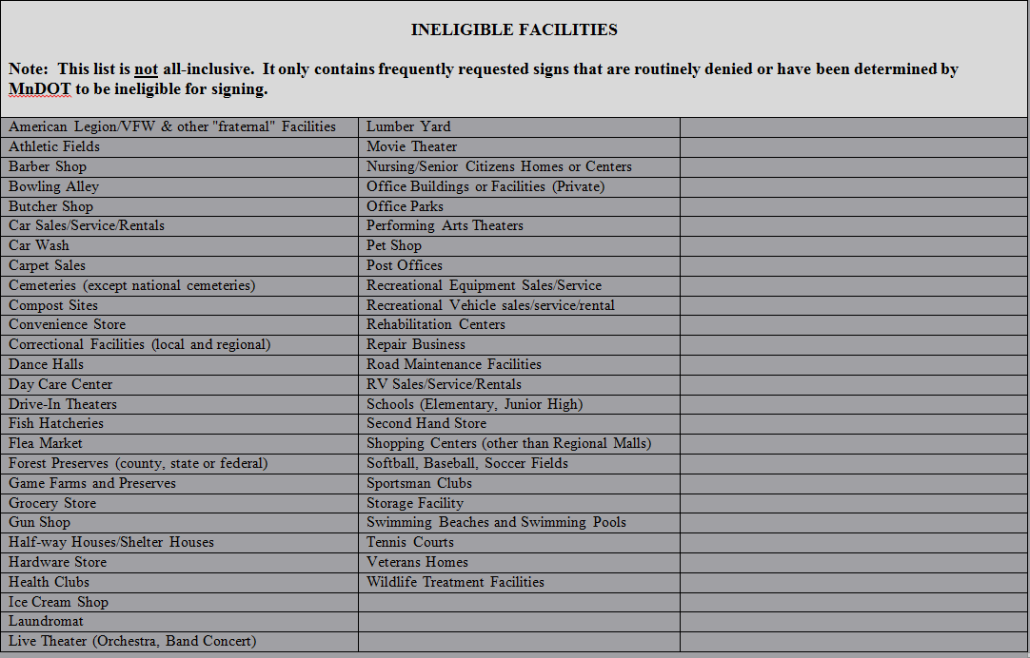
Ineligible Facilities
Notes:
It is the last page of Appendix A - Supplemental Guide Signs.

Slide 10
Where are they allowed?
Conventional Single Lane Highways
Conventional Multilane Highways
Expressways
Freeways & Interstates
Not all programs are allowed on every class of roadway
Notes:
Freeways have more restrictions on signing than conventional highways.
On Freeways, you will see Logo Signs, General Motorist Service signs and signs for Major Traffic Generators.
Minor Traffic Generators are allowed signing on conventional highways and expressways and typically not Freeways unless they qualify as a Logo Attraction.
FHWA allows Logo Attraction signing on Interstates and Freeways.
Attractions need to fall into the following categories: recreation, historic, cultural or amusement.
States are tasked with further defining each category.
Logo Attractions are still quite new to MN. A few years ago, Minnesota DOT initiated an update to the state law to allow expansion of the program to include Attractions on freeways state wide.

Slide 11
What do they cost?
Requester - Pay Signing Costs Tech Memo No. 12-02-T-01
http://dotapp7.dot.state.mn.us/edms/download?docId=1142431
Includes labor, equipment & materials
Standard Designs vs special designs
Notes:
Almost all signs are “requester pays” therefore the name of the tech memo which can be found in your manual.
A couple examples are next that show how large the signs can be and how that impacts cost.

Slide 12

Standard Designs
2 Lane Highways – 36” x 30” (7.5 sq ft)
Expressways – 54” x 48” (18 sq ft)
Cost is approx. = $825 - $1100
Notes:
There are many standard designs. Historic District is one example. Typically all uppercase legend because it’s a generic name. Creates a sign that is smaller in size and therefore, less in price.
Size of the sign is based on the legend and font size.
Smaller fonts are allowed on 2 lane highways where on expressways where there is a greater distance needed to read the sign, the font size needs to be larger.
Approximately 1” height of text is equal to 30ft of legibility distance
We use a 4” text on the smaller sizes and 6” text on the larger signs that are STANDARD.
(7.5 sq ft versus 18 sq ft)
COST is for the life of the sign. Cost goes up the larger the sign. The larger the sign panel, the larger the sign structure is required to hold the sign up.
It includes materials (including the sign structure), labor and equipment.
When it needs replacing, the requester is charged: knockdown or about 15 years service life

Slide 13
Special Designs
Vary in size depending on class of highway
Cost is approx. = $1,000’s
Notes:
Special Design Guide Signs –
Upper lower case with the proper name on the sign.
These signs are larger and significantly cost more. Designed specially by signing staff at MnDOT.
Costs vary. An example is next.

Slide 14

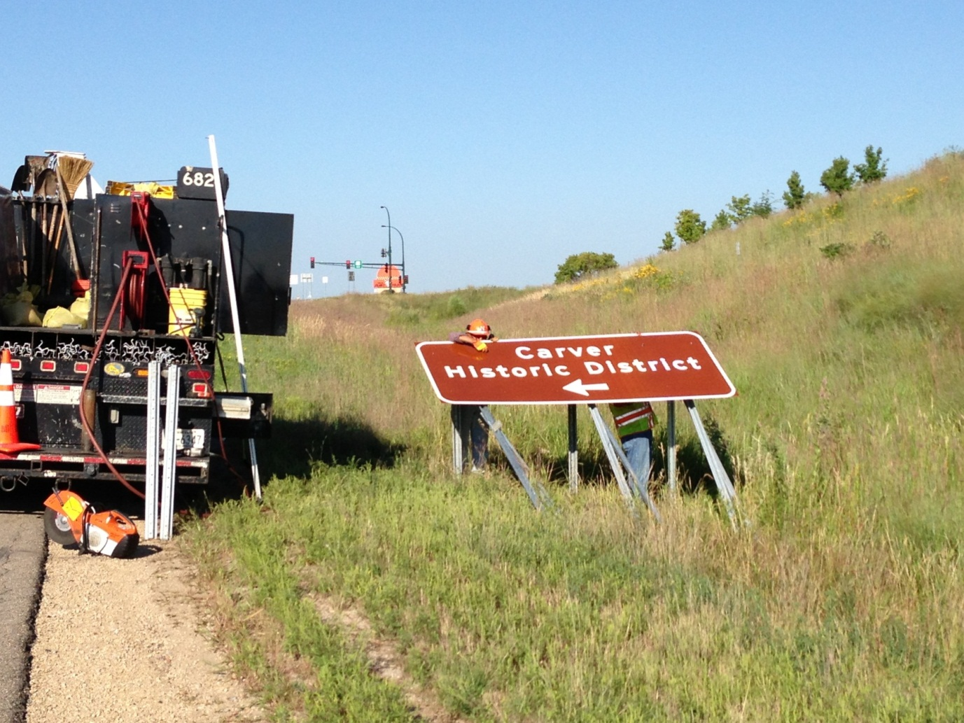
Notes:
MnDOT Crews installing a special design sign for the Carver Historic District.
This exit ramp sign they are installing is 120 x 48 = 10 feet wide by 4 ft high = 40 sq ft sign.
The ramp sign alone costs $1,561.
The sign on the mainline is even larger at 162 x 60 = 13.5 feet wide by 5 feet high = 67.5 sq ft sign
The Cost for the mainline sign is $2,287.75
The City of Carver needed 4 signs total. One in each direction on the mainline and one on each exit ramp. The total cost for all 4 signs was $7,697.50.
In addition they needed signs for trailblazing and identifying the boundaries for the Historic District.

Slide 15
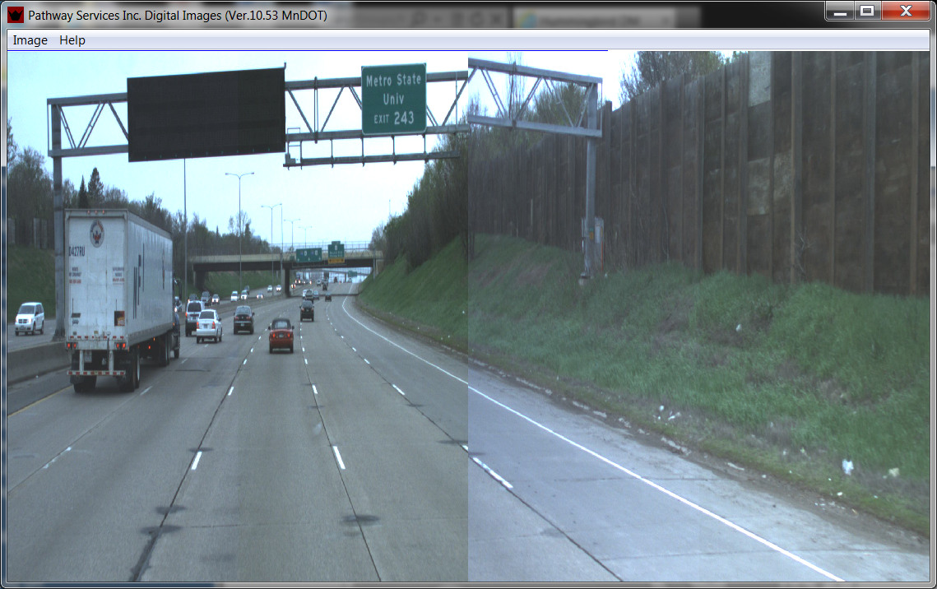
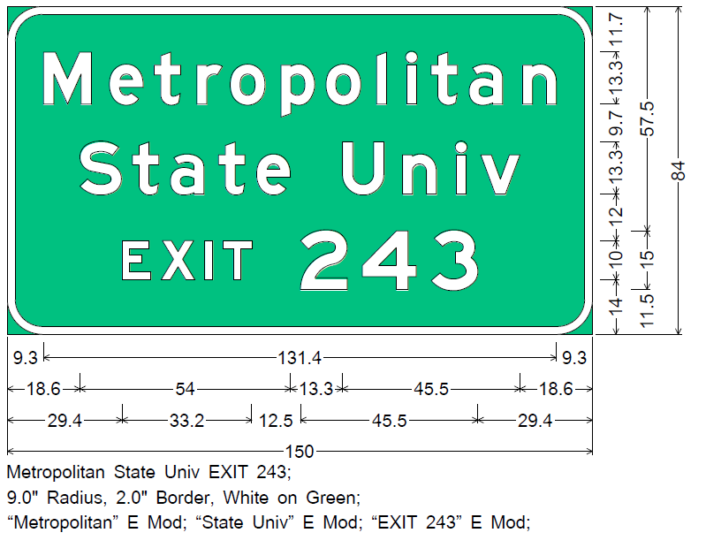
Notes:
Metropolitan State University
Size: 150 x 84 = 87.5 sq ft
Cost of the overhead panel sign overlay (no extruded panels, or structure materials) is $3,677, based on contract prices.
This did not include Traffic Control.

Slide 16
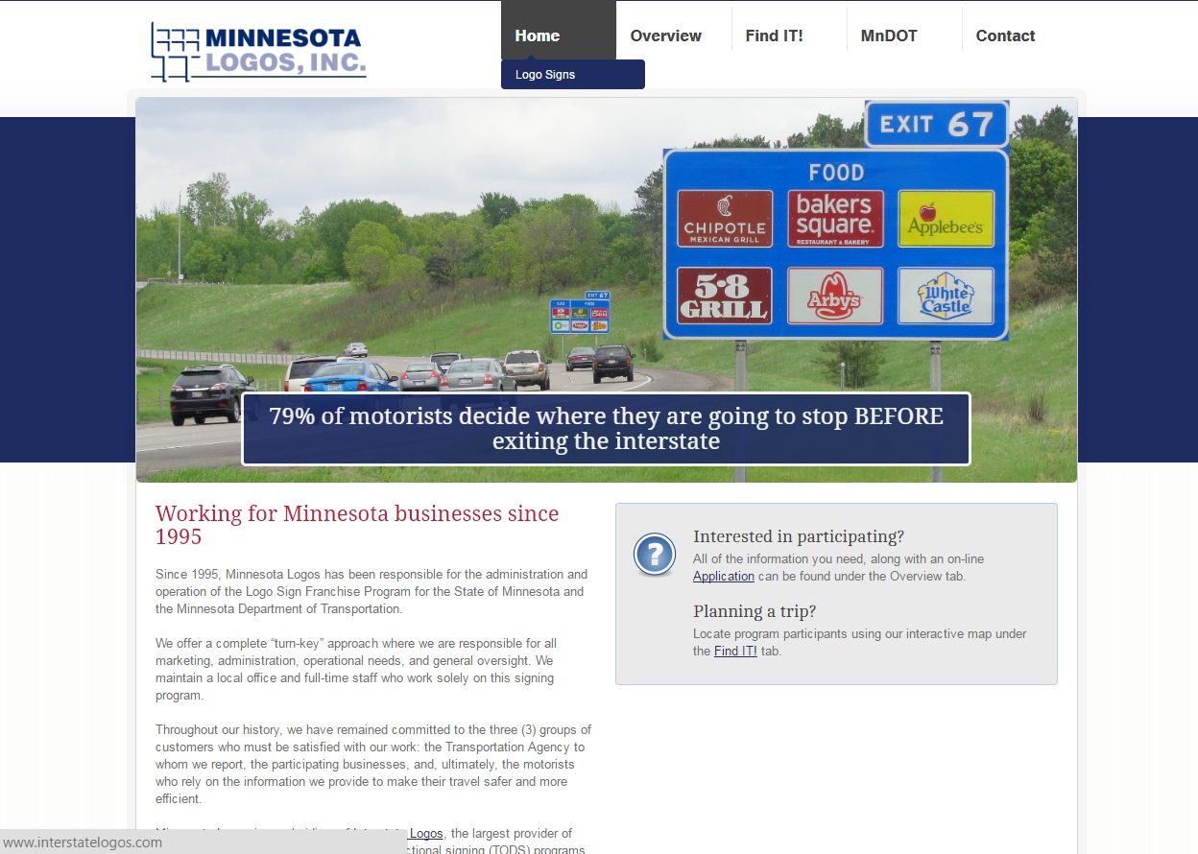
Logo Signs
http://www.dot.state.mn.us/logosigns/
http://www.minnesota.interstatelogos.com/state/
Notes:
MnDOT contracts out the Logo signing program.
Talk about website.
Link on the website for
Criteria for Gas, Food, Lodging, Attractions, 24 Hr Pharm and Camping
FAQ
http://www.minnesota.interstatelogos.com/state/

Slide 17
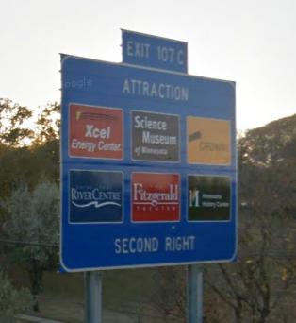
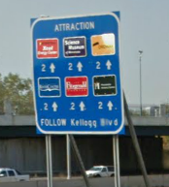
Logo Sign Costs
Mainline Ramp
Monthly cost per sign is $50/$10

Slide 18
What if we’re wrong?
External Sign Variance Committee
Representatives from tourism, chamber of commerce, local government, city planning, AAA
Hear appeal and policy, advise MnDOT Commissioner

Slide 19
Who do I contact?
District Traffic Engineer
For Contact List:
http://www.dot.state.mn.us/trafficeng/contacts.html

Slide 20
Contact Information:
Heather Lott
1500 West County Road B2
Roseville, MN 55113
Heather.Lott@state.mn.us
651-234-7371

