Slide 1
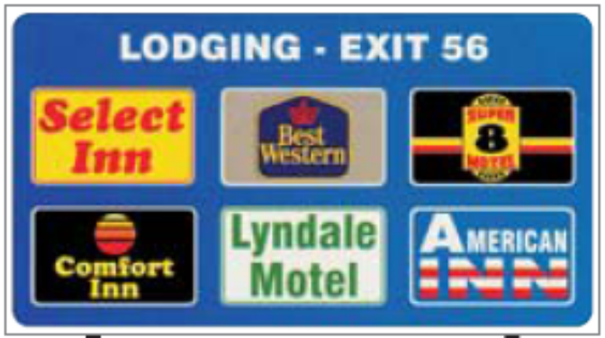
Chapter 5
Supplemental Guide Signs
Traffic Signs 101
June 2020

Slide 2


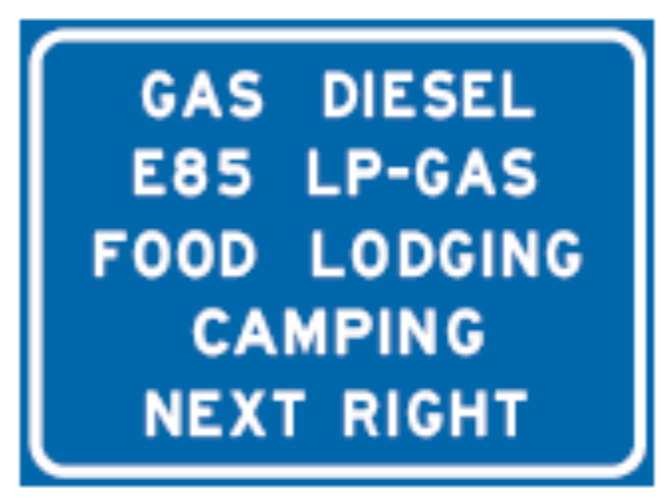

Supplemental
Guide signs which further orient the driver to geographical identification and secondary destinations

Slide 3
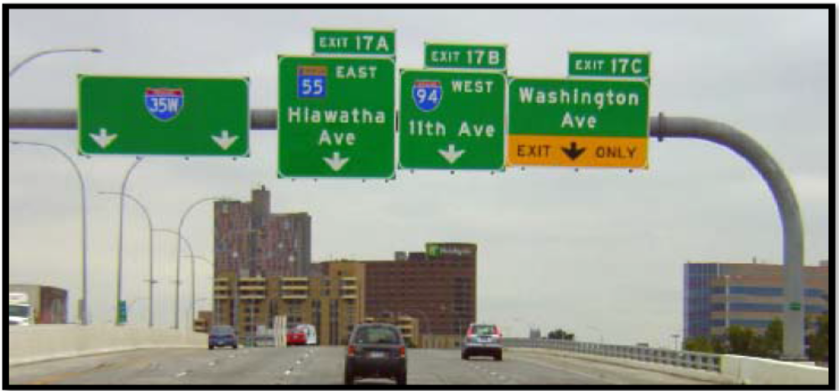
Supplemental
Installation of should be strictly controlled in areas with closely spaced interchanges
Shall not interfere with primary guide signing and sign spacing criteria shall be met

Slide 4
Supplemental
Signs may be provided for the following:
  Geographical features, such as county lines, incorporated city limits, major river and stream crossings, highways and streets crossed by the freeway, and similar features which provide orientation for the driver
  A city in each direction along the intersected route.
  National parks
  National monuments

Slide 5
Supplemental
Signs may be provided for the following:
  Major state parks which are a no more than distance of 15 miles from the freeway and have water, toilets, campsites, picnic areas, and accommodations for 35 overnight camp sites
  Airports
  Educational Institutions
  Major traffic generators
  General motorist services
  LOGO sign franchise program

Slide 6
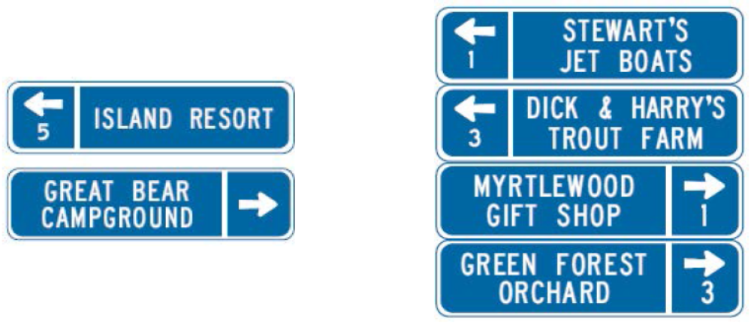
Supplemental
Tourist-Oriented Directional Signs
  Not considered advertising, they are classified as motorist service signs
  The policy on state highways as established in State Statutes 160.292 through 160.296 is contained in the TEM Chapter 6
  In addition, they are included in Chapter 2K of the MN MUTCD

Slide 7
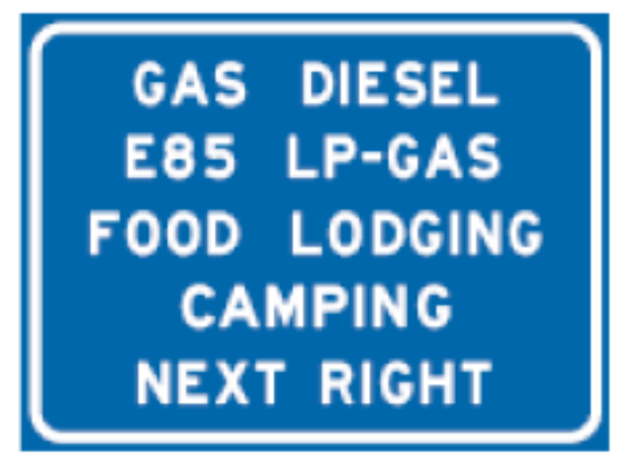
Supplemental
General Motorist Service
  Those that lead to the following locations (as long as they met the requirements of Appendix A in the TEM):
    Gas, Diesel, and/or alternative fuels (LP Gas, E85)
    Food
    Lodging
    Camping
    Hospitals

Slide 8
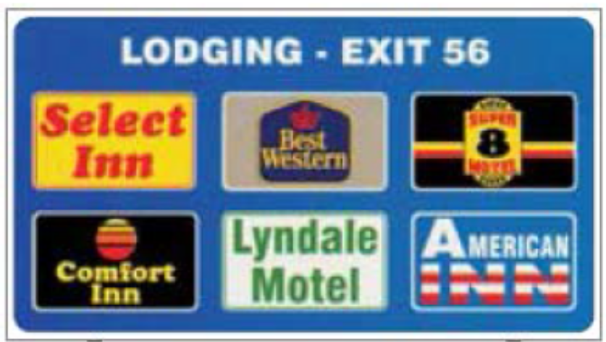
Supplemental
LOGO (Specific Service)
  Defined as guide signs that provide road users with business identification and directional information for services and for eligible attractions
  Shall be limited to gas, food, lodging, camping, attractions, and 24-hour pharmacies
  Qualified requester shall pay for these types of signs

Slide 9

Supplemental
Major Traffic Generator
  May be provided to direct motorists to major traffic generators
  Major regional attractions, events, or facilities which attract persons or groups from beyond a local community, city, or metropolitan area
  All of the following criteria shall be met by the major traffic generator requesting signing:
    Parking for at least 1,000 vehicles
    A minimum of ten events per year
    Average event attendance of at least 5,000 persons
    Located within ten miles of the trunk highway interchange/intersection where signs are requested

Slide 10
Supplemental
Minor Traffic Generators
  Facilities which generally attract non-local persons or groups unfamiliar with the location of the generator, but which do not qualify as major traffic generators
  Shall be limited to only those generators which have broad motorist appeal, serve nonfamiliar motorists, or are the kind of facility for which a motorist normally expects highway signing

Slide 11
Supplemental Signs
Engineering Standards
  Involve the Design and Placement of Signs
  Signs inform motorist of regulations, warn and guide
  Signs must be properly spaced
  Different types of signs can not be combined

Slide 12
Supplemental Signs
MnDOT Policy
  Tremendous demand for signing
  Necessary to limit signing to only that which is sufficient to aid drivers
  State law sets criteria that a facility must meet to be eligible for signing

Slide 13
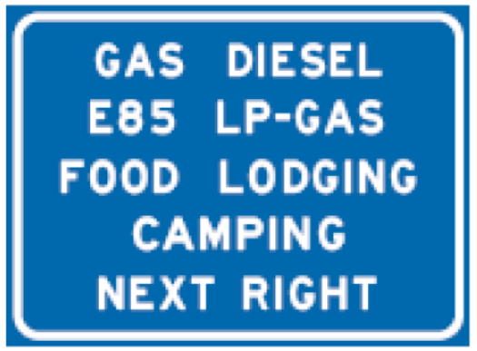


Supplemental Signs
Logo
General Motorists Services
Major Traffic Generators

Slide 14



Supplemental Signs
Other Traffic Generators
Minor Traffic Generators
Specific Services

Slide 15
Appendix A
Appendix A Supplemental Guide Signs
  An alphabetized list of various facility types into several different signing programs available for signing
  Includes a list of ineligible facilities

Slide 16
Appendix A
General Criteria
  1. MnDOT shall fabricate, install, and maintain signs on trunk highways unless otherwise specified by the District Traffic Engineer.
  2. The cost of fabrication, installation, and maintenance shall be paid by the requester.
  3. Appropriate trailblazing signs shall be the responsibility of the facility and approved by the road authority. If appropriate trailblazing cannot be installed, signing on trunk highways shall not be installed. The color and design of trailblazing signs should match that of the signing installed on the trunk highway.

Slide 17
Appendix A
General Criteria
  4. Signs shall not be allowed from intersections or interchanges that do not provide the closest or most direct route from a trunk highway to a facility.
  5. MnDOT retains the authority to specify message content (including abbreviations), size of sign, sign location, and combination of messages, in accordance with standards for acceptable signing practice. The sign design, including message and logos if applicable, shall be identical on ramp and mainline signs at an interchange.

Slide 18
Appendix A
General Criteria
  6. Location and placement of signs is dependent upon space availability as determined by the District Traffic Engineer. Sign installations shall meet sign spacing guidelines for the type of roadway on which they are allowed. No sign installations shall be placed at a location that will interfere with other necessary signing as determined by the District Traffic Engineer. If space is unavailable, requests shall be denied.
  7. Mainline signs shall not be installed for a facility if there is no space available to install signs on the ramp and vice versa.

Slide 19
Appendix A
General Criteria
  8. All sign installations on trunk highways shall conform to MnDOT’s current sign design and sign sheeting standards.
  9. Signs not meeting MnDOT’s current criteria shall be removed through attrition. If mainline signing is removed, ramp signing and any trailblazing on trunk highways shall also be removed.

Slide 20
Appendix A
General Criteria
  10. Only one sign per facility may be installed in each direction along a trunk highway.
  11. The criteria for installing logos (business panels) on Specific Service and LOGO signs are specified in Section 6-7.09.01 and 6-7.09.02, respectively.

Slide 21
Appendix A
General Criteria
  12. Pictographs are defined as a pictorial representation used to identify a governmental jurisdiction, an area of jurisdiction, a governmental agency, a military base or branch of service, a governmental approved university or college, a toll payment system, or a government approved institution. They are allowed on certain signs as specifically designated in the MN MUTCD. The following are examples of such facilities allowed:
    Casinos
    Educational Institutes (post-secondary)
    National Parks, National Monuments
    State Parks
    Trail Access

Slide 22
Appendix A
General Criteria
  13. Signs may be considered on trunk highways that intersect with local roads which serve as logical, primary routes for motorists approaching from other directions.
  14. Signs shall not be provided if the facility is readily visible or if effective off right-of-way directional signing is present or can be provided.

Slide 23
Appendix A
General Criteria
  15. MnDOT retains the authority to deny requests for signing where acceptable standards cannot be met, including locations where other supplemental guide signs are already in place. At the discretion of the District Traffic Engineer, signing requests denied based on MnDOT policy may be appealed to the External Sign Variance Committee. Requests denied based on Minnesota statutes or engineering standards (i.e. insufficient space and design standards found in the MN MUTCD) may not be appealed.

Slide 24
Appendix A
General Criteria
  16. If a district traffic office decides that a contract for signing a minor traffic generator is required, the following process shall be used:
    a. The requester should obtain proposals from at least three consulting engineering firms to prepare the signing contract.
    b. The requester evaluates the proposals and enters into a contract with one of the consulting engineering firms to provide all of the following:

Slide 25
Appendix A
General Criteria
    A complete design of a signing plan (including field cross sections if necessary), assembly of special provisions, and proposal. Technical assistance is available from the State Signing Engineer, Office of Traffic, Safety, and Technology (OTST).
    Submit the plan and proposal to the signing contractors. Typically allow 10 days for the contractor to review and submit bids.
    Review the bids and award the contract to the signing contractor.
    Inspect the signing contractor’s work with technical assistance provided by MnDOT’s district staff.

Slide 26
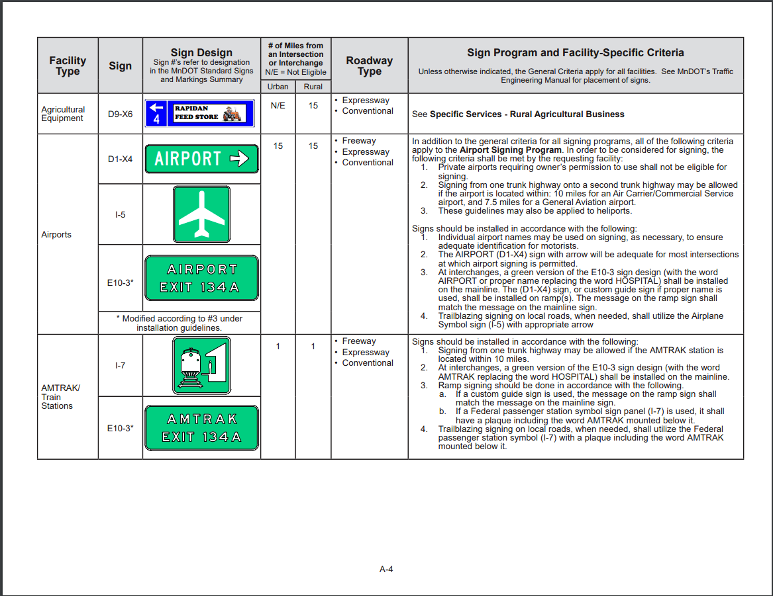
Appendix A
Notes:
The image is linked to Appendix A on my computer. We will go through a few examples of these.

Slide 27
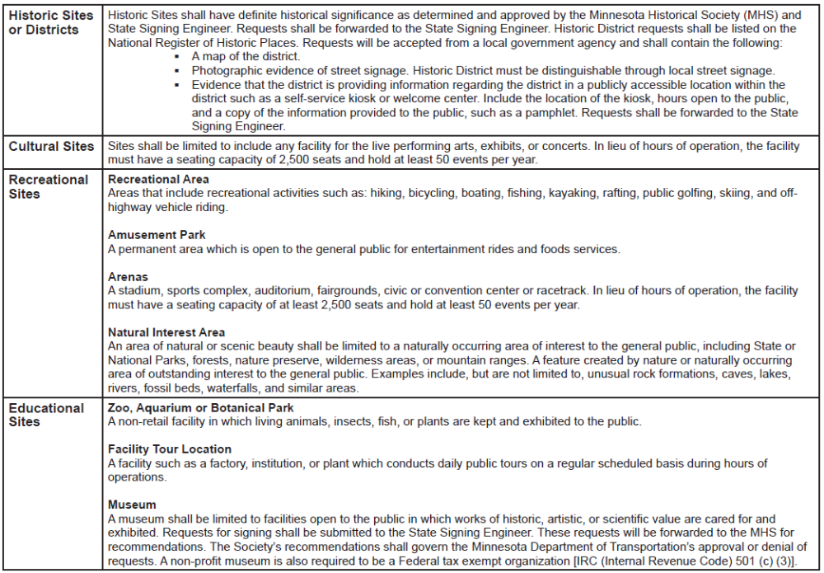
Appendix A
Notes:
Will again go to the appendix and provide an example or two.

Slide 28
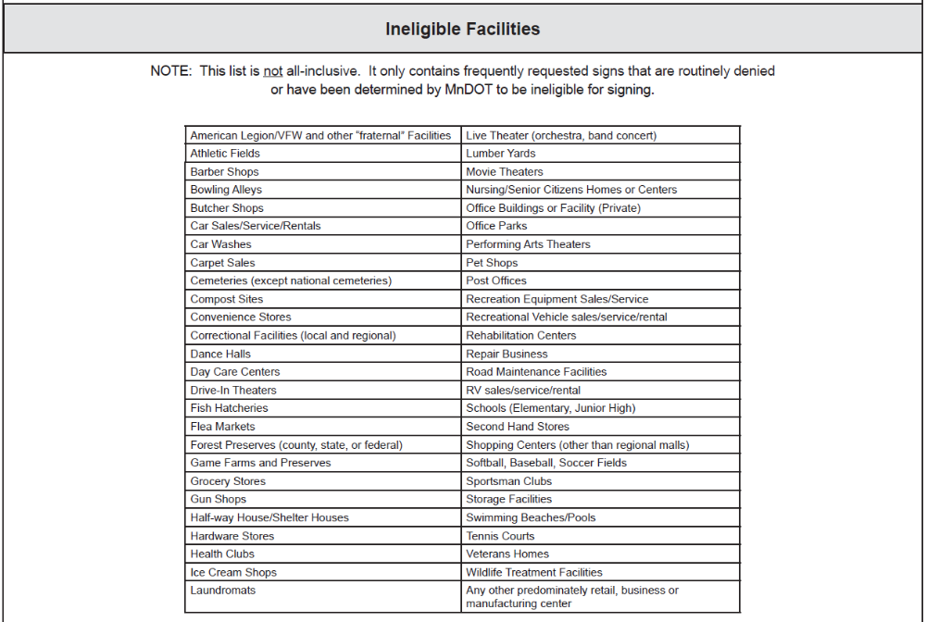
Appendix A
Notes:
Will again go to the appendix and provide an example or two.

Slide 29
Requester Pay Memo
Tech Memo 17-06-T-01
  Requester-pay signs include, but are not limited to,
    signs for local street and road identification
    Airports
    educational institutions
    regional shopping centers
    tourist and travel information
    economic development

Slide 30
Requester Pay Memo
Tech Memo 17-06-T-01
  Major traffic generators are regional attractions which are unique due to their educational, cultural, historical, or recreational experience and public appeal
  Examples of minor traffic generators include
    Museums
    public water accesses
    Parks
    ski areas, and
    recycling centers

Slide 31
Requester Pay Memo
Tech Memo 17-06-T-01
  Requester-pay signs also include Specific Service Signs
  Further explanation of these signs can be found in Chapter 6 of the MnDOT Traffic Engineering Manual
  Requester-pay sign costs are currently specified in Chapter 6 in the MnDOT Traffic Engineering Manual

Slide 32
Requester Pay Memo
Tech Memo 17-06-T-01
  Purpose is to establish current costs for all types of requester-pay signs, including Specific Service Sign
  Cost are reviewed annually

Slide 33
Requester Pay Memo
Tech Memo 17-06-T-01
  Requester-Pay Signing Costs is composed of a base cost plus a fabrication cost
    Base cost includes preparation and installation expenses
    Fabrication cost is a per square foot cost based on current prices for retroreflective sheeting, aluminum substrate, electronic cuttable film, and labor for fabricating each sign
    Overhead charges are included

Slide 34
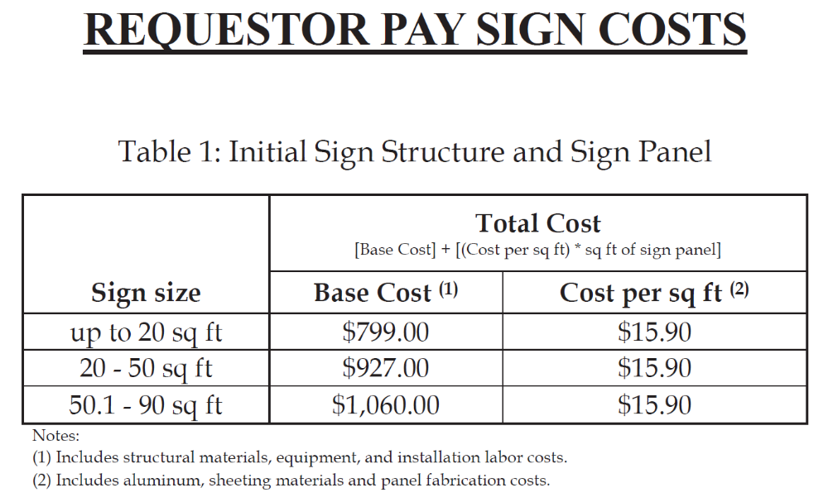
Requester Pay Memo

Slide 35
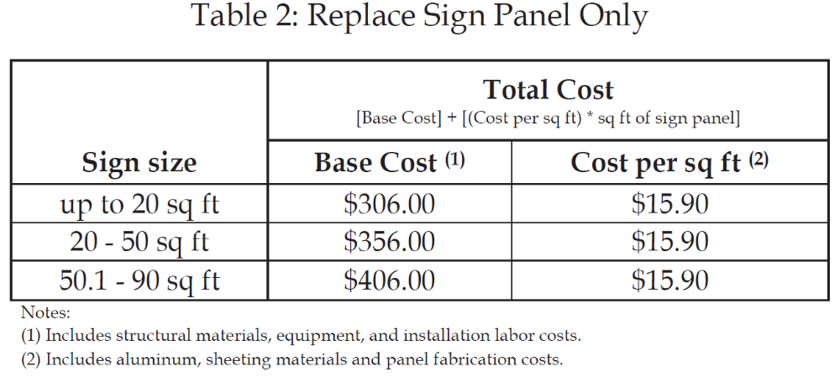
Requester Pay Memo

Slide 36
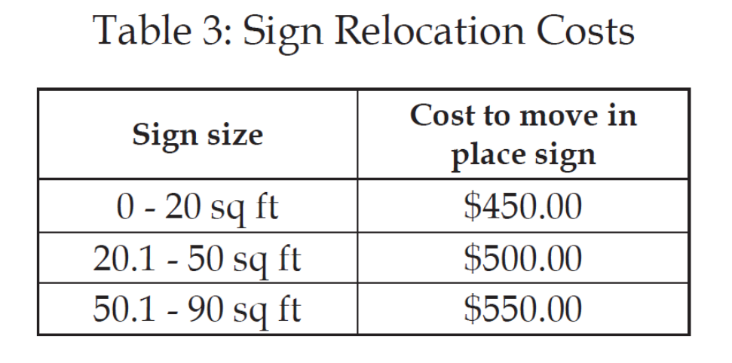
Requester Pay Memo

Slide 37
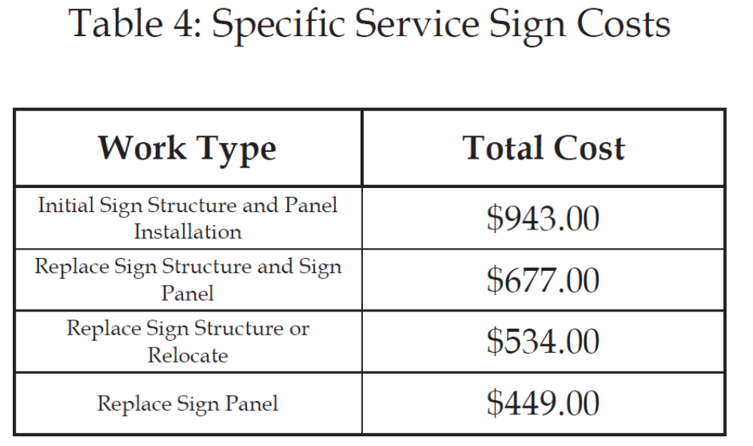
Requester Pay Memo

Slide 38
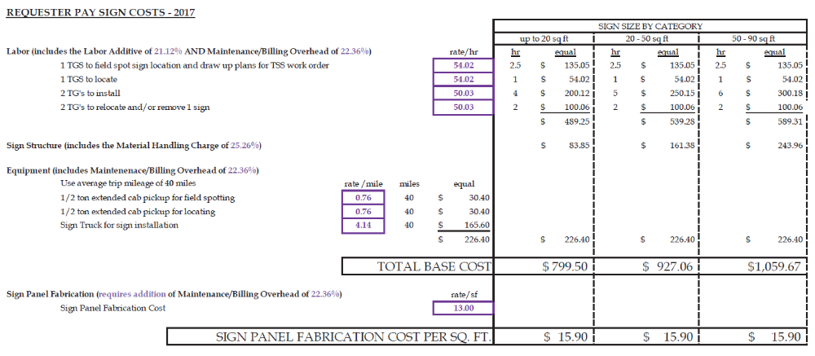
Requester Pay Memo

Slide 39
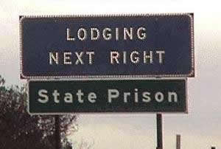
Types of Signs
Comments/Questions?

Slide 40
Supplemental Guide Signing Programs
Requester pays:
  Airports
  Casino
  Educational Institutions (post-secondary)
  LOGO Sign Franchise Program
  Major Traffic Generators
  Minor Traffic Generators
  National Monuments
  National Parks
  Regional Shopping Centers
  Specific Services
  State Parks
  Tourist Information
  Trail Access
MnDOT pays:
  General Motorist Service
  Hospital
Fabrication & Installation Costs
  One fee paid for by requester covers the life of the sign (~15 yr)
  Logo signs have a monthly cost
Notes:
The MN MUTCD,
Minnesota statutes,
& MnDOT policy
allow supplemental guide signs to be installed on trunk highways for a variety of public and private facilities.

Slide 41

Signing Manuals
Minnesota Manual on Uniform Traffic Control Devices (MN MUTCD)
AASHTO Guidelines for Selection of Supplemental Signs - Freeways
Traffic Engineering Manual (TEM)
MnDOT Standard Signs Manual
MnDOT Standard Signs Summary
Guide Design Manual
At-Grade Signing Manual
Freeway Signing Manual
Notes:
So because we have so many things to sign for…we do have to have guidelines to limit sign clutter and we have to abide by state and federal regulations.
The guidelines, standards and laws that MnDOT staff use to evaluate sign requests come from a variety of manuals and laws.
So this is our pecking order so to speak:
A. State Laws- there are many state laws that govern signs. When we have a request which violates a state law, our hands are tied.
B. The Federal Highway Administration publishes a Manual on Uniform Traffic Control Devices which each states needs to adopt and be substantially compliant with. Minnesota adopts our own MUTCD (substantially compliant of course) which is approved by FHWA. This manual tells us what types of signs we can use and how we need to design those signs. Within many sections the manual states that each State develop a policy based on a set of suggested guidelines and includes the following: B2. AASHTO Guidelines
C. Then, the Traffic Engineering Manual houses the guidelines which supplement the MN MUTCD. Much of the signing guidelines have already been developed but any new ones or changes are discussed and approved by a the state wide signing committee and recommended to the Traffic Engineering Organization Executive Committee for final approval.
MnDOT works with industry to develop the guidelines. For example, the specific criteria MN uses for Historic Resources is developed by MnDOT and MHS together.

Slide 42
MnDOT General Criteria
Roadway type
Urban versus rural
Facility type
Hours of operation
Licensing
Distance from intersection/interchange
Visibility
Trailblazing
Notes:
FHWA tells states they need to further define specific criteria for their supplemental guide signs. Unfortunately, there is not room for everyone to have a sign or our highways would be cluttered with signs.
Qualifying criteria is first based on roadway type and whether it is in a rural or urban area.
Specific business criteria include:
Facility type, Hours and days per week that they are open……
How many hours? How many days? If there is a sign for a facility, it should be open the amount of hours that driver would expect.
Some laws and regulations require licensing.
Distance from the highway (many drivers won’t drive even a couple miles out the way for gas, but would for an attraction). So distance varies for individual programs. We also limit it to the closest highway.
Visibility – is a business visible or have off right of way advertising (billboard, etc).
Trailblazing – also so very important. These are the signs that are on local roads between the highway and the facility to safely get drivers to the destination through a combination of turns.

Slide 43

Facility Specific Criteria
Townships
  Shall hold monthly meetings that are open to the public. Township halls are not required to be open eight hours per day, five days per week
  Shall be primarily intended for use as a town hall
  Should provide adequate on-site parking or parking in the immediate area
  Shall post contact information that is visible from the exterior of the building
Notes:
PULL OUT APPENDIX A
Explain it…
General Criteria
Columns in the alphabetized list.
We work with industry to develop criteria, in the case of Historic Resources, we work with MHS.
Give a couple examples:
Townhalls (THIS PAGE)
Golf Courses (( NEXT PAGE ))

Slide 44


Facility Specific Criteria
Golf Courses
  Have at least nine holes.
  Be open to the public.
Disc Golf Courses
  Be its own entity located on its own property (not located on or in another facility that can be signed as a minor traffic generator)
  Have at least 18 holes
  Be a member of the Professional Disc Golf Association (PDGA)

Slide 45
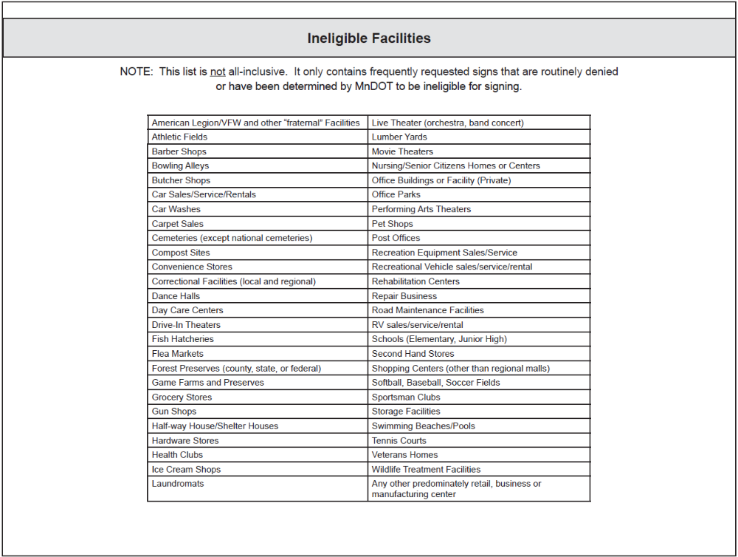
Ineligible Facilities
Notes:
It is the last page of Appendix A - Supplemental Guide Signs.

Slide 46
Where are They Allowed?
Conventional Single Lane Highways
Conventional Multilane Highways
Expressways
Freeways & Interstates
Not all programs are allowed on every class of roadway
Notes:
Freeways have more restrictions on signing than conventional highways.
On Freeways, you will see Logo Signs, General Motorist Service signs and signs for Major Traffic Generators.
Minor Traffic Generators are allowed signing on conventional highways and expressways and typically not Freeways unless they qualify as a Logo Attraction.
FHWA allows Logo Attraction signing on Interstates and Freeways.
Attractions need to fall into the following categories: recreation, historic, cultural or amusement.
States are tasked with further defining each category.
Logo Attractions are still quite new to MN. A few years ago, Minnesota DOT initiated an update to the state law to allow expansion of the program to include Attractions on freeways state wide.

Slide 47
What Do They Cost?
  Requester - Pay Signing Costs Tech Memo No. 17-06-T-01
  https://techmemos.dot.state.mn.us/
  Includes labor, equipment & materials
  Standard Designs vs special designs
Notes:
Almost all signs are “requester pays” therefore the name of the tech memo which can be found in your manual.
A couple examples are next that show how large the signs can be and how that impacts cost.

Slide 48

Standard Designs
  2 Lane Highways – 36” x 30” (7.5 sq ft)
  Expressways – 54” x 48” (18 sq ft)
  Cost is approx. = $920 - $1100
Notes:
There are many standard designs. Historic District is one example. Typically all uppercase legend because it’s a generic name. Creates a sign that is smaller in size and therefore, less in price.
Size of the sign is based on the legend and font size.
Smaller fonts are allowed on 2 lane highways where on expressways where there is a greater distance needed to read the sign, the font size needs to be larger.
Approximately 1” height of text is equal to 30ft of legibility distance
We use a 4” text on the smaller sizes and 6” text on the larger signs that are STANDARD.
(7.5 sq ft versus 18 sq ft)
COST is for the life of the sign. Cost goes up the larger the sign. The larger the sign panel, the larger the sign structure is required to hold the sign up.
It includes materials (including the sign structure), labor and equipment.
When it needs replacing, the requester is charged: knockdown or about 15 years service life

Slide 49
Special Designs
  Vary in size depending on class of highway
  Cost is in the $1,000’s
Notes:
Special Design Guide Signs –
Upper lower case with the proper name on the sign.
These signs are larger and significantly cost more. Designed specially by signing staff at MnDOT.
Costs vary. An example is next.

Slide 50

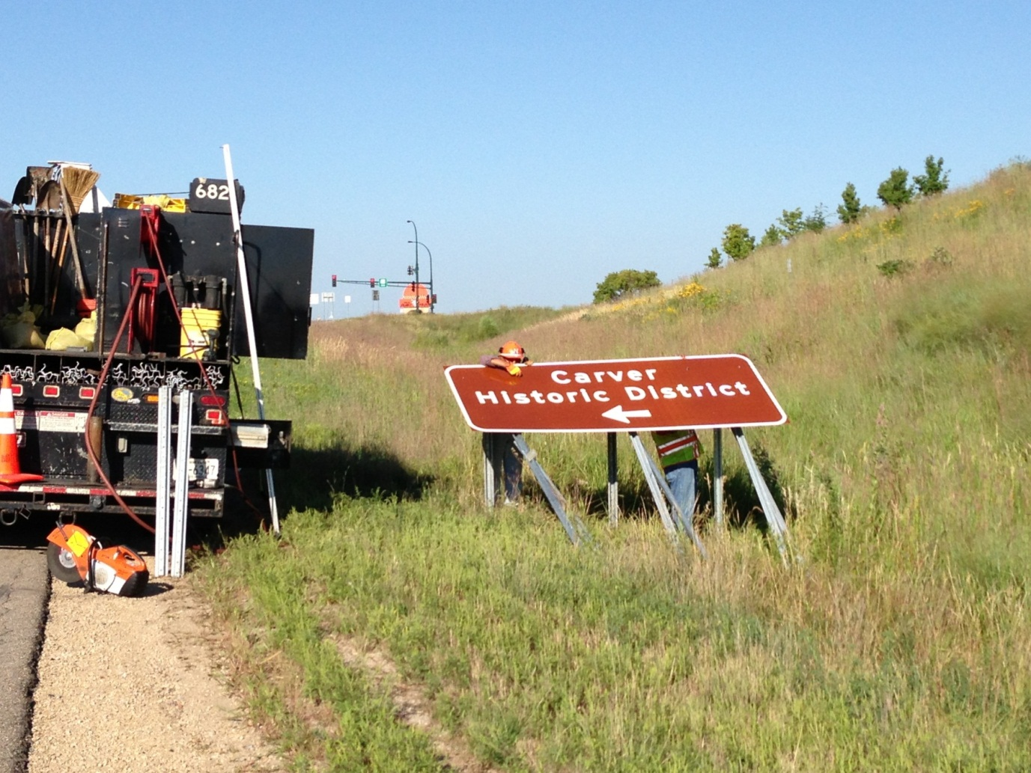
Example
Notes:
MnDOT Crews installing a special design sign for the Carver Historic District.
This exit ramp sign they are installing is 120 x 48 = 10 feet wide by 4 ft high = 40 sq ft sign.
The ramp sign alone costs $1,563.
The sign on the mainline is even larger at 162 x 60 = 13.5 feet wide by 5 feet high = 67.5 sq ft sign
The Cost for the mainline sign is $2,133.25
The City of Carver needed 4 signs total. One in each direction on the mainline and one on each exit ramp. The total cost for all 4 signs was $7,392.50.
In addition they needed signs for trailblazing and identifying the boundaries for the Historic District.

Slide 51
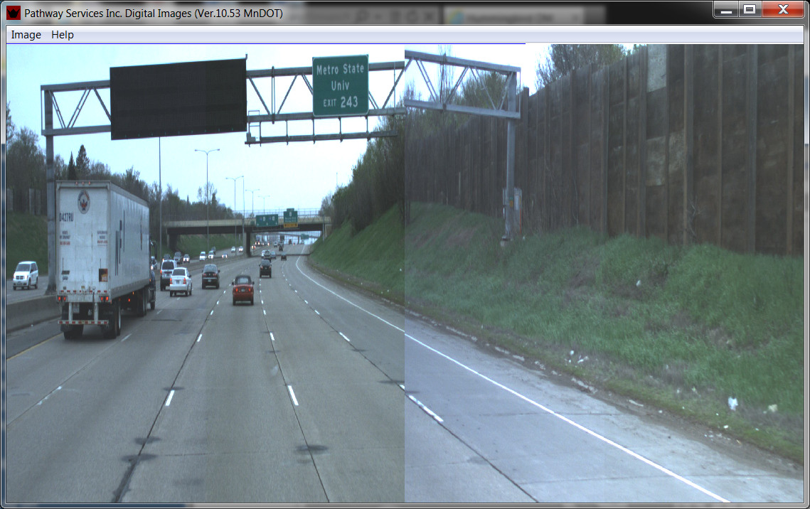
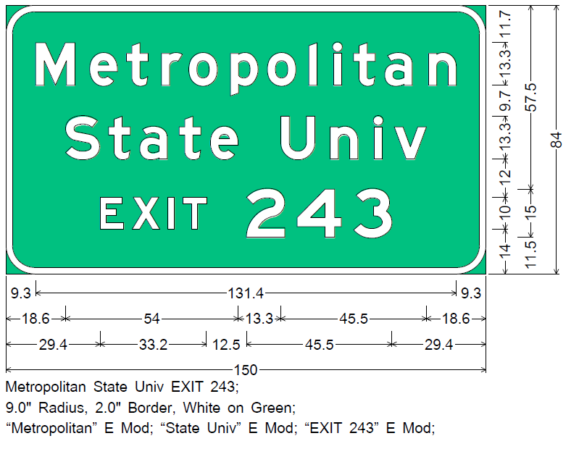
Example
Notes:
Metropolitan State University
Size: 150 x 84 = 87.5 sq ft
Once you have an OH sign structure traffic control is needed and makes the price of the sign go up a few more thousand dollars
This did not include Traffic Control.

Slide 52
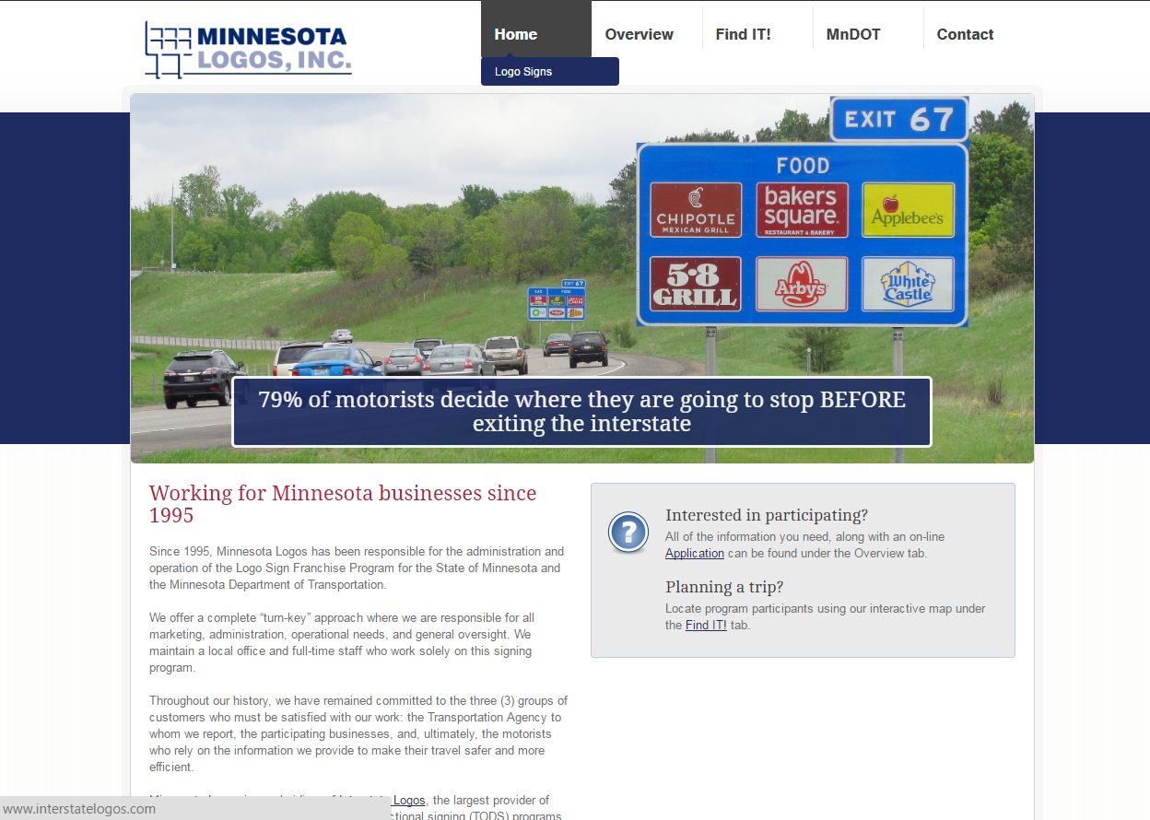
Logo Signs
http://www.dot.state.mn.us/logosigns/
http://www.minnesota.interstatelogos.com/state/
Notes:
MnDOT contracts out the Logo signing program.
Talk about website.
Link on the website for
Criteria for Gas, Food, Lodging, Attractions, 24 Hr Pharm and Camping
FAQ
http://www.minnesota.interstatelogos.com/state/

Slide 53
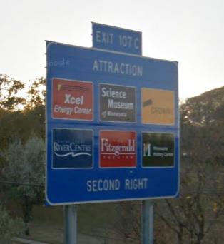
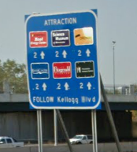
Logo Sign Costs
Mainline Ramp
Monthly cost per sign is $50/$10

Slide 54
What if we’re wrong?
  External Sign Variance Committee
  Representatives from tourism, chamber of commerce, local government, city planning, AAA
  Hear appeal and policy, advise MnDOT Commissioner

Slide 55
Who do I contact?
District Traffic Engineer
For Contact List:
http://www.dot.state.mn.us/trafficeng/contacts.html

