Slide 1

Chapter 4
Types of Signs
Traffic Signs 101
May 2020

Slide 2
Types of Signs
Functional Classifications of Traffic Signs
  Refer to Chapter 2

Slide 3
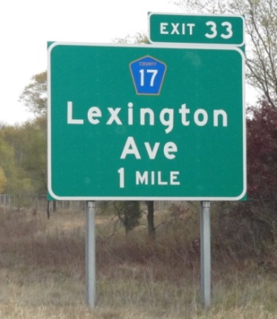
Basic Information/Background
Section 4.1.1
Department Classification by Sign Design Type
Type A signs
  large breakaway guide, directional, or informational signs
  normally installed on mainline freeways, expressways
  occasionally on conventional roads
Notes:
OTE is evaluating sign type nomenclature and most likely will go away from the traditional sign types and start using more plain language and combine pay items sometime in 2021. For Example Sign Type A will become I-beam Sign. This change is still being finalized. They are testing it out on 2 projects this fall and hope to provide training on it next year in the Sign Design Classes.

Slide 4
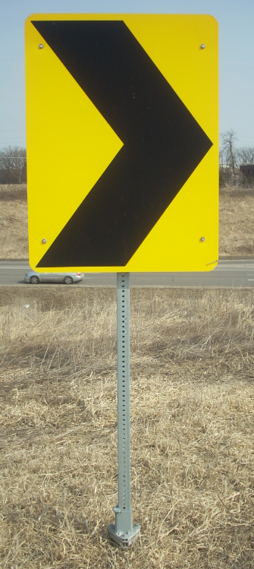
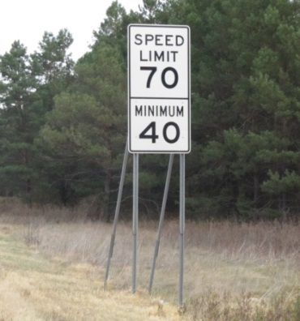

Basic Information/Background
Department Classification by Sign Design Type
Type C signs
  Primarily regulatory, warning, route marker assemblies, and auxiliaries, as found in the Standard Signs Manual
  Most common sign type
  Installed on square tube posts
 | Around the year 1960, MnDOT did have a Type B sign. These signs were on one small wide flange post (W4X13 or W5X16) in concrete and Type C signs were installed on wood posts or U posts. Around 1962 MnDOT dropped the Type B signs and installed only Type C signs on U posts or X posts (two U posts back to back).

Slide 5
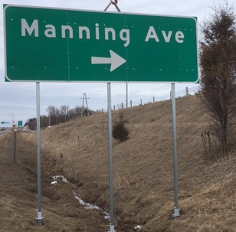
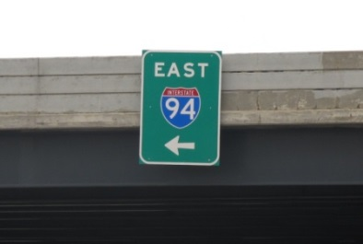
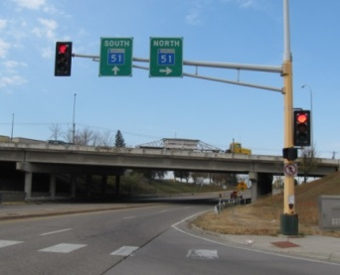
Basic Information/Background
Department Classification by Sign Design Type
  Type D signs are the smaller guide, destination, or informational signs.

Slide 6
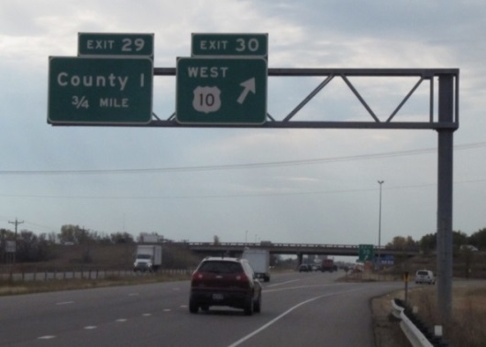
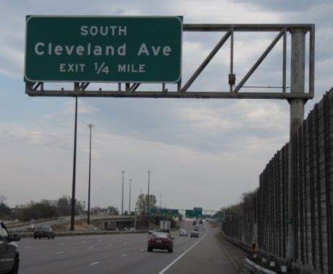
Basic Information/Background
Department Classification by Sign Design Type
  Type OH – mounted overhead
    Sign support (no walkway or sign lighting)

Slide 7
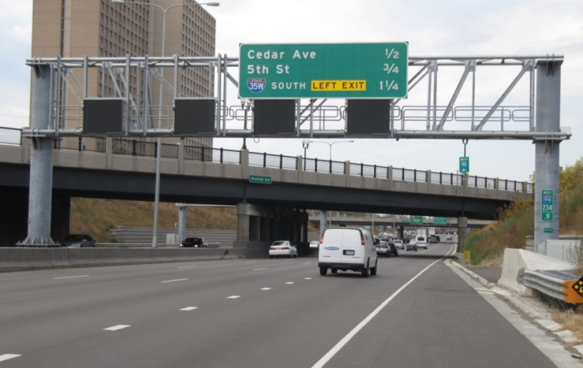
Basic Information/Background
Department Classification by Sign Design Type
  OH – Sign Bridge

Slide 8
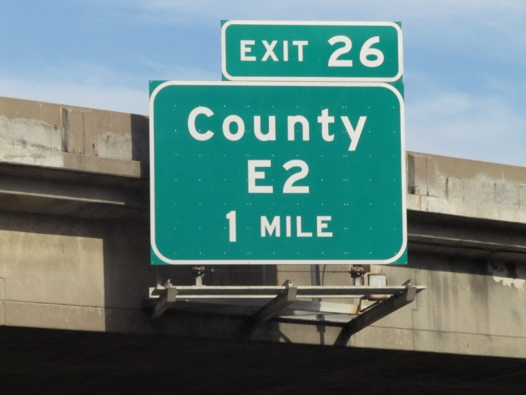
Basic Information/Background
Department Classification by Sign Design Type
  OH - bridge mounted (may or may not include walkway and sign lighting)

Slide 9
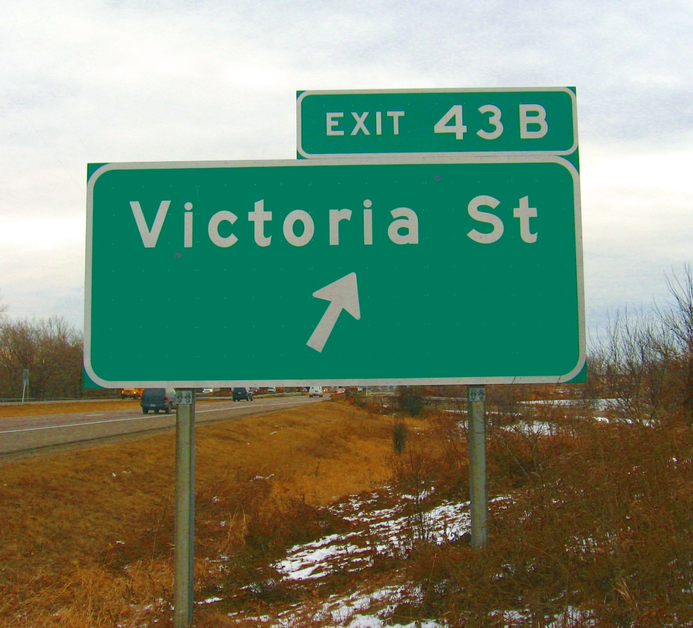
Basic Information/Background
    Type EA signs are exit number panels attached with U-posts to Type A sign panels

Slide 10
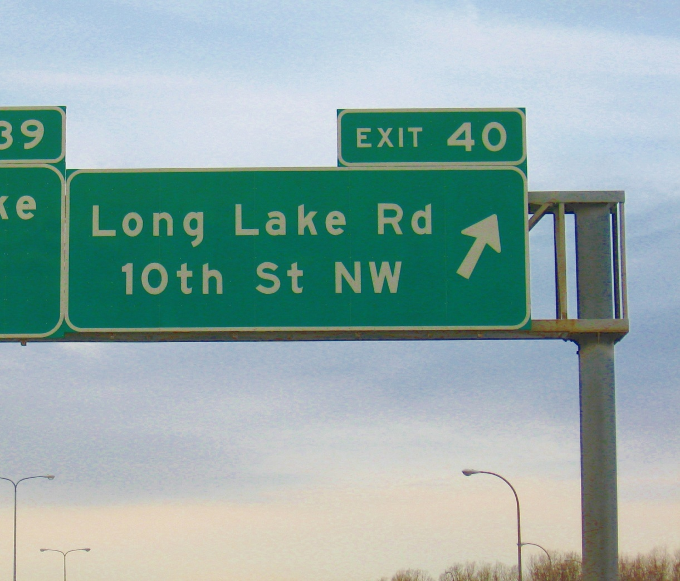
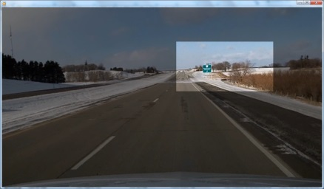
Basic Information/Background
    Type EO signs are exit number panels attached with U-posts to Type OH sign panel

Slide 11
Types of Signs
Regulatory Signs
  Application of Regulatory Signs
  Establishment of Priorities
  MN MUTCD Chapter 2B

Slide 12
Types of Signs
Warning Signs
  MN MUTCD Chapter 2C Handout

Slide 13
Types of Signs
Guide Signing
  MN MUTCD Chapter 2D and 2E Handouts

Slide 14
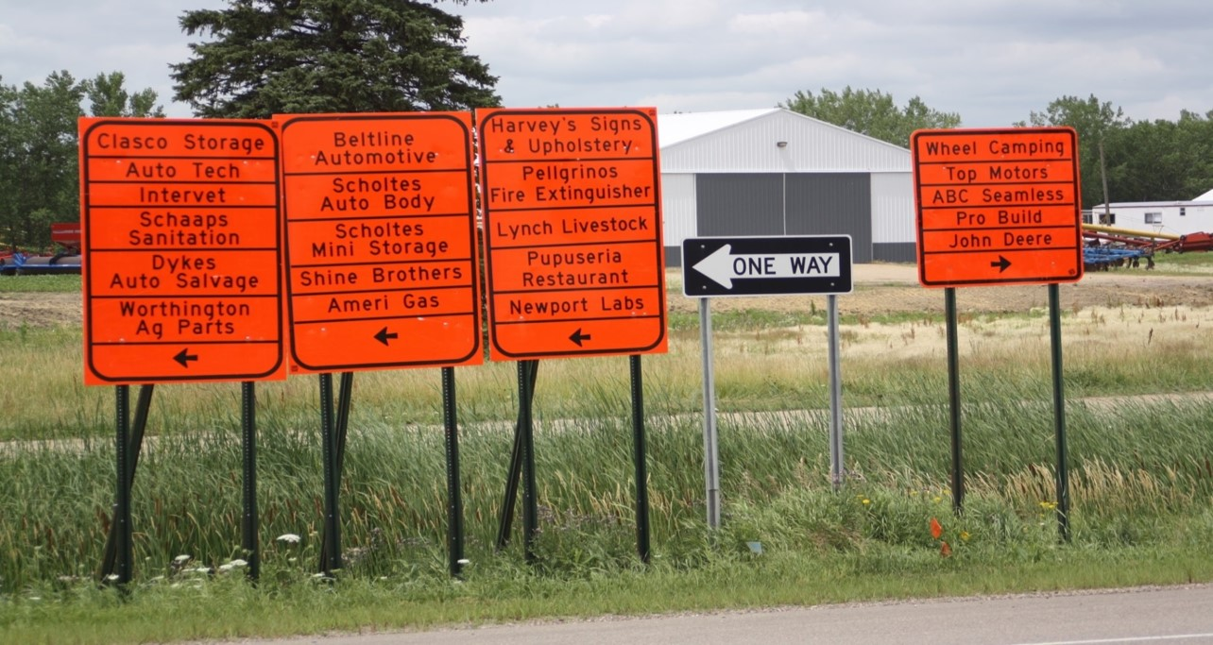
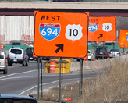




Types of Signs
Work Zone and Detour Signing
  Devices used on construction or maintenance work shall conform to
    latest edition of the MN MUTCD
    MnDOT Standard Specifications for Construction
    all other appropriate MnDOT technical manuals
Notes:
Test: which direction would turn to go to “Lynch Livestock”?

Slide 15
Types of Signs
Standard Signs Summary

Slide 16

Visit to the Sign Shop!

Slide 17
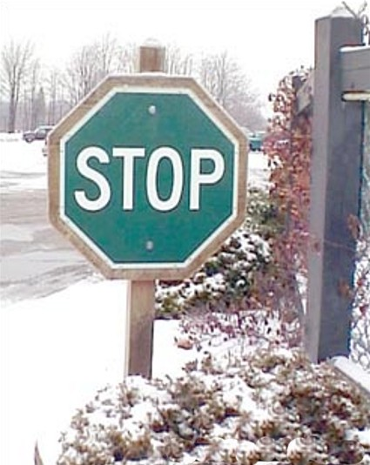
Types of Signs
Comments/Questions?

