Slide 1
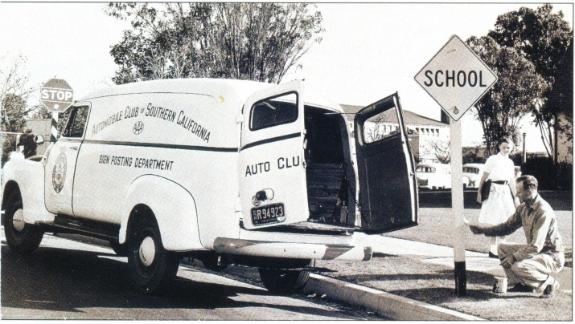
Chapter 3
Why Signs are Installed
Traffic Signs 101
June 2020

Slide 2
Why Signs are Installed
Introduction
  Sign may be initiated/requested by:
    Developer
    City/County
    Politician
    Public
    State
  No matter where the request, follow Engineering Standards

Slide 3


Why Signs are Installed
Engineering Standards
  MN MUTCD
    A statement of required, mandatory, or specifically prohibitive practice regarding a traffic control device. The verb “shall” is typically used. Standards are sometimes modified by Options
    A statement of recommended, but not mandatory, practice in typical situations, with deviations allowed if engineering judgment or engineering study indicates the deviation to be appropriate. The verb “should” is typically used. Guidance statements are sometimes modified by Options

Slide 4


Why Signs are Installed
Engineering Standards
  MN MUTCD
    A statement of practice that is a permissive condition and carries no requirement or recommendation. Options may contain allowable modifications to a Standard or Guidance. The verb “may” is typically used
    An informational statement that does not convey any degree of mandate, recommendation, authorization, prohibition, or enforceable condition. The verbs “shall”, “should”, and “may” are not used in Support statements
Office of Traffic Engineering

Slide 5
Why Signs are Installed
  Definition of Should, Shall and May
    Shall: Indicates a statement of required, mandatory, or a specifically prohibitive practice regarding a traffic control device.
    Should: Indicates a statement of recommended practice, but not mandatory, in typical situations, with deviations allowed if engineering judgment or engineering study indicates the deviation to be appropriate.
    May: Indicates a statement of practice that is a permissive condition and carries no requirement or recommendation.
Office of Traffic Engineering

Slide 6
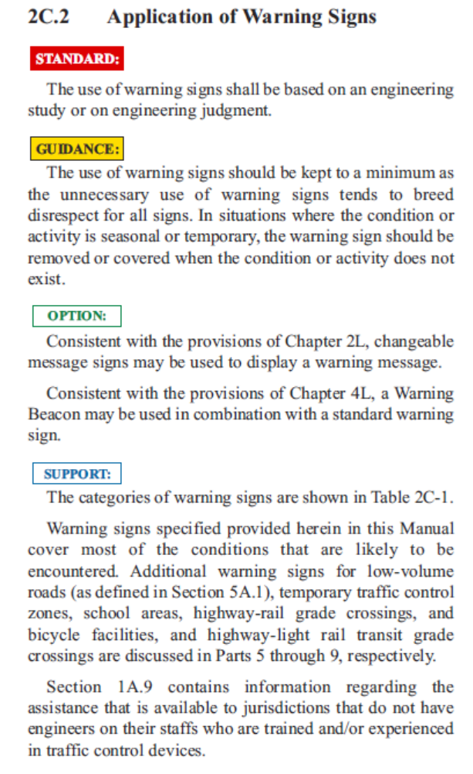
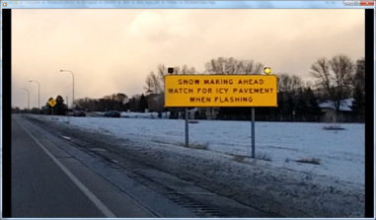
Why Signs are Installed
Engineering Standards
  Sample from MN MUTCD 2C.2

Slide 7
Why Signs are Installed
Signing Standards (from Chapter 2)
  Signs should:
    Fulfill a need
    Command attention
    Convey a clear, simple meaning
    Command respect from road user
    Give adequate time for proper response
  Engineering standards must be followed to fulfill these needs

Slide 8
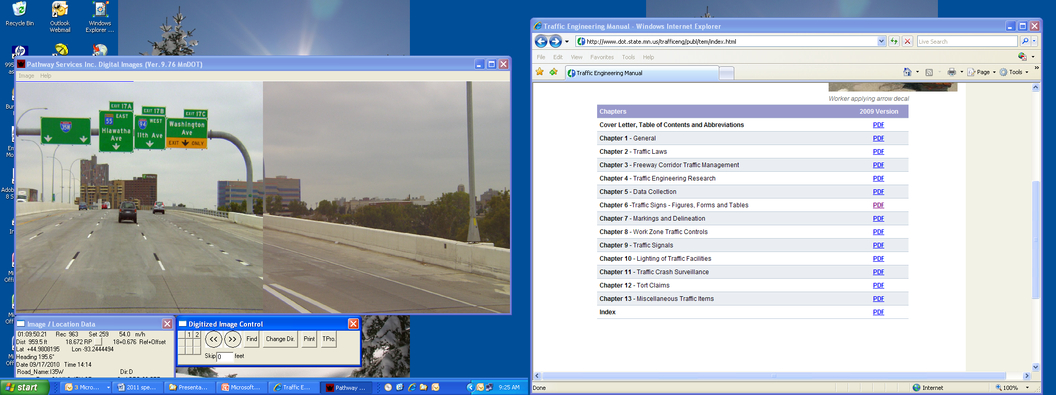
Why Signs are Installed
Signing Standards
  Every 2 miles, average driver makes
    400 observations
    40 decisions
    1 mistake

Slide 9

Why Signs are Installed
Signing Standards
  Freeway Guide Signs
    spaced at least 800 feet apart
    400 feet between guide signs and all other types of signs
 | Principle #1 of signing is to ensure the sign fulfills a need. The question to ask, what do they “need”?
Notes:
Although conditions may exist where lesser sign spacing will be found necessary, freeway guide signs should be spaced at least 800 feet apart. A spacing of at least 400 feet should be provided between guide signs and all other types of signs on freeways.

Slide 10
Why Signs are Installed
Engineering Judgment
  Engineering judgment may be required
  For instance, definition of Guidance allows for “engineering judgment”

Slide 11
Why Signs are Installed
  Engineering Judgment Definition:
    “The evaluation of available pertinent information, and the application of appropriate principles, provisions, and practices as contained in this Manual and other sources, for the purpose of deciding upon the applicability, design, operation, or installation of a traffic control device. Engineering judgment shall be exercised by an engineer, or by an individual working under the supervision of an engineer, through the application of procedures and criteria established by the engineer. Documentation of engineering judgment is not required.”

Slide 12
Why Signs are Installed
Documentation of Engineering Judgment
  Not specifically required in MN MUTCD
  HIGHLY RECOMMENDED
  Liability issues
 | Proper documentation of decision-making during design and proper review and implementation during construction results is not only a better design and safer work zone, but clearly reduces risk and liability.

Slide 13
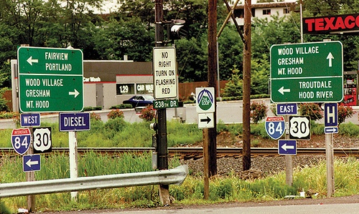
Why Signs are Installed
Signing Priorities
  Order of precedence
    Regulatory Signs (location specific)
    Warning Signs
    Regulatory Signs (non-location specific)
    Guide Signs
    Motorist Services
    Traffic generator signs
    General information signs
Source: ITE Traffic Control Devices Handbook

Slide 14
Why Signs are Installed
Functional Classification of Signs
  Refer to Chapter 2

Slide 15
Why Signs are Installed
Sign Effectiveness
  Effectiveness of Traffic Signs on Local Roads (Handout)
  Minnesota’s Best Practices for Traffic Sign Maintenance / Management Handbook (Handout)

Slide 16
Why Signs are Installed
Effectiveness of Signs on Local Roads (Handout> Page 3-5)
  The MUTCD includes requirements for the management and maintenance of all roadway signs
  This can pose administrative and financial challenges for local road authorities
  MnDOT is reviewing whether the removal of ineffective traffic signs may be part of an overall sign management

Slide 17
Why Signs are Installed
Part F – Effectiveness of Traffic Signs

Slide 18
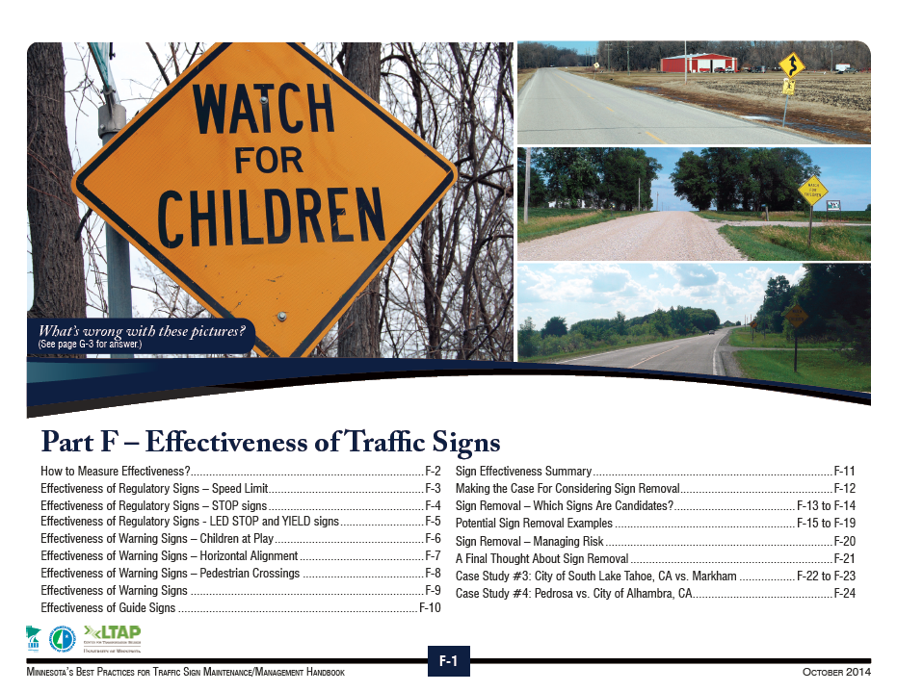
Why Signs are Installed

Slide 19
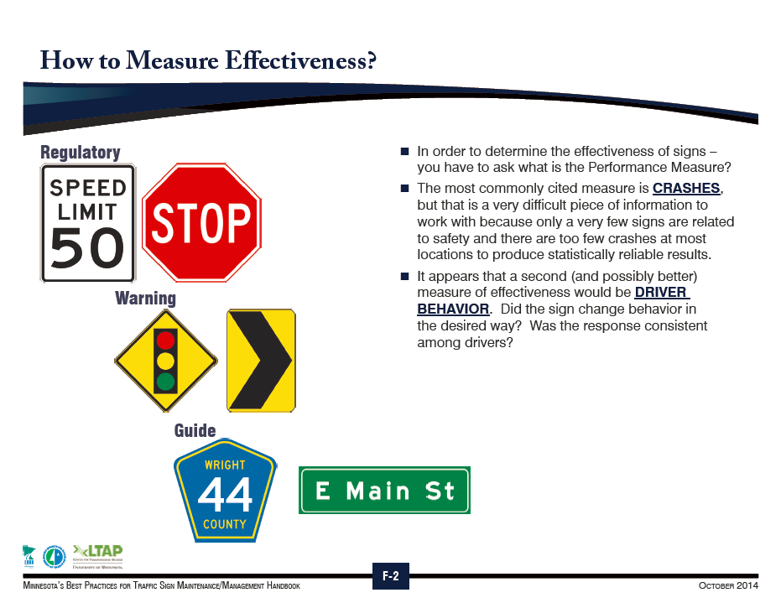
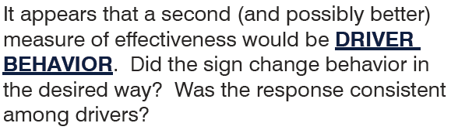
Why Signs are Installed

Slide 20
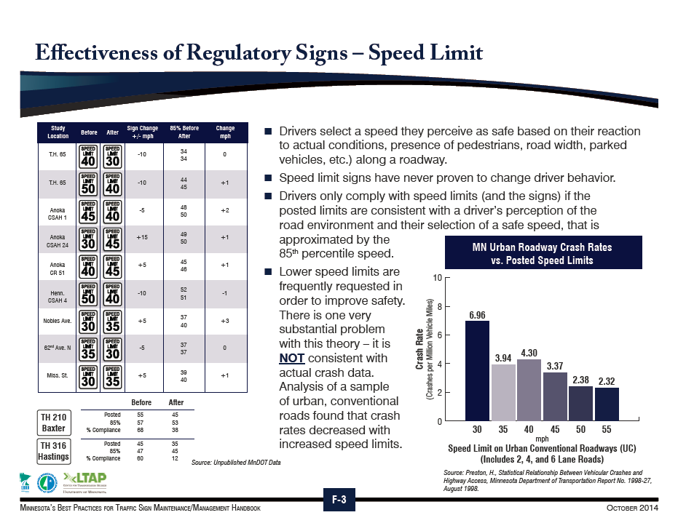
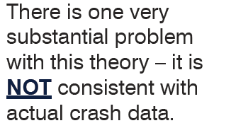
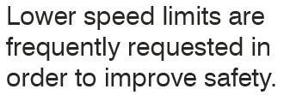
Why Signs are Installed

Slide 21
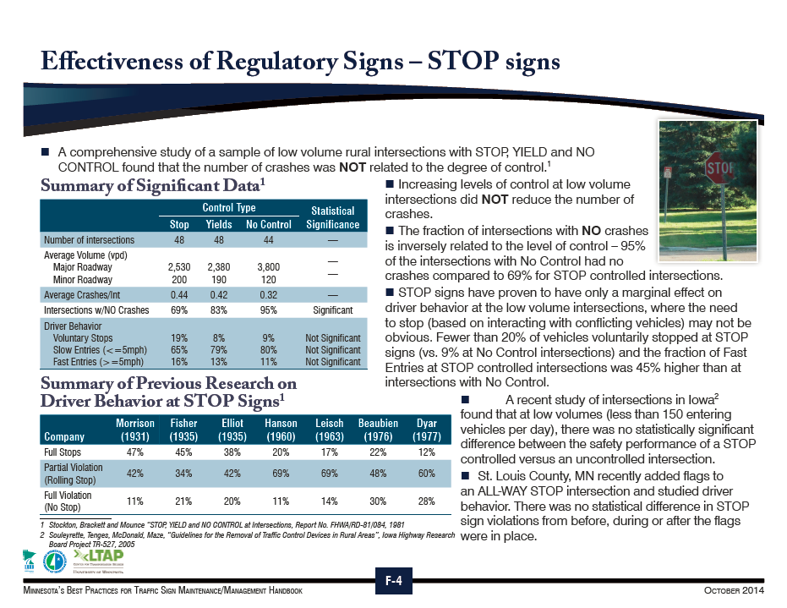
Why Signs are Installed

Slide 22
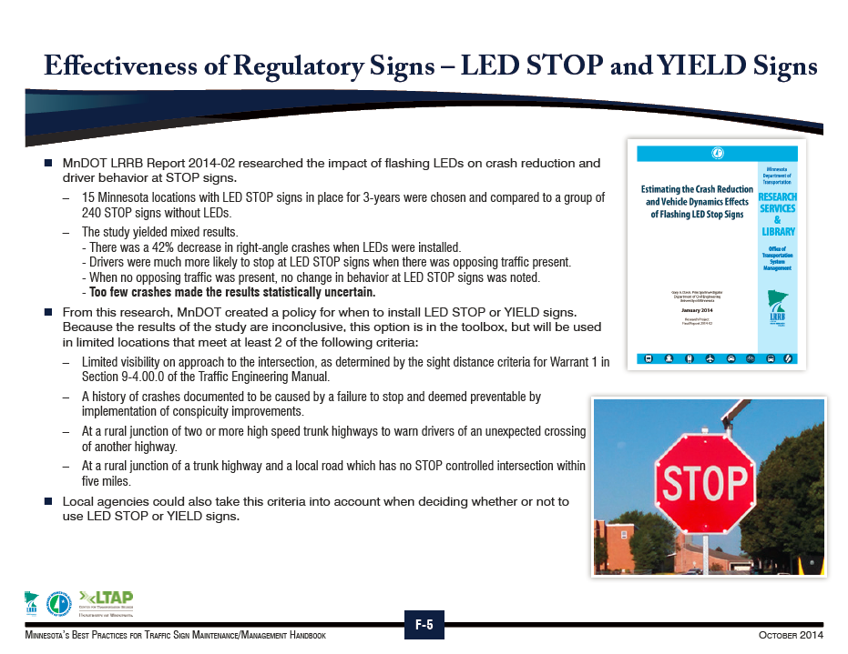
Why Signs are Installed

Slide 23
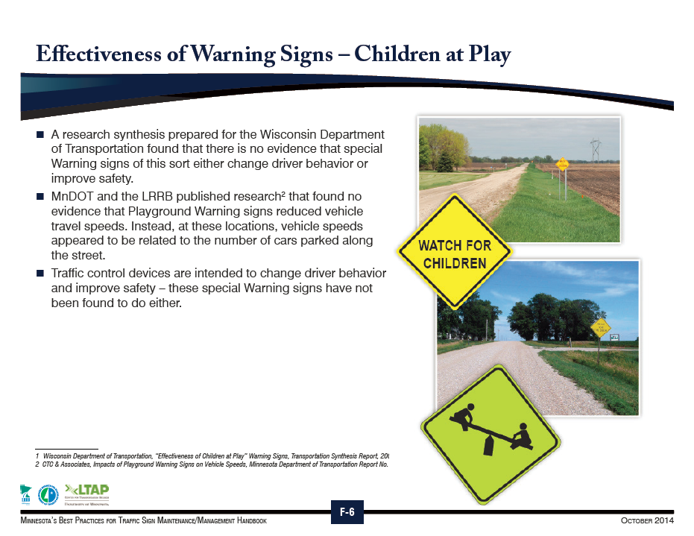
Why Signs are Installed

Slide 24
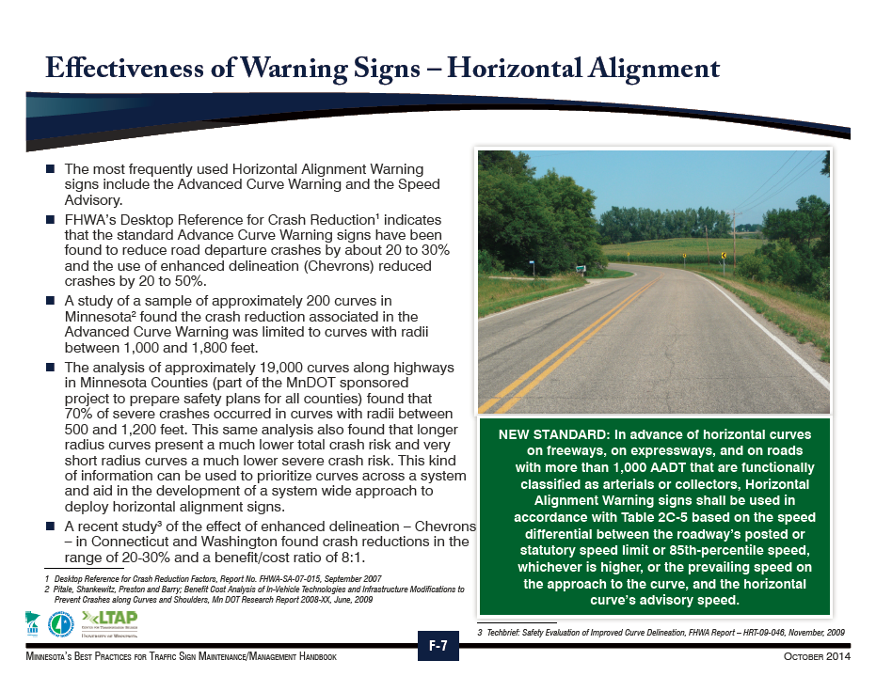
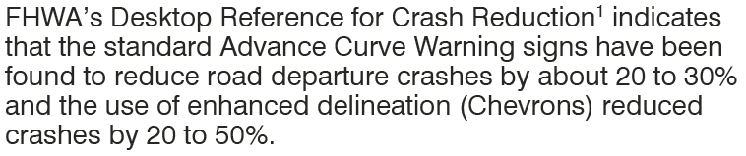
Why Signs are Installed

Slide 25
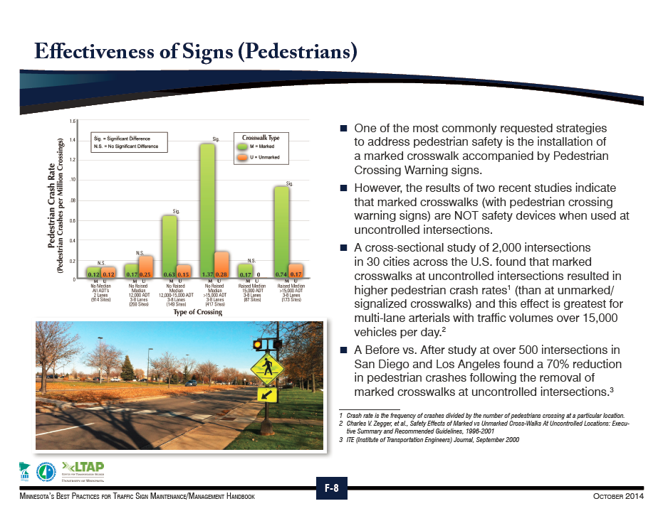
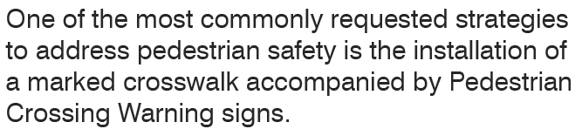
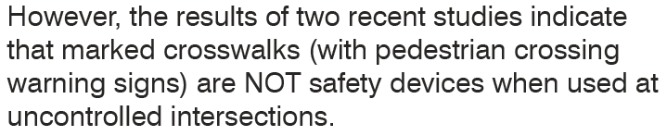
Why Signs are Installed

Slide 26
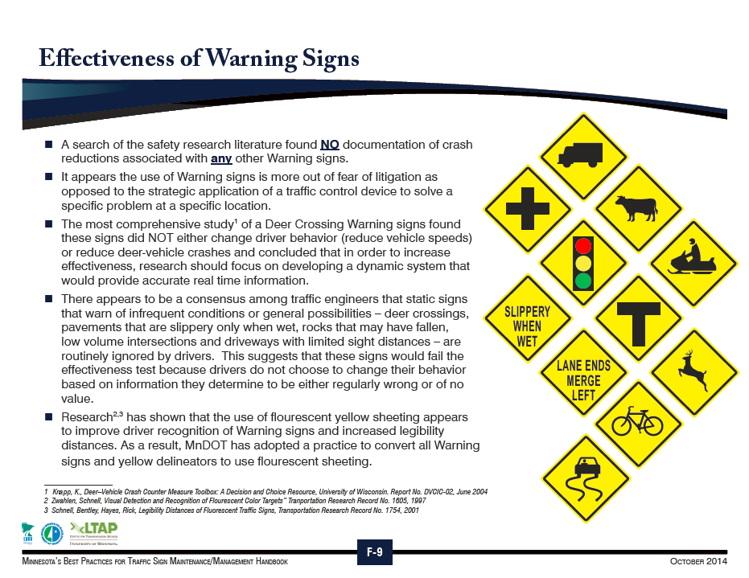
Why Signs are Installed

Slide 27

Why Signs are Installed

Slide 28
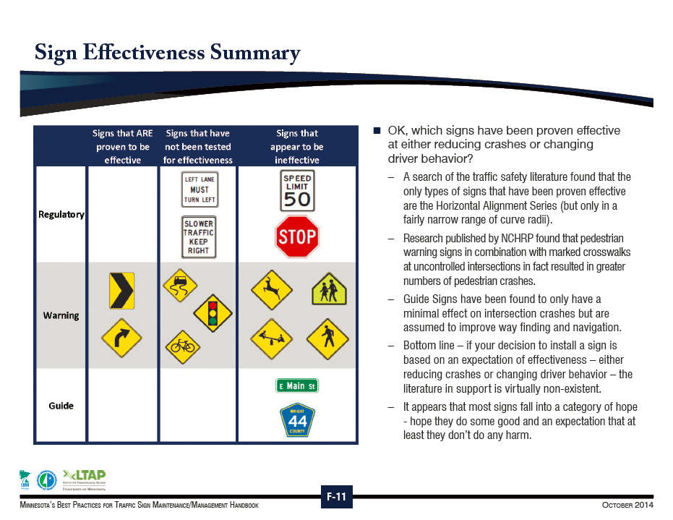
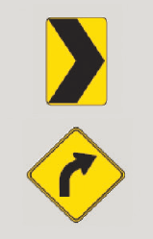
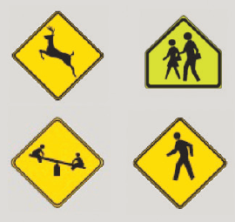
Why Signs are Installed

Slide 29
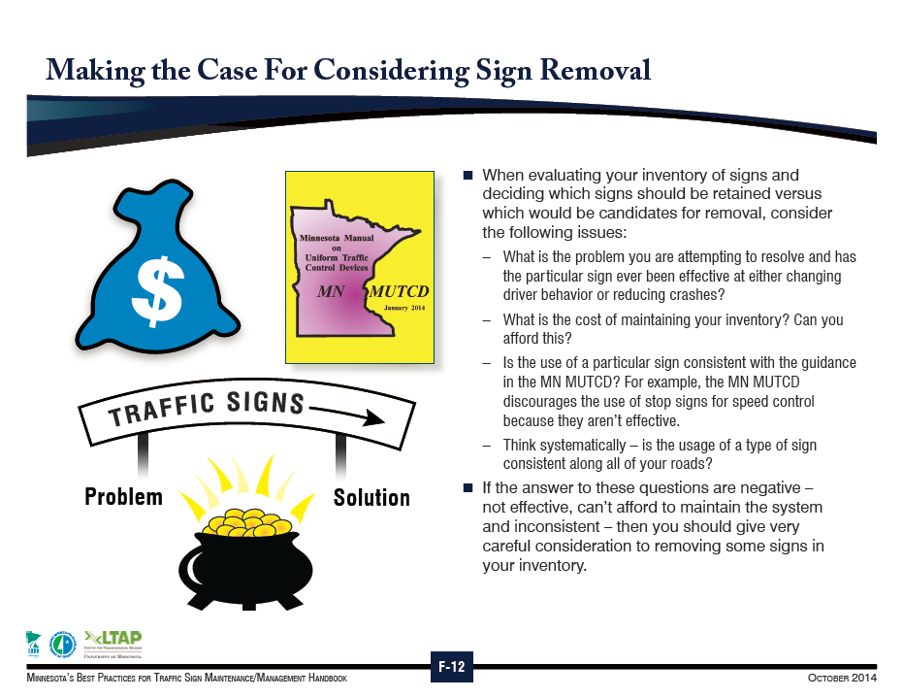
Why Signs are Installed

Slide 30
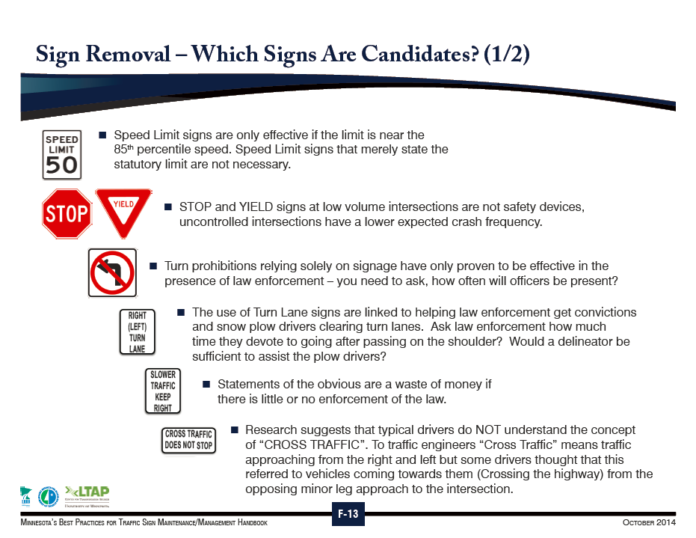
Why Signs are Installed

Slide 31
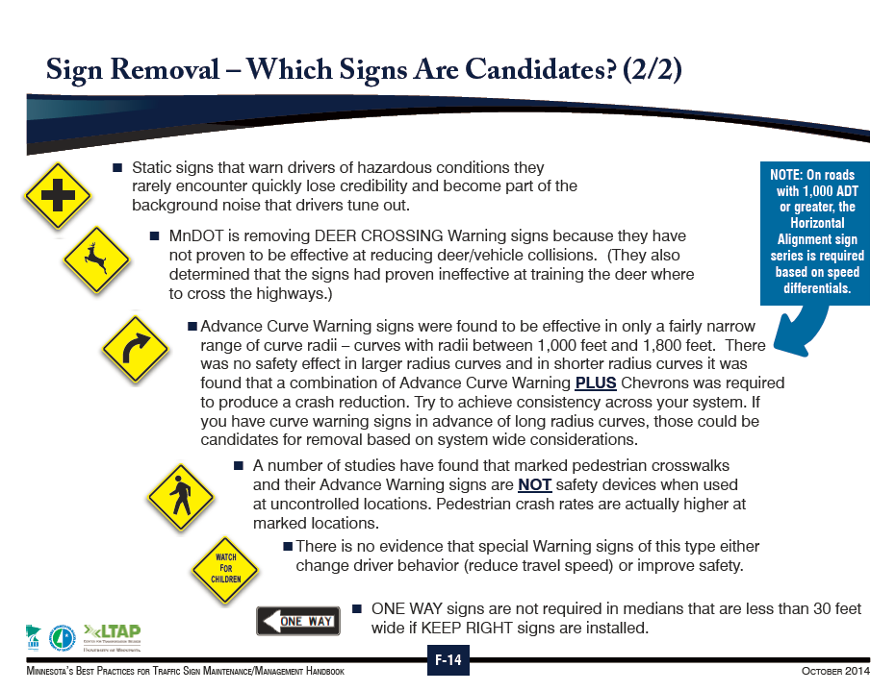
Why Signs are Installed

Slide 32
Why Signs are Installed
Excessive Use of Sign
  The MN MUTCD states:
    “Regulatory and warning signs should be used conservatively because these signs, if used to excess, tend to lose their effectiveness.”
    “If used, route signs and directional guide signs should be used frequently because their use promotes efficient operations by keeping road users informed of their location.”

Slide 33
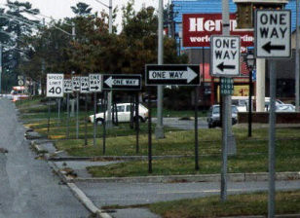
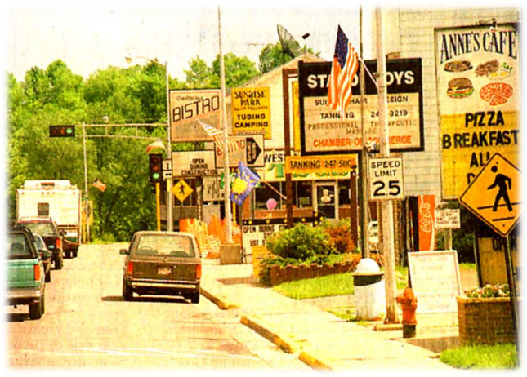
Why Signs are Installed
Sign Clutter
  Existing signs should be regularly reviewed to ensure that all of the signs are official and are necessary for regulatory, warning or guidance purposes
  Unnecessary signs increase sign clutter and should be considered for removal as discussed in the handouts in Section 3.3.

Slide 34
Why Signs are Installed
Sign Grouping
  Traffic signs of different functional classification should not be mixed in a given sign installation
  It is not always feasible to erect signs separately in urban areas where mounting space is limited and visibility problems occur
    In such cases, a sign of major importance may be placed above a relatively small sign of routine or secondary significance

Slide 35
Why Signs are Installed
Justification
  A traffic sign may be initiated in a variety of ways
  They are requested by a wide variety of individuals
  Everybody wants a sign!
  A traffic sign is not installed simply because of a request for it
  Must fulfill the needs previous stated

Slide 36
Why Signs are Installed
Politically Motivated Signs
  Signs contrary to the engineering principles
  Also might be from state law

Slide 37
Why Signs are Installed
Example – Memorial Highway Signs
  State law was passed to include these signs on an Interstate
  The MUTCD, section 2.M.10 Guidance states "Freeways and expressways should not be signed as memorial or dedicated highways.“

Slide 38
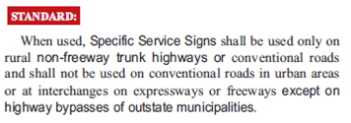
Why Signs are Installed
Example – SF 1270 3rd Engrossment 88th Legislature
  Sec. 68. SPECIFIC SERVICE SIGN.
  Specific service sign on east side of Highway 52
  Law does not meet MUTCD requirements

Slide 39
Why Signs are Installed
Example – SF 1270 3rd Engrossment 88th Legislature
  MN Statutes 160.293 Subd 1.
    “Purpose. Specific service signs are to be used to create and implement a system of signing for the purpose of displaying specific service information to the traveling public on nonfreeway trunk highways in rural areas.”

Slide 40
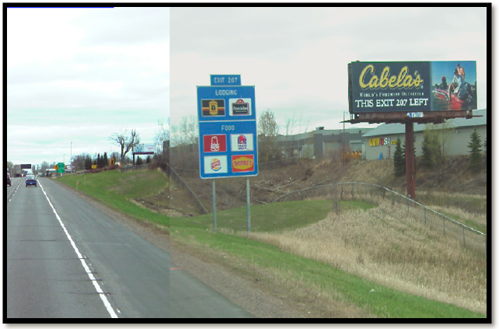
Why Signs are Installed
Advertising Signs vs. Traffic Control Signs
  Logo Signs are located on Interstate highways/freeways and are motorist service signs
  Billboards and other advertising is found off of the public ROW
 | Logo signs are NOT advertisements. They are motorist service signs

Slide 41
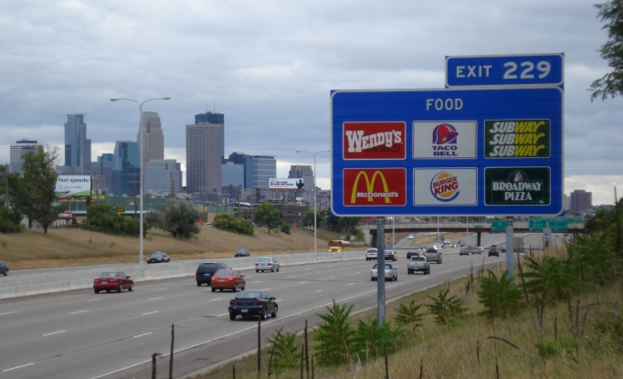
Why Signs are Installed
Logo Sign
  Guide signs
    Business identification
    Directional information for services and eligible attractions
    Eligible Signs covered in Chapter 5

Slide 42
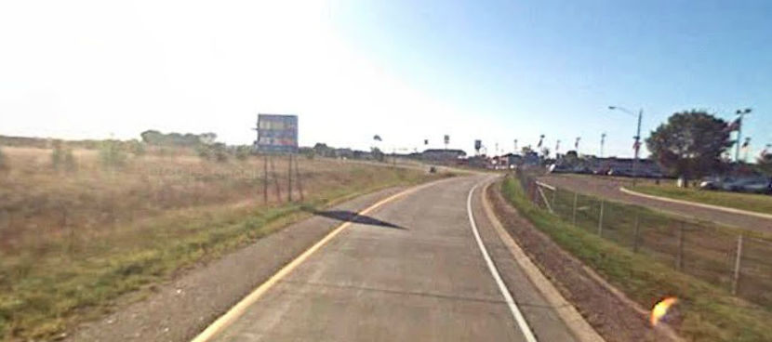
Why Signs are Installed
Logo Sign
  Trailblazing signs
    Smaller signs
    located on freeway exit ramps and local roads
    direct motorists from the freeway to the business

Slide 43
Why Signs are Installed
Bonus Law (1958)
  In 1958, Congress passed the first outdoor advertising control legislation which is commonly known as the "Bonus Law
Highway Beautification Act (1965)
  The Highway Beautification Act of 1965 called for control of outdoor advertising, including removal of certain types of signs, along the nation's growing Interstate Highway System and the existing federal‐aid primary highway system

Slide 44
Why Signs are Installed
  Highlights
    Signs allowed: directional or other official signs required or authorized by law
    87% of motorists prefer logo signs to billboards or high‐rise signs
    Billboards detract from scenery and contribute to visual pollution
    Traffic control devices shall not bear any advertising message or any other message that is not related to traffic control
    Tourist‐oriented directional signs and Specific Service signs are not considered advertising
      Rather they are classified as motorist service signs

Slide 45
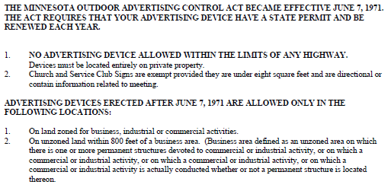
Why Signs are Installed
Minnesota Advertising Act

Slide 46
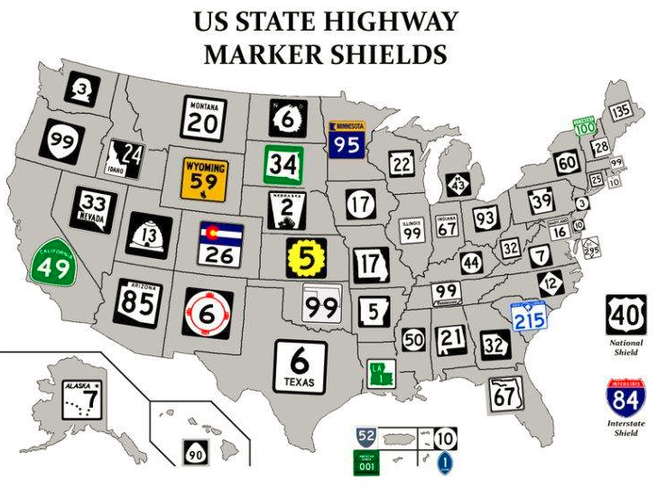
Why Signs are Installed
End

