Slide 1
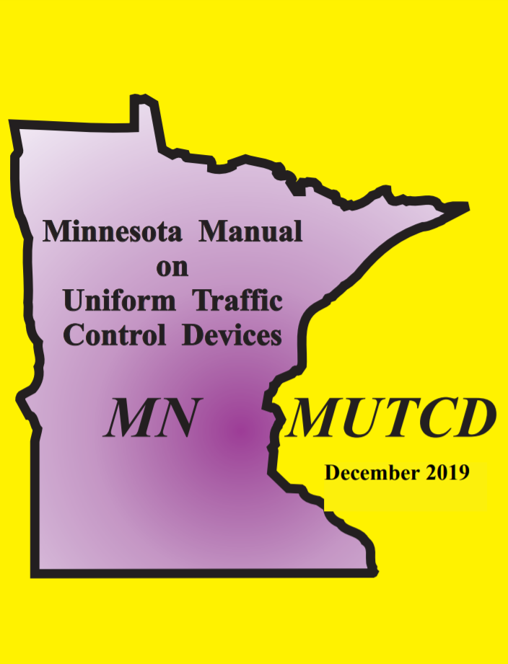
Chapter 2
Signing Overview
Traffic Signs 101
June 2020

Slide 2
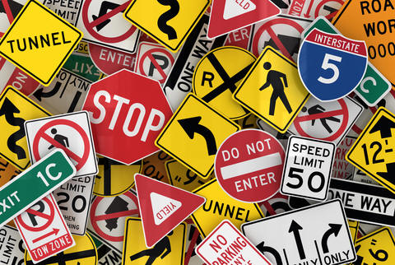
Signing Overview
Purpose of Signs
  National studies indicate
    Deficient signing number one complaint of 60 percent of drivers
    Third leading cause of crashes
    Sign improvements have one of the highest benefit‐to‐cost ratios of all safety improvements

Slide 3
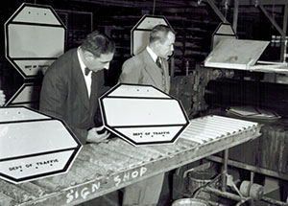
Signing Overview
Purpose of Signs
  Traffic signs
    Regulate
    Warn
    Guide motorists, pedestrians, and other traffic on all public roads
  Most used traffic control device
    Oldest device for controlling
    Safeguarding & Expediting traffic

Slide 4

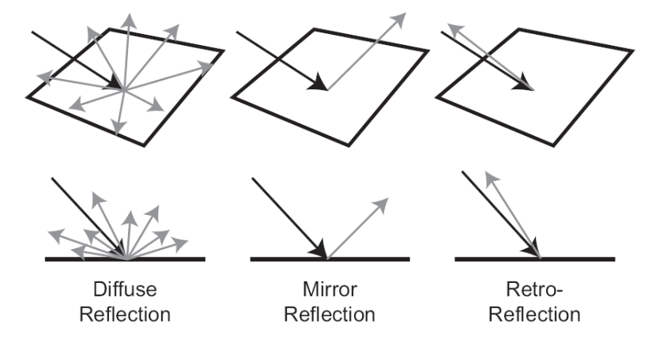
Retroreflectivity
What is Retroreflectivity
  The MUTCD requires traffic signs to be either retro-reflective or illuminated to show the same shape and color both day and night

Slide 5
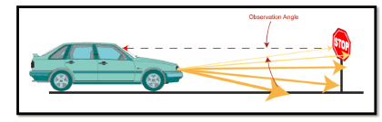
Retroreflectivity
Retroreflective Sheeting Materials
  To make signs retroreflective, sign manufacturers apply retroreflective sheeting, which contains either microscopic glass beads or cube corner reflectors, to the face of each sign

Slide 6
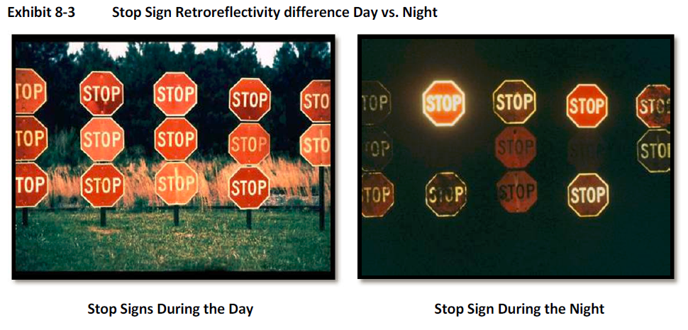
Retroreflectivity
Why is Retroreflectivity Important?
  The nighttime visibility of signs and pavement markings is essential for highway safety
  National studies show that 50 percent or more of all fatal crashes occur at night despite lower travel volumes
  In fact, the average fatality rate (fatalities per 100 million vehicle‐miles of travel) is about three times higher during the night than during the day
3M Video

Slide 7
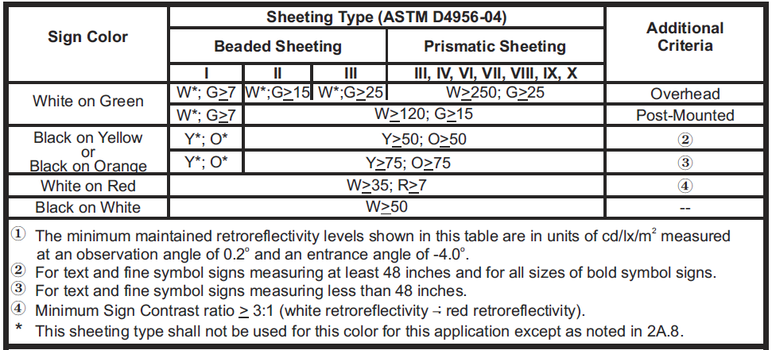
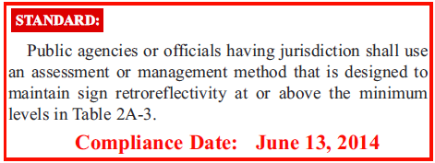
Retroreflectivity
Minimum Retroreflectivity
  In 1993, Congress directed the U.S. Secretary of Transportation to include minimum retroreflectivity values for traffic signs in the Federal MUTCD
  Following extensive research and public input, FHWA adopted minimum retroreflectivity values for most traffic signs on December 21, 2007, and incorporated them into the MUTCD

Slide 8
Principles of Traffic Control Devices
As stated in the MN MUTCD, for traffic signs to be effective, they should meet the following basic requirements:
    Fulfill a need
    Command attention
    Convey a clear, simple meaning
    Command respect of road users
    Give adequate time for proper response

Slide 9
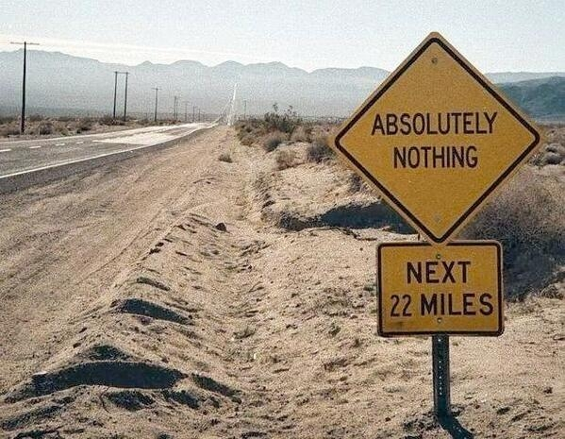
Signing Overview
Fulfilling a need?

Slide 10

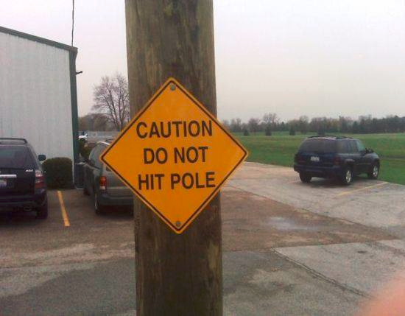
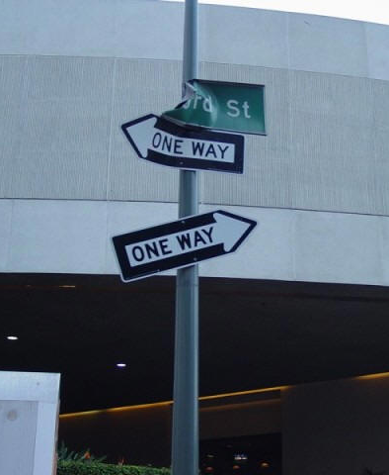
Signing Overview
Commanding Attention?

Slide 11
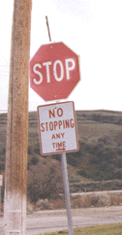
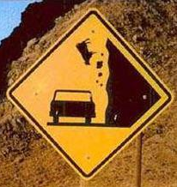
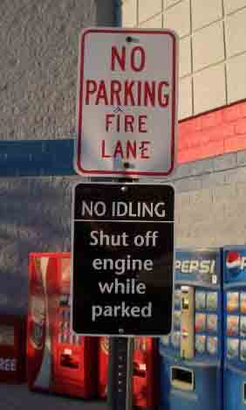
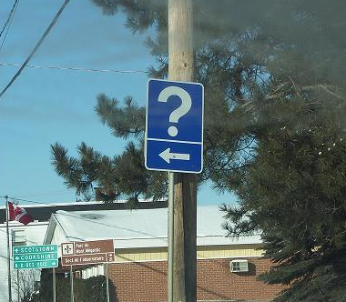
Signing Overview
Conveying a clear, simple meaning?

Slide 12
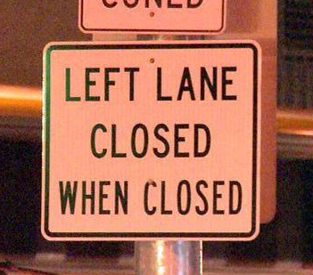
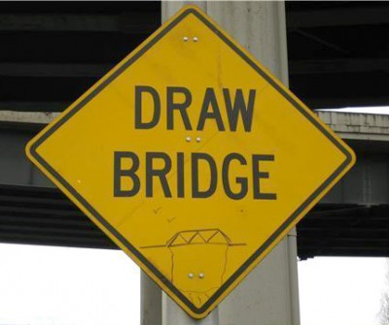
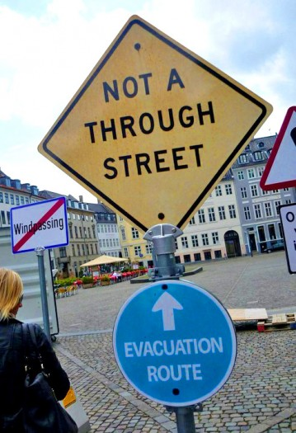
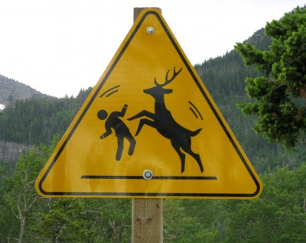
Signing Overview
Commanding Respect of Road Users?

Slide 13
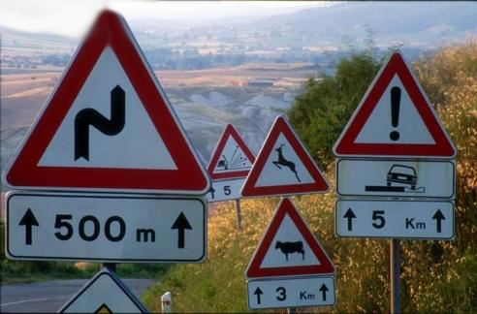
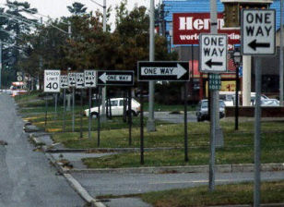
Signing Overview
Giving Adequate Time for Proper Response?

Slide 14




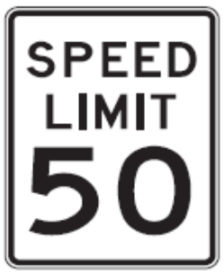

Classifications of Traffic Signs
Regulatory Signs
  inform highway users of traffic laws or regulations and indicate the applicability of legal requirements that would not otherwise be apparent

Slide 15
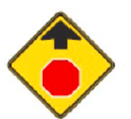
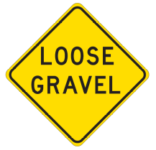







Classifications of Traffic Signs
Warning Signs
  Used to call attention to hazardous conditions, actual or potential, on or adjacent to a highway or street, that would not be readily apparent to the motorist

Slide 16
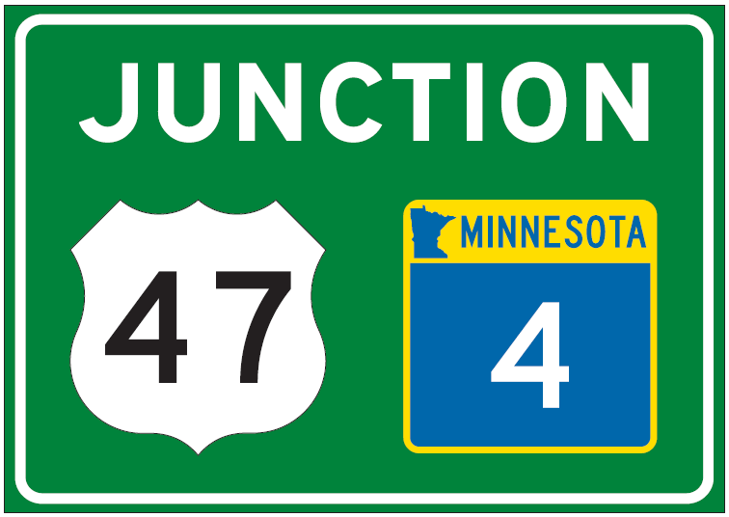

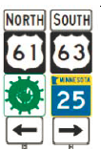
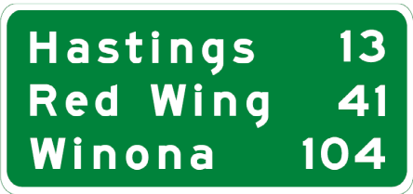


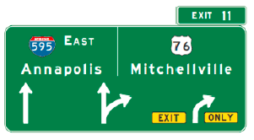
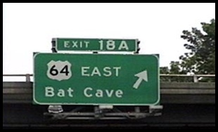

Classifications of Traffic Signs
Guide Signs
  Used to provide directions to motorists, informing them of intersecting routes, directing them to cities and other important destinations, and guiding them to available services, points of interest, and other geographic, recreational, or cultural sites
Slide Clutter??

Slide 17
Signing Overview
Design of Signs
  Improve safety and reduce driver frustration
    Promotes uniformity in the design and application of traffic control devices
  MN MUTCD (see Section 2.7.2) establishes the basic framework for the design and application of signs
  Standard Highway Signs and Markings manual (see Section 2.7.4) provides detailed drawings of the standard signs and alphabets

Slide 18
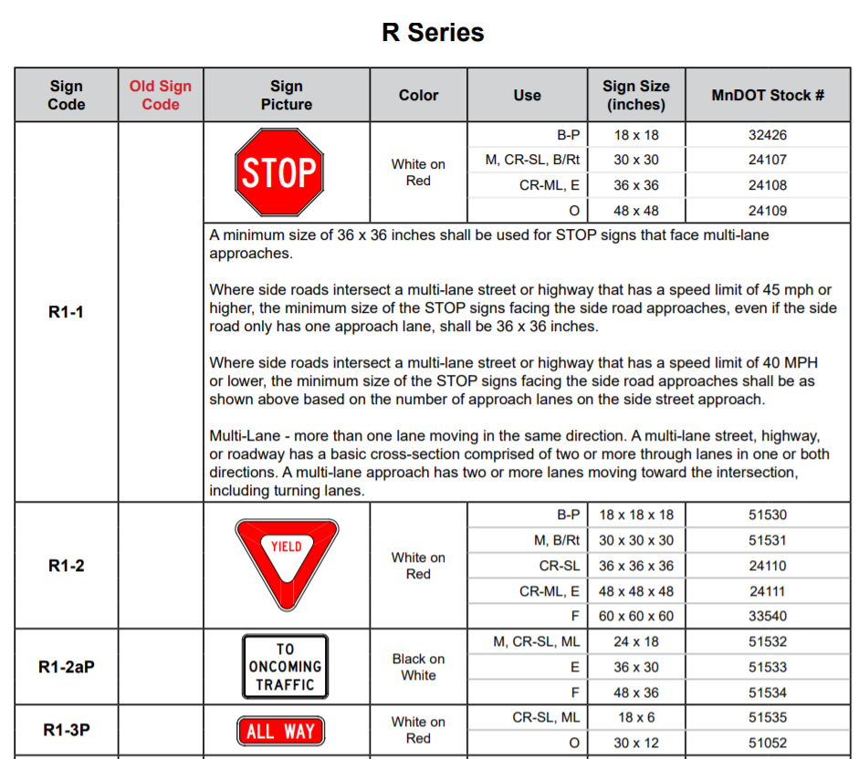
Signing Overview
Sign Nomenclature
  R Series
    Regulatory signs

Slide 19
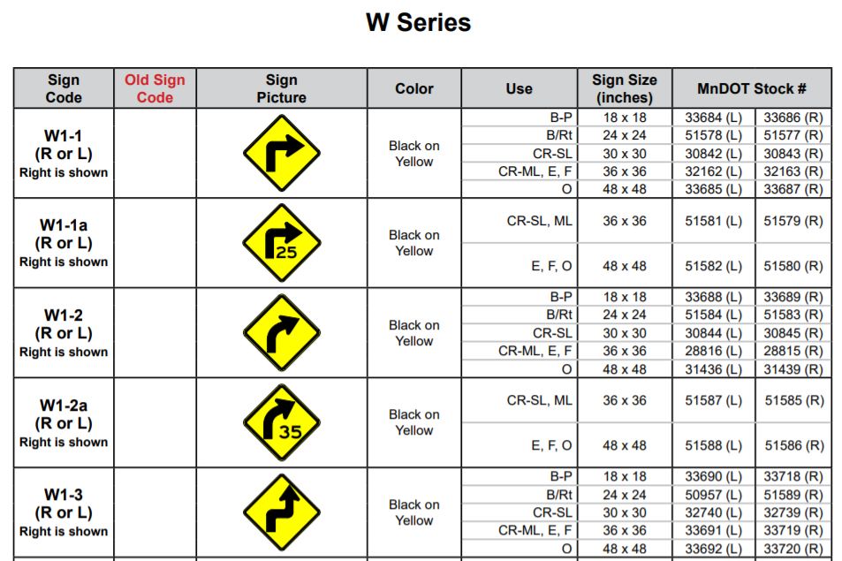
Signing Overview
Sign Nomenclature
  W Series
    Warning Signs

Slide 20
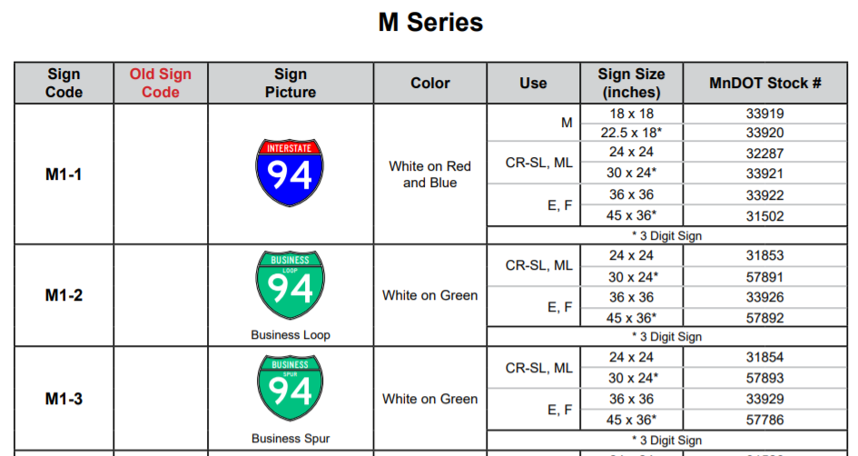
Signing Overview
Sign Nomenclature
  M Series
    Route Markers & Auxiliaries

Slide 21
Signing Overview
Sign Nomenclature
  G Series
    Construction Information
  S Series
    School Warning
  D Series
    Guide Signs
  I Series
    Informational
  E Series
    Exit Signs
  OM Series
    Object Marker
  X Series
    Miscellaneous
  PM Series
    Pavement Messages

Slide 22
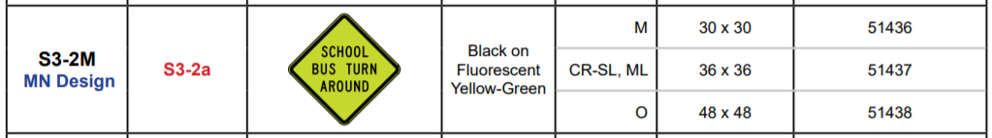
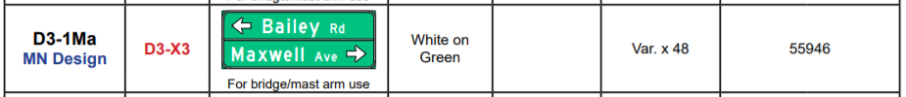
Signing Overview
Sign Nomenclature Modifications
  Designs that are a modification of a federal design will be designed with an “M” at the end
  Another modification of the same sign, an “a” will be added at the end of the code

Slide 23
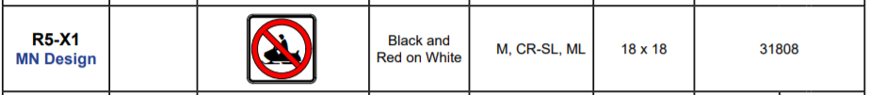
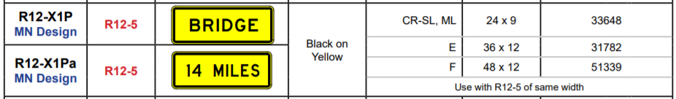
Signing Overview
Sign Nomenclature Modifications
  Special designs start with the numbers associated with the sign design and after the dash an “X” (Specific to MN, not found in the FHWA MUTCD)
  Another modification of the same sign, an “a” will be added at the end of the code
  If a plaque is associated with that sign code then a “P” will be added

Slide 24
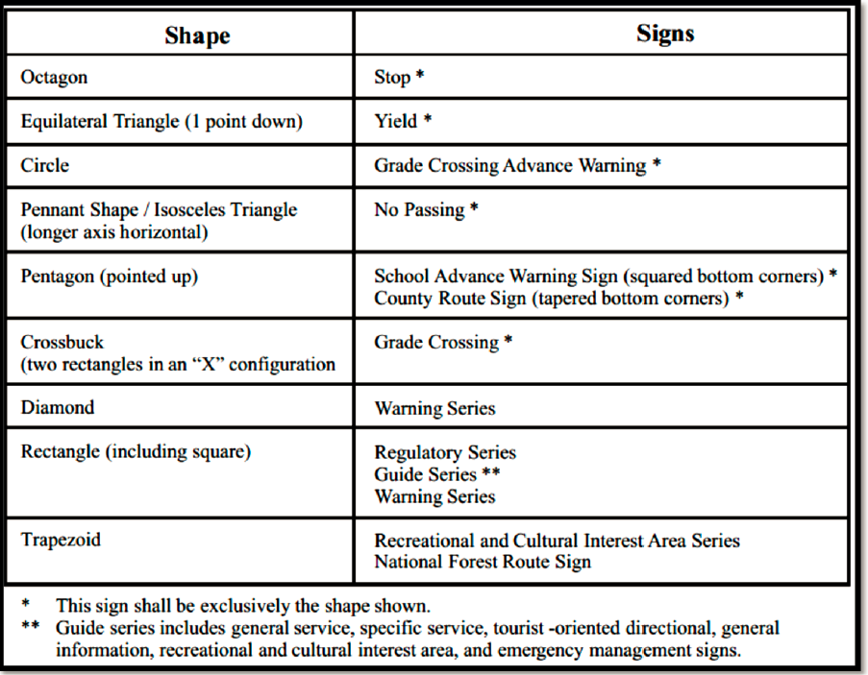
Signing Overview
Elements of Traffic Sign Design
  Shape

Slide 25

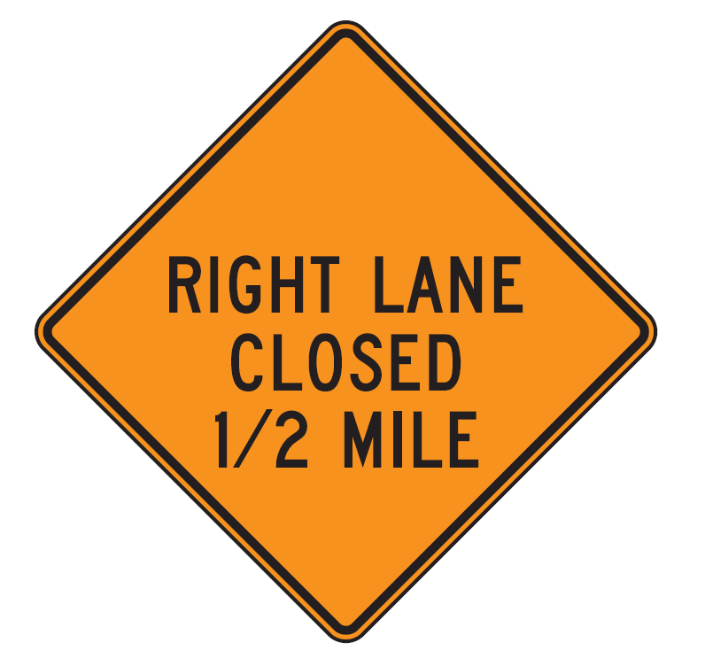


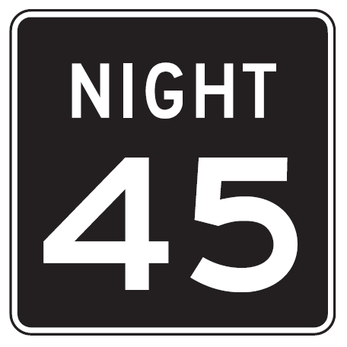
Signing Overview
Colors
  Black: Used as legend color for signs with orange, white or yellow backgrounds. Black also is used as the background color for some regulatory signs.
    Legend
    Background

Slide 26
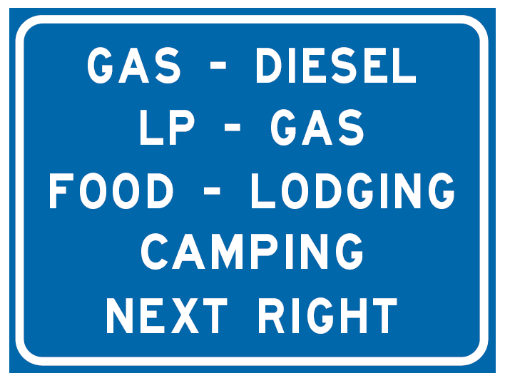






Signing Overview
Colors
  Blue: Indicates services available to road users. It is used as the background color in motorist information signs, interstate, Minnesota, and county route markers, and auxiliary markers. Blue is not used as a legend color except on Adopt-a-Highway signing.
    Background
    Legend

Slide 27
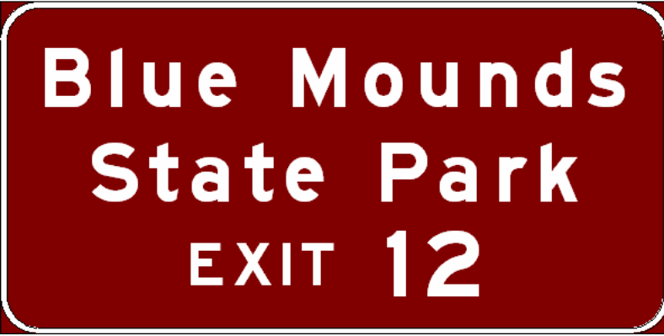
Signing Overview
Colors
  Brown: Indicates recreational and cultural facilities. It is used only as the background color in recreational and cultural interest signs. It is not used as a legend color.
    Background
    Legend
      None

Slide 28

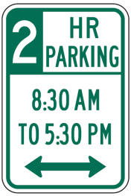
Signing Overview
Colors
  Green: Indicates movement permitted or gives directional guidance. It is used as the background color in guide signs and as the legend color in permissive parking signs.
    Background
    Legend

Slide 29
Signing Overview
Colors
  Orange: Warns of temporary traffic conditions with a higher than normal potential hazard level. It is used as the background color in temporary traffic control signs and is most commonly seen in construction zones. It is not used as a legend color.
    Background

Slide 30

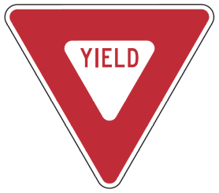


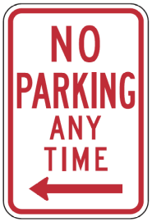

Signing Overview
Colors
  Red: Indicates right-of-way control, prohibition or exclusion. It is used as the background color for STOP, DO NOT ENTER, WRONG WAY, and interstate route marker signs and as the legend color for YIELD, parking prohibition and prohibitory (circular with slash) signs.
    Background
    Legend

Slide 31
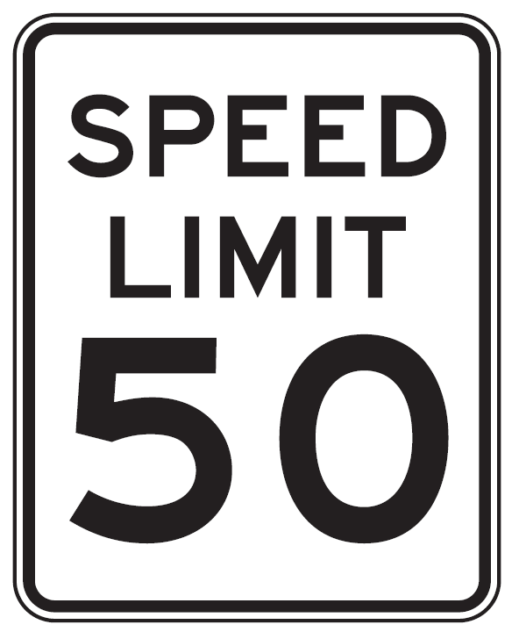



Signing Overview
Colors
  White: White either indicates a law, regulation or legal requirement in effect at or near the sign or provides directional guidance. It is used as the background color for regulatory signs, route markers and route marker auxiliaries. It also is used as the legend color for signs with a black, blue, brown, green or red background.
    Background
    Legend

Slide 32

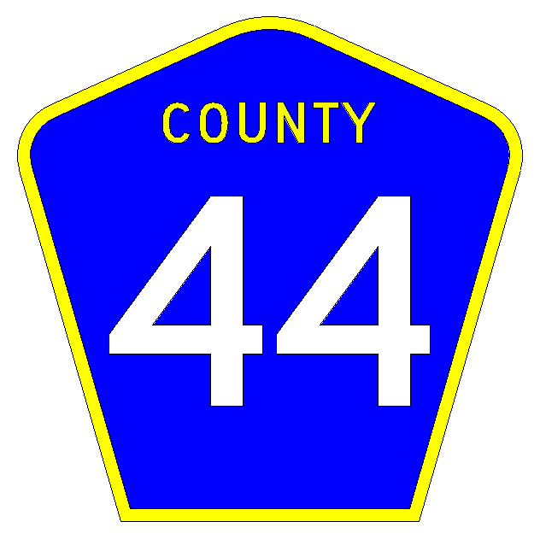
Signing Overview
Colors
  Yellow: Warns of a potential hazard. It is used as the background color for warning signs and as the legend color for county route marker signs.
    Background
    Legend

Slide 33

Signing Overview
Colors
  Fluorescent Yellow-Green: Designated for use as background color for warning signs and their supplemental plaques associated with pedestrians, bicyclists, playgrounds and schools. SCHOOL plaque is also included.

Slide 34

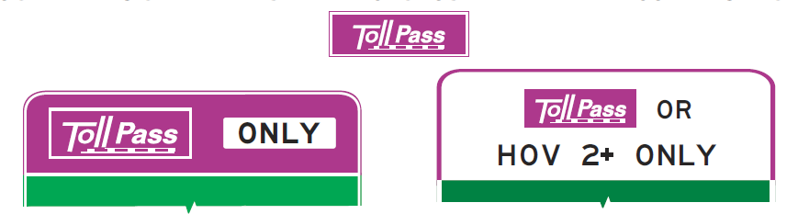
Signing Overview
Colors
  Fluorescent Pink: Incident Management
  Purple: Electronic Toll Accounts (ETC) such as Minnesota’s MnPASS lanes.

Slide 35
Basic Information/Background
Say the COLOR of the text as fast as possible
Yellow
Red
Blue
Orange
Green
Grey
Pink
Black
Brown

Slide 36
Basic Information/Background
Say the COLOR of the text as fast as possible
Green
Grey
Orange
Black
Brown
Pink
Grey
Green
Black
Notes:
Stroop Effect: The words themselves have a strong influence over your ability to say the color. The interference between the different information (what the words say and the color of the words) your brain receives causes a problem.

Slide 37
Signing Overview
What controls size of sign?
  Message on sign
  Font used for text
  Letter and object spacing
  Borders and margins

Slide 38

Signing Overview
  An accepted “rule-of-thumb” for legibility of signs (other than Interstate)
    1 inch of letter height for every 30 feet of desired legibility
    Overall dimensions should be in multiples of 6 inches
Notes:
An accepted “rule-of-thumb” to follow for legibility for signs other than Interstate is to have 1 inch of letter height for every 30 feet of desired legibility. Whenever practicable, the overall dimensions of the sign plates should be in multiples of 6 inches.

Slide 39
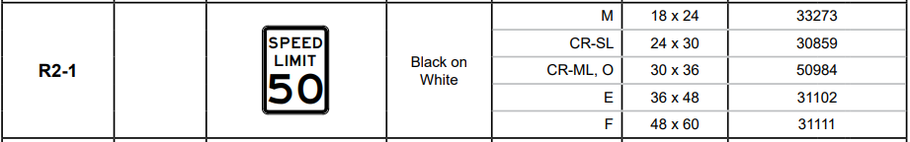
Size of Sign Example
Speed Limit Sign
  Conventional road with a single lane

Slide 40
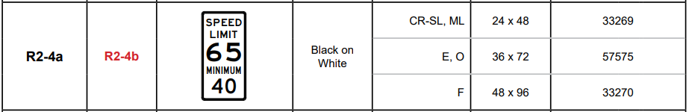
Size of Sign Example
Speed Limit Sign
  Freeway with Minimum Speed

Slide 41
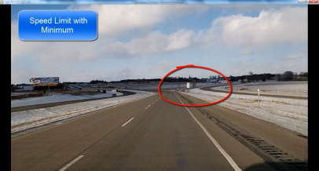





Size of Sign Example
So What?
  24” x 30”
  48” x 96”

Slide 42
Signing Overview
Guide Signs
  Minimum sizes have been established
  Give motorist ample opportunity to respond
  Refer to Guide Sign Design Manual/Course
MnDOT OTE has implemented a new 2k font for use in Sign CAD. Projects let starting July 1, 2020 will use this font type.

Slide 43


Size of Guide Sign Example
Freeway Overhead Exit

Slide 44
Signing Overview
Elements of Traffic Sign Design
  Legend
    MnDOT's preferred practice is to use symbol messages when the MN MUTCD allows the use of word messages as alternatives to symbols
    New warning or regulatory symbol signs not readily recognizable by road users should be accompanied by an educational plaque (for 3 years)
    MN MUTCD Standard to use upper/lower case lettering on all guide signs with proper name destinations

Slide 45

Signing Overview
Legal Authority for Placement of Traffic Signs

Slide 46
Signing Overview
  Traffic Signs Installed by MnDOT Maintenance Forces
    Minnesota Statute (MS) 169.06, subd.2, provides that the Commissioner of Transportation (Commissioner) shall place and maintain traffic signs conforming to the MN MUTCD and the MnDOT Standard Specifications for Construction as deemed necessary to regulate, warn, or guide traffic on the Minnesota trunk highway system
    MnDOT district traffic offices and maintenance forces act as agents of the Commissioner in this duty
    Additional Statutes may also be applicable.

Slide 47
Signing Overview
  Traffic Signs Installed by Contract
    Under the provisions of MS 161.32, subd.1, the Commissioner may elect to conduct sign installation work by construction contract rather than by maintenance forces
    Additional statutes may also be applicable

Slide 48
Signing Overview
  Traffic Signs Installed by Others by Maintenance Permit
    Under the provision of MS 169.06 subd. 2, the Commissioner may authorize others to install approved traffic signs by maintenance permit (MnDOT Form 1723)
    All signs shall conform to the MN MUTCD, Minnesota Standard Specifications for Construction, this Manual, and any specific conditions outlined in the permit
    District traffic engineers should approve all sign installations to ensure that all applicable standards and practices are followed

Slide 49
Signing Overview
  Temporary Traffic Control Signs Installed by Construction Contracts and Public Utility Companies at Work Sites
    The MN MUTCD, Part 6, Temporary Traffic Control provides standards and guidelines for placing traffic control signs at work sites to protect the public, workers, and equipment
    Section 6A covers the legal responsibility of authorities having jurisdiction to comply with the requirements of Part 6

Slide 50
Signing Overview
Associated Manuals
  There are a variety of manuals related to highway signs in Minnesota
  In this section, some of the more common manuals are presented

Slide 51


Signing Overview
Associated Manuals
  Federal Manual on Uniform Traffic Control Devices (MUTCD)
    The purpose of the MUTCD is to provide uniformity of these devices, which include signs, signals, and pavement markings, to promote highway safety and efficiency on the Nation's streets and highways

Slide 52

Signing Overview
Associated Manuals
  Federal MUTCD
    Title 23 of the CFR requires all States to do one of three things within two years :
      1. adopt the new or revised national MUTCD as the standard for traffic control devices in the State;
      2. adopt the national MUTCD with a State Supplement that is in substantial conformance with the new or revised national MUTCD; or
      3. adopt a State MUTCD that is in substantial conformance with the new or revised national MUTCD.

Slide 53

Signing Overview
Associated Manuals
  Minnesota Manual on Uniform Traffic Control Devices
    Minnesota develops and adopts a state MUTCD that is in substantial conformance with the Federal MUTCD
    The Minnesota MUTCD (MN MUTCD) was recently updated in 2018
    Chapter 2 of the MN MUTCD is dedicated to traffic signs.

Slide 54

Signing Overview
Associated Manuals
  Minnesota Manual on Uniform Traffic Control Devices
    Minnesota develops and adopts a state MUTCD that is in substantial conformance with the Federal MUTCD
    The Minnesota MUTCD (MN MUTCD) was recently updated in 2018
    Chapter 2 of the MN MUTCD is dedicated to traffic signs.

Slide 55


Signing Overview
Associated Manuals
  Traffic Engineering Manual
    The Traffic Engineering Manual (TEM) is issued and updated by the MnDOT Office of Traffic, Safety, and Technology (OTST)
    The purpose of the TEM is to establish uniform guidelines and procedures, primarily for use by personnel at MnDOT

Slide 56


Signing Overview
Associated Manuals
  Minnesota Standard Signs and Markings Manual
    The Standard Signs Manual contains a wide variety of standard signs that are used in the state

Slide 57


Signing Overview
Associated Manuals
  Standard Signs Summary

Slide 58


Signing Overview
Associated Manuals
  Guide Sign Design Manual

Slide 59


Signing Overview
Associated Manuals
  At-Grade Signing Manual

Slide 60


Signing Overview
Associated Manuals
  Signing Plan Design Course Freeways – Interchanges
Signing Plan Design Course Freeways – Interchanges

Slide 61

Replacing Guide Sign
Notes:
Do we still want this video?

Slide 62

Chapter 2 Review
End

