Slide 1

Chapter 1
Introduction
Traffic Signs 101
June 2020

Slide 2


Housekeeping
Start/End
Restrooms (N/A)
Breaks
Mobile Phones/Pagers
Introductions

Slide 3
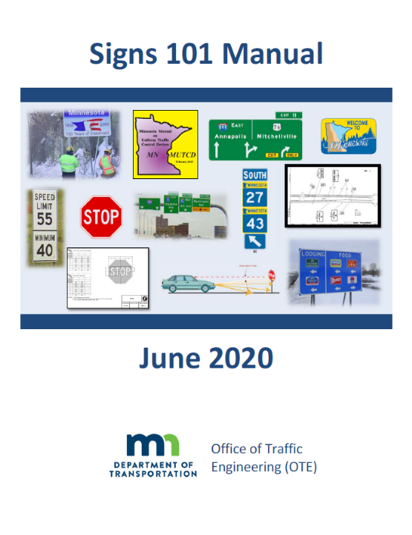
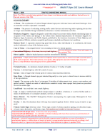
Traffic Signs 101 Manual
Manual
  10 Chapters
  Includes a Series of Handouts
  Review Handout Format

Slide 4
Chapters
Chapters Covered in the Workshop
  Chapter 1: Introduction
  Chapter 2: Signing Overview
  Chapter 3: Why Signs are Installed
  Chapter 4: Types of Signs
  Chapter 5: Sign Agreements
  Chapter 6: Sign Components
  Chapter 7: Signing Plan Sets
  Chapter 8: Maintenance of Signs
  Chapter 9: New Technologies

Slide 5

Overview
High-level course on signing
To enable traffic personnel to acquire basic understanding on traffic signing
Prerequisite to other instructor lead courses

Slide 6

Goals
Goals of the Course
  List the principles of traffic control devices
  Name the different functional classifications of signs
  Navigate the manuals related to signing
  Note the considerations for why signs are installed
  Define the difference between advertising and traffic signs

Slide 7
Goals
Goals of the Course
  Recognize some of the typical components used in signing
  List the typical sheets in a signing plan set
  Describe some of the maintenance responsibilities related to signs
  List some of the new technologies in traffic signing

Slide 8
MnDOT Technical Contacts
Josie Tayse, P.E.
Steven McBurney
Rick Sunstrom
Brian Barrett

Slide 9
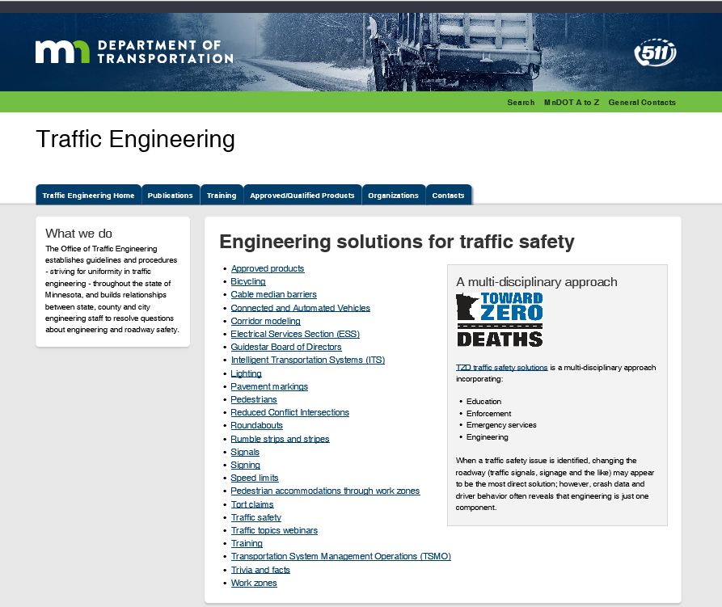
OTE Website

Slide 10
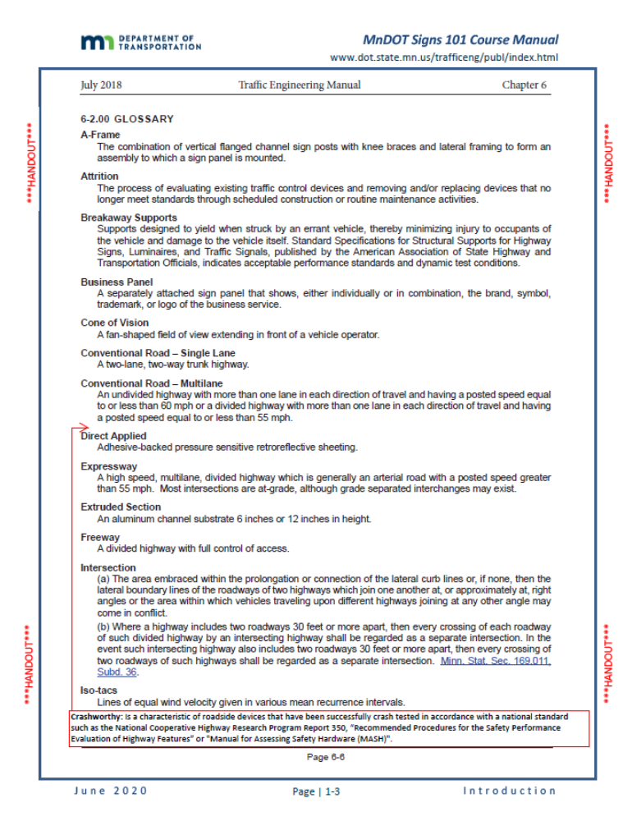
Glossary of Terms

