Slide 1
Minnesota Air Quality and Attainment Status
Frank Kohlasch • Kari Palmer
Statewide Travel Demand Coordinating Committee Meeting
October 14, 2010
Notes:
I’m here today to give an update on EPA’s regulatory actions concerning criteria air pollutants, and the impact these changes are going to have on the MPCA and our regulated facilities.

Slide 2
Summary
National Ambient Air Quality Standards (NAAQS)
State Implementation Plans (SIPs)
Pollutants of concern for transportation
  Carbon dioxide (CO)
  Nitrogen oxides (NO_{X})
  Ozone
  Fine particles (PM_{2.5})
Impacts

Slide 3
NAAQS Basics
Primary standards are set to protect human health
Secondary standards are set to protect public welfare
Set for six “criteria” pollutants
  CO,
  Lead
  NO_{X}
  SO₂
  Ozone
  Particles (PM₁₀ and PM_{2.5})
Notes:
Under the Clean Air Act, the EPA can set National Ambient Air Quality Standards, or NAAQS, for pollutants that endanger public health and welfare. The main focus is the primary standards, which are set to protect human health. There are currently NAAQS for six pollutants, which are called criteria pollutants.

Slide 4
NAAQS Revisions
EPA must periodically review each NAAQS
  NAAQS must protect human health with an adequate margin of safety
  Costs cannot be considered in setting the level
Between 2008 and 2012, EPA will review ALL
  Reviews often result in lower standards and shorter averaging times
  Some level of regulatory uncertainty during transition
Notes:
The NAAQS are not meant to be static. Rather, the Clean Air Act requires EPA to review the ambient air quality standards on a regular basis – every five years. This review allows EPA to take into account new scientific information, and ensure that the NAAQS are continuing to serve their primary purpose of protecting human health.
For the most part, NAAQS have been fairly static on SO2, NOX, lead, CO – most changes have focused on ozone and PM2.5, as understanding of the health impacts of these two pollutants has changed the most.
EPA has been challenged for not completing this review process, with the result that between 2008 and 2012, EPA will review the NAAQS for all six criteria pollutants.
This is arguably the largest concentration of changes since the beginning of the Clean Air Act. Increasing knowledge of the health impacts of these pollutants is leading to standards that are significantly lower and based on shorter averaging times.
The speed of these reviews means that all of us may be struggling together through some times of regulatory uncertainty.

Slide 5
Ongoing NAAQS reviews:
Milestone | Pollutant
 | Lead | NO₂ Primary | SO₂ Primary | Ozone | CO | PM | NO₂/SO₂ Secondary
Timeline | Oct 15, 2008 | Jan 22, 2010 | Jun 2, 2010 | Oct 31, 2010 | May 13, 2011 | July 2011 | Mar 20, 2012
NOTE: Underlined dates indicate court-ordered or settlement agreement deadlines.
Notes:
Nitrogen oxides
Feb 2010—a new short-term Nox NAAQS finalized
Twin Cities will have 2 new roadside monitors
May have a community monitor requirement
New monitors in place in 2013
Lead
New standard in 2008
10x stricter
Monitors over the standard near a lead recycler in Eagan
3 new source-oriented lead monitors in 2010

Slide 6
State Implementation Plan (SIP)
Demonstrates how a state will attain the NAAQS
Contains state rules/statutes, programs, and site-specific requirements
Notes:
Although EPA sets the standards, the primary responsibility for implementing the standards is placed on the states. States must submit to EPA a plan, known as a State Implementation Plan (SIP), that demonstrates how they will meet the NAAQS. SIPs generally contain state regulations or programs for controlling the criteria pollutants and any site-specific requirements that are needed on individual facilities.

Slide 7
SIP Basics
SIPs apply to nonattainment and attainment areas
Nonattainment SIPs have specific requirements
  Nonattainment area must include the air that does not meet the standard and all sources that contribute to nonattainment
  Transportation conformity takes effect one year later
  An attainment SIP must be developed
Notes:
So let’s talk about what happens when there is a new NAAQS and that state has to do a SIP. There are SIP requirements regardless of whether the state is in attainment or nonattainment.
Even attainment areas must have a SIP that demonstrates that the agency has adequate authority to prevent ambient pollutant levels from exceeding the standard. This is also known as having the appropriate infrastructure, which is why it is called an infrastructure SIP. (Also known as a 110(a) SIP after the portion of the Clean Air Act.) This infrastructure SIP includes things like the requirement to be able to institute enforceable measures, compliance and enforcement, ambient monitoring, and permitting program. In most cases, states have already met these requirements but a change in the NAAQS triggers a requirement to take a new look and recertify to EPA that you have appropriate authorities. (For instance, states whose rules list out specific pollutants might not have the authority to regulate new pollutants without a rule change – this happened with PM2.5).
Nonattainment SIPs must demonstrate how an area that is exceeding the new standard will come into attainment with the standard. Nonattainment SIPs have more specifics. First, nonattainment is “any area that does not meet (or that contributes to ambient air quality in a nearby area that does not meet)” a NAAQS. This means that an area can be designated as nonattainment even if the monitors in that area show attainment.
Once an area is officially designated as nonattainment, it must begin doing nonattainment NSR permitting, which requires stringent controls from stationary sources that are undergoing construction. One year after the nonattainment is designated, transportation conformity requirements take effect. The state must develop a SIP demonstrating how attainment will be achieved, which is due 18 months after designation.

Slide 8
SIP steps
Legal Authority
Air Quality
Monitoring
Control Strategy
Demonstration
Resources
State
Implementation
Plan
(SIP)
Modeling data
Emission Limiting
Rules and Regs
Enforcement
New Source Review
Voluntary and
Non-traditional
Measures
Mobile Measures
and Fuels
Permitting
Permitting
Taken from presentation by Tom Helms, EPA, on nonattainment/SIP
Notes:
This is a visual depiction of all the pieces that go into a SIP, and everything that we will be looking at as we face potential nonattainment.
The MPCA will need to use all these tools to write a SIP that demonstrates that we will attain the new standards.
So, having talked generally about SIPs, let’s talk about specific NAAQS that have transportation related components.

Slide 9
Implementing a New NAAQS
EPA sets a new standard
Immediate impact on facility review
Additional monitoring often required
1 yr
States make a designation recommendation
EPA makes a final designation
1 yr
1 yr
1.5 yrs
Attainment must be shown
(5 years after designation)
Transportation conformity applies
States submit SIP demonstrating attainment
Notes:
When EPA revises a NAAQS due to their 5 year review, it kicks off a state level implementation process as shown in this slide. Once a new standard is set, it often has an immediate impact on permitting, because sources cannot cause or contribute to a violation of a NAAQS. A change in the standard also often requires a change in how or where states monitor for a particular pollutant. In the year following the standard being finalized, each state must determine if it attains the standard or not, and make a recommendation to EPA to designate the state as either attainment or non-attainment with the standard. EPA reviews that data and then makes a determination. If a state is in nonattainment with a NAAQS, it must submit a SIP that contains control measures which allow the state to come into attainment.
The attainment demonstration has many required elements, including emissions inventories that are consistent with attainment. This includes developing a mobile source budget, which is then used in confor
So, having talked generally about SIPs, let’s talk about specific NAAQS that have transportation related components.
mity determinations as well.

Slide 10
CO NAAQS
CO NAAQS is being reviewed
  Available background documents to support the review
  The evidence provides “support for a standard at least as protective as the current standard”
Schedule is court ordered
  Notice of proposed rule to be signed October 28, 2010
  Notice of final rule to be signed May 13, 2011
Notes:
Background documents are the integrated science assessment, risk and exposure assessment, and policy assessment. These documents often serve to give us an indication of the direction that EPA is going, prior to the official proposal of the rule.
The policy assessment gives the EPA staff assessment of the adequacy of the current standard and the need to consider alternative standards. Of course, it is not a done deal, but here is what they are looking at:

Slide 11
Twin Cities CO Trends
1998 – 2009 One Hour Design Value Trends
1998 – 2009 Eight Hour Design Value Trends
Potential standard range of 3-9 ppm
Potential standard range of 5-15 ppm
Notes:
Concentrations in Minnesota are well below the proposed standards, so we should remain in attainment.
An 8 hour standard of 3 – 9 ppm (currently 9 ppm)
A 1 hour standard of 5 – 15 ppm (currently 35 ppm) with a change in the form of the standard for each.
Some alternative standards to consider are mentioned
8 hour standard: 3 – 9 ppm, using a 99th percentile average concentration over three years
1 hour standard: 5 – 15 ppm, using a 99th percentile average concentration over three years
Could also revoke if 8 hour is made more protective

Slide 12
NO_{x} NAAQS
New standard of 100 ppb, one hour average
Annual 53 ppb standard remains effective
EPA focused on near roadway concentrations
  New roadway monitors being required (by 2013)
  Areas without monitors will be designated as unclassifiable
Nonattainment designations not likely until 2016 or 2017
Notes:
First is the new one hour NAAQS for nitrogen dioxide, which became effective on April 12, 2010. It is designed to protect against exposure to all nitrogen oxides (NOx). EPA seems to be moving towards shorter averaging times, due to increased knowledge of the health effects of exposure to short term high concentrations of air pollutants.
The form for the 1-hour NO2 standard, is the 3-year average of the 98th percentile of the annual distribution of daily maximum 1-hour average concentrations.
EPA is particularly concerned about people’s exposure to high levels of NO2 near roadways, or while in their cars. However, areas near major roadways are not currently monitored. Therefore, the new NAAQS requires states to monitor near roadways. Any urban area with a population ≥ 500,000 people must have at least one roadway monitor, and areas with either population ≥ 2.5 million people or annual average daily traffic (AADT) count ≥ 250,000 vehicles must have a second monitor near a different major road. Therefore, two new roadway monitors will be installed in the Mpls/St Paul metro area.
These new monitors are not required to be operational until the beginning of 2013. Because three years of data is necessary to demonstrate compliance, it is likely that most areas will be designated as unclassifiable. (Our existing area monitors show compliance.) Therefore, any nonattainment that is designated for these areas is likely still some distance in the future. Designations may not occurs until 2016 or 2017
We’ll have to wait and see what we’ll do then, as only the federal government can set vehicle emission standards. Perhaps congestion, etc.
Twin Cities area will need two new monitors near major roads
May have a community monitor requirement
Placed near road segments where the peak NO2 concentrations are expected to occur
Based on highest traffic levels, considering fleet mix, congestion, etc..
Monitors must be no more than 50 meters from the edge of the nearest traffic lane
Operational by January 1, 2013

Slide 13
NO₂ annual average trends
NO2 Standard

Slide 14
NO_{x} and Secondary Formation
Reductions may be needed even if Minnesota attains the NAAQS
Important component of secondary formation
  VOCs + NO_{x} + sunlight = ozone
  Ammonia + NO_{x} = ammonium nitrate
  (~⅓ of fine particle mass)
Notes:
Even if Minnesota attains the NO2 NAAQS, reduction may be important due to contributions to ozone and fine particles.
Minnesota is close to both the ozone and fine particle NAAQS

Slide 15
Ozone NAAQS
The final NAAQS scheduled for October 2010
  Current standard: 75 ppb (set 2008)
  Proposed levels: 60–70 ppb
Key Issues
  Shorter timeframe for designations (June 2012)
  What data will be used for designations?
Notes:
Let’s begin with ozone. We were hoping to know by now what the final ozone standard would be, but EPA has delayed announcing the standard until the end of October. EPA has proposed three levels at which they could possibly set the final standard.
The key issues we are concerned about for the ozone standard are as follows:
EPA proposed an expedited time frame, particularly for states to make designation recommendations and for EPA to make official designations. Originally, it was expected that states would have about 6 months to make recommendations, and EPA would have 6 months to review, resulting in final designations by August 2011. For a state that has never been in ozone nonattainment, this would be a very difficult timeline to meet, due to a lack of technical expertise. We think that EPA has relaxed somewhat on this time frame, and I now expect final designations in June 2012, so we would have until June 2011 to make a recommendation.
Finally, a big issue will be what data EPA uses for designations. Why is this such a big issue?

Slide 16
Ozone NAAQS Design Values (DVs)
8-Hour Ozone DVs, 2007-2009
Estimated 8-Hour Ozone DVs, 2008-2010
Data through August 23, 2010
Range of Proposed Standard
Range of Proposed Standard
Notes:
This is why what data is used for designations is very important. Ozone levels can be very susceptible to changes in meteorology. When EPA put out their proposed rule, they showed parts of Minnesota would not attain a 65 ppb standard, based on 2007 – 2009 data. (Ozone uses a three year rolling average.) However, when we move to looking at 2008 – 2010 data, it looks more likely that we would attain even a 65 ppb standard. (Note that this is very preliminary data, does not include the whole ozone season – which runs through the end of September – and is subject to change.)
With the delay in the release of the ozone standard, it looks like the state could make a designation recommendation based on 2008 – 2010 data, but that EPA would be able to look at 2009 – 2011 data in order to make the designation. 2008 was a very low year for ozone in Minnesota, so that change could be critical.
Gradually decreasing trend
Because of the nature of ozone as a regional pollutant, any nonattainment designation would likely draw in the entire 18 county metro area that is the core-based statistical area. This includes two counties in Wisconsin, which would for the first time draw us into a multi-state nonattainment area, which requires extensive cross state collaboration.

Slide 17
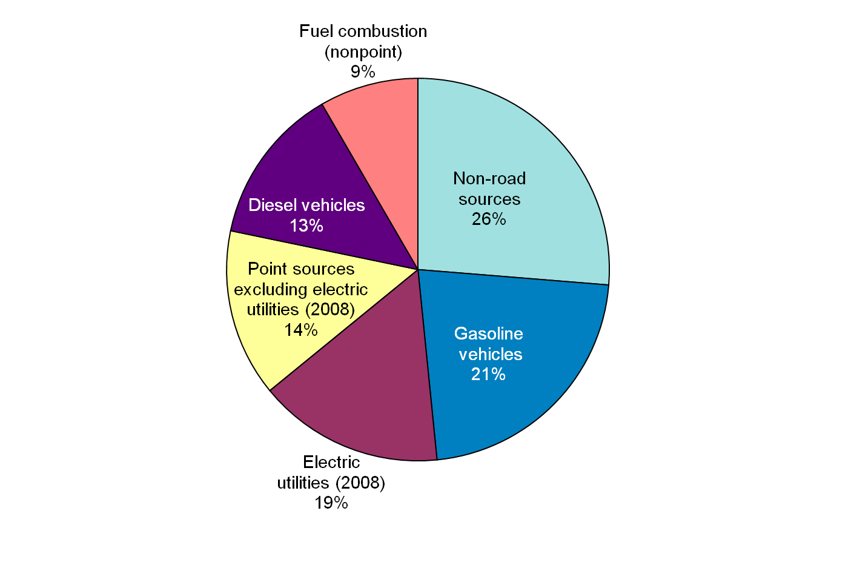
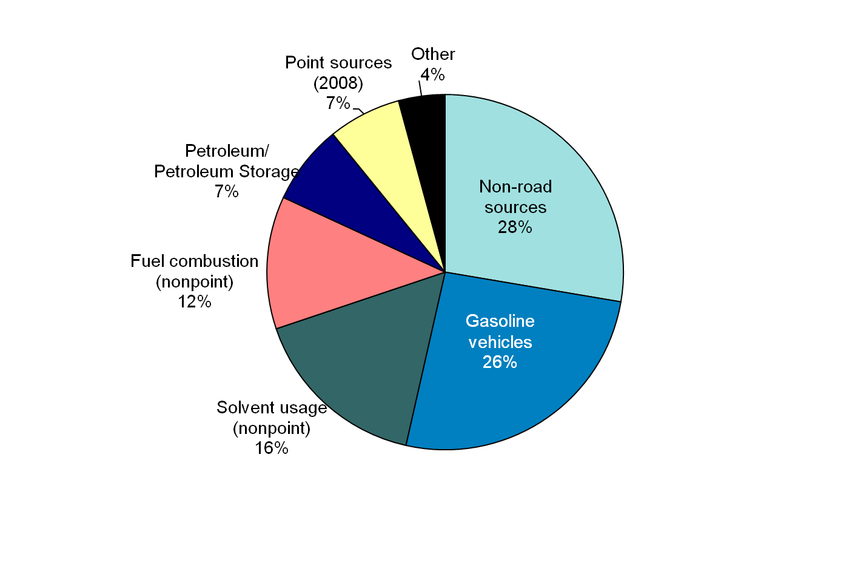
Sources of Ozone (2005 data)
Nitrogen oxides
Volatile organic compounds
Notes:
Both have almost half from non-road and gasoline vehicles
Nox primarily combustion of fossil fuels
VOCs include combustion of fossil fuels and evaporative emissions from liquid fuels and solvents.
VOCs do not include biogenic or natural sources which can be important, particularly in remote area such as Ely and Voyageurs National Park.

Slide 18
Ozone Nonattainment
Based on prior EPA implementation guidance
  Ozone nonattainment has different levels
    Marginal/moderate/serious/severe
    An area’s classification will affect SIP requirements
  SIP Required Elements
    Reasonably available control measures/technology (RACM/RACT)
    Vehicle Inspection/Maintenance (I/M)
    Reasonable further progress (RFP)
EPA will propose implementation guidance when they finalize the standard
Notes:
Ozone in particular has some specific requirements that we will have to look at if we are in nonattainment. These requirements may very depending on the severity of the nonattainment. Many of these requirements are written into the Clean Air Act (Sec. 182) itself, rather than being in EPA regulations.
One major component is reasonably available control measures and reasonably available control technology (RACM/RACT), which mandates certain controls, mainly on VOC sources and major stationary sources. One major component is vehicle inspection and maintenance programs. These programs are mandated in the CAA, but EPA appears to be given the authority to write the requirements for the program. EPA seems to be working towards some kind of vehicle program that will fulfill the Act’s requirements while not being as burdensome as traditional I/M.
For reasonable further progress (RFP): According to EPA, areas that will attain within five years of designation, RFP is met by ensuring emission reductions are implemented by the beginning of the ozone season prior to the attainment date.
For areas that will not attain within five years (more serious nonattainment), an RFP plan will set forth increments of progress from the baseline year to the attainment date. Must have 15% emission reduction within 6 years of baseline, and then for each three year period provide an additional increment of proportional progress.
All of this is something we’ll have to all get up to speed on if we do go into ozone nonattainment. EPA is planning to propose implementation guidance for the new standard when they finalize the standard, so that should help provide us with information on what we need to do.

Slide 19
Fine Particulate Matter (PM_{2.5})
PM_{2.5} is both primary and secondary
Notes:
The second regional pollutant is PM2.5. PM can be both natural and man-made. In addition, PM2.5 has both primary and secondarily formed components. Primary PM2.5 is directly emitted from sources, while secondary PM is formed from the interactions of other pollutants in the atmosphere (forms ammonium sulfate and ammonium nitrate).

Slide 20
PM_{2.5} NAAQS Design Values (DVs)
Estimated Daily PM_{2.5} DVs 2008-2010*
Data through March 2010
Annual PM_{2.5} NAAQS DVs, 2007-2009
Range of Proposed Standard
Current Standard
Notes:
The increase in 24-hour PM2.5 has led to monitors in St. Paul showing exceedances of the daily standard. The 24-hour standard is based on the three year average of the 98th percentile of 24-hour concentrations. Several days with high PM2.5 in the winter of 2009 – 2010 pushed this average in St Paul over the level of the current standard. These exceedances are generally related to weather patterns: we had several temperature inversions and other meteorological phenomenon that contributed to these exceedances.
However, our main focus right now is the fact that EPA is in the process of revising the standard. Based on the background documents available, this box shows the likely proposed range for the new standard.
PM2.5 has both annual and 24-hour standards
15 µg/m³ annual standard;
35 µg/m³ 24-hour standard
Daily PM2..5 trending higher while annual trending lower
Daily driven by weather events-inversions
Annual driven by overall concentration

Slide 21
New PM_{2.5} Standard
Will be proposed and finalized in 2011
EPA will likely wait for this new standard to designate us as nonattainment
  State designation recommendation likely December 2012
    Based on 2009 – 2011 data?
  Designation likely in December 2013
    Based on 2010 – 2012 data?
Notes:
Although we already know that some monitors in St Paul are exceeding the standard, the data for 2010 will not be fully certified to EPA until April 2011. By then, EPA will presumably be in the middle of promulgating a new PM2.5 standard. It appears that the new standard will be proposed in February 2011 and finalized in October 2011. Based on the background materials that EPA is developing, it seems quite likely that both standards will be lowered. EPA Region 5 has indicated an unwillingness to move forward with a designation of nonattainment under the 2006 standard, when they are in the process of doing this new standard, so we are focused on the 2011 standard.
Designation for new standards takes some time, so the data that will be used will change, which make change the picture that we are looking at. MPCA is likely to have to make a designation recommendation to EPA in December 2012, and EPA will then officially designate in 2013.
The MPCA has formed a team to focus on ozone and PM2.5 issues, from modeling and monitoring to policy and communications. The goal is to make sure that we are communicating and working together effectively so that we can provide the best information to others within the MPCA and to other stakeholders. Stay tuned – you will certainly be hearing more from me and from other members of the team.

Slide 22
Trend in Daily PM_{2.5} Design Values
Note: actual design value is 3-yr average
Notes:
Single year 98th percentile values (not used for NAAQS demonstration). Increasing over last two years.

Slide 23
Trend in Annual PM_{2.5} Design Values
Note: actual design value is 3-yr average
Notes:
Single year annual average (not used for NAAQS demonstration). Shows slight downward trend.

Slide 24
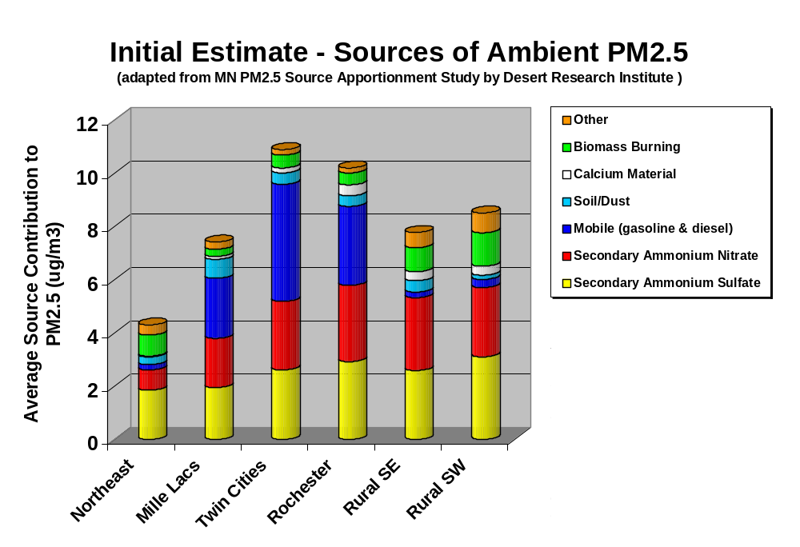
Sources of PM_{2.5}
Chen, L.-W. A.; Watson, J. G.; Chow, J. C.; DuBois, D. W.; Herschberger, L. Chemical mass balance source apportionment for combined PM2.5 measurements from U.S. non-urban and urban long-term networks. Atmos. Environ. 2010, in press.
Notes:
The MPCA is beginning our work to understand the composition of PM2.5 around the state. We learned from a PM2.5 source apportionment study and modeling done for regional haze. However, we still have a lot to learn, so we need to be careful not to overinterpret what we have.
This graph is based on a source apportionment study done for MPCA by DRI. Clearly much of the PM2.5 in rural areas is from secondary formation, and transport of pollutants from other areas. Based on the DRI study, roughly half of the PM2.5 in our metro area is formed secondarily.
In terms of human exposure to PM2.5, the “hotspots” where people tend to have relatively higher exposures are often in areas of directly emitted PM2.5 (near traffic, wood combustion, etc.).
“How well have we identified and quantified source contributions using receptor models?”
“Reasonably well, but not perfectly.”
“Reasonably well” means sufficiently to estimate that a contribution is:
1) small,
2) about the same as others, or
3) dominant in the sample.
Mobile source NOX isn’t in the blue, but other nonmobile are likely included… similarly, recall that mobile doesn’t specify on vs. offroad

Slide 25
Impacts
MPCA team formed to work on ozone and PM_{2.5} issues
  Modeling, monitoring, policy
Changes in standards likely mean changes to business as usual
  More things to look at when permitting a new or expanding source
  More pollutants subject to transportation conformity
  More likely that existing source emissions will be examined and mitigated
  May move into the world of Lowest Achievable Emission Rate (LAER) and offsets
Notes:
Basically the point of transportation conformity is to ensure that new transportation projects do not jeopardize the air quality improvement set forth in the SIP (ie, conform to the SIP). It is only required for nonattainment and maintenance areas. When you do an attainment SIP, you develop a mobile budget - a level of emissions from mobile sources that is consistent with attainment. When a transportation project of a certain size is planned, it has to be analyzed to ensure that its emissions fit within that budget.
RACT, or Reasonably Available Control Technology, is required on existing sources in areas that are not meeting national ambient air quality standards (i.e., non-attainment areas).
BACT, or Best Available Control Technology, is required on major new or modified sources in clean areas (i.e., attainment areas).
LAER, or Lowest Achievable Emission Rate, is required on major new or modified sources in non-attainment areas.
or Lowest Achievable Emission Rate, is required on major new or modified sources in non-attainment areas.
CAA section 176(c) requires that federally supported transportation projects in PM2.5and PM10nonattainment and maintenance areas cannot:Cause or contribute to new NAAQS violations,
Worsen NAAQS violations, or
Delay timely attainment of NAAQS or interim milestones

Slide 26

Frank Kohlasch
Frank.Kohlasch@state.mn.us
651-757-2500
Kari Palmer
Kari.Palmer@state.mn.us
651-757-2635
Thanks to MPCA staff
Catherine Neuschler
Cassie McMahon
Lisa Herschberger

Slide 27
Looking even farther forward…
Past 2018
  Redesignation requests and maintenance plans
  Second maintenance plans
  SIP requirements never expire
Impacts of any further five year NAAQS review
Notes:
Changes in the NAAQS that lead to nonattainment areas or the inclusion of any specific rules in the SIP will result in long term impacts.
First, once an area that was designated as nonattainment attains the standard, the state needs to submit a redesignation request and maintenance plan showing that the area will continue to attain the standard for the next 10 years. Once any nonattainment area attains
Lead, PM2.5, maybe ozone and SO2
EPA must review and approve the request, changing the area’s status from nonattainment to attainment. The area is then known as a maintenance area; at that time, NA NSR would no longer apply. Eight years after the first maintenance plan is approved, the state must submit a second maintenance plan that demonstrates attainment for another 10 years. (We have, admittedly, been lax about this.)
One the twenty years of maintenance plans expire, there are no more requirements and the area is essentially an attainment area.
However, SIP requirements never expire. If a facility has Title I SIP requirements in their permit, those cannot be changed without EPA approval. Any changes must be demonstrated not to be backsliding.

Slide 28
NAAQS Review Schedule
Year | Ozone | Lead | SO2 (Primary) | NO2 (Primary) | PM2.5 | Carbon Monoxide
2010 | Oct – Final Standard | Nov – EPA Designations | June – Final standard | Jan – Final Standard |  | Oct – Proposed new standard
2011 | June (?) – State designations | Oct – 110(a) SIP | July – State designations | Jan – State designations | Jan – Proposal Oct – Final | May – Final
2012 | June (?) – EPA Designations | June – Attainment SIP | July – EPA Designations | Feb – EPA Designations
2013 | Oct – 110(a) SIP Dec – Attainment SIP |  | June - 110(a) SIP (substantive) | Jan – 110(a) SIPs Aug – Attainment SIPs | Dec – Designation | June – Designations
2014 |  |  |  |  | Oct – 110(a) SIP
2015 |  | Nov – Attainment Date
2016 |  |  |  |  | December – Attainment SIP
2017 | Dec- Attainment Date |  | July – Attainment Date | Feb – Attainment Date
2018 |  |  |  |  | Dec – Attainment Date | May – Attainment Date
Notes:
This is the schedule as of May 2010, with some changes made to reflect the change in the ozone timelines.
This slide shows the schedule for reviewing the NAAQS, and when we expect all the implementation requirements to take effect. There is a lot to do over the next eight years, particularly between now and 2013.

Slide 29
Implementing a New NAAQS
EPA sets a new standard
  Immediate impact on facility review
  Additional/changed monitoring is often required
  States make a designation recommendation to EPA
    1 year after standard finalized
  EPA makes a final designation
    2 years after standard finalized
  Transportation conformity applies (for relevant pollutants)
    1 year after designation must have mobile budget
  Nonattainment states must submit a SIP that demonstrates attainment
    18 months after designation
  Attainment must be shown
    5 years after designation
Notes:
When EPA revises a NAAQS due to their 5 year review, it kicks off a state level implementation process as shown in this slide. Once a new standard is set, it often has an immediate impact on permitting, because sources cannot cause or contribute to a violation of a NAAQS. A change in the standard also often requires a change in how or where states monitor for a particular pollutant. In the year following the standard being finalized, each state must determine if it attains the standard or not, and make a recommendation to EPA to designate the state as either attainment or non-attainment with the standard. EPA reviews that data and then makes a determination. If a state is in nonattainment with a NAAQS, it must submit a SIP that contains control measures which allow the state to come into attainment.
The attainment demonstration has many required elements, including emissions inventories that are consistent with attainment. This includes developing a mobile source budget, which is then used in conformity determinations as well.

Slide 30
Trends in ozone design value

Slide 31
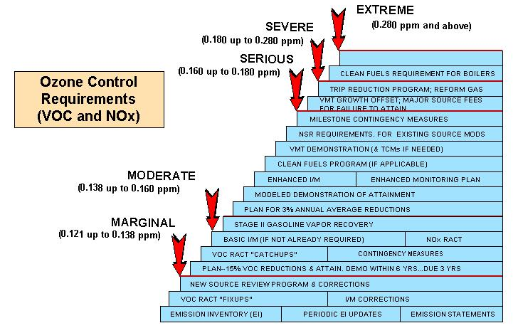
Mandated 1990 CAA controls by ozone classification ….

