Slide 1
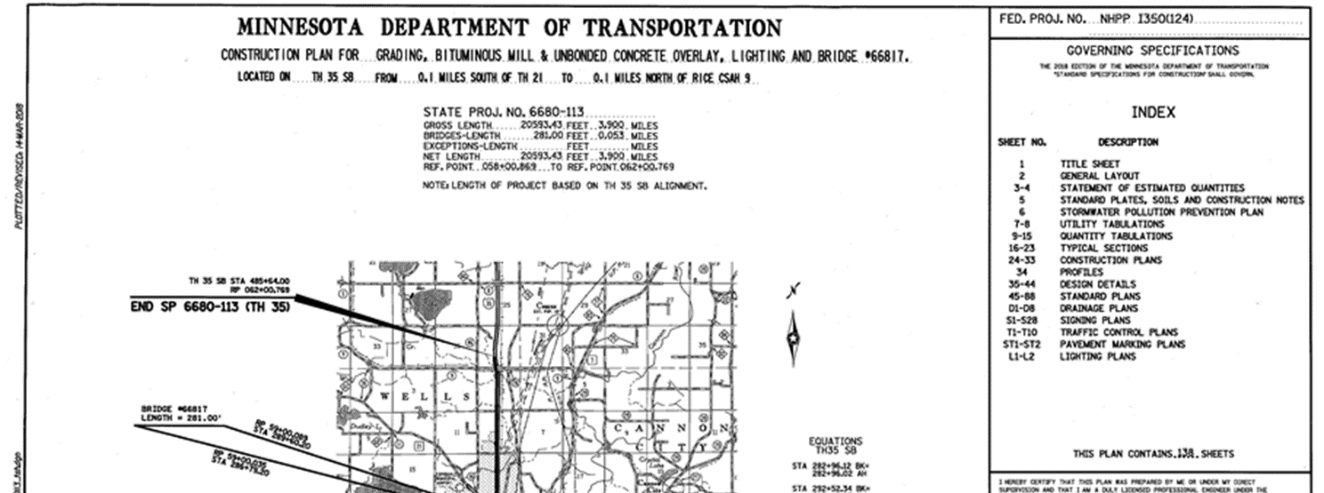
PLAN PREPARATION BASICS
TITLE SHEET
Project Design Services Unit
December 2018

Slide 2
THE BASICS OF THE TITLE SHEET
In this section you will be introduced to the basic parts of the title sheet. This is required for ALL MnDOT let plans.
Title sheets should be printed on Vellum not bond or mylar paper. This allows central office to edit the sheet if necessary so that the district does not have to re-route it for signatures should revisions be needed after submittal.

Slide 3
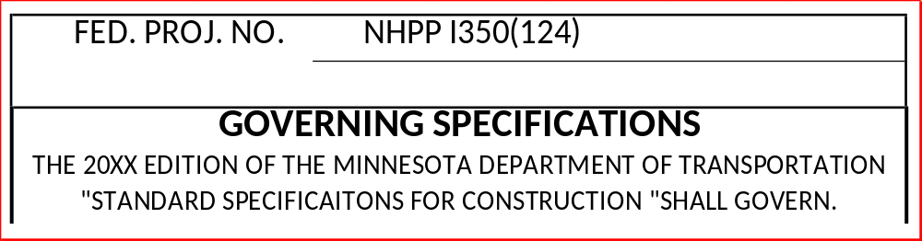
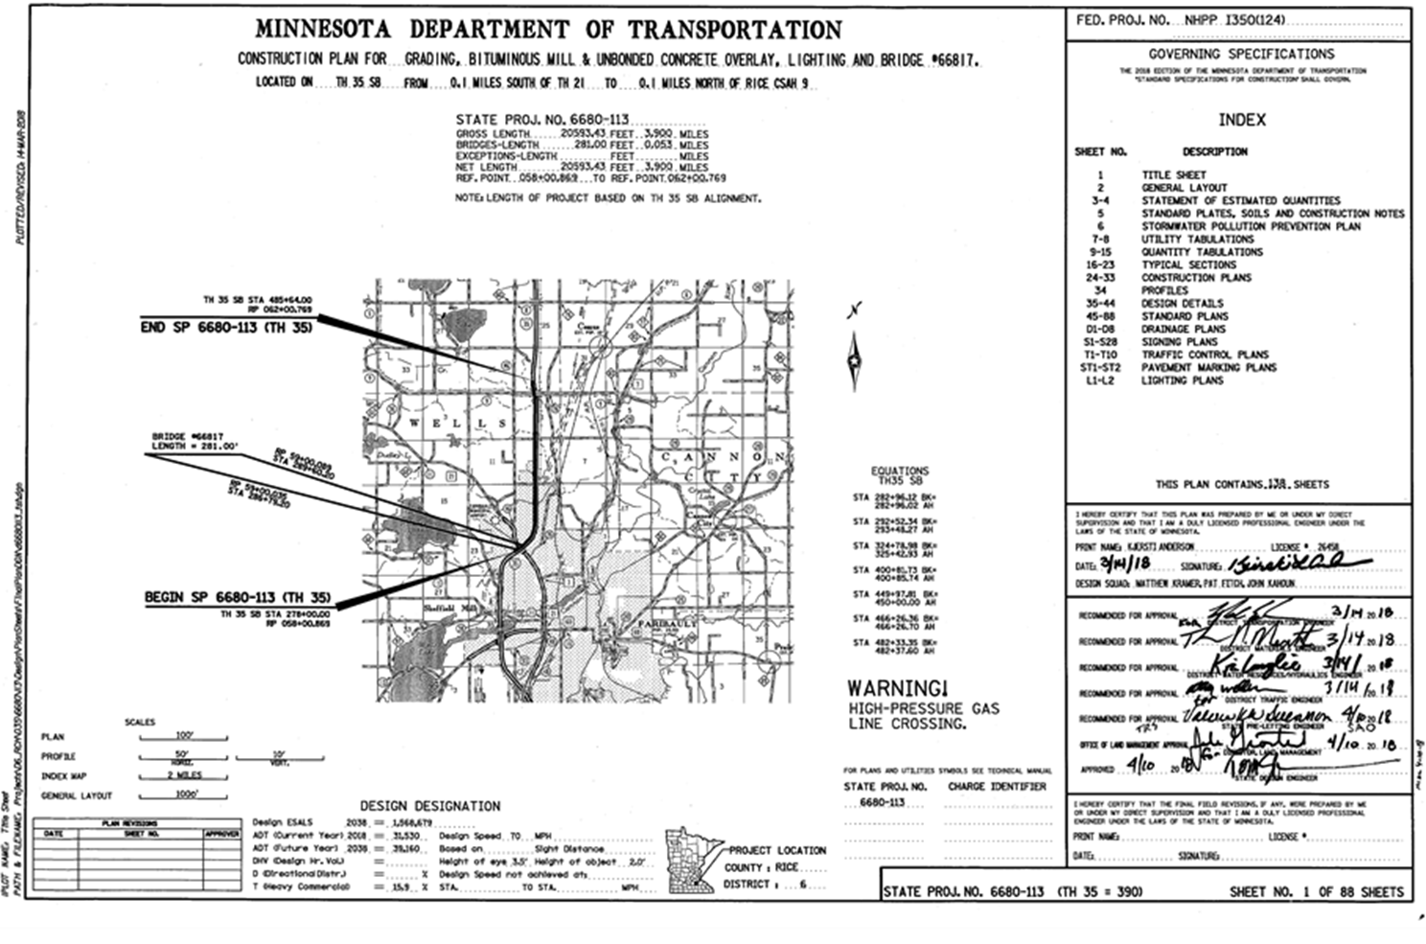
GOVERNING SPECS
This defines the governing specifications for the project and should be the current spec year (fill in the 20XX).
It is located in the top right corner under the federal project number and above the index.

Slide 4
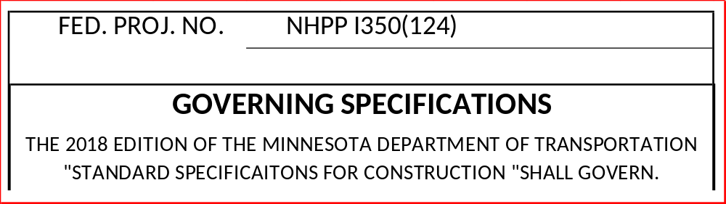

FUNDING
Funding is shown in the top right corner of the plan above the governing specifications.
If Federally funded include the Federal Project Number in the top right corner of the sheet.
If State funded include the words “STATE FUNDS”
If unknown leave it blank and CO Plan Review will add it when it is known.
highli

Slide 5
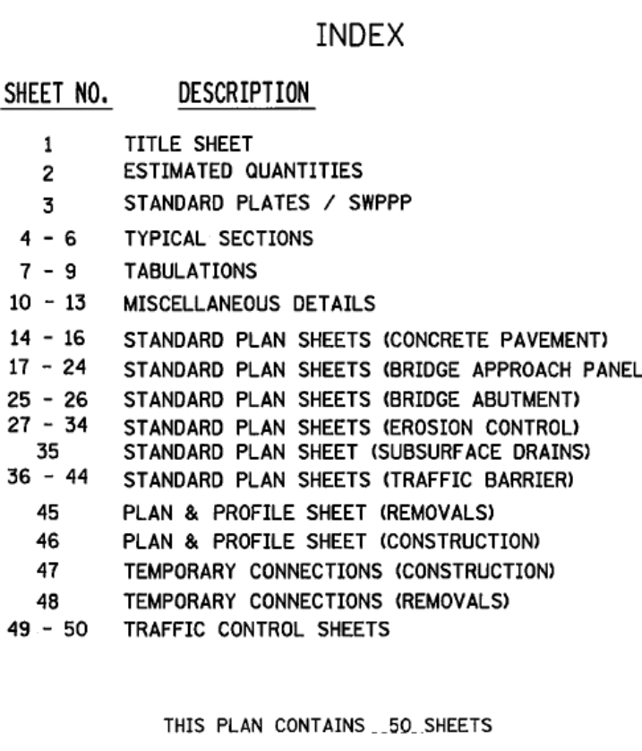
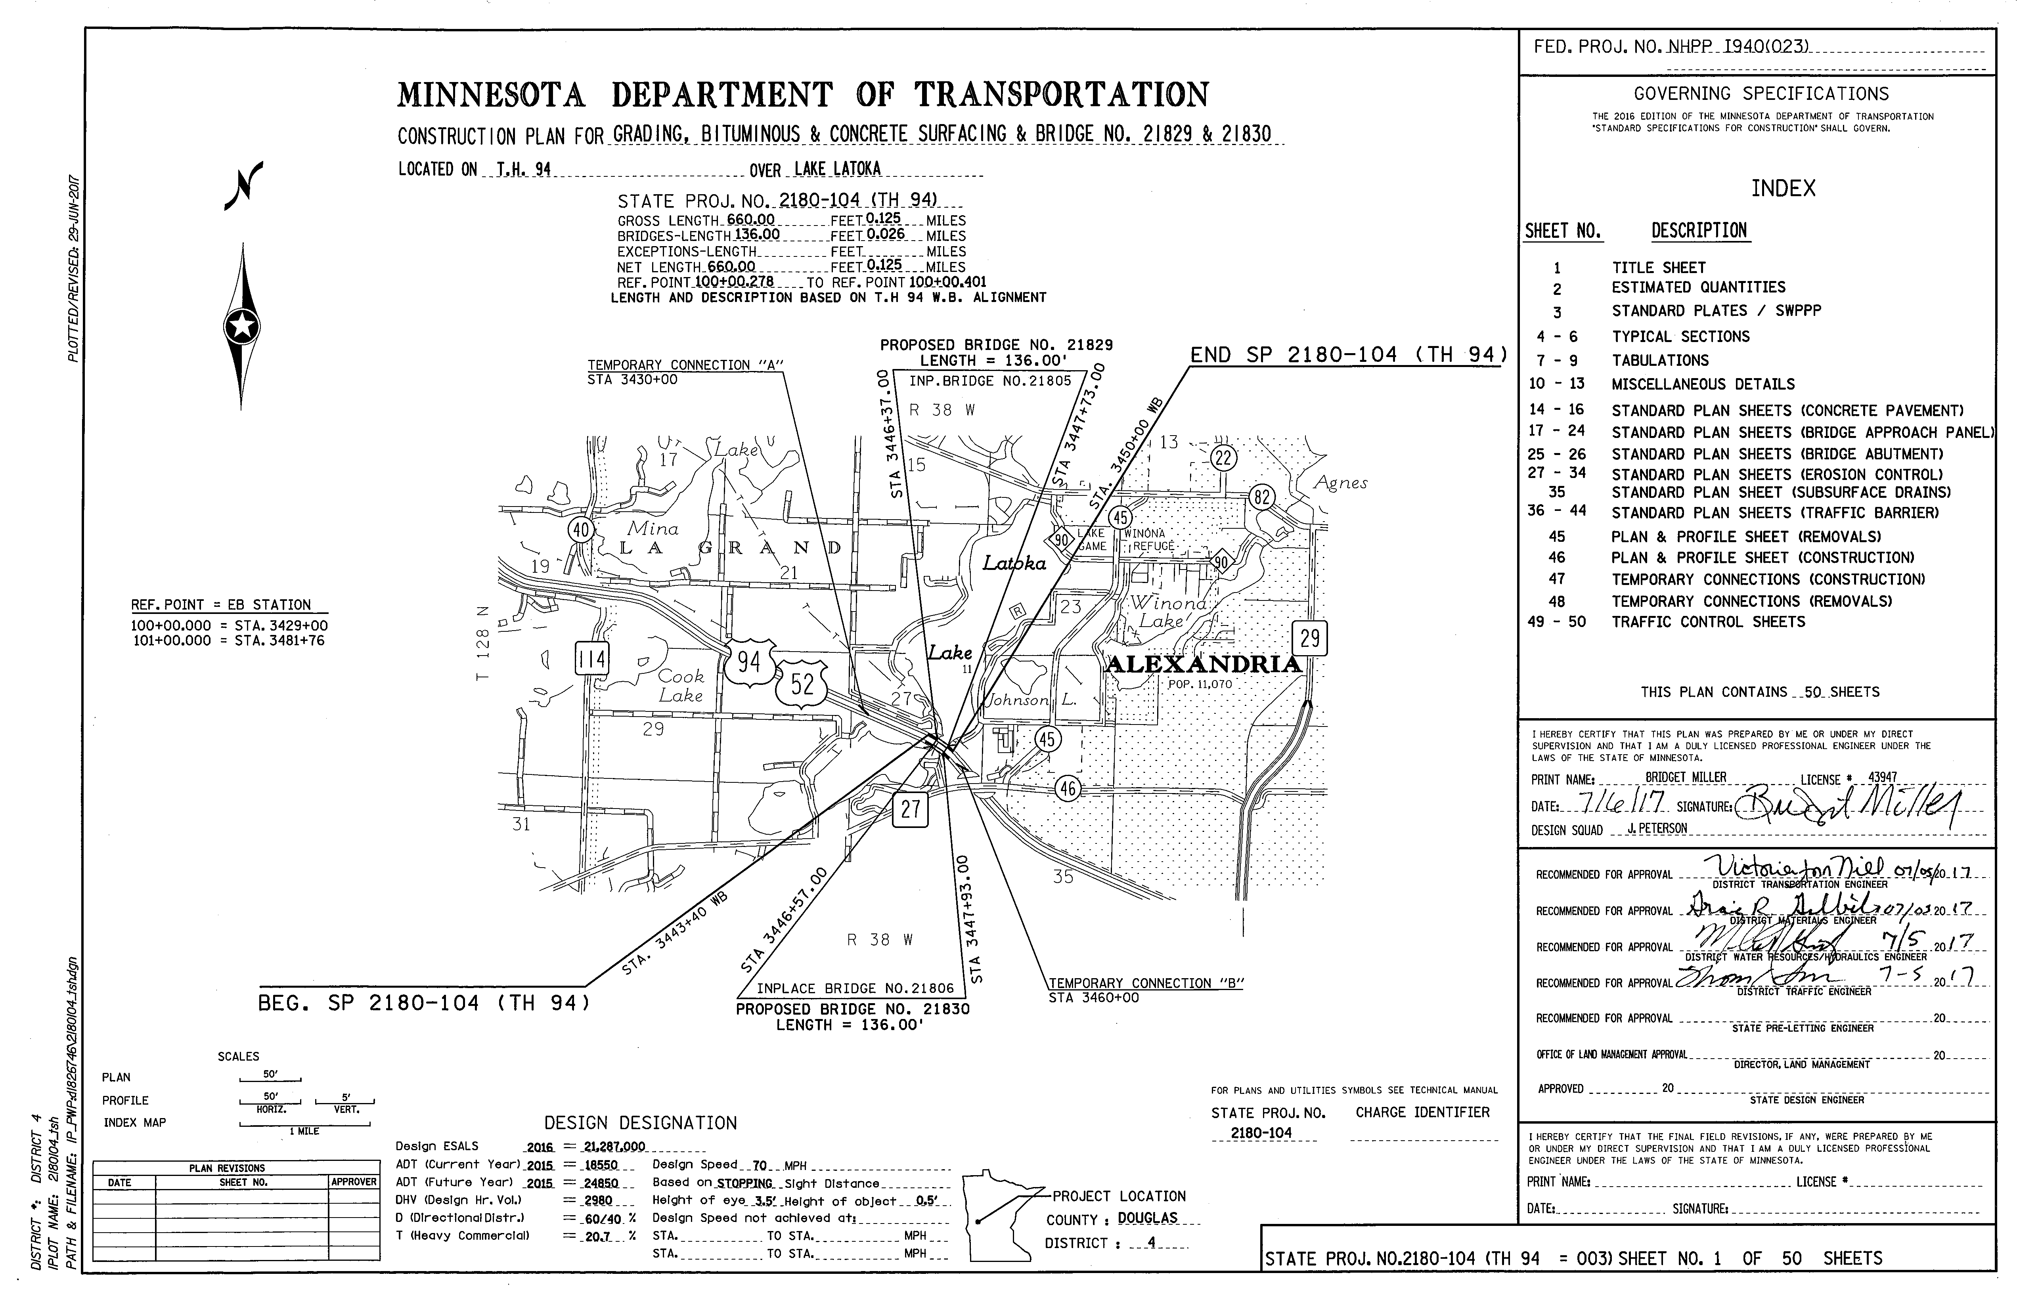
INDEX OF SHEETS
This contains the sheet descriptions for the plan.
Is located below the governing specifications and above the signatures.
Sheet numbers and descriptions match what
is in the plan.
It is preferred that the sheet numbers all be
numbers not lettered sheets if possible.

Slide 6
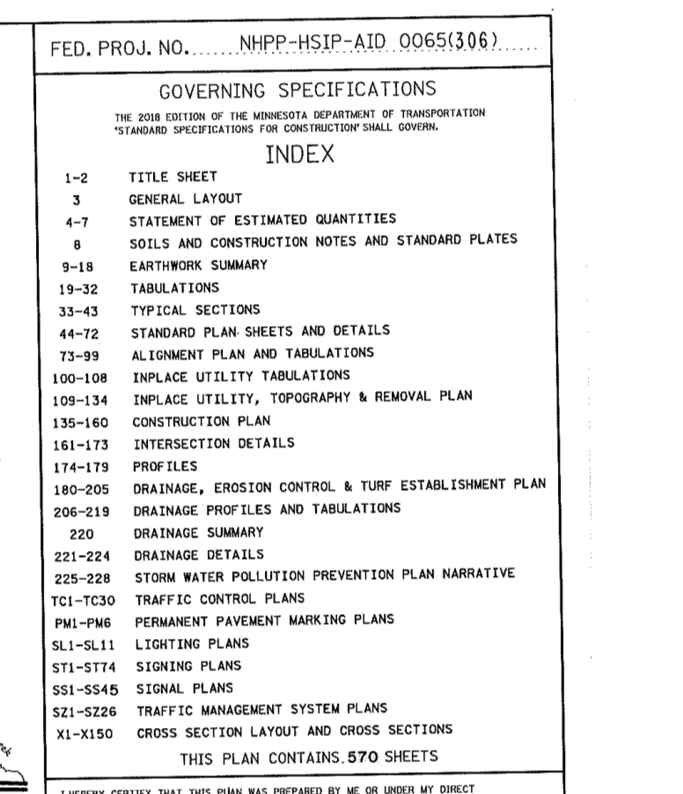
INDEX OF SHEETS
There can be lettered sheets but these must following the number sheets. You cannot mix and match. In other words you CANNOT have sheets 1-50 then PM1-PM5 then back to 51-100.
Typically the following are used if using lettered sheets (they follow the special provision labels)…
TC TRAFFIC CONTROL PLANS
PM PAVEMENT MARKING PLANS
SL LIGHTING PLANS
ST SIGNING PLANS
SS SIGNAL PLANS
SZ TRAFFIC MANAGEMENT SYSTEM PLANS
X or XS CROSS SECTION PLANS

Slide 7
INDEX OF SHEETS
Cross sections come last.
There is a plan sheet total note and it’s phrased as…THIS PLAN CONTAINS XXX SHEETS
bo

Slide 8
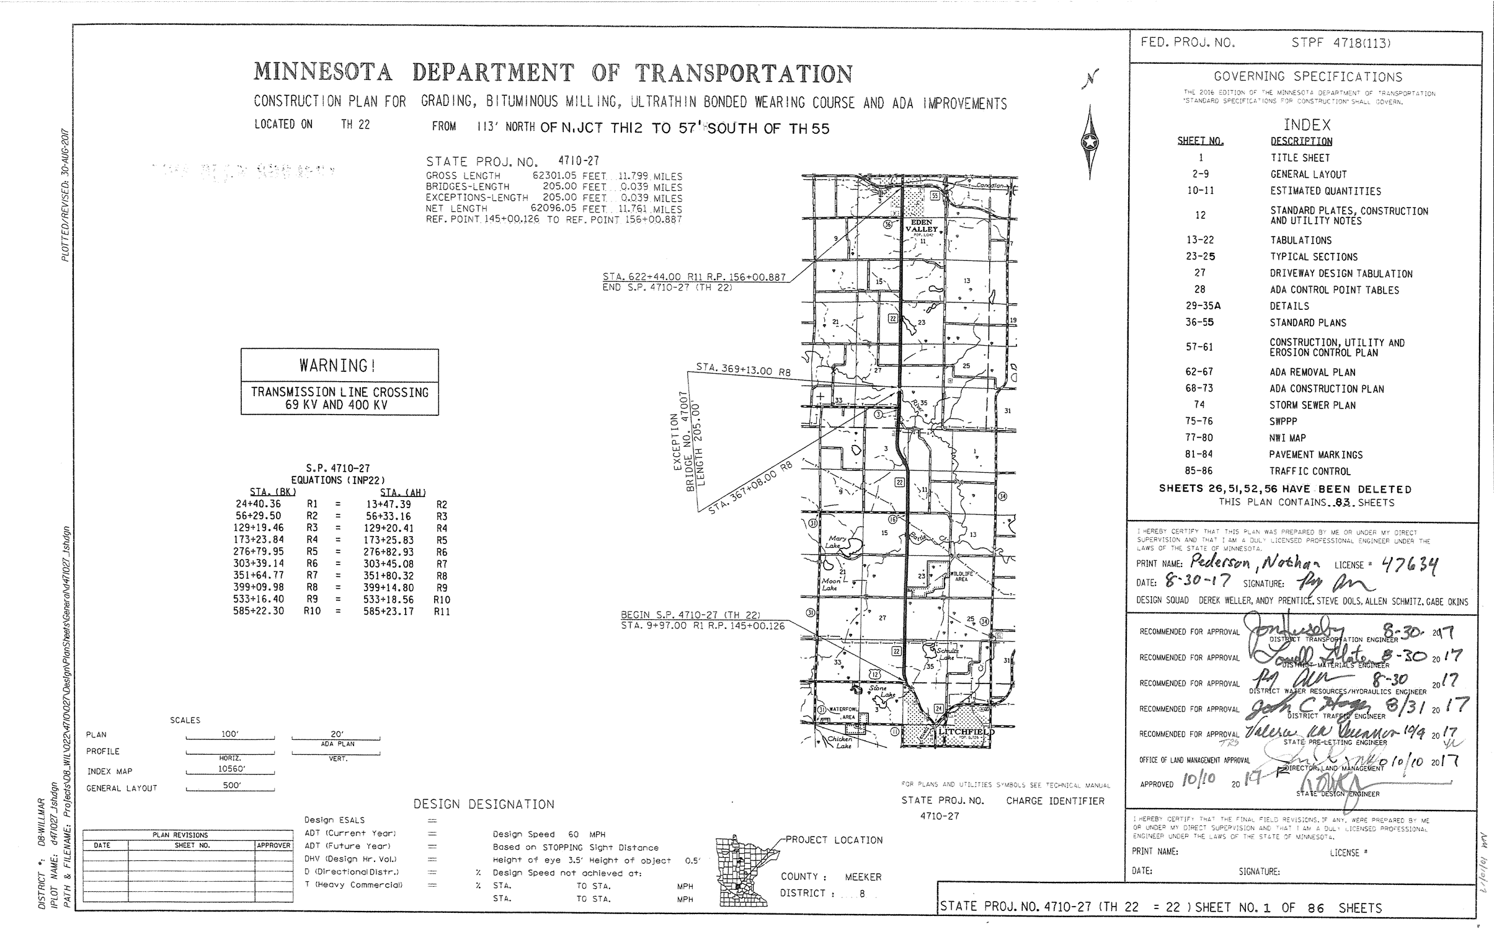
INDEX OF SHEETS
List any deleted sheets.
  The note should read….SHEETS XX HAS BEEN DELETED…or… SHEETS XX, XX HAVE BEEN DELETED.
  The note should be placed after the cross section and before the total quantity note.
  Leave some space between the cross section and total quantity note in case CO has to add the deleted note.
  Make sure to remove the deleted sheet from the total sheet quantity.

Slide 9
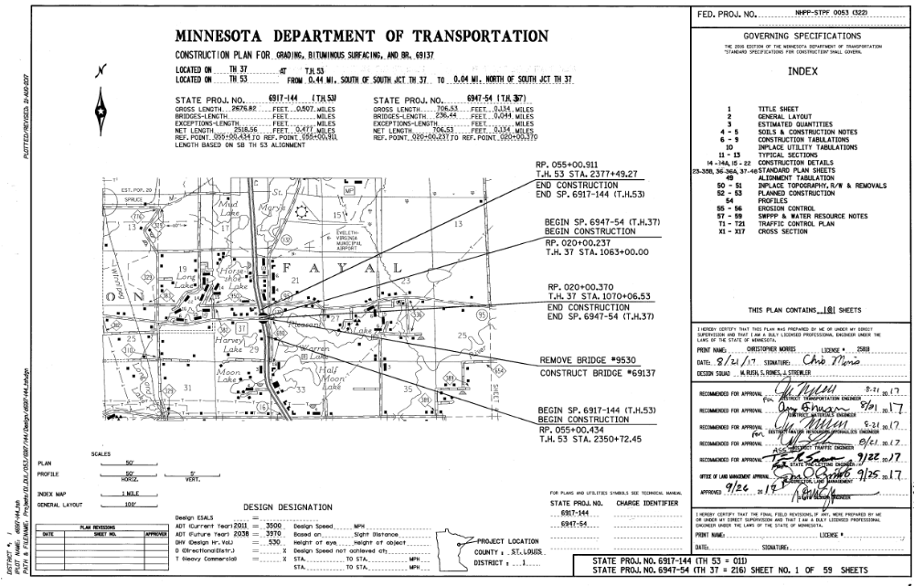
INDEX OF SHEETS
List any added sheets.
  Added sheets should be alpha numbered sheets as we NEVER, EVER renumber a plan after it is submitted to CO for review.
  The plan CAN have added alpha sheets before it is submitted to CO for review.
  It should be shown in the index similar to 23-35B, 36-36A, 37-48.

Slide 10
INDEX OF SHEETS
The last numerical sheet is shown in the bottom right corner of the plan.

Slide 11
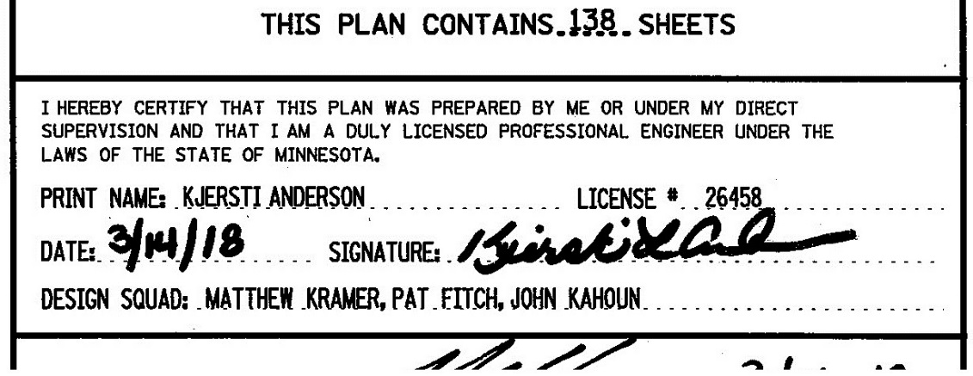
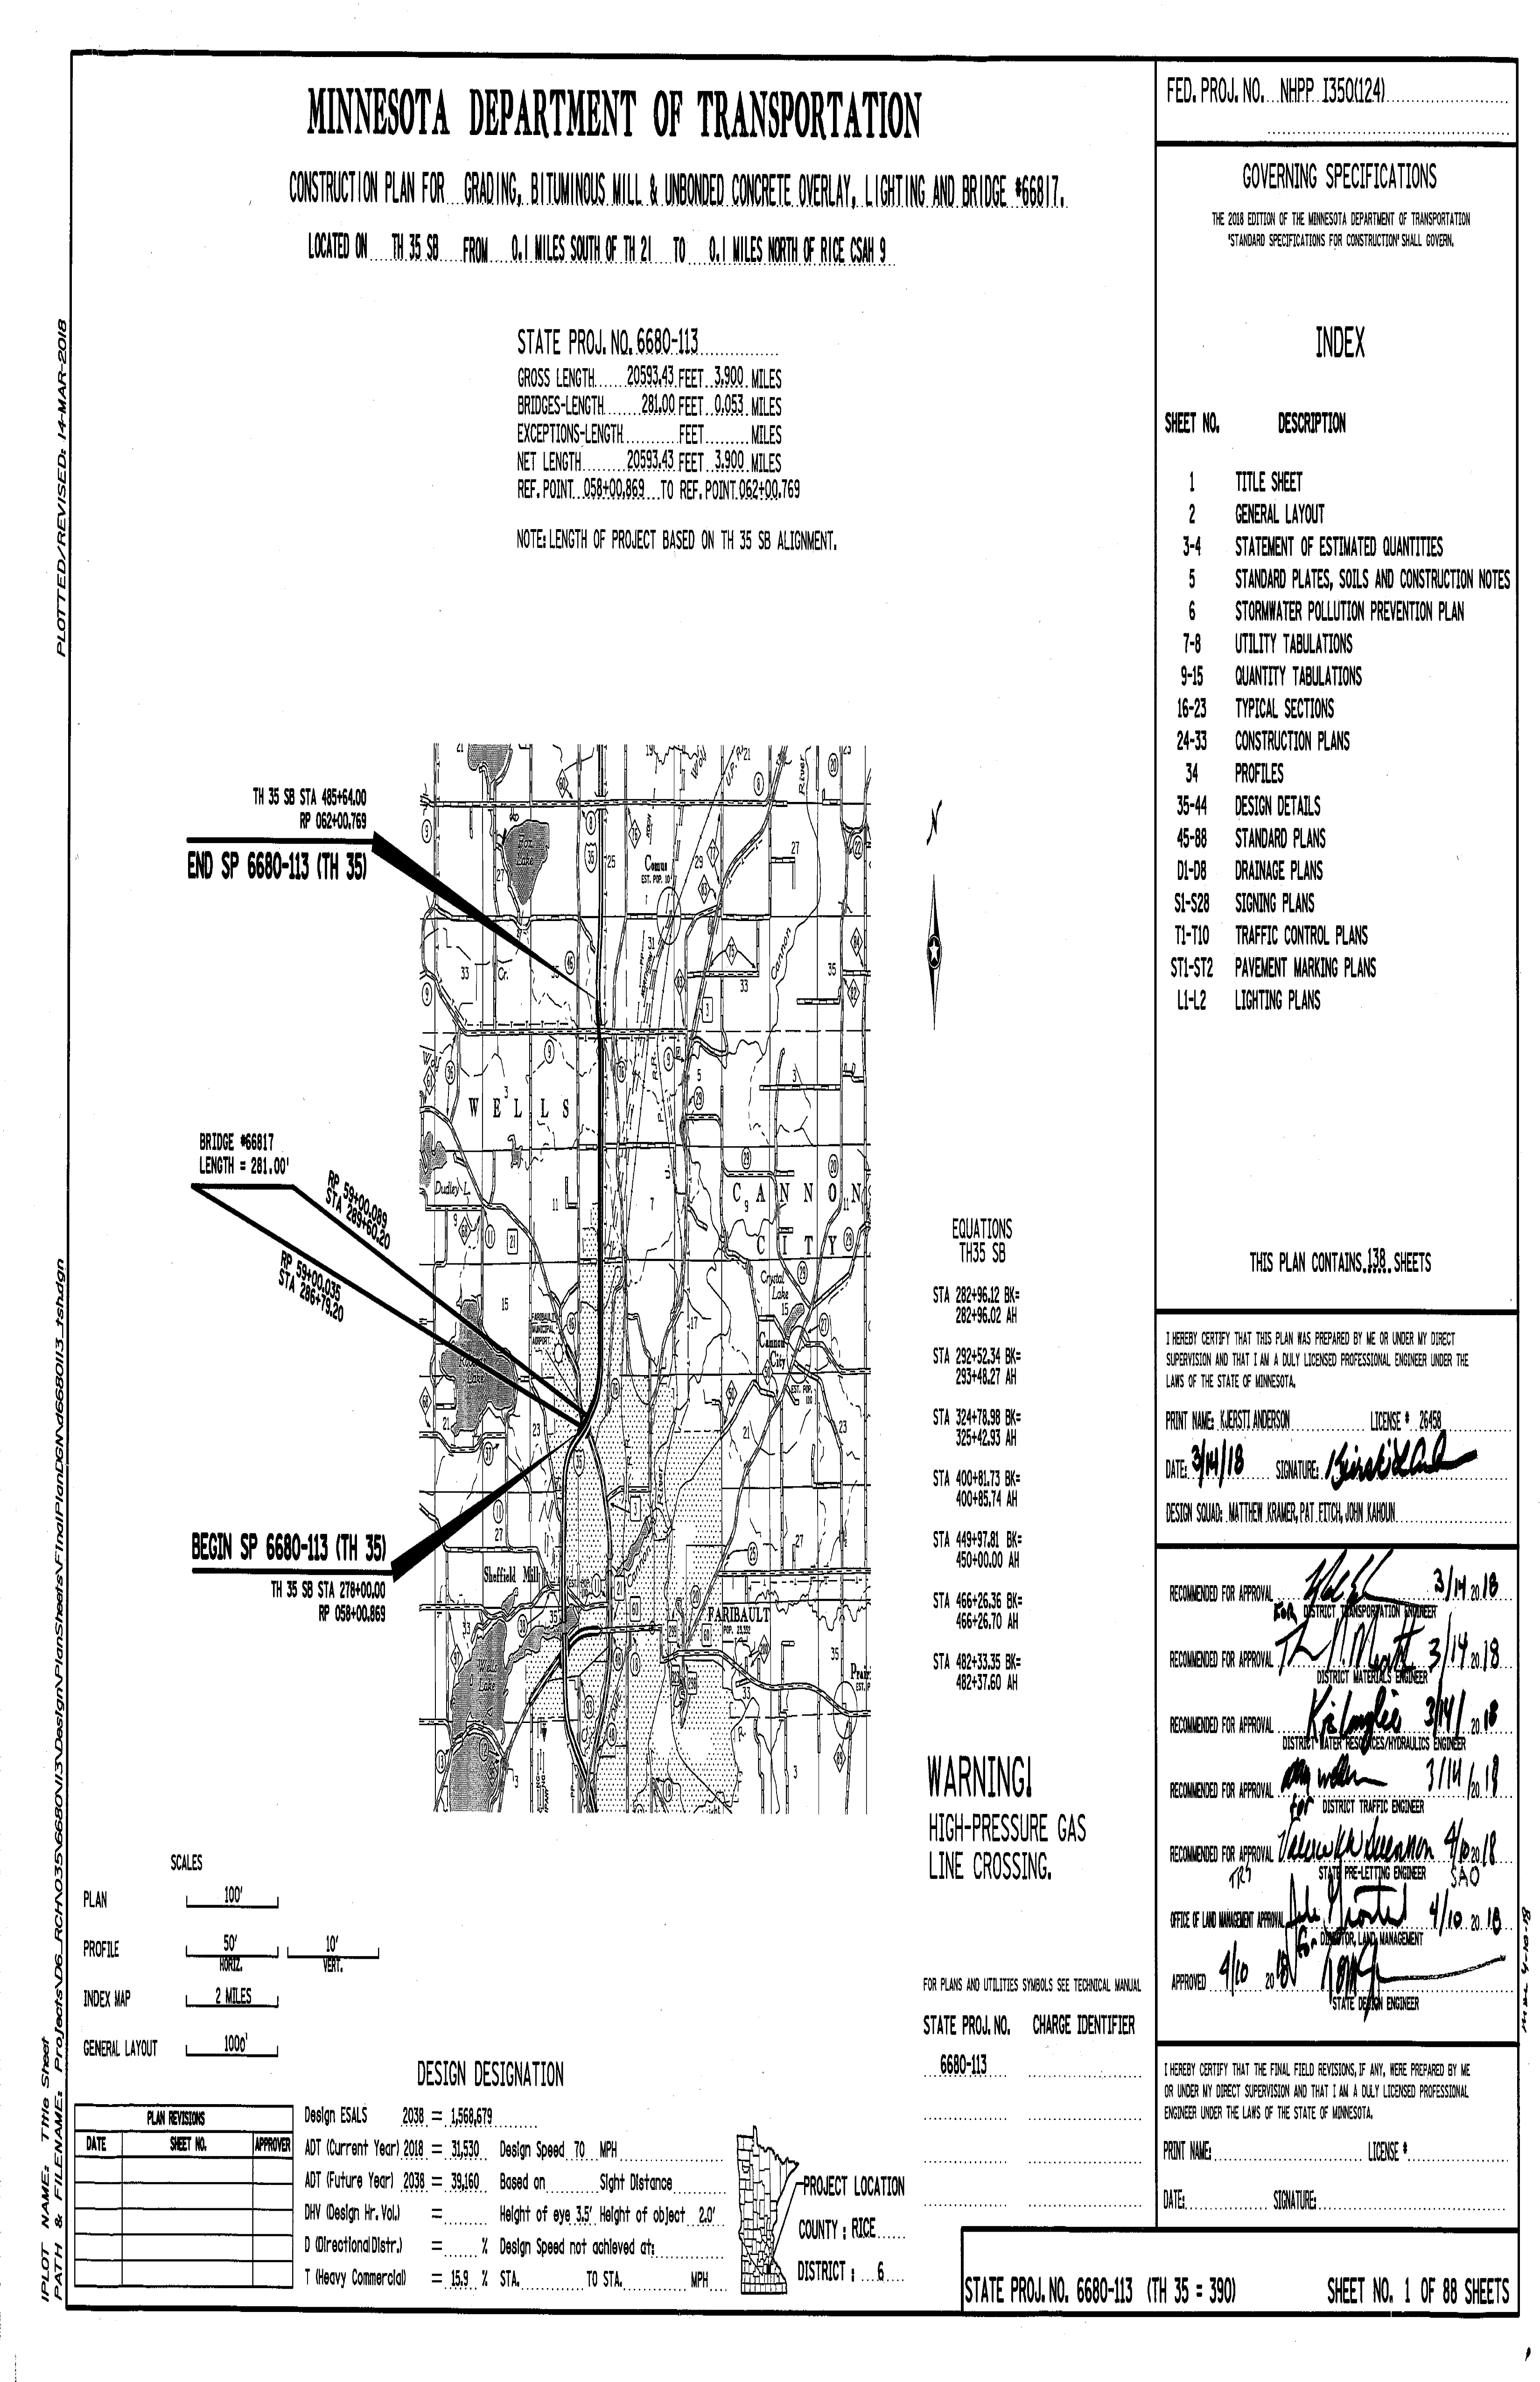
PROJECT ENGINEER SIGNATURE BLOCK
The title sheet should include signature of who developed the plan set (or
under the direct supervision of). This will include the Project Engineers….
Printed name
Signature
License Number
Date
It needs to include the language as required by the board (see above).
This signature block is required on both the process “A” and “B” plans.

Slide 12
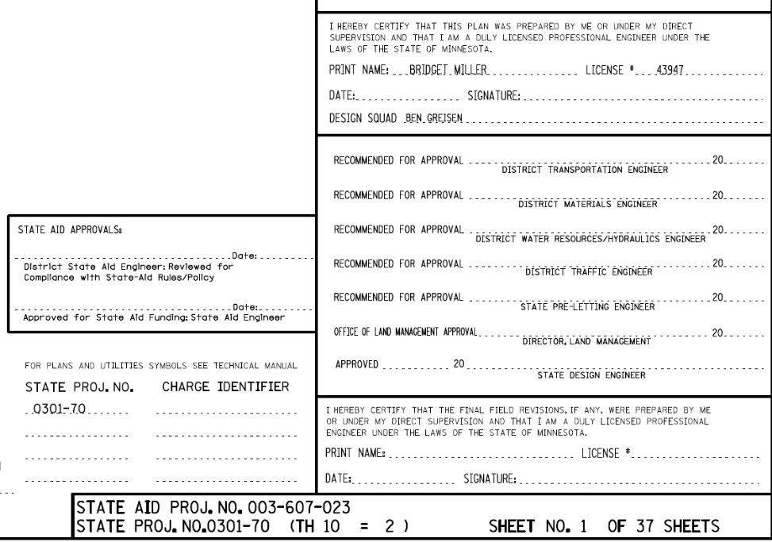
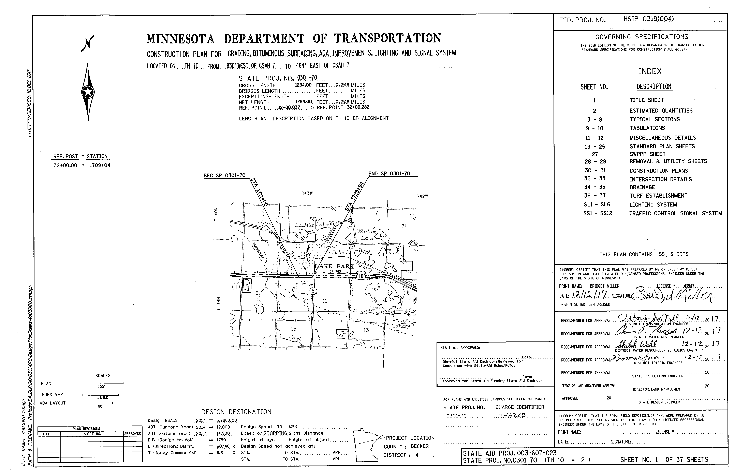
SIGNATURE BLOCK – PROCESS “B”
The signature block is placed below the Project Engineer signature as shown in the previous slide.
District Transportation Engineer
District Engineers of areas that had input in the plan such as…
  District Traffic Engineer
  District Materials Engineer
  District Hydraulics Engineer
  State Aid (usually two signature blocks)

Slide 13
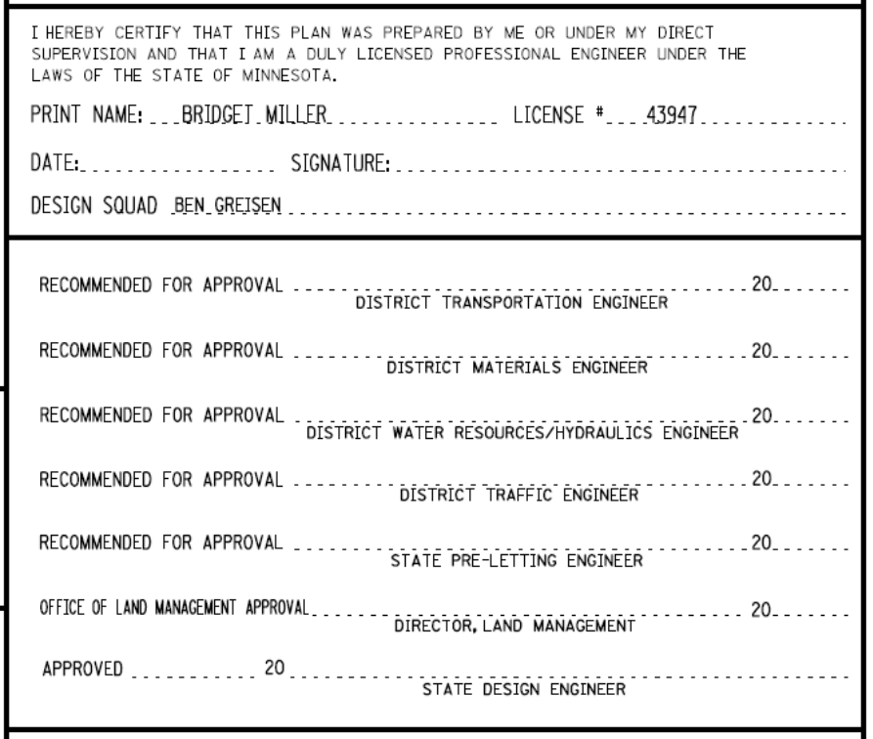
SIGNATURE BLOCK – PROCESS “B”
(Continued)
The following signature blocks will be included at the end and will be left blank for Central Office Signatures...
State Pre-Letting Engineer
Director of Land Management (this leads with…OFFICE OF LAND MANAGEMENT APPROVAL)
State Design Engineer

Slide 14
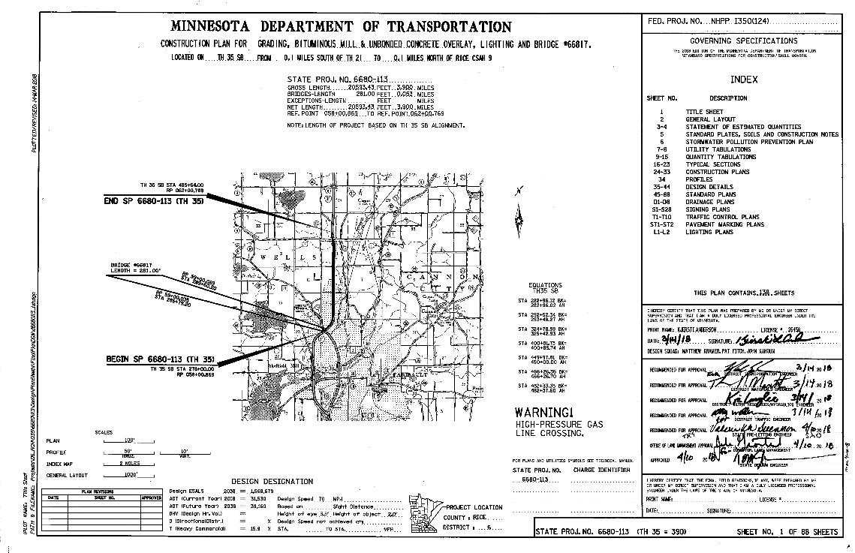
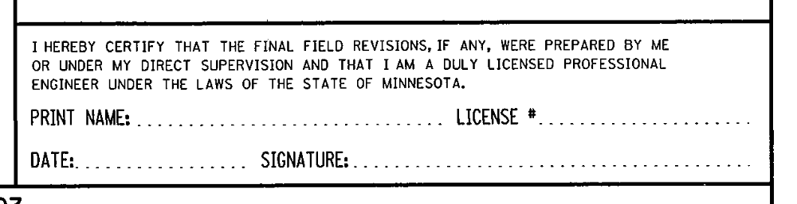
AS BUILT SIGNATURE BLOCK
The AS-BUILT signature block is used on both Process “A” and “B” projects. It is left blank to be filled out by construction and includes a line for…
Printed name
Signature
Date
License Number
Placed at the bottom of the sheet, usually under the State Design Engineer
Notice the language states “…CERTIFY THAT THE FINAL FIELD REVISIONS…”

Slide 15
CONSTRUCTION PLAN FOR…
This is a description of all the major types of work for the project. Such as….
Grading
Alternate Bituminous or Concrete surfacing
Bituminous and/or Concrete surfacing
Mill, Overlay, Surfacing, CPR, Reclamation
Lighting, Signals, TMS, RWIS
Walls
ADA Improvements
Bridges, Box Culverts

Slide 16
CONSTRUCTION PLAN FOR…
(Continued)
It does NOT include….
Drainage
Signing
Striping
Sidewalks
Culvert Repairs
Guardrail
Rumble Strips/StripEs
Erosion Control
Landscaping
Unless these are the ONLY types of work being done on the plan.

Slide 17
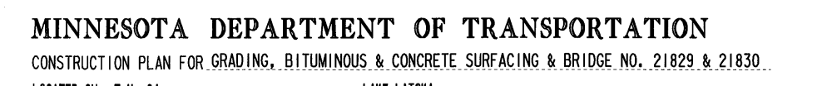
CONSTRUCTION PLAN FOR…
(Continued)
It is located at the top center of the title sheet.
Grading is listed first (if applicable)
Bridges are listed last (if applicable)

Slide 18
LOCATED ON….
The description of the project location should reflect the beginning and ending location of the project.
This should include…
  The TH number,
  A cross road or water feature name of where the project begins and where the project ends.
If there is more than one TH then more than one line of information should be included.
It should NOT use reference points, bridge numbers, or city limits as location descriptions.
The location it references should be shown and readable on the index map.
Do NOT include City/County names as they should be shown in the index map instead.

Slide 19
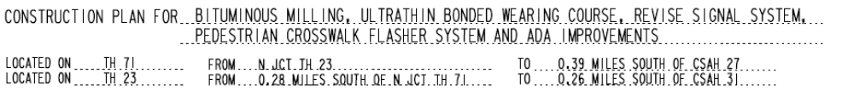
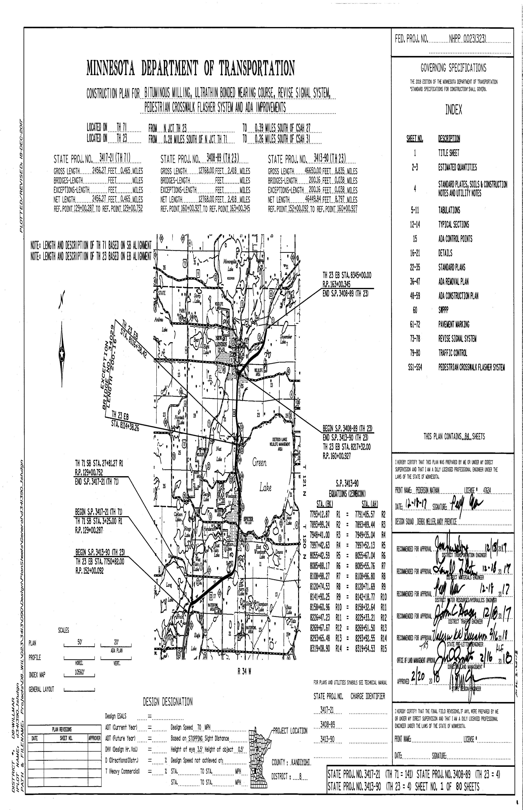
LOCATED ON….
(Continued)
LOCATED ON is located just below the CONSTRUCTION PLAN FOR line and above the length blocks.
JCT should NOT be used for intersections, it is only used if it is an EWNS junction as in a shared/split roadway.

Slide 20
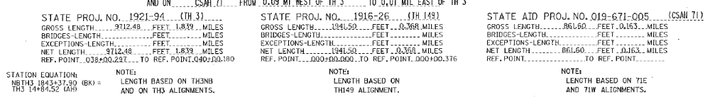
LENGTH BLOCKS
Each plan should contain a length block for each SP number.
It should be centered below the LOCATED ON line and above the index map.

Slide 21
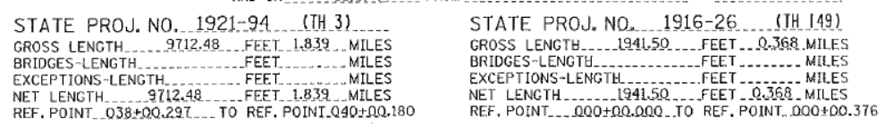
LENGTH BLOCKS
(Continued)
The length block should include the SP number and if more than one roadway applies then the TH should also be listed with the SP in parenthesis.

Slide 22
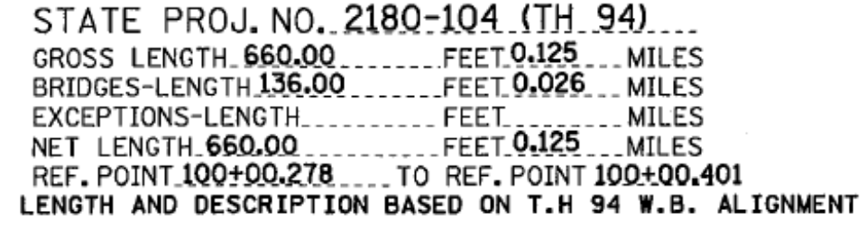
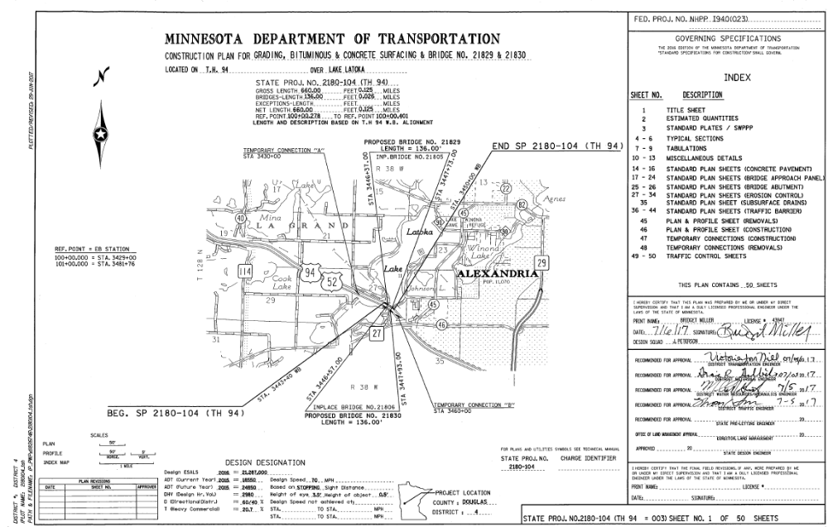
LENGTH BLOCKS
(Continued)
If the roadway is divided it should include a note below the length block which states…THE PROJECT LENGTH AND DESCRIPTION IS BASED ON XX ROADWAY ALIGNMENT.
Do NOT add this note if the roadway is NOT divided.

Slide 23
LENGTH BLOCKS
(Continued)
The length block should also include all bridge lengths on the project. This does NOT include culverts.
In the length block the bridge length are only the bridges that are on the alignment that the length and description is based on. For example if the length and description is based on the WB alignment then only the WB bridges should be included in the length block, not the EB bridges.

Slide 24
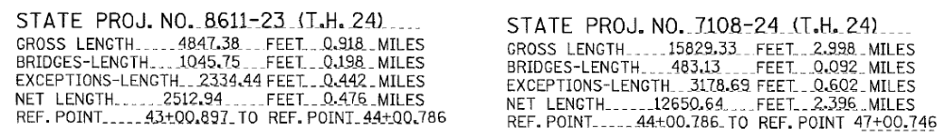
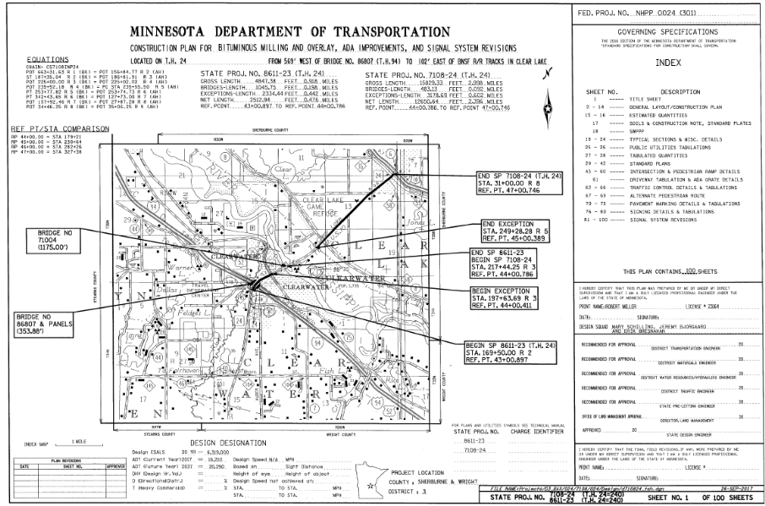
LENGTH BLOCKS
(Continued)
The length block should also include…
The exception length, if any. If a bridge is an exception then it should be included in both the bridge length AND the exception length.
The net length should be the difference between the gross length and the exception length.

Slide 25
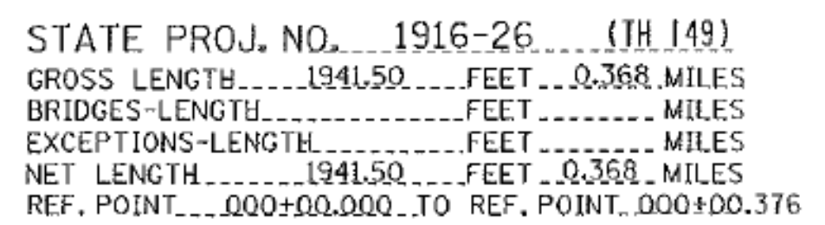
LENGTH BLOCKS
(Continued)
Do NOT put zero’s or NA in the length block but rather leave them blank if they don’t apply.
The FEET length should be one less decimal place than the MILES length.
The beginning and ending reference points also need to be included at the end of the length block and need to follow the reference point format (e.g. XXX+XX.XXX).

Slide 26
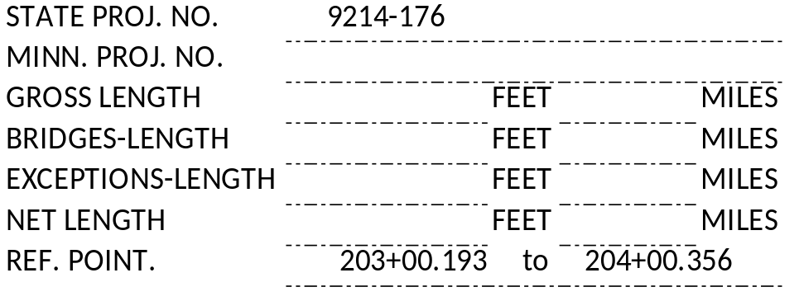
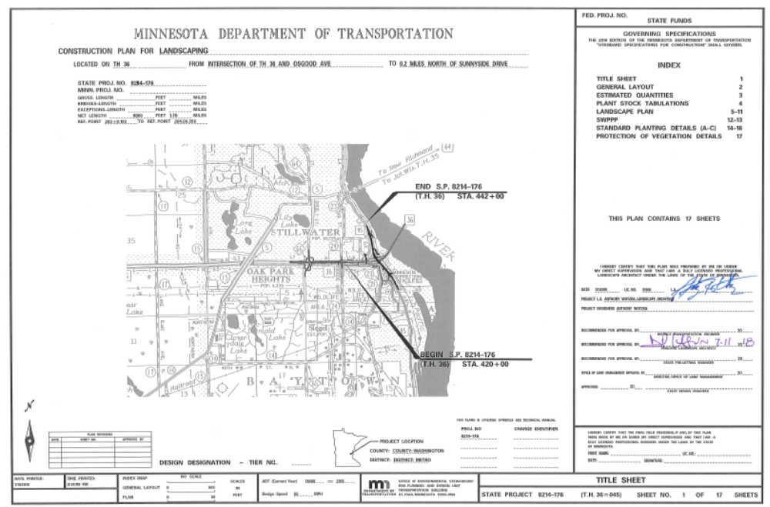
LENGTH BLOCKS
(Continued)
In some cases a stand alone project does not run along a continuous line but rather is sporadic as in a landscaping, signals, lighting, signing, traffic management system and traffic control plans.
These plans may NOT require a length block to be filled in with lengths. But at a minimum the length block should contain the begin and end reference points.

Slide 27
INDEX MAP
This is used to identify the location of the project(s).
It is centered on the title sheet below the length blocks and to the left of the index/signatures.
Judgment should be exercised regarding the project map size. In many cases the maps are too small in scale, while on others, too much area not related to the project is shown. By limiting the project map to the project itself and adjacent area, larger scale maps can often be utilized.

Slide 28
INDEX MAP
(Continued)
The Index Map should be a highlight of where the project is.
It is typically located in the center of the title sheet.
The main roadways and nearby cities should be a sufficient font to be readable.
On rare occasions there may be more than one map shown.

Slide 29
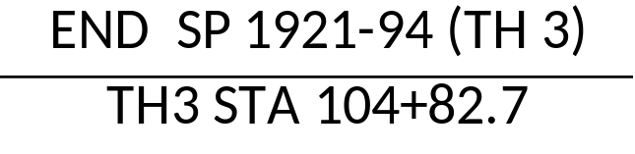
INDEX MAP
(Continued)
The Index Map should label all SP#s, with Beginning/Ending stationings
Pay attention to what side of the leader line you place the begin/end on. See the design scene chapter 1 for more information.

Slide 30
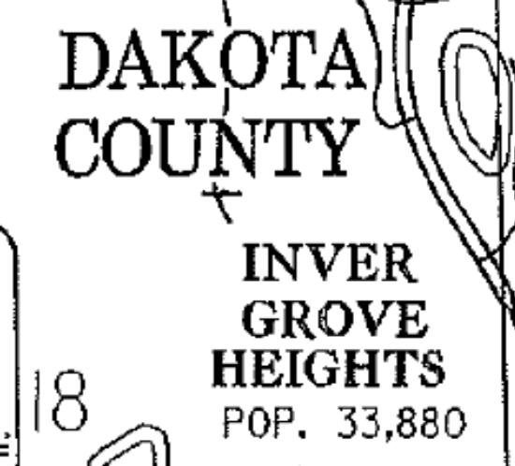
INDEX MAP
(Continued)
The Index Map should label all Major Cities and Counties.

Slide 31
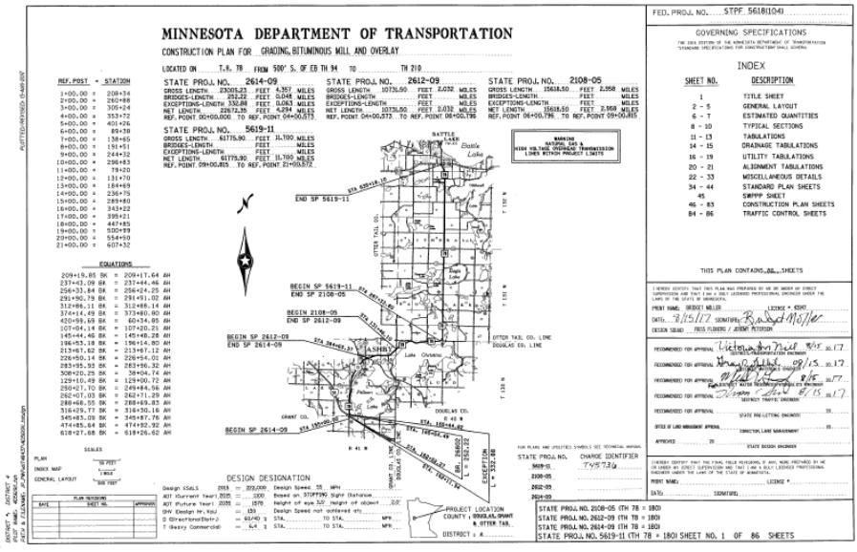
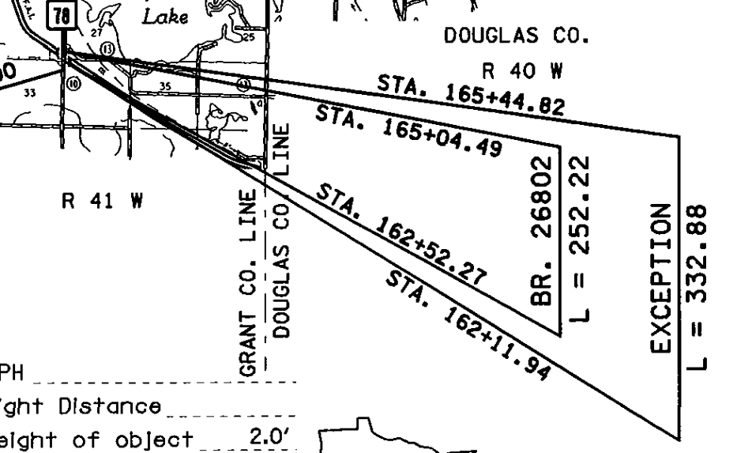
INDEX MAP
(Continued)
The Index Map should label all exceptions.

Slide 32
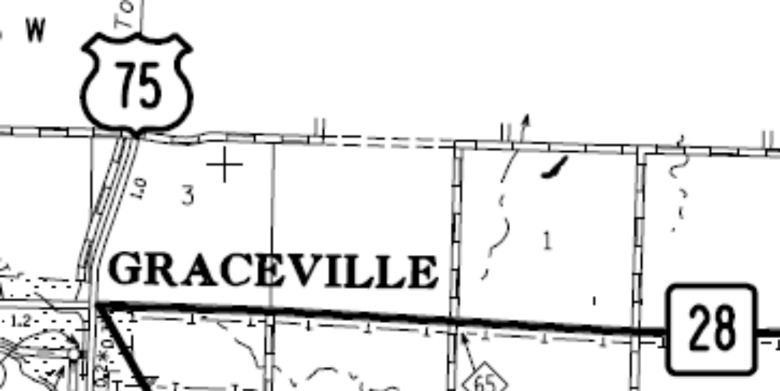
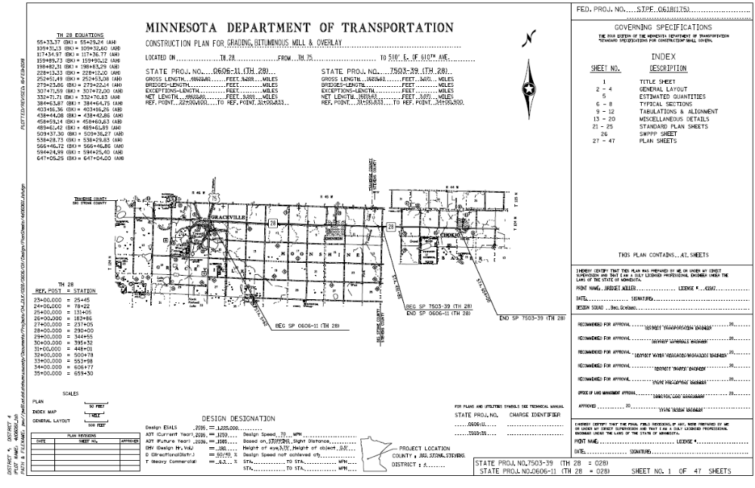
INDEX MAP
(Continued)
The Index Map should label all major roadways.

Slide 33
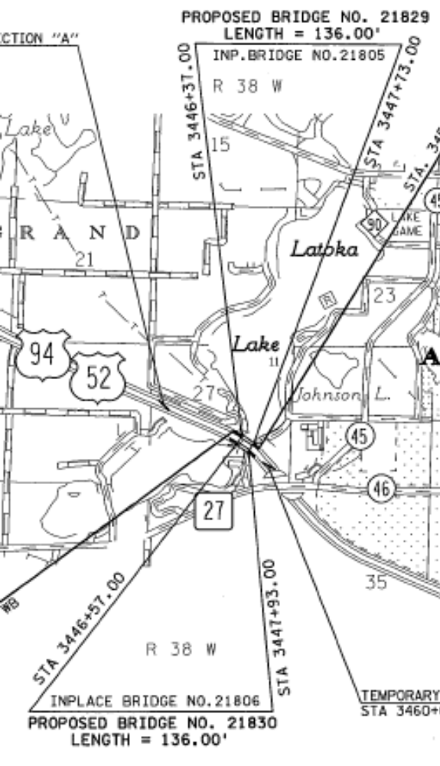
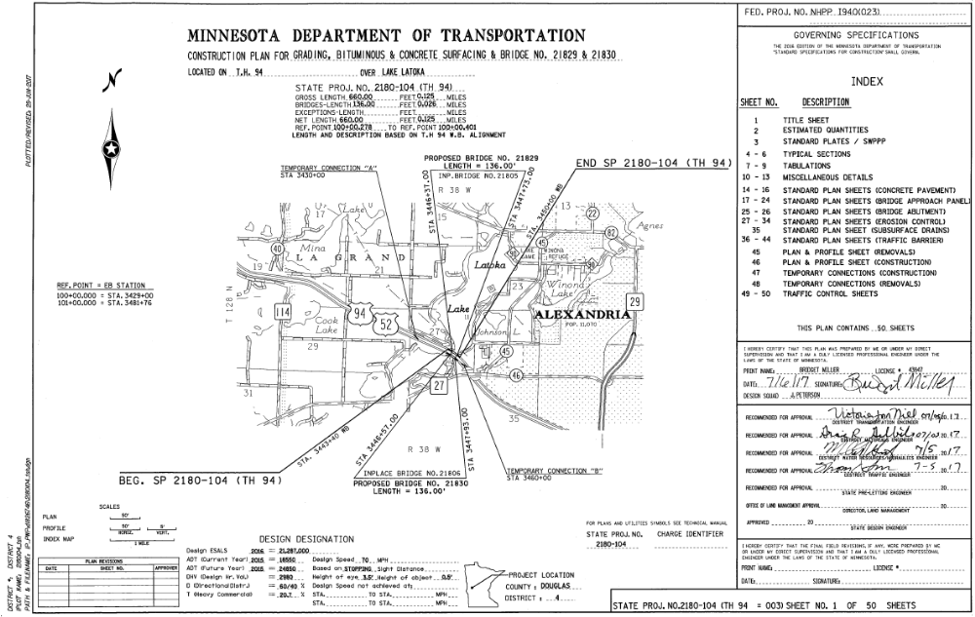
INDEX MAP
(Continued)
The Index Map should label all Bridges.

Slide 34

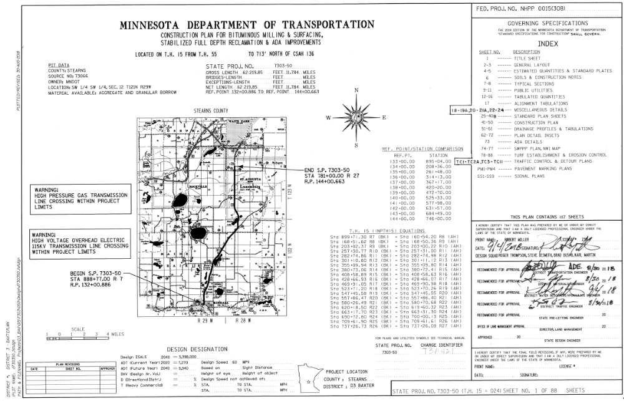
INDEX MAP
(Continued)
The Index Map should include a north arrow.

Slide 35
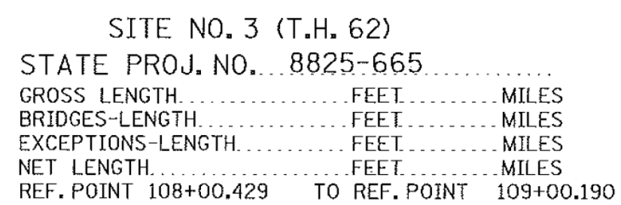
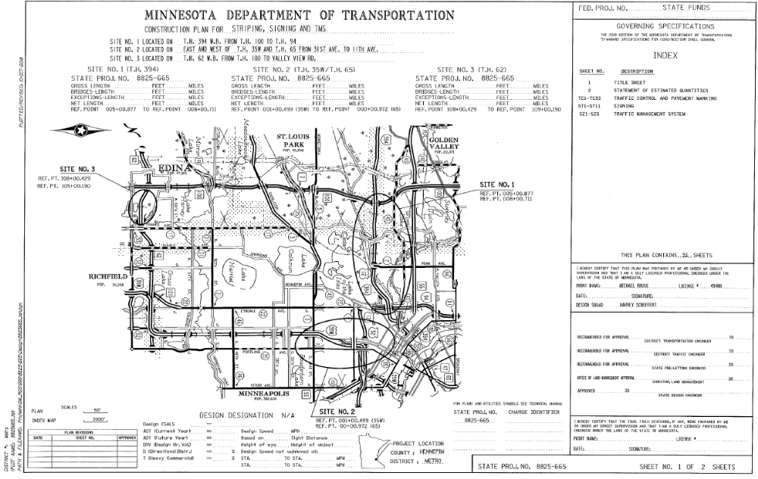
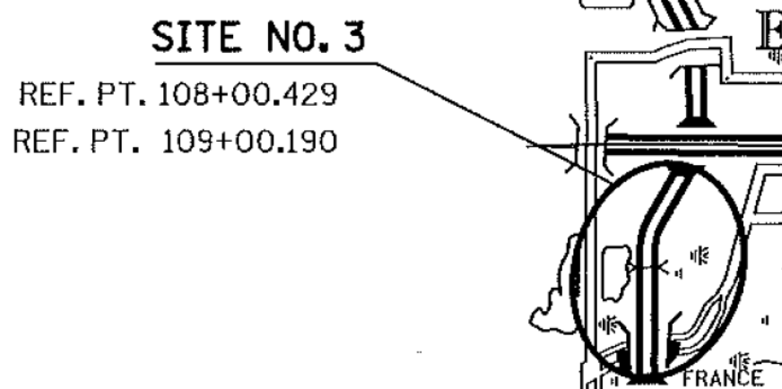
INDEX MAP –
SPORADIC SPOT LOCATIONS
These are typically signing, lighting, signal, and/or culvert repair projects.
Label each location where work
is being performed. Include the
reference point
Label major roadways
Label major Cities
Include a north arrow

Slide 36
EXCEPTIONS
A project typically runs from point A to point B along a specified alignment. Sometimes there are gaps where no work is being done. These gaps are typically considered an EXCEPTION if they are over 50 feet long. For example there is a 2 mile long overlay section but there is a 500 foot section where no work is being done. If in the 500 foot gap there is only…
Striping then it is NOT considered an exception.
Signing then it IS considered an exception.
Culvert then it is NOT considered an exception.
Guardrail then it is NOT considered an exception.
Exception limits should be shown in the plan, as a minimum, on the index map, general layout, and construction plan views.

Slide 37
EXCEPTIONS
(Continued)
A bridge is NOT an exception if there are bridge sheets either in the plan or submitted separately to be advertised with the plan. This typically requires a bridge sub-contractor to perform the work.
When there is work on the bridge such as guardrail or striping only, the bridge would be considered an exception as it does do not require a bridge contractor to perform this work.
When the work is primarily off the roadway such as high tension cable, signing, snow fence, landscaping, etc. and it skips the bridge. The bridge would NOT be shown as an exception.
A box culvert is not considered a bridge when it comes to the length block and/or exceptions.

Slide 38
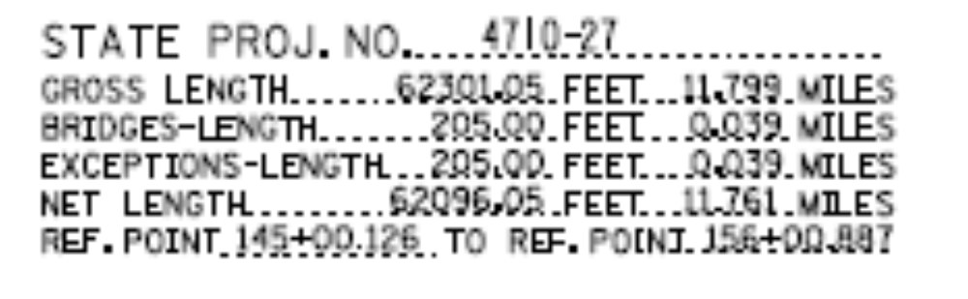
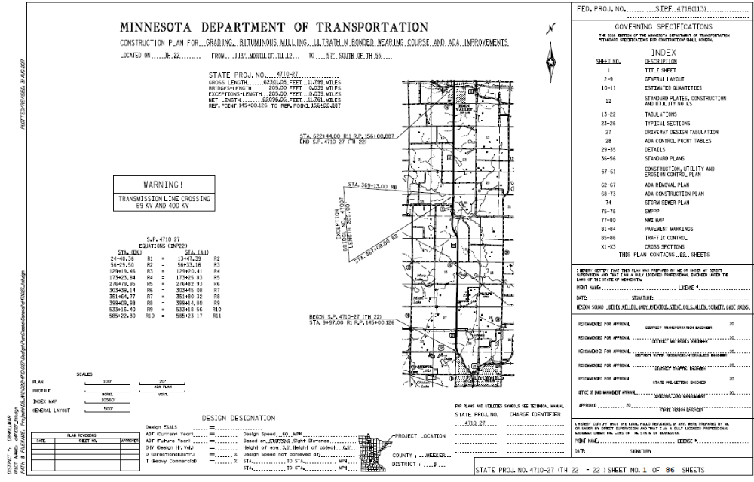
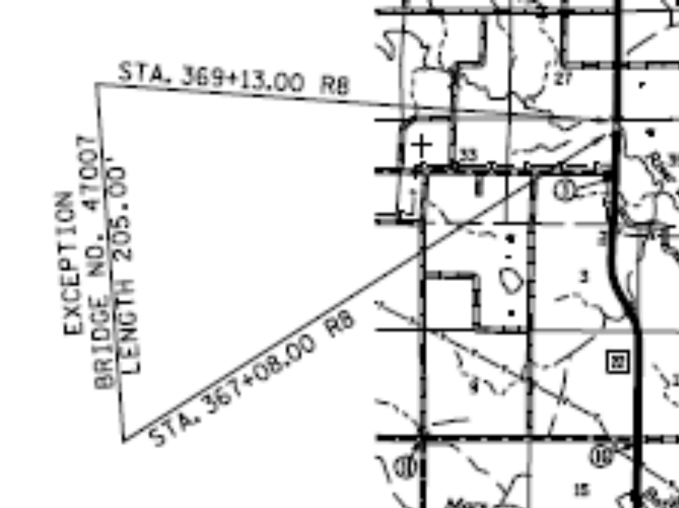
EXCEPTIONS
(Continued)
The exception should be shown in both the length block and the index map.
37

Slide 39
EXCEPTIONS
(Continued)
Sometimes a stand alone project does not run along a continuous line but rather is sporadic as in a signal or culvert project. In these cases no length is stated in the length block, and no exceptions are listed. Rather the index map will show each location with a reference point.

Slide 40
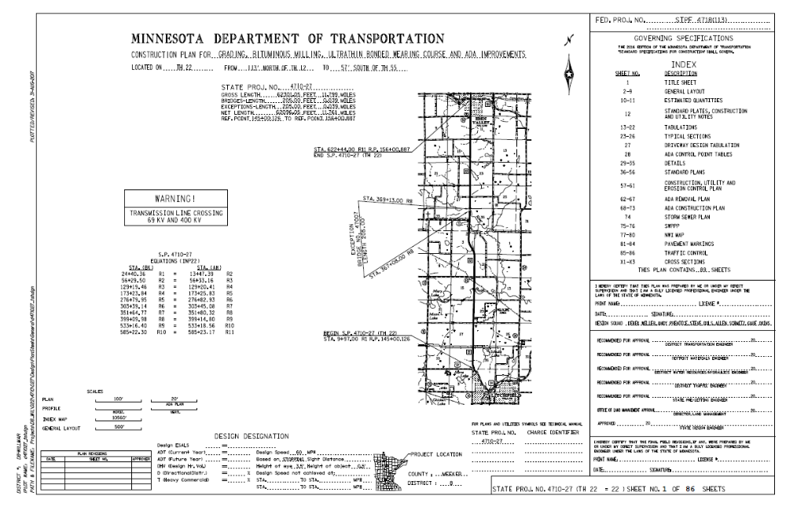
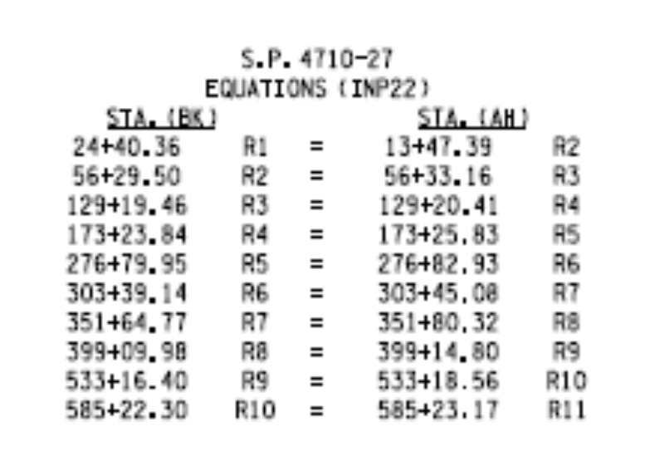
EQUATIONS
The equations that pertain to the project limits should be included on the title sheet. The back equation is always listed before the ahead equation as it pertains to the previous section (left).

Slide 41
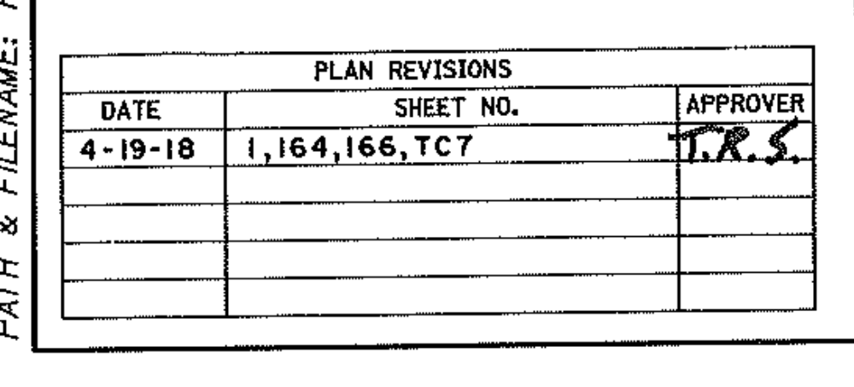
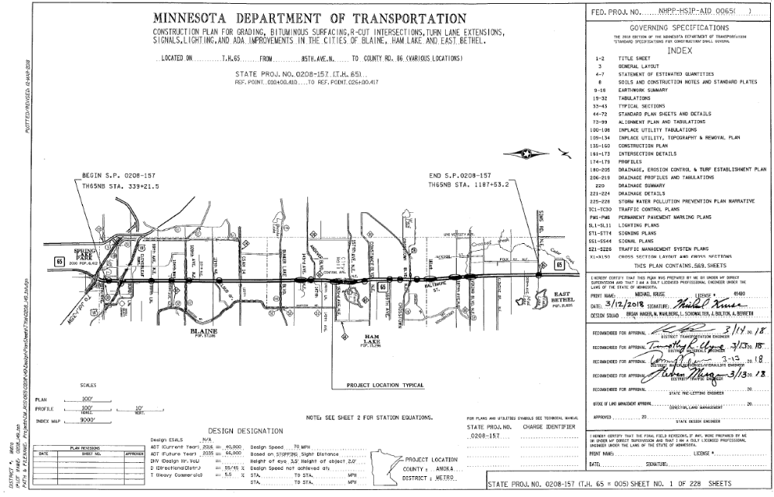
REVISION BLOCK
The revision block is used when sheets are revised after the plan is signed.
It is typically located in the bottom left corner of the title sheet.
Make sure you leave the left column large enough to enter a full date.

Slide 42
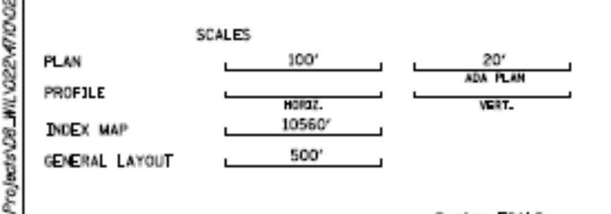

SCALES
The scale is sometimes used for the various plan sheets.
It is typically located in the bottom left corner of the title sheet.
Make sure it includes units (e.g. feet, miles, etc.)

Slide 43

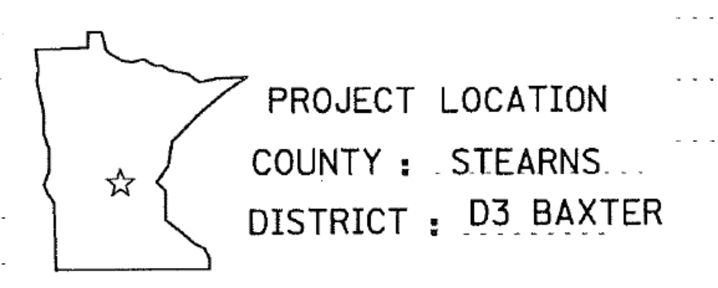
MINI MINNESOTA
The Mini Minnesota shows the
Approximate location of the project
All counties where the project is located. Cannot state “various counties”, must list them all.
The District where the project is located
It is typically located at the bottom portion of the title sheet.

Slide 44
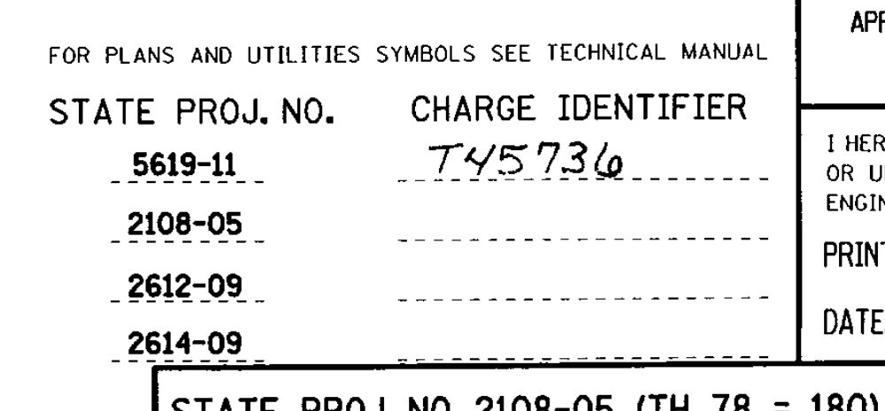

CHARGE IDENTIFIER
The charge identifier is the number that the project design work is charged to on timesheets.
It is located at the bottom portion of the title sheet between the mini Minnesota and the signatures.
It is written in pencil as it is erased before the plan goes out for bids.

Slide 45
PROJECT NUMBERS
The title sheet should include ALL the project numbers in the plan.
Show the project number along with T.H. number, followed by the primary statutory route number, (T.H. 94=392) This should be shown for all SP’s even if the TH and Legislative numbers are the same.
Sometimes there are multiple Legislative Routes on the same roadway. These can change over the course of a route and over time. When in doubt use the statutory route number that represents the greatest extent of the highway route or the lower number.
When there are multiple project numbers the PRIME SP number should be shown on the bottom.
Make sure to also include all State Aid project numbers.

Slide 46

PROJECT NUMBERS
The project number(s) should be shown in the bottom right corner of the plan sheet.

Slide 47
SHEET NUMBERS
The number should be shown in the bottom right corner of the plan sheet.
The last numerical sheet is shown in the bottom right corner of the plan.

Slide 48


WARNING LABELS
If there is a petroleum or high-pressure gas line in the vicinity of the project, include a warning note on the title sheet of the plan. (e.g. WARNING! PETROLEUM PIPELINE CROSSING). Contact the CO utility office for exact wordage.
The note is usually bold, larger font, and/or double outlined to draw attention to it.

Slide 49
QUESTIONS????
Any questions contact us ANYTIME:
Tim Swanson, P.E. @ 651-366-4689
  tim.swanson@state.mn.us
Yvonne Crocker, P.E. @ 651-366-4610
  yvonne.crocker@state.mn.us
Jane Krebsbach@ 651-366-3183
jane.krebsbach@state.mn.us

