Slide 1
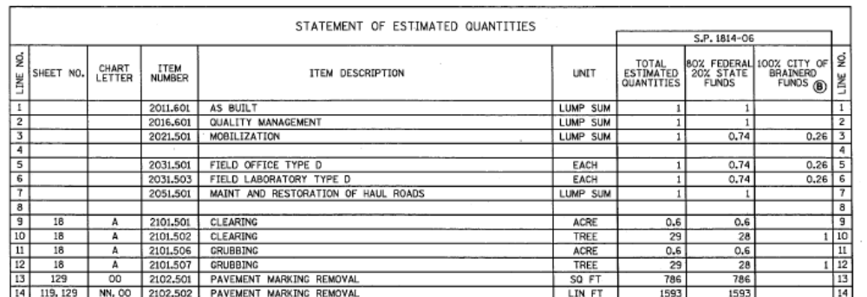
PLAN PREPARATION BASICS
STATEMENT OF ESTIMATED QUANTITIES
(SEQ)
Project Design Services Unit
December 2018

Slide 2
STATEMENT OF ESTIMATED QUANTITIES
In this section the Statement of Estimated Quantities (SEQ) section of the plan is probably the most important section. This contains the pay items and quantities for the project.
It is typically located after the general layout (if applicable). If there is no general layout then it follows the title sheet.
Additional information can be found in…
The Design Scene & Guidance website in “SEQ Guidance (PDF)” under the “General” heading.
Metro Sample Plan “Estimated Quantities” chapter under the “Sample Plan Sheets” heading.

Slide 3
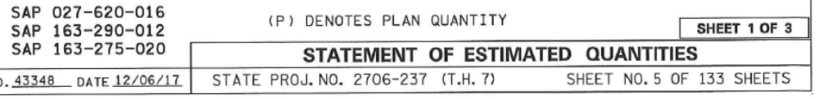
SEQ PROJECT NUMBER(S)
The project number(s) should be shown in the bottom right corner of the plan sheet. It should include the (TH #) but not the legislative number.
When there are multiple project numbers as a minimum the PRIME SP number should be shown. It is optional to show all of the SP numbers. The main thing it to be consistent.
ALL State Aid project numbers must also be shown on every sheet in the bottom right corner.

Slide 4
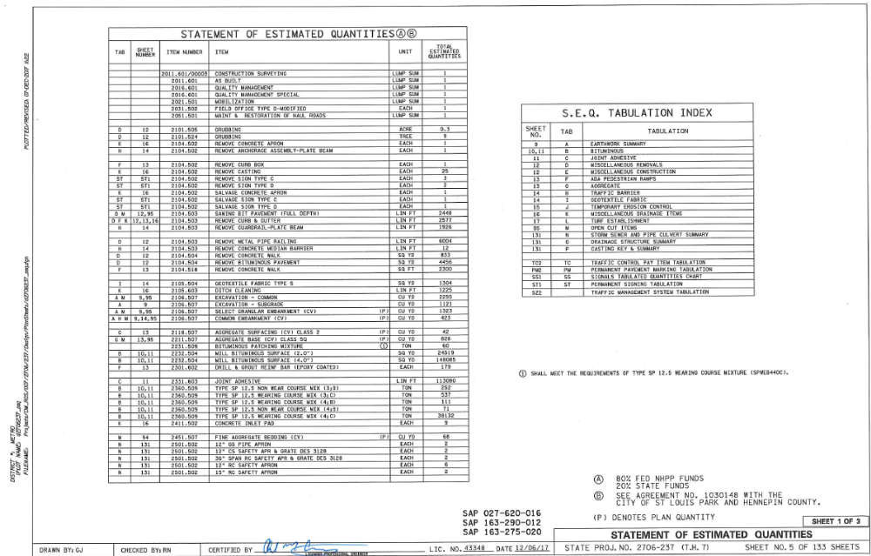
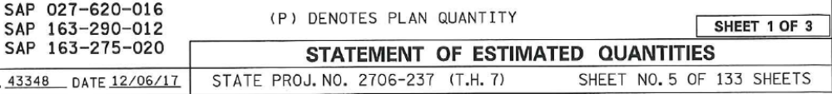
SEQ SHEET LABEL
The sheet label should be shown in the bottom right corner of the plan sheet. Above the SP # and SHEET number.
Some designers like to label the sheet sequence.
(e.g. Sheet 1 of 3).
This is optional.

Slide 5
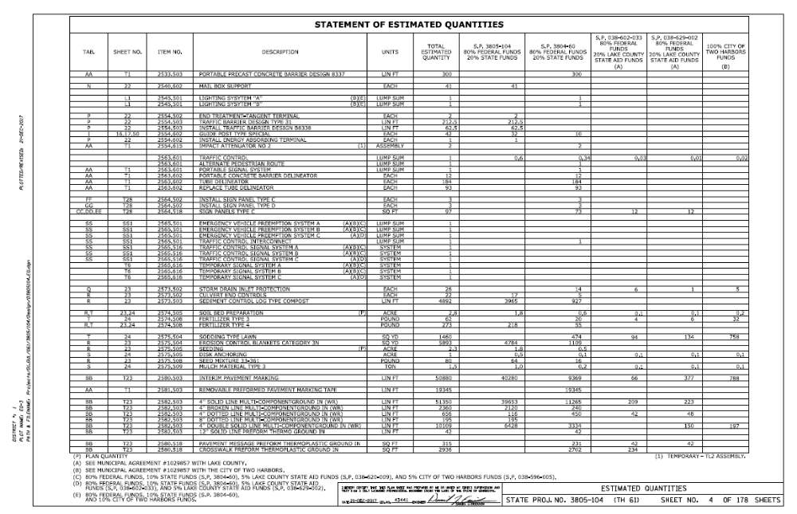

SEQ SHEET SIGNATURE
Each SEQ sheet must be signed. This is typically located in the bottom center of the sheet just left of the SP #.
This will include the Design Engineers (same person who signed the plan title sheet). It will include….
Printed name
Signature
License Number
Date

Slide 6
SEQ SHEET SIGNATURE
(Continued)
A different signature block will be used if these are signed by an Engineer different than the one who signed the title sheet. This will require the Board of AELSLAGID signature language.

Slide 7
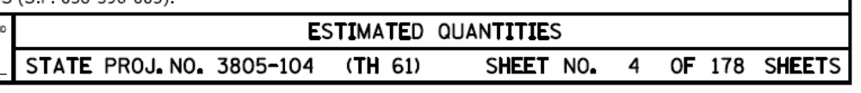
SEQ SHEET NUMBER
The number should be shown in the bottom right corner of the plan sheet.

Slide 8
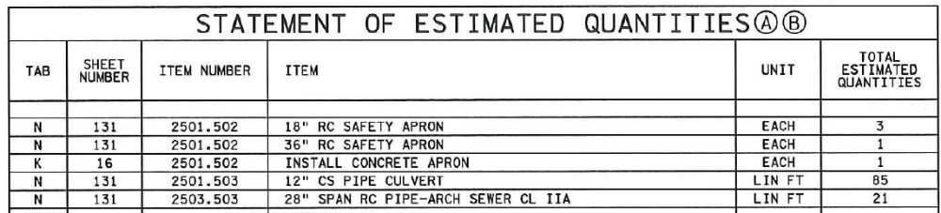
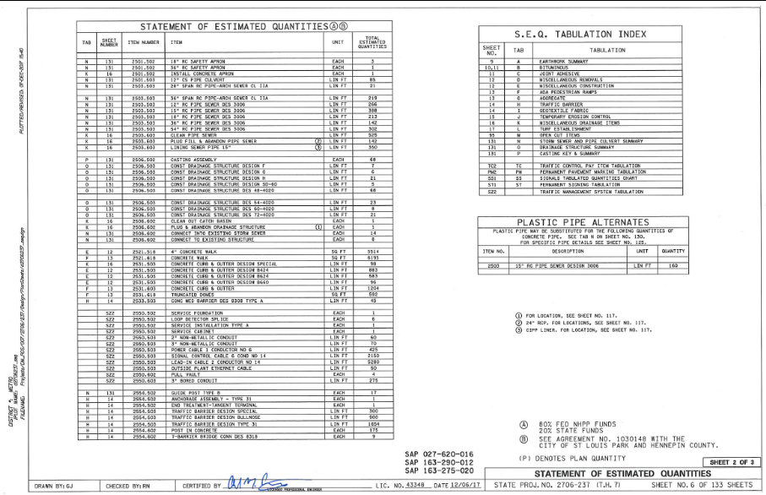
SEQ TABULATION HEADING
The SEQ TABULATION should have a heading and it should say “STATEMENT OF ESTIMATED QUANTITIES”.
It is located at the top center of the tabulation and there should only be ONE tabulation labelled as this.

Slide 9
SEQ TABULATION FORMAT
TAB COLUMN
The columns in the SEQ tabulation should be in a specific order from left to right. The first (far left column) should be the TAB column.
This refers to the tabulation letter that the quantity for this item is located in. It may be located in more than one tabulation.

Slide 10
SEQ TABULATION FORMAT
SHEET NUMBER COLUMN
The second column from the left should be the Sheet Number (Reference) column.
This refers to the sheet that the
Tabulation for this item is located in. It may be located in more than one tabulation.
Special detail for modified and special items is located on.
Sometime these first two column are reversed but the preference is the tab letter first.

Slide 11
SEQ TABULATION FORMAT
ITEM NUMBER COLUMN
The third column from the left should be the Item number column.
This refers to the item numbers that pertain to the pay item in TRNS*PRT (ASHTOWARE).
Only show the first seven digits, not the extension numbers.

Slide 12
SEQ TABULATION FORMAT
ITEM DESCRIPTION COLUMN
The fourth column from the left should be the Pay Item Description column.
This refers to the pay item description as it is shown in TRNS*PRT.
It must match TRNS*PRT (ASHTOWARE) exactly, even the abbreviations.
Both long and/or short descriptions my be used in the tabulation. However, each item must be one or the other, they cannot be mixed.

Slide 13
SEQ TABULATION FORMAT
UNIT COLUMN
The fifth column from the left should be the units column.
This refers to the pay item units used
It must match the units used in the tabulation(s).
It must use the standard abbreviations as shown in TRNS*PRT list plan units column.

Slide 14
SEQ TABULATION FORMAT
QUANTITIES COLUMN
The sixth column from the left should be the total quantity column.
This refers to the total quantity from all the tabulations referenced.
If there is only one SP number there will only be one column after the units column. Do NOT repeat the SP column.

Slide 15
SEQ TABULATION QUANTITIES COLUMN
The quantities put on the estimate sheet should normally be rounded to the nearest whole number. We should avoid using decimals, if possible. Only in cases of extremely small quantities should decimals be used and then only to the tenths place.
Commas should not be used either. For large numbers either leave a space where the comma would typically go or just continue the number (e.g. 12 345 or 12345 instead of 12,345).
When using small numbers as in the case of prorata items, a zero should be placed before the decimal number. (e.g. 0.5 instead of .5).
Do NOT use zeros or dashes in the estimated quantities table or any tabs. These locations should be left blank.

Slide 16
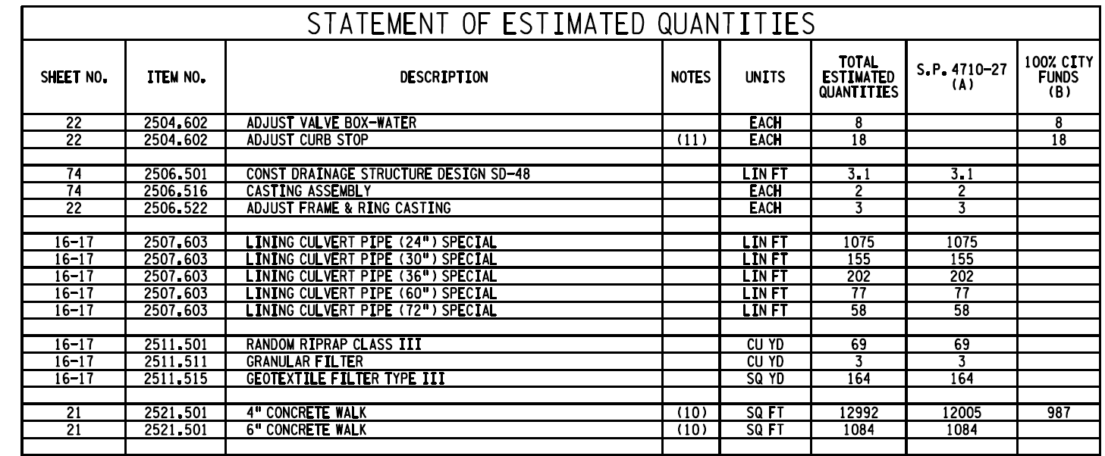
SEQ TABULATION FORMAT
GENERAL INFORMATION
When SEQ is under development it is good practice to leave an open line space every 5 or 6 lines. This practice is desirable when corrections or additions have to be made on the sheets. Some designers are not leaving enough space below the tabulations for the addition of notes if some have to be added after the plan is turned in for processing. A two inch minimum space from the bottom
border line
of the plan
sheet to the
lower line on
the tabulation
is desirable.

Slide 17
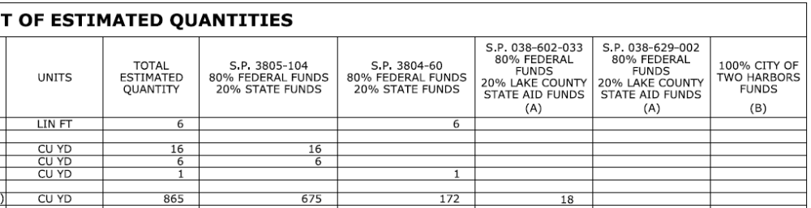
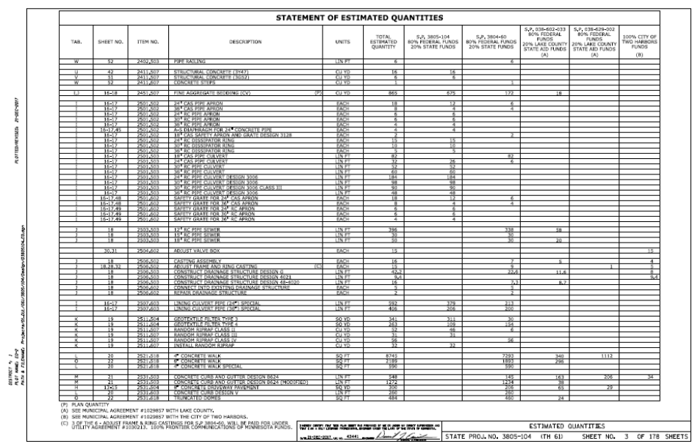
SEQ TABULATION FORMAT
MULTIPLE SP/FUNDING TYPES
After the total are the SP/Funding Type Columns if more than one SP and/or Funding Type.
The first column will be the PRIME SP # column.
The last column will be the CITY/COUNTY funding column.
Each SP # will have a separate column.

Slide 18
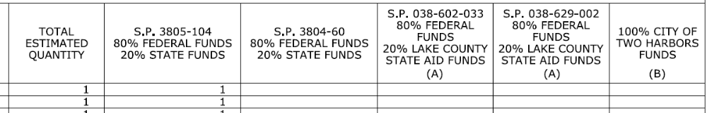
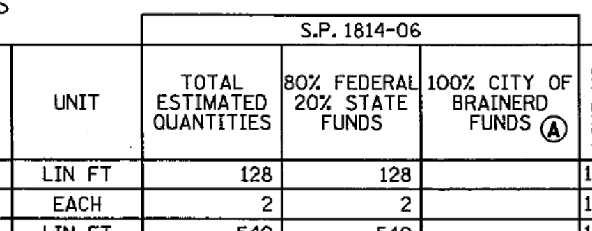
SEQ TABULATION FORMAT
SP and/or FUNDING COLUMNS
Include a column for each type of funding including city, county, and state aid funds.
Each funding type should have a separate column, even if it shares an SP #.

Slide 19
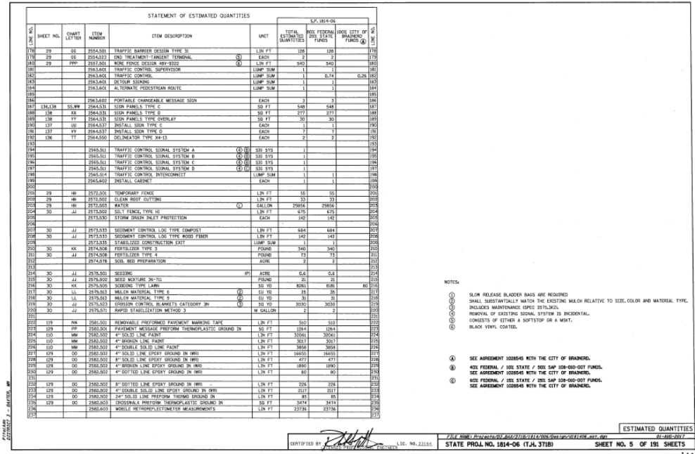
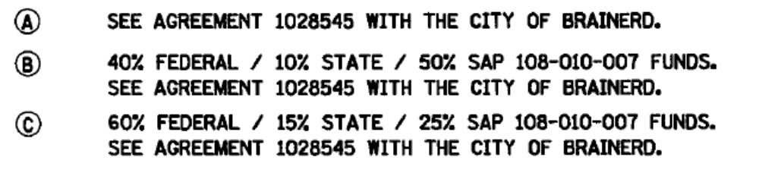
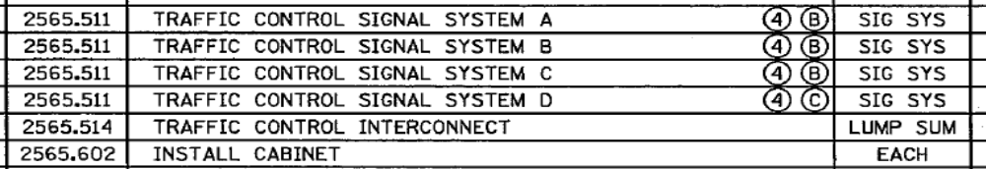
SEQ TABULATION FORMAT
SP and/or FUNDING COLUMNS
There are exceptions to this rule which could have a lettered note instead such as signals and lighting. Or when there are less than five items for a specific funding type.

Slide 20
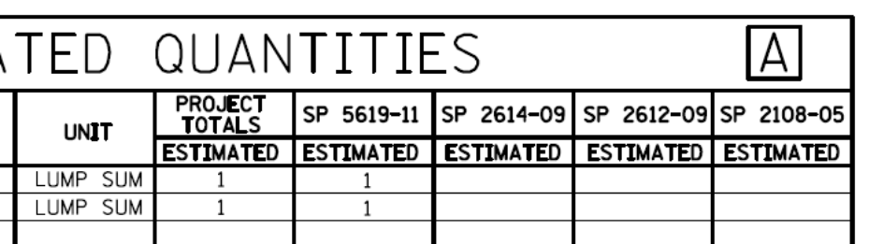
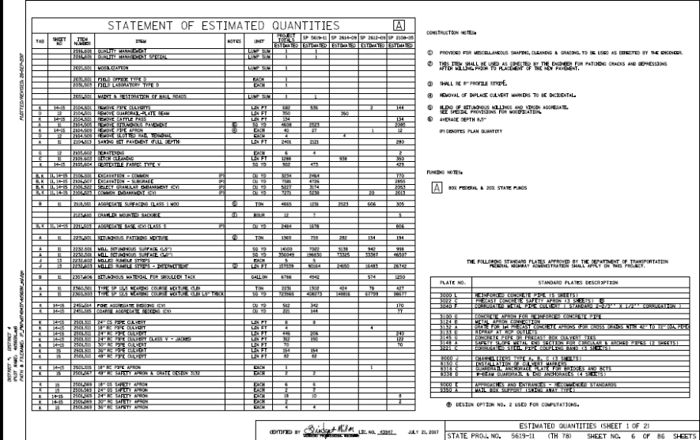

SEQ FUNDING NOTES
If the project has federal funds they must be noted in the SEQ. It can be placed in the column heading as part
of the narrative or as a lettered note. Never use number notes for funding as they need to stand apart from the rest of the notes.
The funding notes should stand apart from the numbered notes. If possible they should be…
Larger font
Bold
Placed away from the numbered notes.

Slide 21
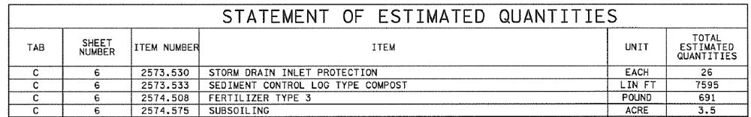
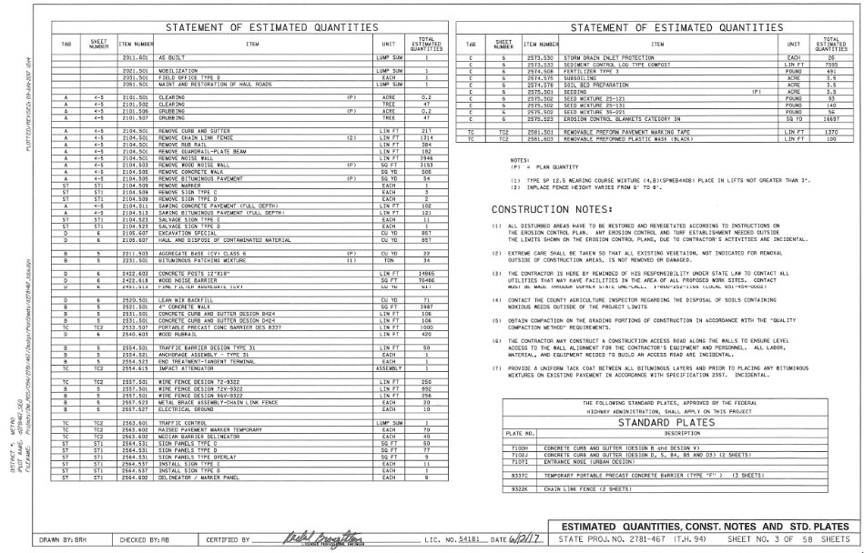
SEQ FUNDING NOTES
(Continued)
If the project is only State funded then no note is needed.
If the project is both federally and state funded then the state funds need to be noted.
If the project is both state and city/county funded then the state funds need to be noted.

Slide 22
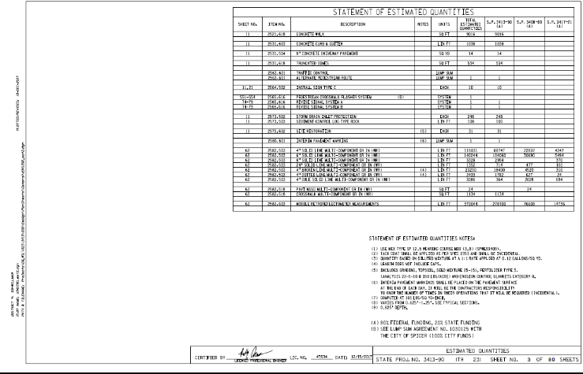
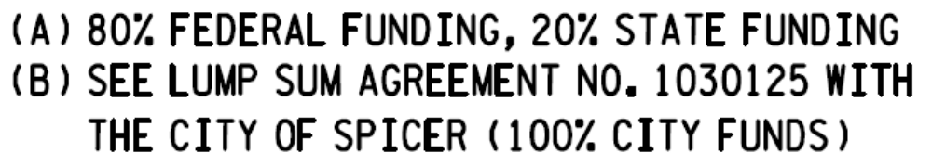
SEQ AGREEMENT NOTES
If the project has an agreement it should
Reference either
  SEE LUMP SUM AGREEMENT, or
  SEE AGREEMENT…if schedule “I”
Agreement number
Who the agreement is with (e.g. City/County name)
Note the percentage of federal funds, if applicable

Slide 23
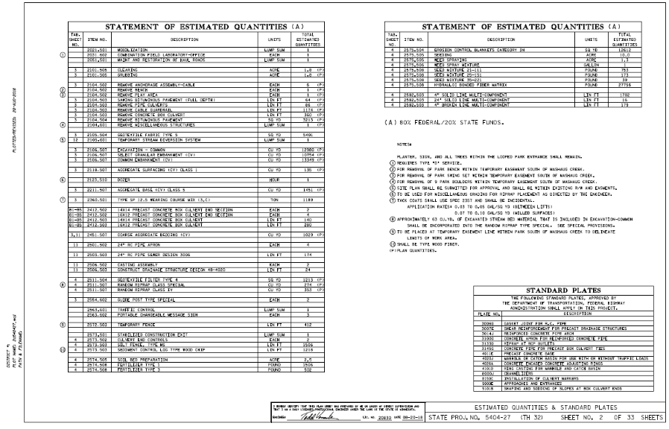
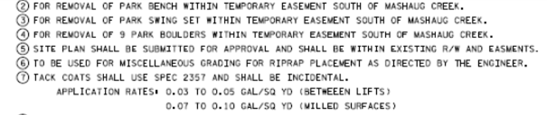
SEQ NOTES
All SEQ notes should be accounted for.
If a note is written in the SEQ it should not be repeated in the Tabulation. The note should only appear in one location (either the SEQ or the tabulation, not both).
They note should be clear, understandable
The note should be necessary, don’t have more notes than you need.
Or here

Slide 24
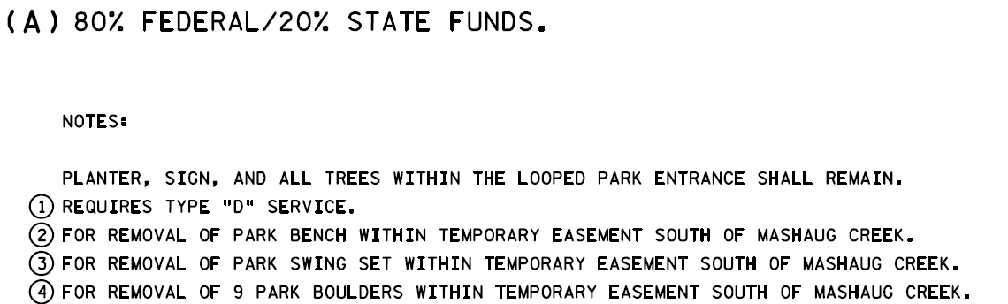
SEQ NOTES
(Continued)
Location of the note number in the SEQ should be consistent either on the left side of the tabulation or on the far right side of the Item Description column.
Numbered notes should be set apart from the lettered (funding) notes.
Or here

Slide 25
QUESTIONS????
Any questions contact us ANYTIME:
Tim Swanson, P.E. @ 651-366-4689
  tim.swanson@state.mn.us
Yvonne Crocker, P.E. @ 651-366-4610
  yvonne.crocker@state.mn.us
Jane Krebsbach@ 651-366-3183
jane.krebsbach@state.mn.us

