Slide 1
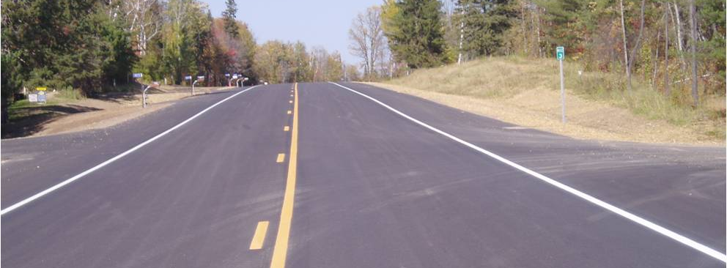
PLAN PREPARATION BASICS
GENERAL LAYOUT
Project Design Services Unit
December 2018

Slide 2
GENERAL LAYOUT
In this section you will be introduced to the basic parts of the general layout sheets.
These typically follow the title sheet but are before the Statement of Estimated Quantities sheet(s).
Simpler, more straight forward projects may not need a general layout section in the plan.

Slide 3
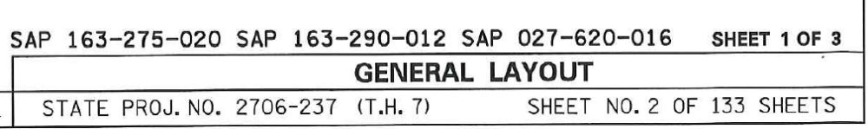
PROJECT NUMBER(S)
The project number(s) should be shown in the bottom right corner of the plan sheet. It should include the (TH #) but not the legislative number.
When there are multiple project numbers as a minimum the PRIME SP number should be shown. It is optional to show all of the SP numbers. The main thing it to be consistent.
ALL State Aid project numbers must also be shown on every sheet in the bottom right corner.

Slide 4
SHEET LABEL
The sheet label should be shown in the bottom right corner of the plan sheet. Above the SP # and SHEET number.
Some designers like to label the sheet sequence.
(e.g. Sheet 1 of 3).
This is optional.

Slide 5
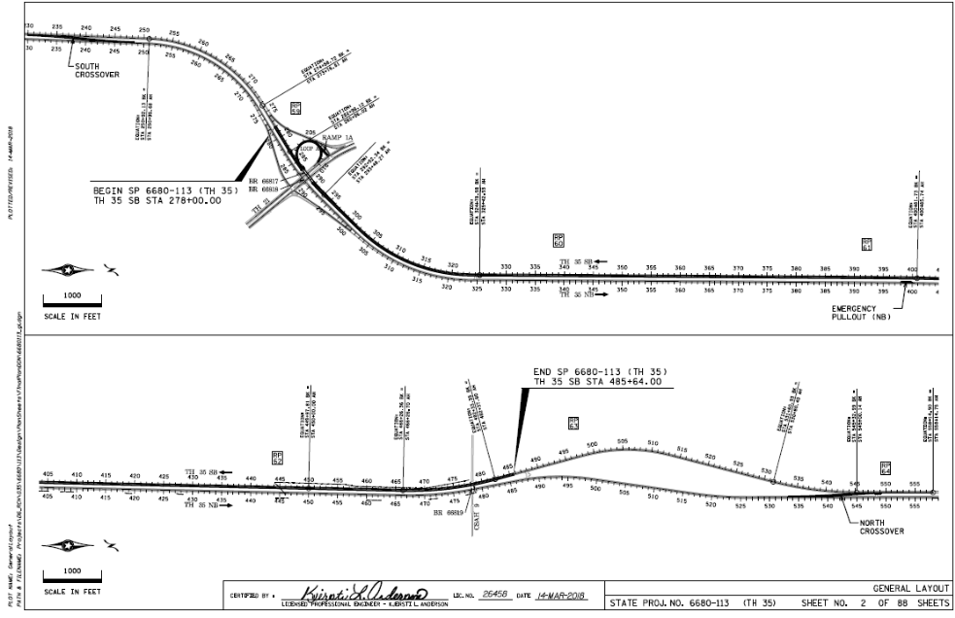
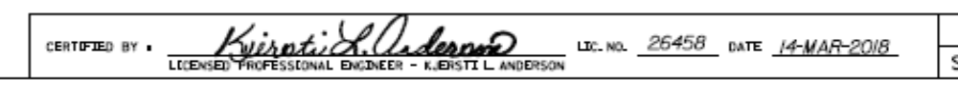
SHEET SIGNATURE
Each general layout sheet must be signed. This is typically located in the bottom center of the sheet just left of the SP #.
This will include the Design Engineers (same person who signed the plan title sheet). It will include….
Printed name
Signature
License Number
Date

Slide 6
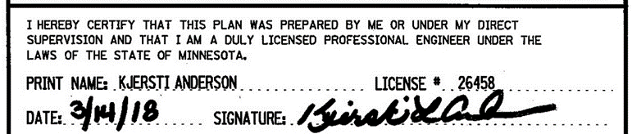
SHEET SIGNATURE
(Continued)
A different signature block will be used if these are signed by an Engineer different than the one who signed the title sheet. This will require the Board of AELSLAGID signature language.

Slide 7
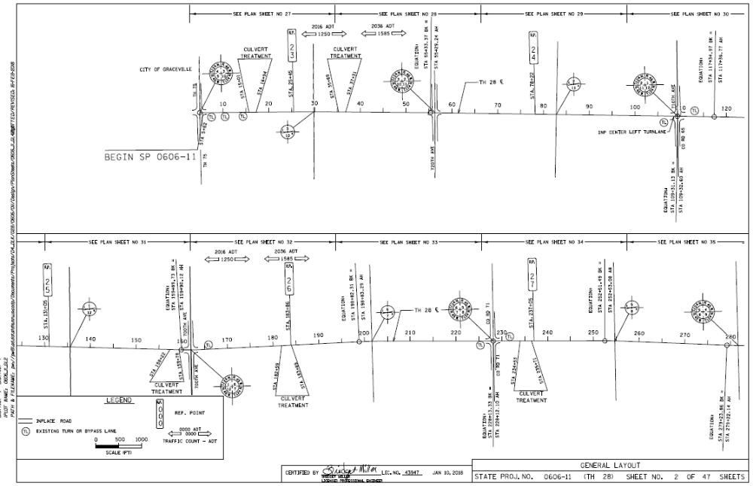
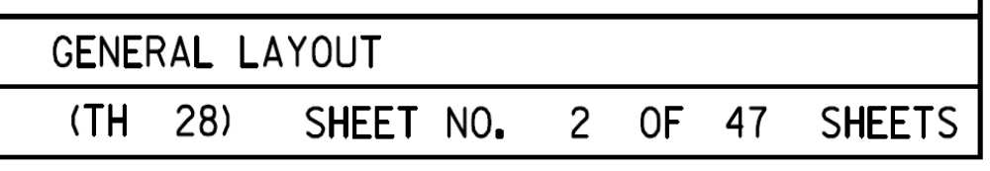
SHEET NUMBER
The sheet number is shown in the bottom right corner of the plan sheet.

Slide 8
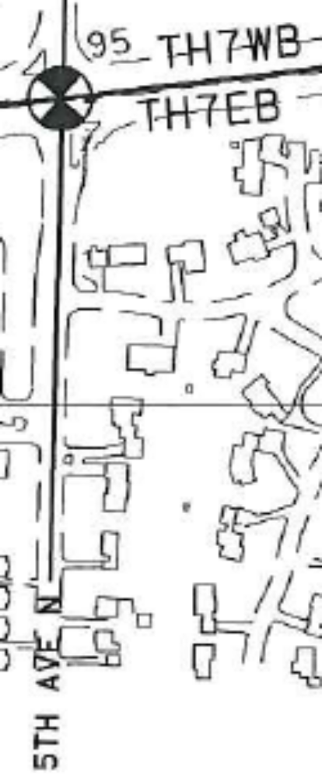
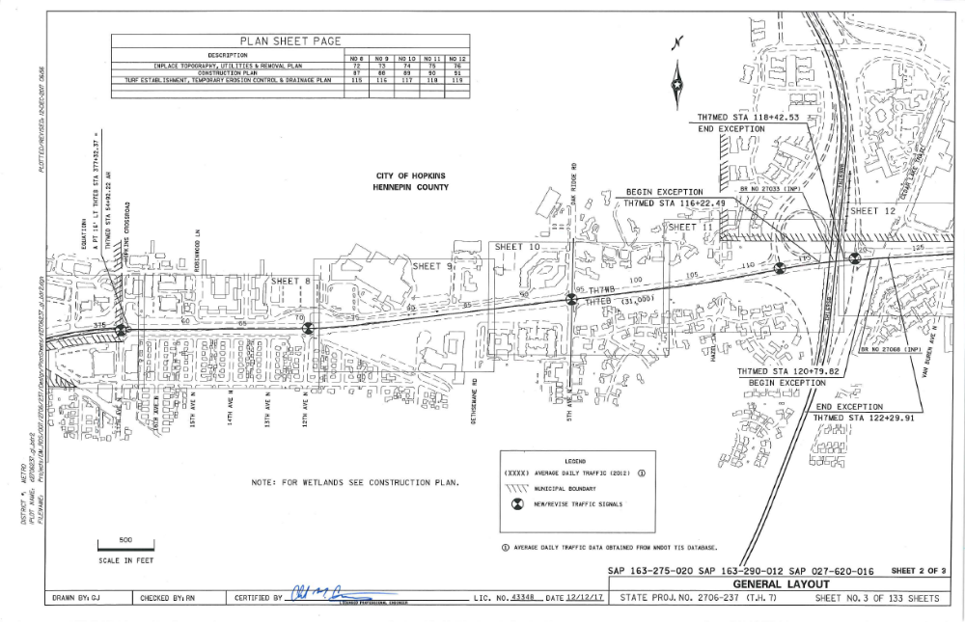
ROADWAYS
All major roadways and side streets should be labeled. MnDOT used “TH” not “I” or “US” or “MN” for all state highways.

Slide 9
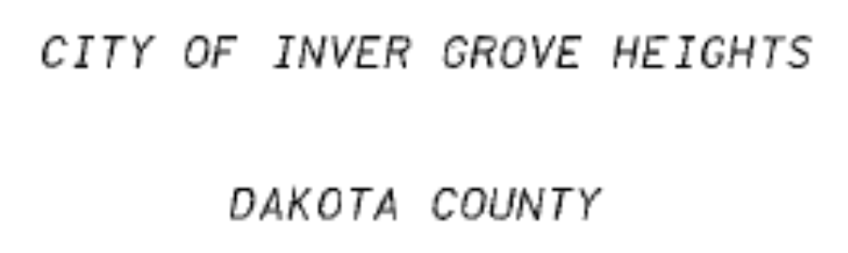
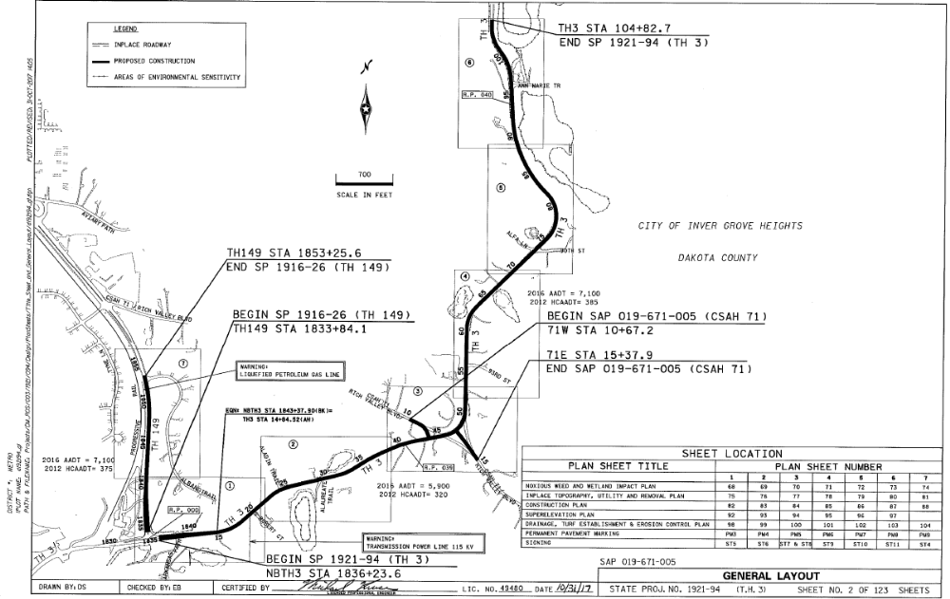
CITY, COUNTY, CORPORATE LIMITS
The general layout should label all Major Cities, Counties, and Corporate Limits.

Slide 10
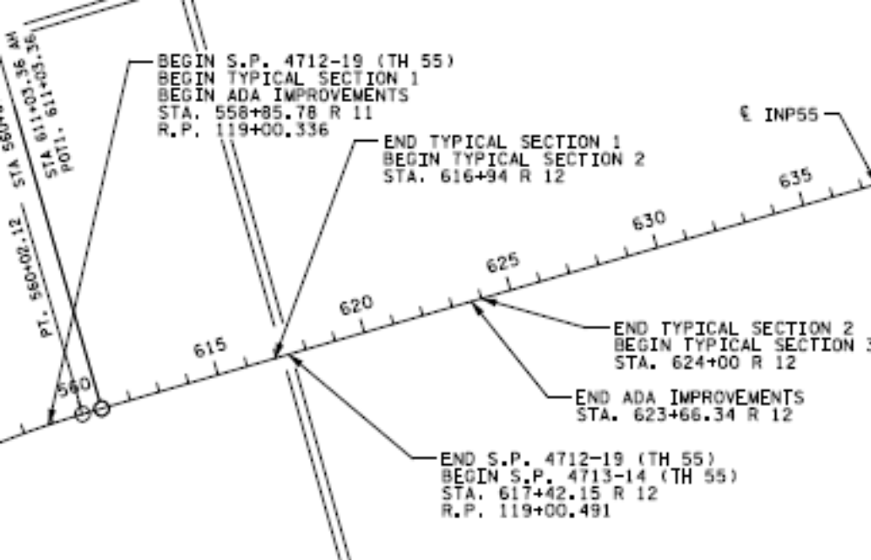
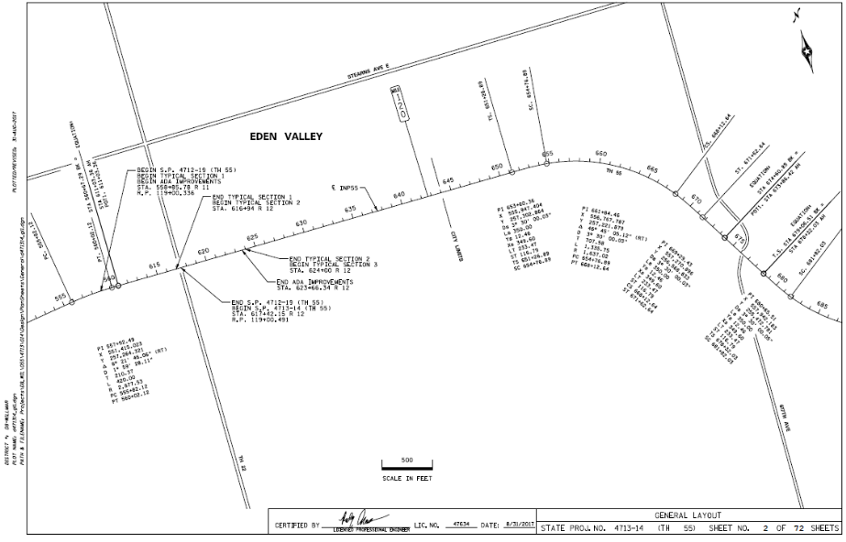
BEGIN/END SP#
The general layout should label all SP#s, with a Beginning and Ending stationing

Slide 11
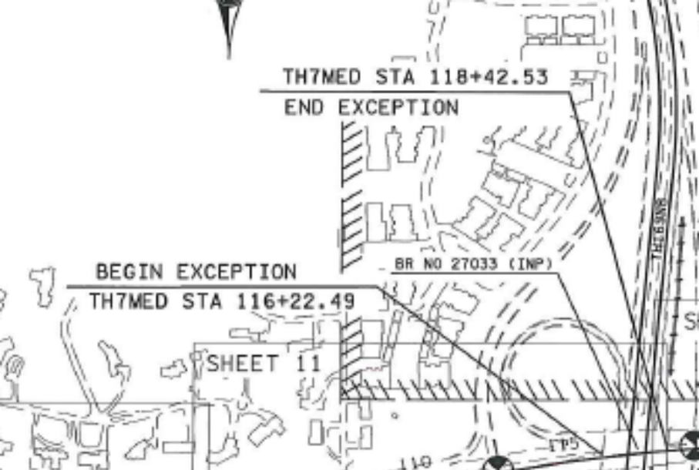
EXCEPTIONS
The general layout should label all exceptions. These are based on the alignment as stated in the length block(s) on the title sheet.

Slide 12
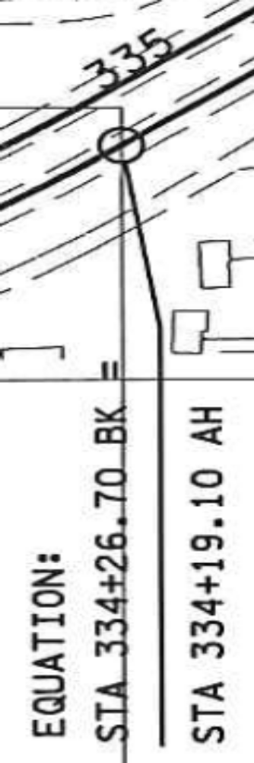
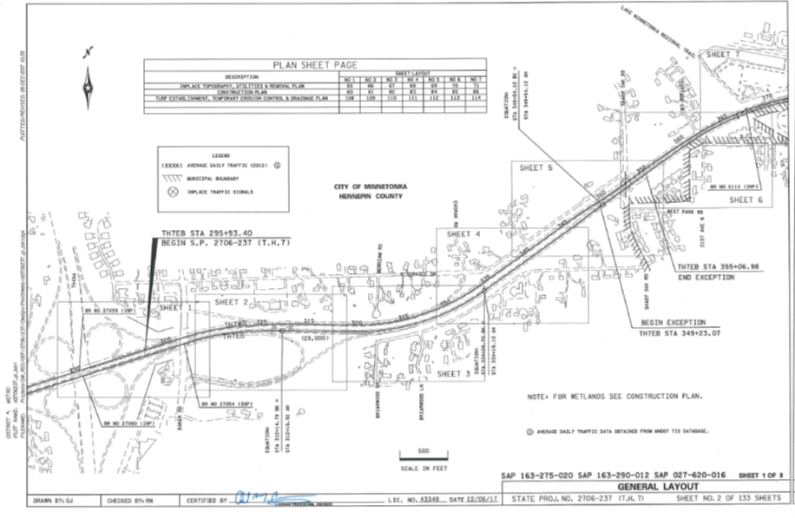
EQUATIONS
The equations that pertain to the project limits should be included on the general layout. The back equation is always listed before the ahead equation as it pertains to the previous section (left).

Slide 13
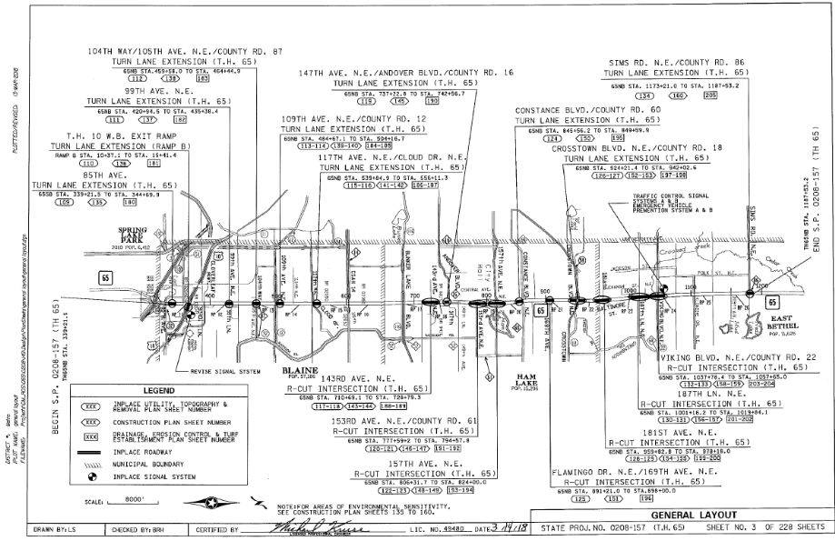
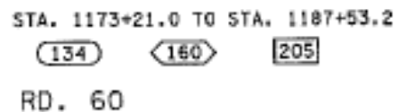
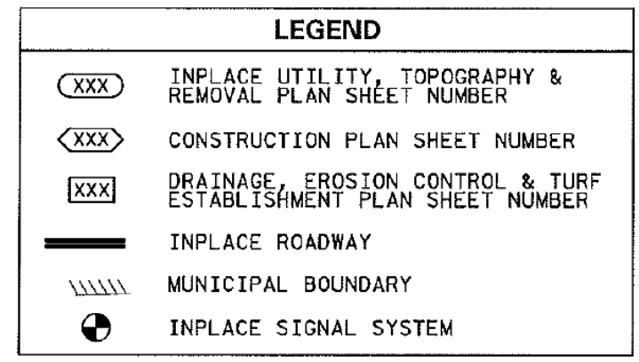
PLAN SHEET REFERENCES
Indicate on the general layout where in the plan the major components of the plan can be found.
Sheet numbers can be labelled on the layout using different symbols for such things as topography sheets, construction plan sheets, drainage plan sheets, etc., with the corresponding sheet number in the corresponding symbol.

Slide 14
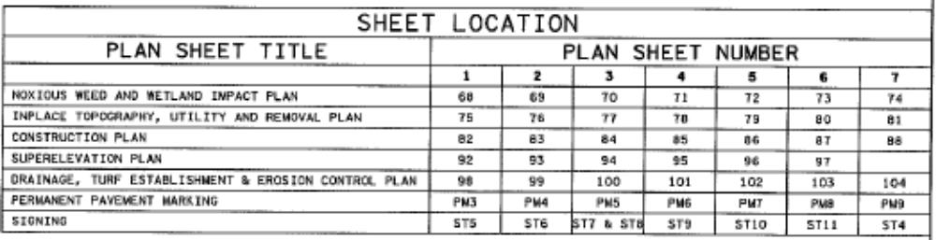
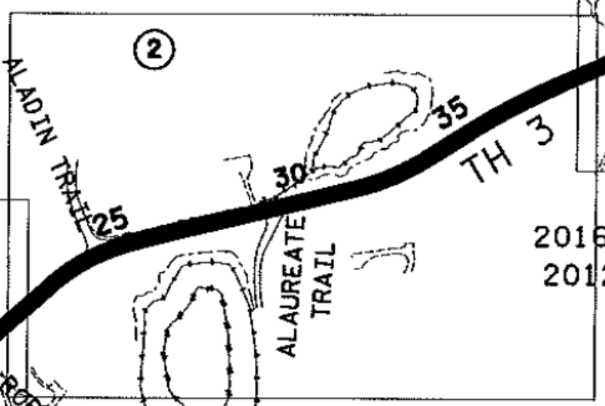
PLAN SHEET REFERENCES
Another way to show it is with a table referencing the various plan sheet numbers. This is typically used when the sheet sections are labelled as X of X in the bottom right corner.

Slide 15
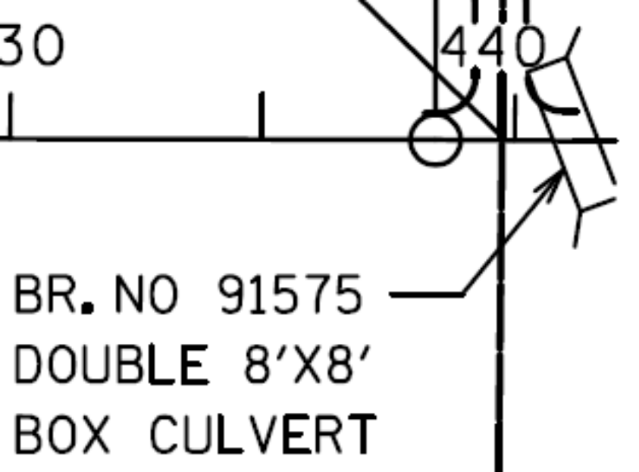
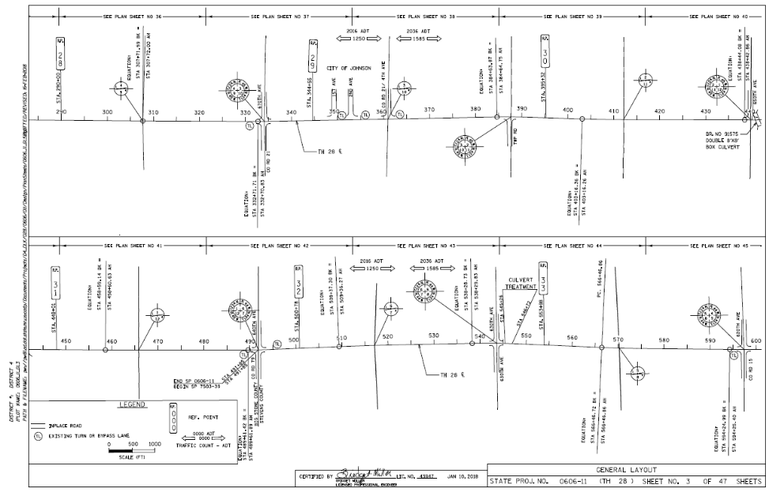
BRIDGES
All inplace and proposed bridges should be labeled on the general layout. What they cross over/under should also be labeled. (e.g. Rivers, Railroads, roads, etc.).

Slide 16
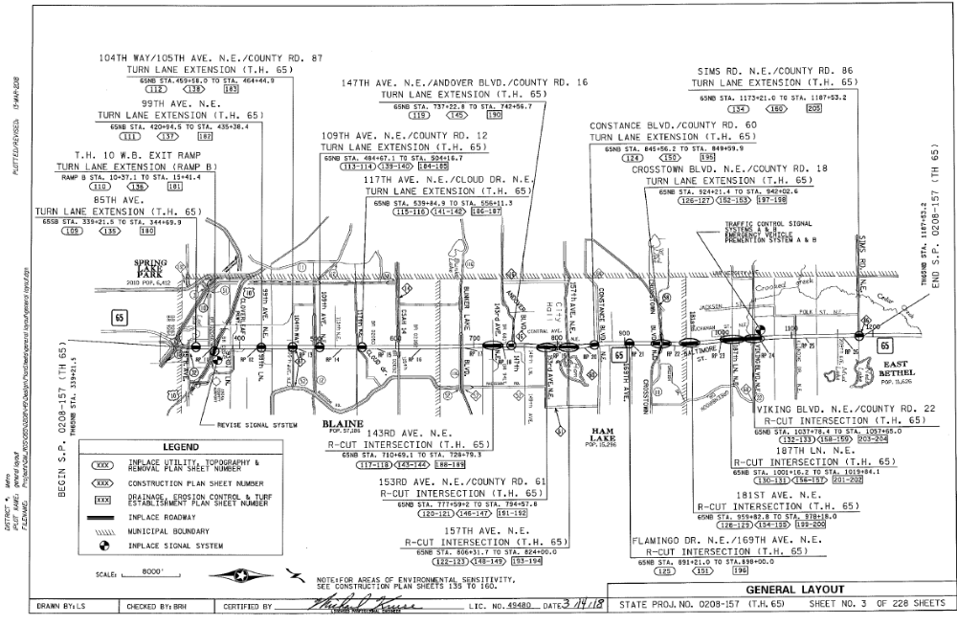
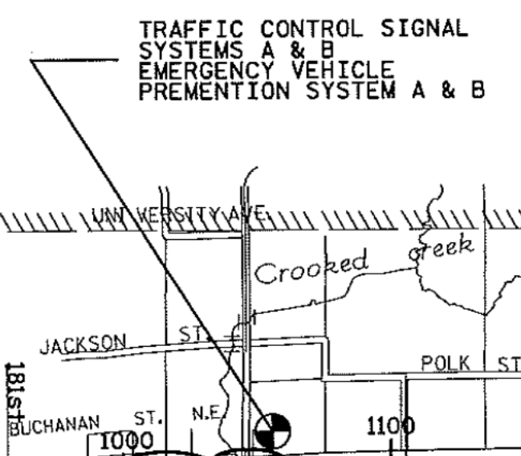
SIGNALS & LIGHTING
The general layout is a good place to show proposed signal locations.

Slide 17
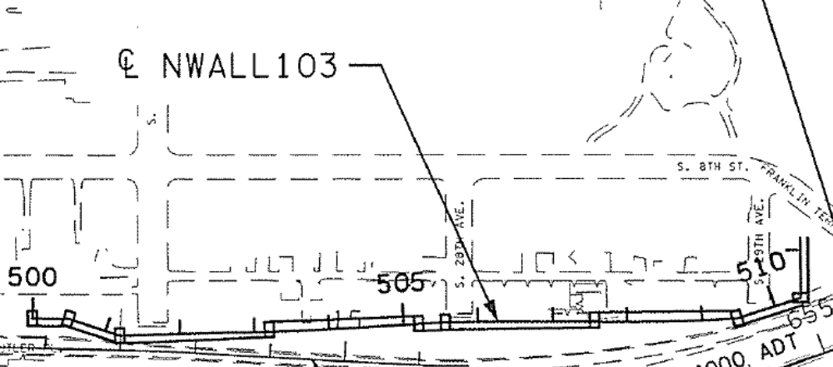
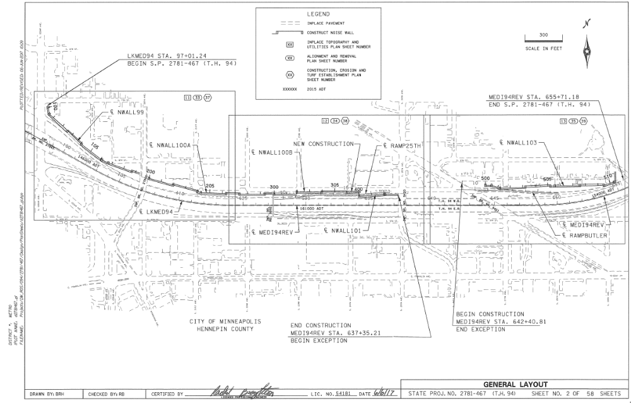
WALLS
The general layout should show the proposed wall locations.

Slide 18
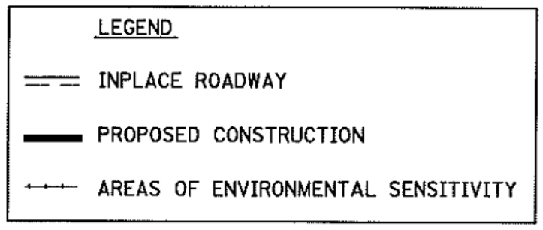
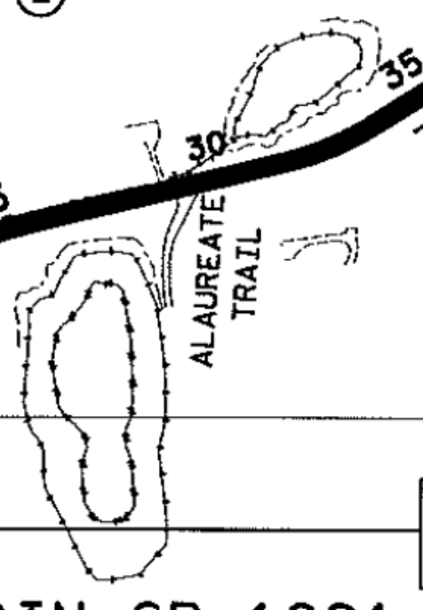
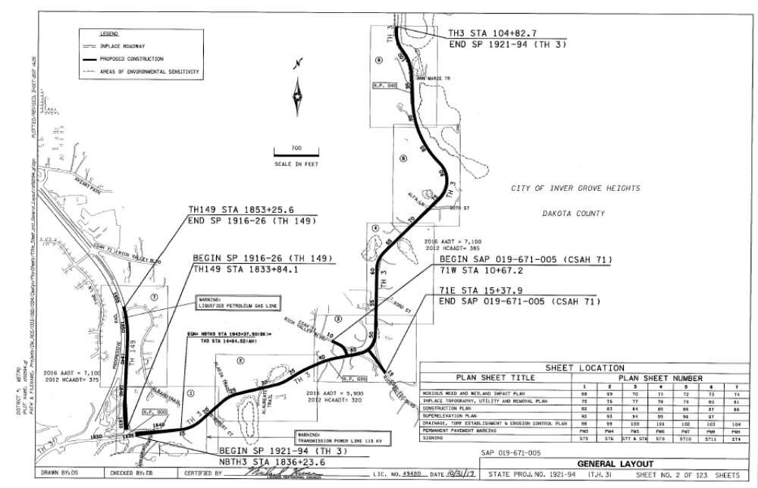
AREAS OF ENVIRONMENTAL SENSITIVITY
It is important to show the areas of environmental sensitivity in the plan to make sure these areas are not impacted. These locations must be shown on the general layout sheets. It is recommended to also show them on the removal and construction plan sheets as well.

Slide 19

INDEX MAP
(Continued)
The Index Map should include a north arrow.

Slide 20
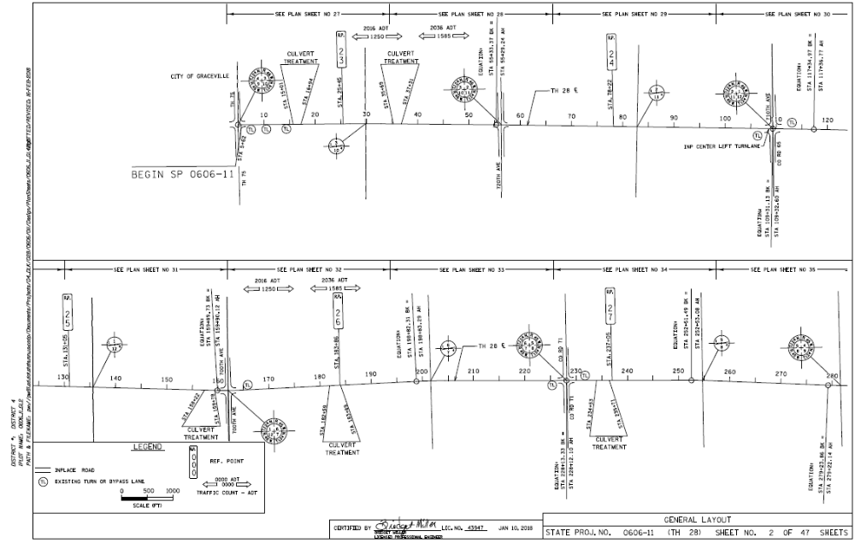
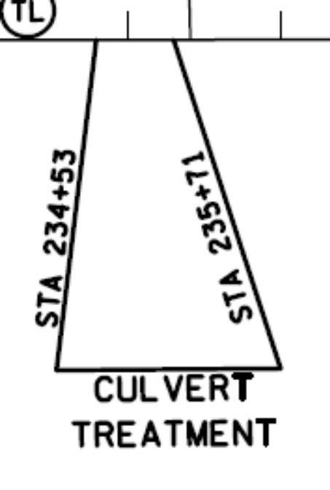
GENERAL LAYOUT –
CONSTRUCTION PLAN VIEW
Sometimes general layouts are used in place of construction plan views. Such as is sporadic culvert work or turn lanes.

Slide 21
CONCLUSION
There are several ways to show information on the general layout. The above slides were a few examples of how they can be shown.
The information included should be the same no matter which example you follow.

Slide 22
QUESTIONS????
Any questions contact us ANYTIME:
Tim Swanson, P.E. @ 651-366-4689
  tim.swanson@state.mn.us
Yvonne Crocker, P.E. @ 651-366-4610
  yvonne.crocker@state.mn.us
Jane Krebsbach@ 651-366-3183
jane.krebsbach@state.mn.us

