Slide 1
Enhanced Project Management Implementation Workshop

Slide 2
When you walk out of here today you should know…
Why MnDOT needs enhanced project management
Where the department is going
What is expected of you
What help is available to you
And have had a hand in shaping how your district moves forward

Slide 3
District/Office Implementation
Throughout the day, think about:
What does MnDOT and District or Office management expect of project staff?
What are the training needs?
What data/reports/guidance/tools/etc. do we need to be successful?
Do there need to be organizational changes?

Slide 4
Project Success
Department Objectives
Public Needs & Wants
Scope
Schedule
Budget
Quality
Staff
Public Trust
Notes:
Classically project management focuses on delivering the full scope on time and on budget.
Fundamentally, the project needs to be aligned with department objectives and public needs and wants. A project not in alignment with those objectives can be on time and on budget, but still not successful.
How we deliver the project matters too. High quality products, proud staff with a good life-work balance, and increased public trust are hallmarks of an excellent project.

Slide 5
Schedule Float
Notes:
Negative float makes it difficult to forecast staffing needs because it would not be clear if the predecessor activities will be delivered when you expect to begin.

Slide 6
Reason for Negative Float
Notes:
We asked PMs of projects with more than 30 days negative float why there was negative float. Some gave multiple answers, some did not respond. There were 114 responses.
This shows that simply holding ourselves to a minimum standard of progress reporting would have a big impact on our schedules.

Slide 7
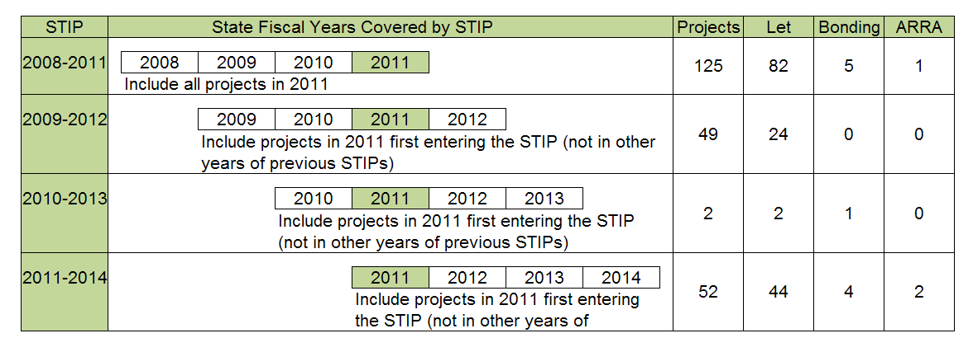
Data Used for Inclusive Project Delivery Measure when Project First Enters STIP
67% of 2011 projects were let in SFY 2011 or earlier

Slide 8
Reasons for Delay
Notes:
Presumably some of these issues can be averted with better scoping, improved schedules (e.g. more details, buy in from partners), and risk management.
A lot of the reasons for delay revolve around program issues. This is a big frustration. It seems the target is always moving.

Slide 9
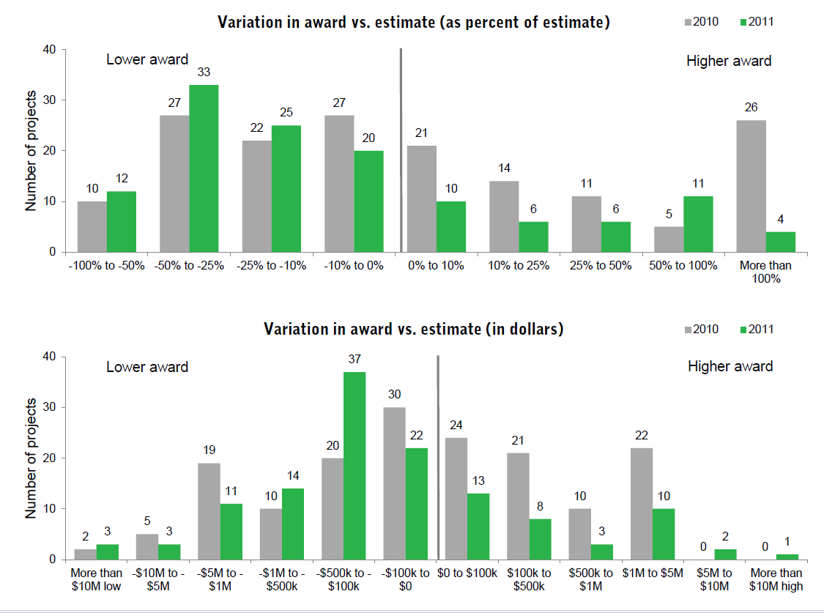
Notes:
It appears that we tend to overestimate more on lower cost projects. That makes sense.
The ideal is a bell curve centered on the 0% mark. Then some are higher, some lower, but it balances out.

Slide 10
Why Project Management?
Engineering delivers solutions to technical problems.
Processes make the flow of work, information, and decisions predictable.
Project management puts intelligence to processes to deal with the complexity and risks unique to a project

Slide 11
MnDOT Strategic Vision
MnDOT will be a global leader in transportation, committed to upholding public needs and collaboration with internal and external partners to create a safe, efficient, and sustainable transportation system for the future.

Slide 12
Project Management Vision
To achieve the Strategic Vision, MnDOT project management utilizes professional, expert people, effective processes, and appropriate support tools to deliver high quality projects that provide business value on scope, on time and on budget.

Slide 13
Vision Components
PEOPLE
TOOLS
PROCESS
Line of Authority
Expectations
Accountability
Scalable processes
Portfolio & program management
Lessons learned
Continuous improvement
Get the right people doing the job
  Technical skills
  People skills
Train them
Define roles/responsibilities
Work as Teams
Scalable templates
Resource loaded schedules
Project Management Information System
Collaboration tools

Slide 14
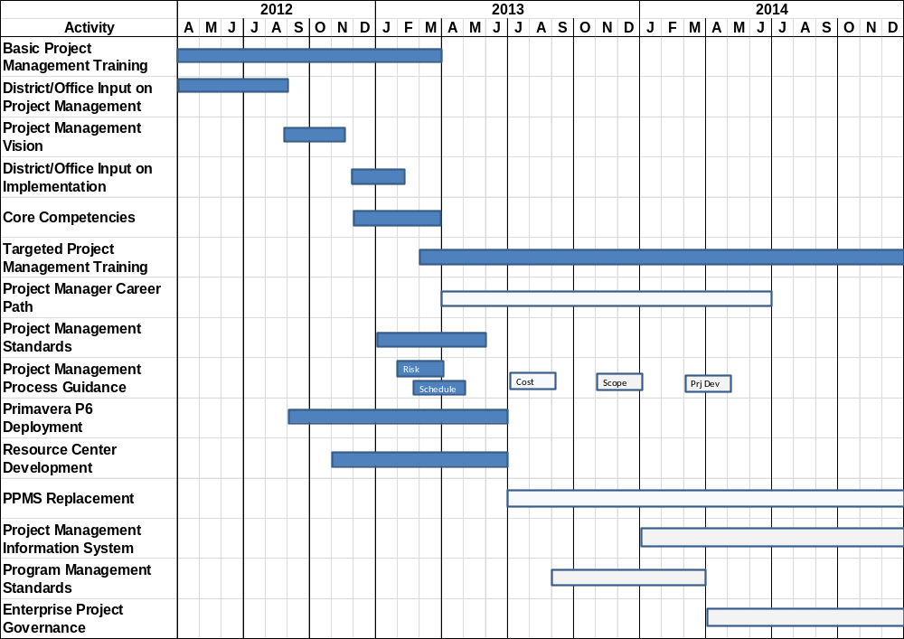
Roadmap to Enhanced
Project Management

Slide 15
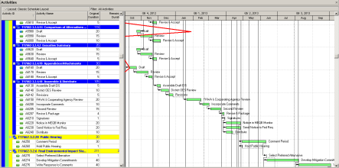
Project Management Expectations
In Order to Achieve

Slide 16
Project Organization
This can be the same person
Program Manager
Project Sponsor
Project Sponsor
Project Sponsor
Project Manager
Project Manager
Project Manager
Staff FG 1
Staff FG 1
Staff FG 1
Functional Group Manager
Staff FG 2
Staff FG 2
Staff FG 2
Staff FG 3
Staff FG 3
Staff FG 3
Notes:
For highway projects: Usually the sponsor will be the ADE. The ADE will also typically be the Program Manager.

Slide 17
Program Manager
Balance the following between projects to meet program objectives:
  Scope
  Schedule
  Budget
  Staff
  Risks
Represent program internally and externally
Hold staff accountable for delivery
Notes:
In the fall, after we have some experience working with resource loaded schedules, we will have training for program managers in techniques to manage programs.

Slide 18
Project Sponsor
Convey objectives to project team
Set PM authority
Approve project management plan
Ensure PM gets access to resources
Use clout to assist during issue escalation

Slide 19
Project Manager
Individual responsible for successful delivery
Manages stakeholders
Provides leadership to project team
Develops scope, schedule, and budget with team
Manages project activities to deliver on scope, on schedule, on budget with high quality
Note – if they have a production role, that is separate from their role as PM

Slide 20
Team Member
Represent functional group at project team and project needs to functional group
Participate in project planning
Provide or manage delivery of technical content
Work with team to resolve issues

Slide 21
Functional Group Manager
Develop and maintain pool of technical resources
Analyze impact of proposed projects on ability to deliver previous commitments
Manage utilization of resources to fulfill commitments
Subject matter experts

Slide 22
Project Management Office and Resource Centers
Develop process standards and guidance
Provide training and coaching
Provide facilitation services
Perform project management functions on projects if assigned to assist
Provide reports
Track measures of project/program success

Slide 23
Authority and Internal Issue Escalation
PM authority defined in project charter
Issue escalation defined in project mgmt plan
Resolve issues on project when possible through stakeholder management
Elevate if effect goes beyond project or there is a dispute
1st Step – Project Sponsor
2nd Step – District Engineer/Office Director
3rd Step – Division Director
Notes:
This may be modified on a project based on the district or program area (e.g. IT may be different).
External issue escalation can be discussed with partners and included in the PMP.

Slide 24
Project Management Process Groups
Initiate Project
Plan Project
Close Project
Execute Project
Monitor & Control Project

Slide 25
Project Management Processes
Project Charter → Stakeholder Identification
Monitor → Change Control
Close
Scope → Schedule → Cost Estimate → Risk Mgmt→ Project Management Plan
Lead & Do Work
Note that methods and intensity of the processes should scale with project needs

Slide 26
Project Charter
Purpose:
  Authorize use of resources on project
  Define objectives
  Identify complexity and risk
  Name project manager
  Define authority
Process
PM drafts Charter
Sponsor Approves

Slide 27
Stakeholder Management
Purpose: Know the stakeholders, consider their interests
Process
Identify Stakeholders
Identify their Interests
Identify Conflict Risks
Develop Stakeholder Mgmt Plan
Work with Stakeholders

Slide 28
Project Management Plan
Purpose: Lay out how project will be managed
Process:
Prepare PMP w/ Team
Sponsor Approves
Execute Plan
Monitor & Change Plan
  Scope
  Schedule
  Budget
  Quality
  Stakeholder Management
  Communications
  Project Team
  Risk Management
  Consultant Use
  Ongoing Management
  Monitoring
  Change Management
  Closing

Slide 29
Scope
Purpose: Specify what will and will not be done on the project in terms of Product and Process
Process:
Get Stakeholder Input
Decide what’s in
and what’s not
Document the Decisions
Manage Scope
Scoping Worksheets, letters, public input meetings
Scoping Meetings
Level of detail
Scoping Report
Metro Database
Sponsor approval
Verification
Scope changes

Slide 30
Schedule
Purpose
  Project team knows when deliverables are due
  Resource managers can plan how to deliver
  Impact of issues can be analyzed at project and program level
WBS
Activities
Sequence
Resources
Durations
Refine until Baseline
Manage Schedule
Deliverables
100% Rule
Work packages
Actions
Level of Detail
Logic
Estimated
Roles
Resources
6-12 months
Estimated
Work Days
Time Avail.
Most Likely
Risk
Contingency
Critical path
Crash
Fast Track
Buy in
Baseline
2 week updates
Physical %
Rem Dur
Reports
Progressive elaboration

Slide 31

Implementing Primavera P6
Resource Center Operational
December 2012
Enter All Construction Phase Projects Let after 1/1/13
Ongoing beginning January 1, 2013
Scheduling Protocols Determined
Preliminary: January 2013
Production: April 2013
Enter All New Projects and Associated PT Contracts
Ongoing starting April 2013
Migrated from PPMS (APV) & Role/Resource Loaded
Active projects: July 2013
Remaining: July 2014
Projects in Construction Phase Role/Resource Loaded
January 2014
What P6 offers:
Schedule mgmt
Cost mgmt
Resource mgmt
Risk mgmt
Project Information mgmt
Program views of information

Slide 32
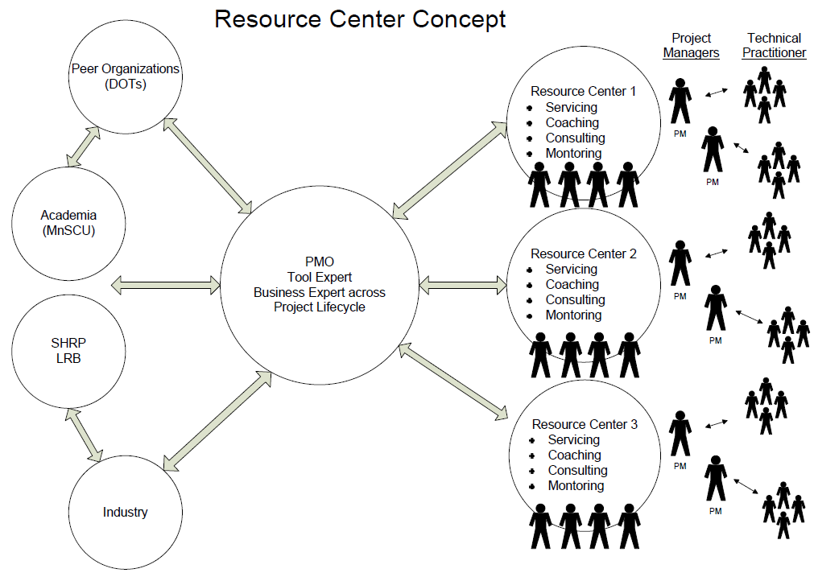

Slide 33
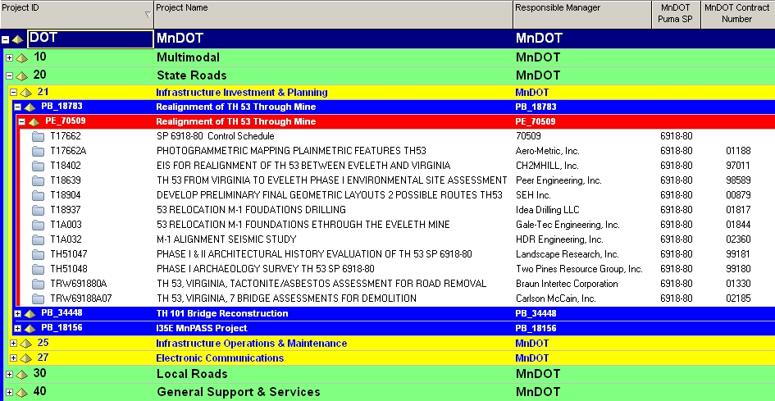
1
2
3
PUMA Bundle.
PUMA Element (This number is directly related to the SP).
This represents all work performed under an SP by all parties.
General Note: All work will roll up to the Element (SP) and the Bundle as well. This includes costs of
each separate contract.

Slide 34
Cost Estimate
Purpose: Maximize use of funds by forecasting when money is needed for activities
Process:
Estimate Base Costs
Determine Contingencies
Set Budget
Manage Budget
All costs
Basis – scope
Base cost
Identify risks
Determine contingency
TPCE = budget
Includes approved contingency
Actual cost reports
Release contingency
Budget changes

Slide 35
Risk Management
Purpose: Be aware of what might happen that would alter project plan and be prepared for it
Identify Risks
Qualitative Analysis
Quantitative Analysis
Plan Risk Responses
Manage Risks
Opportunities
Threats
Effect
Risk Register
Probability
Impact
Range
Prioritize
Detailed analysis
3 point estimates
Expected value
Monte Carlo
Avoid/Exploit
Transfer/Share
Mitigate/Enhance
Accept
Budget time or $:
mitigation
contingency
Update regularly
Retire contingency

Slide 36
Project Execution
Information – getting info to the right people at the right time
Workflow – ensuring that people are working on the right things at the right time
Decisions – ensuring issues are resolved in a timely way

Slide 37
Monitor & Control
Monitoring
  Scope for refinements, deliverables, changes
  Schedule for updates, deviations, changes
  Budget for expenditures, overages, changes
  Risks for changes (add, retire, probability, impact)
  Issues for resolution
  Team for performance
  Lessons Learned
Deviations from the Plan
Changes to the Plan

Slide 38
Project Change Management
Identify Potential Change
Investigate impact of change
Resolve if Change will be Made
Communicate Change
Impact of Change: | Functional Group Level | Project Level | Program or Beyond Level
Scope/ Design | Change to details within work package | Change that affects other work packages | Change to approved scope
Schedule | Change only affects functional group activities | Change requires duration changes by other functional groups or fast tracking | Change to major milestones (e.g. letting, open)
Budget | Change managed within assigned work package budget | Change managed within assigned project budget | Change to project budget
Approved by: | Functional Group Supervisor | Project Manager (with team participation) | Project Sponsor
Commun-icated to: | Functions that use work package & PM | Whole project team | Stakeholders as needed

Slide 39
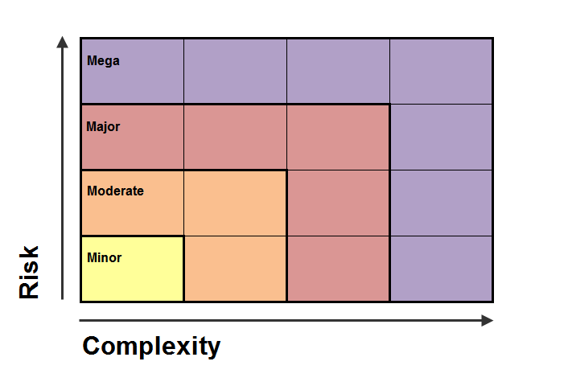
Projects come in different scales

Slide 40
Guide to Highway Project Scale
 |  | MINOR | MODERATE | MAJOR | MEGA
Complexity | Work Type | Resurfacing Signals, lighting, signing | Resurfacing Reconstruction Bridge | Reconstruction New construction Major bridge
 | 2ndary Work Type | Exclusive pavement fix | Culvert replacement Minor structures Utilities | ITS Agreements Railroad
 | Setting | Rural | Rural Urban | Urban Sensitive environment
 | Functions Involved | Few groups | Several groups | Many groups Widely dispersed Interrelated activities
 | Environmental Doc | Exempt or Cat Ex | Cat Ex, EA, EIS | EIS
Risk | Stakeholders | Minor local interest | Heightened local or regional interest | Potential for major conflict Municipal consent | Statewide and/or national notoriety
 | RW | No new R/W | Some new RW Few relocations | Many relocations Sensitive properties
 | Delivery Method | Standard designs Normal delivery time Standard letting process | Design flexibility Accelerated delivery Tested alternative delivery | New engineering technology Recovery schedule Innovative delivery Uncertain objectives or implementation
 | Funding | State Road Construction |  | Innovative financing Local funding | Budget buster
Notes:
This will be refined in January to make it more definitive.

Slide 41
Match Project Management Processes to Project Scale
Project Manager and Sponsor look at complexity and risk of project
Project scale is noted in the Project Charter
Project Manager proposes appropriate approaches to deliver the project
Project Sponsor approves

Slide 42
Expectations: Project Organization
 | Minor | Moderate | Major | Mega
Project Sponsor ² | Assistant District Engineer or Designee (Resident or Design Engineer) | Assistant District Engineer or Designee | District Engineer or Designee | Operations Division Director or Designee
Minimum PM Level | 1 – Project Coordinator | 2 – Project Manager | 3 – Senior Project Manager | 4 – Principal Project Manager
Project Team Organization | Weak Matrix - Project Coordinator coordinates process driven project | Balanced Matrix - Project Manager brings functional groups together on as needed basis | Strong Matrix – Core team with assigned reps from key functional areas authorized to make decisions Team Charter Regular project meetings | Projectized – Core staff reassigned to project and report to PM Team Charter Regular project meetings

Slide 43
Expectations: Processes
 | Minor | Moderate | Major | Mega
Charter | Required | Required | Required | Required
Project Mgmt Plan | One page – includes scope | Simple – includes scope | Full PMP | Full PMP (if over $500,000,000 FHWA approval is required)
Conflict Scoping Process | Apply on all projects, process is naturally scalable to complexity and risk of project |  |  | Conflict Specialist on project team
Scope | In PMP | •In PMP •WBS developed by PM | •Scoping Report •WBS developed by team •Requirements tracking | •Scoping Report •WBS developed by team •Requirements tracking •Scope verification documentation
Schedule⁴ | •Single activity for Work Packages •Updates every 2 weeks | •Single or Multiple activities for Work Packages •Developed by PM •Updates every 2 weeks | •Multiple activities for Work Packages •Developed by team •Project Controls professional to prepare schedule •Updates every 2 weeks | •Multiple activities for Work Packages •Fully cost loaded •Developed by team •Project Controls professional on team •Updates every two weeks and start/finish
Notes:
These will be updated to make simpler, and more definitive

Slide 44
Expectations: Processes
 | Minor | Moderate | Major | Mega
Cost estimate | •TPCE •Engineering estimated by activities •Rule of thumb estimates for contingency •Cost updated as scope changes | •TPCE •Engineering estimated by activities •Contingency based on specific risk items •Cost updated annually | •TPCE •Engineering estimated by activities •Contingency based on specific risk items •Cost updated annually and major milestones | •TPCE •Contingency based on specified confidence in Monte Carlo simulation •Cost updated annually and major milestones •Independent Estimate Validation •Constructability Review •Financial Plan with approval by FHWA required if over $500,000,000
Risk Mgmt | Identify risks | •Risk Register •Annual update | •Risk Workshop •Risk Register •Cost and schedule Monte Carlo •Ongoing updating | •Risk Workshop •Risk Register •Cost and schedule Monte Carlo •Ongoing updating
Change Mgmt | Changes to scope, schedule, cost approved according to Change Matrix | Changes to scope, schedule, cost approved according to Change Matrix | •Changes to scope, schedule, cost approved according to Change Matrix •Utilize Change Management Workflow | •Changes to scope, schedule, cost approved according to Change Matrix •Utilize Change Management Workflow

Slide 45
In Summary…
PM responsible for
      Scope, schedule, budget
      Project charter, PMP, scope, schedule, cost estimate, stakeholders, team, risks, monitoring, project changes
      Remember, these elements are scalable to your project!

Slide 46
In Light of New Expectations…
What does MnDOT and District or Office management expect of project staff?
What are the training needs?
What data/reports/guidance/tools/etc. do we need to be successful?
Do there need to be organizational changes?

