Slide 1
Conflict Scoping Process
Project Managers Forum
November 15, 2012
St. Cloud

Slide 2
CSP Outline
Development of the CSP
  What is conflict?
  What is CSP?
  Why create CSP?
The nine steps of CSP
First Phase Implementation Projects
Training & more
Q & A

Slide 3
What is conflict?
“Conflict is an expressed struggle between at least two independent parties who perceive incompatible goals, scarce resources, and interference from others in achieving their goals.”
-William Wilmot & Joyce Hocker, Interpersonal Conflict

Slide 4
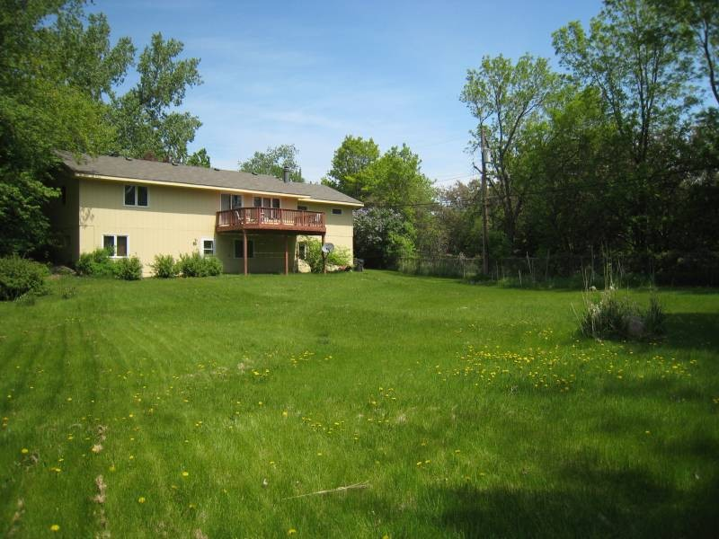
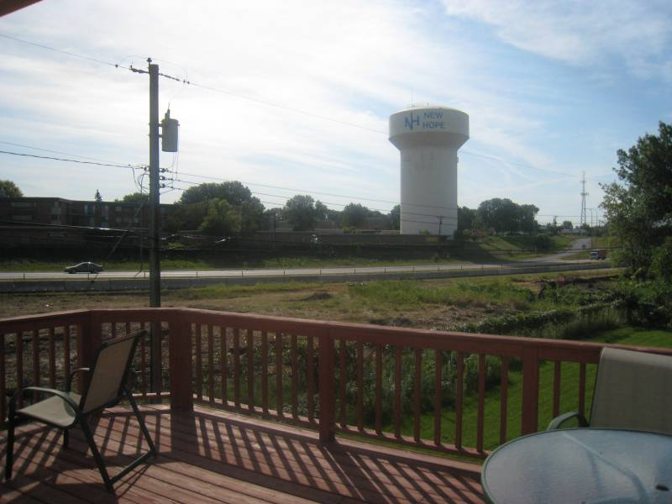
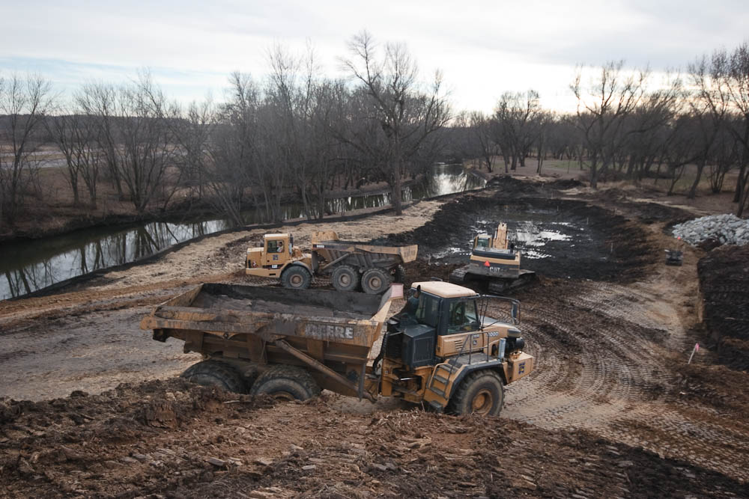
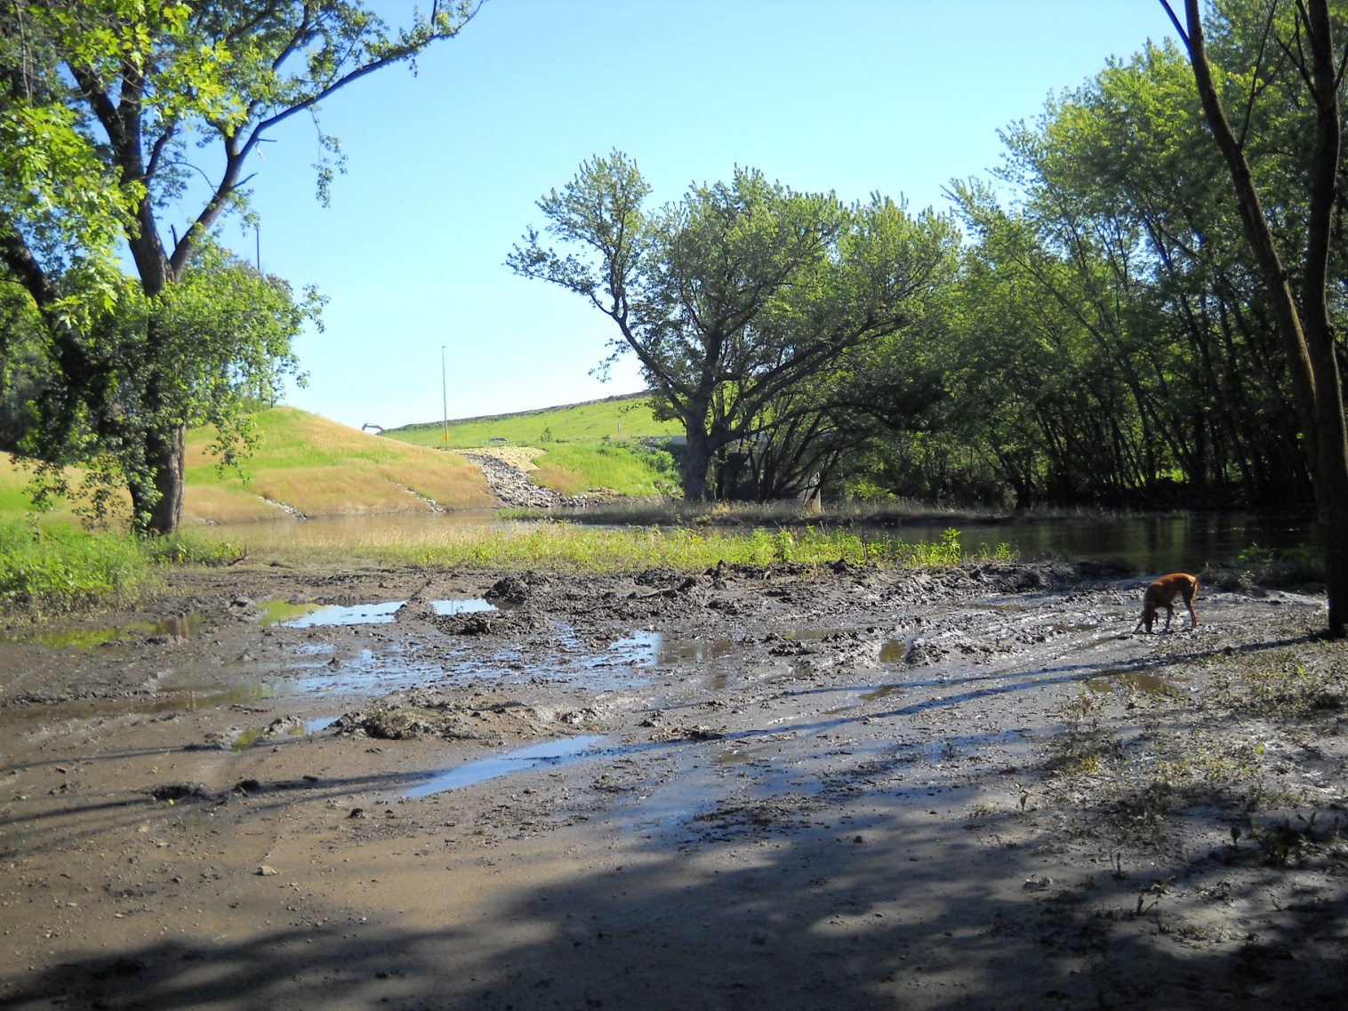
Conflict
MnDOT Trees
Property line

Slide 5
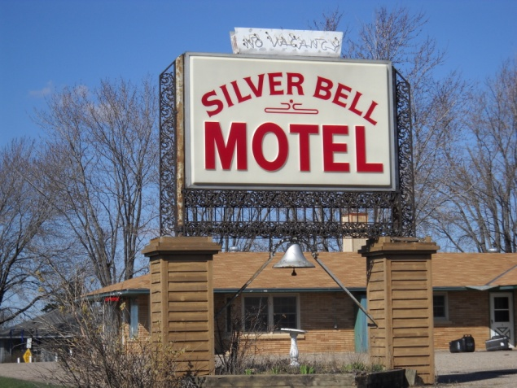
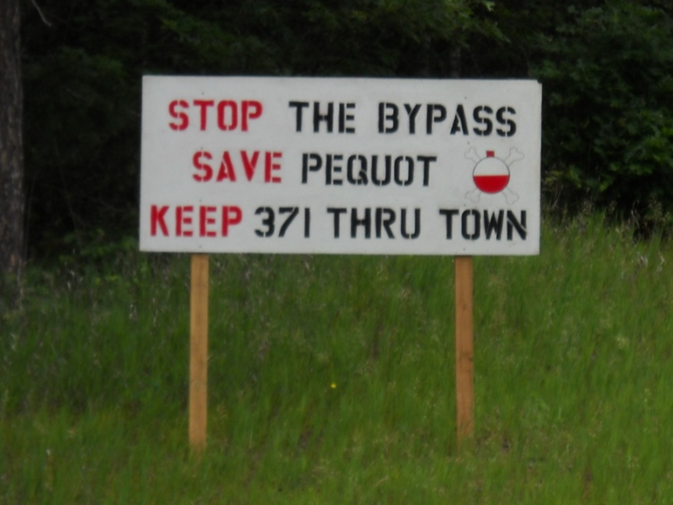
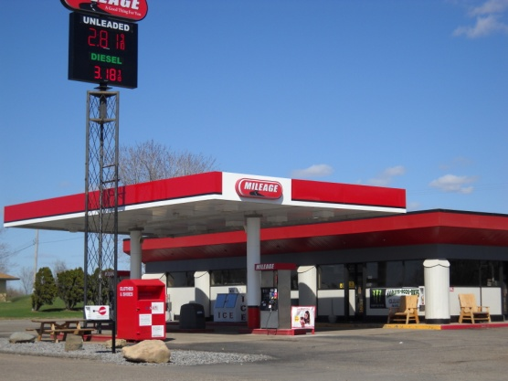
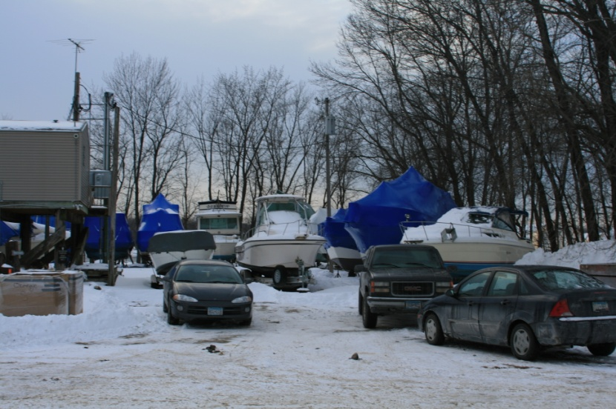
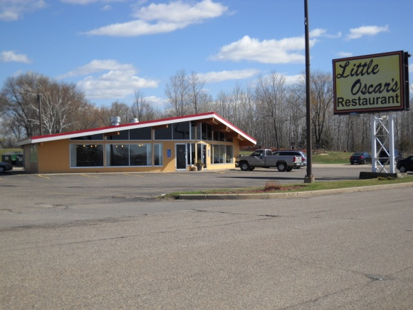
Conflict

Slide 6
What is CSP?
“A formalized, proactive process for the identification, prediction, assessment, management and resolution of conflict.”

Slide 7
What is CSP?
Based on interpersonal relationships
  Historical relationships
    Alliances
    Friction
    Broken
  Power imbalances
  Stakeholders without a voice
Dynamic, fluid

Slide 8
Why create CSP?
Escalation of conflict costs the agency and project time and money
CSP increases accountability, transparency and trust with stakeholders
CSP improves project management processes and links to Hear Every Voice

Slide 9
Risks of escalating conflict
  Cost increases
  Staff time (agency and other) increases
  Media scrutiny
  Relationships tested, potentially damaged
  Trust reduced
  Anxiety increases
  Project purpose questioned or sidetracked
  Many others

Slide 10
CSP
Benefit - PMs, project teams, districts, agency
Unique – formalizes the conflict resolution process
Familiar – contains many elements we already do
Full Expectation - will be part of the project management process and placed into each project on a scalable level

Slide 11
CSP Advisory Committee
Chris Moates, developer and manager
Phil Barnes Deb Ledvina
Jeff Brunner Greg Ous
Mike Ginnaty Jean Wallace
Consultation with the Commissioner, Mike Barnes, Peter Harff and others

Slide 12
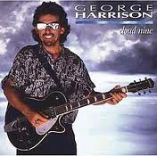
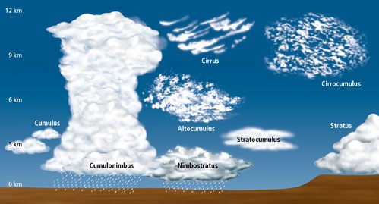
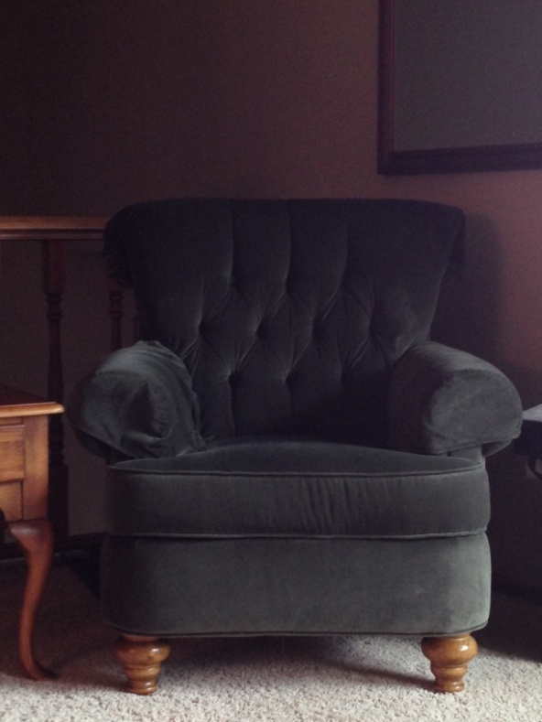
Inspiration: the nine steps/clouds
Cloud 9: A state of extreme happiness

Slide 13
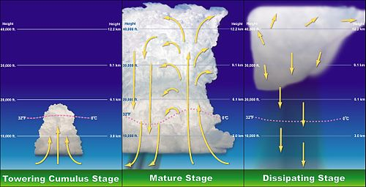
The Nature of Conflict

Slide 14
The nine clouds/steps
Cloud 9: A state of extreme happiness
Project analysis 6. Conflict strategy
Stakeholder ID 7. Conflict management
Conflict ID 8. Conflict review
Conflict ranking 9. Conflict resolution
Conflict mapping

Slide 15
Role of the CPRS
More resources dedicated up front, fewer resources needed later for conflict resolution
The Conflict Prediction and Resolution Specialist
  Could be PM or someone reporting to the PM
  Assists in identifying, predicting and resolving conflict
  Manages CSP Tracker

Slide 16
Step 1: Project Analysis
Team members are educated in self-assessment and conflict resolution
Thorough project research is completed
Analysis of project strengths, weaknesses, opportunities and threats (SWOT) need to be conducted
Project Goals Statement is formalized

Slide 17
Step 2: Stakeholder ID
Internal and external stakeholders are identified
Includes existing and potential relationships between agencies, elected and appointed officials, advocacy groups, and adjacent property owners/tenants

Slide 18
Step 3: Conflict ID
Existing and potential issues are identified at the macro-level related to the stakeholders identified in #2

Slide 19
Step 4: Conflict ranking
Identification of influence and interests of stakeholders is completed
Conflicts are assembled and classified by color (critical – moderate – low)
Strategic resolution options are assessed

Slide 20
Step 5: Conflict mapping
Power Wheel - Systems approach
Identifies relationships between stakeholders
  Alliances
  Friction
  Broken
Power imbalances
Triggering events

Slide 21
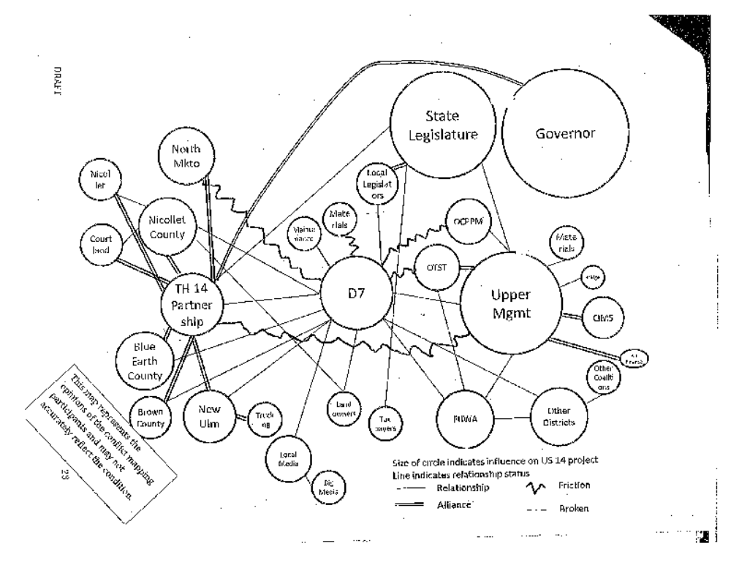

Slide 22
Step 6: Conflict strategies
Many possible options for resolution are generated by the project team
Focus on identifying potential impacts, outcomes, strategies, and planned responses

Slide 23
Step 7: Conflict management
Implementation stage of CSP
Action toward resolution
Communications with stakeholders
Progress tracked

Slide 24
Step 8: Conflict review
Reflective state
Some conflicts resolved
Reevaluate existing conflicts
Regeneration of some conflict
Emergence of other stakeholders and issues
Return to steps 2-7 (?)

Slide 25
Step 9: Conflict resolution
Conflicts tracked until final resolution
Issues where potential conflict never materializes monitored until project completion
Everyone understands each other / “state of happiness” achieved?

Slide 26
CSP post-project analysis
Final report
Lessons learned, best practices
Estimated cost and time savings
Outline of key issues and resolutions
Available on-line for the benefit of other PMs

Slide 27
Implementation
All districts identified at least two projects in the program to deploy CSP immediately
  Consultation with the Operations Division
  Concurrence from Operations Division Manager
Placement on all projects within 18 months
  Designed to carry through planning, scoping, design and construction
  Scalable

Slide 28
First Phase Implementation Projects
  St. Croix Crossing
  TH 53 relocation - Eveleth mine
  TH 1/169 Eagles Nest
  TH 61 Little Marais reconstruction
  Baudette International Bridge
  East Grand Forks Sorlie Bridge
  TH 197 issue with Bemidji
  TH 371 Nisswa-Jenkins expansion
  TH 24 bridge over Mississippi River – Clearwater
  Mill & overlay - TBD (D3)

Slide 29
First Phase Implementation Projects
  I-94/TH 29 interchange - Alexandria
  I-94/TH 75 interchange - Moorhead
  TH 10/TH 59 bridge & reconstruction – DL
  I-35E/Cayuga (N)
  Shakopee Hwy 101 Bridge (S)
  TH 65 railroad bridge (E)
  Metro (W)
  Red Wing Bridge
  Winona Bridge

Slide 30
First Phase Implementation Projects
  TH 60 Worthington
  TH 14 Mankato-New Ulm
  TH 22 Mankato roundabouts
  TH 109 mill & overlay
  TH 12 downtown Litchfield
  TBD (D8)
  TBD (D8)

Slide 31
Other key points
Audiences reached to date: Division Directors, Operations, PCMG-CMG, PMs
CSP document available soon (PM friendly)
Modifications every six months on average
District visits with PMs – November-January
Training for all PMs & others on CSP, conflict resolution & negotiating skills starting March/April 2013

Slide 32
Questions?
Chris Moates
CSP Developer and Manager
Deputy Ombudsman
Chris.Moates@state.mn.us
651-366-4790

