Slide 1
Thermally Insulated Concrete Pavements:
Life-Cycle Cost Analysis Methods and Preliminary Results
January 10, 2011
John Harvey
Nick Santero
Lev Khazanovich

Slide 2
Background
Compare thermally insulated concrete pavements (TICP) with conventional concrete designs using life-cycle cost analysis (LCCA)
  Use net present value (NPV) to calculate life-cycle costs
  Develop model to compare various alternatives and test variable sensitivity
Identify situations/circumstances where TICP offers potential cost savings, for example:
  Construction type (new, rehab, etc.)
  Desired service life
  Location/Region/Agency

Slide 3
Tasks and Status
Create TICP/JPCP LCCA tool
  First version tool created
  Tool will need updating based on feedback from initial studies and to better reflect non-California practices
Survey TICP agencies for input data
  California information taken from LCCA manual and knowledge, not yet discussed with Caltrans
  Initial data collected from WSDOT and MnDOT
Perform preliminary comparisons
  Two California cases analyzed using conceptual performance data
  Additional studies should be performed after performance analyses are completed

Slide 4
Data Collection and Sources
Surveyed three states for data
  California (Caltrans)
  Minnesota (MnDOT)
  Washington (WSDOT)
Current analysis uses California data
  Maintenance schedules, annual maintenance costs and LCCA protocol adapted from Caltrans’ LCCA Manual
  Unit material and construction costs for contract maintenance and rehabilitation estimated from Caltrans’ Construction Cost Database, LCCA Manual and UCPRC studies

Slide 5
Model Development
LCCA model based in Excel
  Focuses exclusively on agency cost
Calculates NPV and Crossover Points
  NPV: establishes life-cycle costs over a specified analysis period
  Crossover points: identifies the future year when one alternative (e.g., TICP) becomes economically rational decision
All inputs are user-defined
  Users can specify agency- or project-specific values for every parameter
  Additional parameters (e.g., specific material and unit costs) can be added as necessary

Slide 6
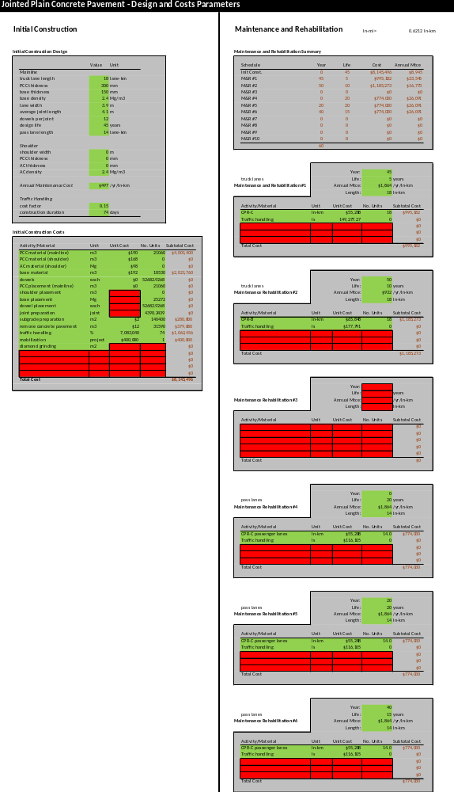
Model Screenshots (1 of 3)
Design and Maintenance Inputs

Slide 7
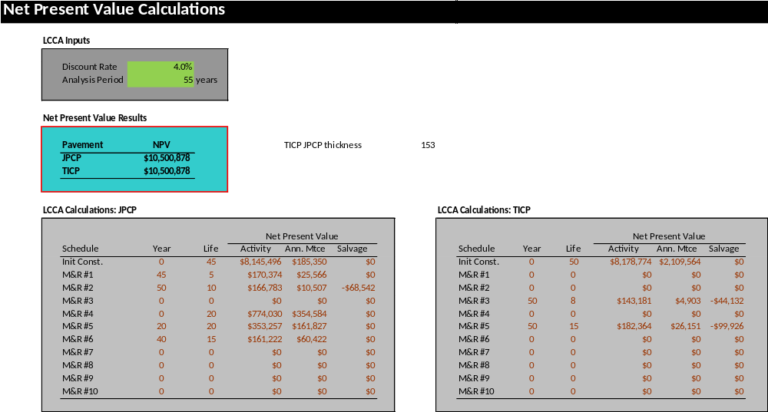
Model Screenshots (2 of 3)
NPV Results

Slide 8
Model Screenshots (3 of 3)
Time Series and Crossover Points

Slide 9
LCCA Approach
Solve for two key unknowns:
  Maximum PCC thickness for TICP in order to be cost effective compared to JPCP
  Minimum extension of life needed by TICP design in order to be cost effective compared to JPCP

Slide 10
California Case Studies
Case 1: Lane replacement of truck lanes in Southern California as TICP instead of JPCP. This project is based on the scope of a real project on I-15 near Devore (District 8).
Case 2: Convert multi-lane highway in Northern California into divided highway by adding new direction with TICP instead of JPCP. This project is roughly based on the scope of a real project on State Route 70 near East Nicholas (District 3).

Slide 11
California Designs
Case 1 – Lane Replacement
Case 2 – New Construction
(in mm) | JPCP | TICP #1 | TICP #2
AC surface |  | 30, 45 | 75, 105
PCC | 300 | 300* | 255*
AC base | 150 | 150 | 150
 | JPCP | TICP # 1 | TICP #2
AC surface |  | 30, 45 | 75, 105
PCC | 255 | 255* | 225*
LCB base | 150 | 150 | 150
Two TICP designs are compared for each Case Study
  Thinner versus thicker PCC slab thickness
When solving for PCC thickness, asterisked (*) thickness are solved for rather than inputted
AC surface is either conventional hot-mix asphalt (HMA) or rubberized hot-mix asphalt (RHMA)
  Factorial considers price of both materials
Future maintenance schedules adapted from Caltrans LCCA manual

Slide 12
California Factorial
Each case and design was evaluated by altering several key parameters
  AC surface thickness and type (30, 45 for HMA and RHMA; 75 for RHMA and 105 mm for HMA)
  AC unit cost ($154 or $192/m³ for HMA, $192 or $240/m³ for RHMA); unit cost for PCC was $190/m³
  Traffic handling costs (15%, 50% of construction costs)
Future factorials could be run for other design uncertainties
  Unit price for TICP concrete slab
  Cost changes for smoothness requirements

Slide 13
California Results
Example for Thickness Solutions
Traffic Handling Cost on M&R (% pave cost) | TICP HMA/RHMA type, thickness | TICP Design No. | JPCP PCC thickness (mm) | TICP PCC thickness for equal NPV (mm)
15 | HMA 105 mm | 1 | 300 | 171
15 | RHMA 75 mm | 1 | 300 | 185
15 | HMA 30 mm | 2 | 255 | 217
15 | HMA 45 mm | 2 | 255 | 196
15 | RHMA 30 mm | 2 | 255 | 207
15 | RHMA 45 mm | 2 | 255 | 180
50 | HMA 105 mm | 1 | 300 | 175
50 | RHMA 75 mm | 1 | 300 | 190
50 | HMA 30 mm | 2 | 255 | 229
50 | HMA 45 mm | 2 | 255 | 208
50 | RHMA 30 mm | 2 | 255 | 218
50 | RHMA 45 mm | 2 | 255 | 192

Slide 14
California Results
Example for Life Extension Solutions
Traffic Handling Cost on M&R (% pave cost) | HMA/RHMA type, thickness | TICP Design No. | JPCP PCC thickness | TICP PCC thickness | TICP % PCC life change for same NPV
15 | HMA 105 mm | 1 | 300 | 300 | >70%
15 | RHMA 75 mm | 1 | 300 | 300 | >70%
15 | HMA 30 mm | 2 | 300 | 255 | 24%
15 | HMA 45 mm | 2 | 300 | 255 | 54%
15 | RHMA 30 mm | 2 | 300 | 255 | 37%
15 | RHMA 45 mm | 2 | 300 | 255 | >70%
50 | HMA 105 mm | 1 | 300 | 300 | >70%
50 | RHMA 75 mm | 1 | 300 | 300 | >70%
50 | HMA 30 mm | 2 | 300 | 255 | 17%
50 | HMA 45 mm | 2 | 300 | 255 | 44%
50 | RHMA 30 mm | 2 | 300 | 255 | 30%
50 | RHMA 45 mm | 2 | 300 | 255 | 67%

Slide 15
California Results
Summary
Results indicate that marginal PCC thickness reductions in TICP are needed to make the pavement cost effective compared with JPCP
  Results are similar for both Case 1 (lane replacement) and Case 2 (new construction)
  Results are especially favorable to TICP when asphalt costs are lower
Life extension results are mixed for the different cases
  Case 1: some scenarios (e.g., shorter initial service lives and lower asphalt costs) found minimal (<30%) life extension needed to be competitive with JPCP, others found unreasonably high life extensions needed
  Case 2: all scenarios required large life extensions in order to be competitive with JPCP

Slide 16
Key Limitations and Assumptions
Cost of PCC assumed to be same for life extension cases, where PCC layer has same thickness in both JPCP and TICP. May be conservative if specifications for TICP pavement PCC include relaxed smoothness and other surface characteristics requirements.
For PCC thickness requirement cases, cost per volume of the PCC is assumed to be same for new JPCP and TICP pavements. PCC unit costs for TICP may be lower if mix specification changes regarding surface durability.
Potential environmental benefits not considered through a Life Cycle Assessment (LCA).
  PCC in TICP pavements may use higher percentages of supplementary cementitious materials, recycled concrete aggregates, or lower cost local aggregates. Offsetting benefits are environmental costs of HMA.
Analysis does not consider noise or ride quality over the life cycles.
No user delay costs caused by construction were included.

