Slide 1


Merits and Demerits of Stringlines
Bernard Igbafen Izevbekhai P.E.; Ph.D.
Research Operations Engineer
Norma Farah B.S.; M.S. Candidate
Student Worker Paraprofessional (Snr)
Research Section
Office Of Materials & Road Research
Minnesota Department of Transportation
"If I have seen further it is by standing on the shoulders of Giants.“
--Sir Isaac Newton 1675
Presented at NRRA Pavement Workshop 05/23/2019 AD

Slide 2
Scope
Does not analyze stringless paving.
Evaluates potential errors in Stringline paving
Generates and analyzes extremal catenaries in the Spectral Domain
Determines and interprets extremal influences
Validates the demerits of Stringlines
Makes a philosophical case for stringless paving
Recommends Stringless paving

Slide 3
Completed Federal Study
SHRP 2 R06(E) [Completed]
Real-Time Smoothness Measurements on Portland Cement Concrete Pavements During Construction
Funds: | $550,000
Research Agency: | The Transtec Group, Inc.
Principal Investigator | Robert Otto Rasmussen & Steven M. Karamihas
Effective Date: | 2/20/2009
Completion Date: | 11/30/2011
National Academies of Sciences, Engineering, and Medicine 2013. Real-Time Smoothness Measurements on Portland Cement Concrete Pavements During Construction. Washington, DC: The National Academies Press.
https://doi.org/10.17226/22767.
Was a member of the expert task group for stringless paving
Notes:
Was a member of the expert task group for stringless paving

Slide 4
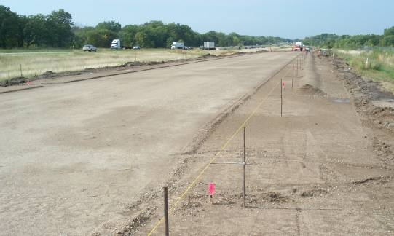
Sources of Field Errors
Rasmussen et al identified 3 unique effects of stringlines as
The chord effect,
The sag effect and
Survey errors
Susceptible to Diurnal Swings
Susceptible to Impacts
Rasmussen, R O; Karamihas, S M; Cape, W R; Chang, G K; Guntert Jr, R M Stringline Effects on Concrete Pavement Construction TRB Transportation Research Record 2000 Issue Number:

Slide 5
Addition and Subtraction of Profilograms (Previous Work)
Random+15-ft upward catenary 104%
Random+15-ft downward catenary 106%
Random+15-ft sine wave 115%
Random+25-ft upward catenary 21%
Random+25-ft sine wave 22%
Random+50-ft upward catenary 9%
Random+50-ft sine wave 9%
Random+15-ft and 25-ft upward
catenaries 118% Increase over Random
Wilde, Izevbekhai & Cruze (2007)

Slide 6
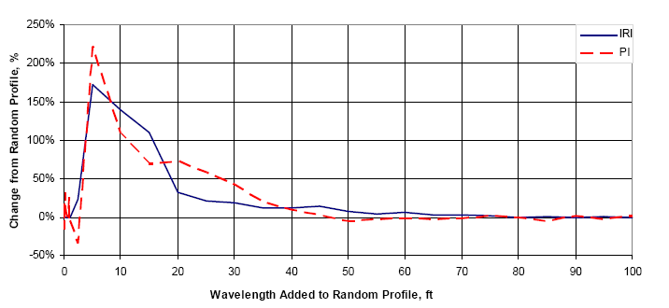
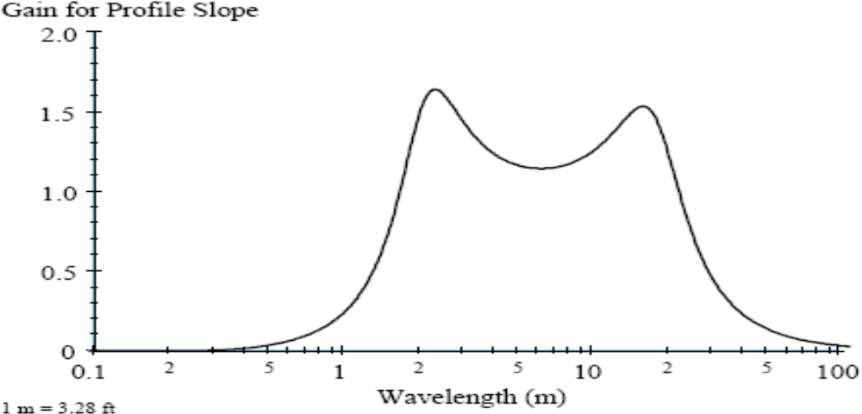
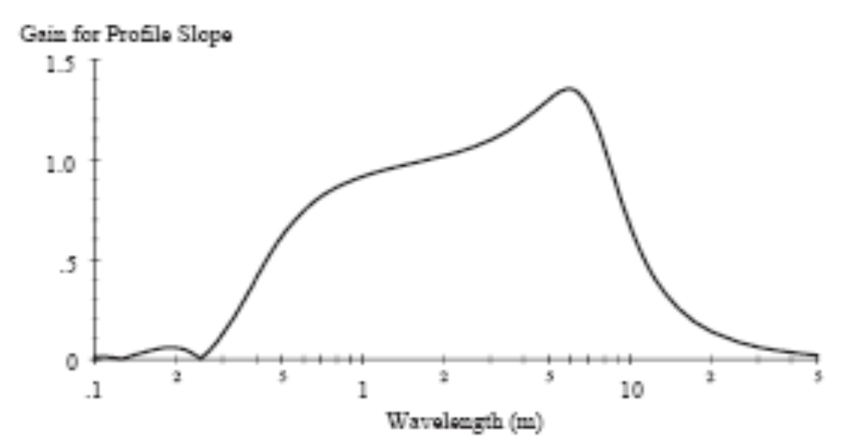
Addition and Subtraction of Profilograms
Wilde, Izevbekhai & Krause 2007

Slide 7
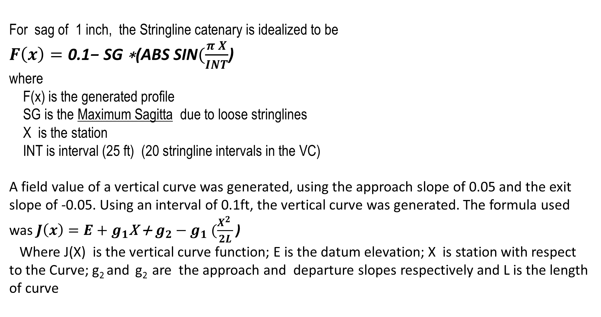
Generating a Sag in Stringline Catenary & Vertical Curve
For sag of 1 inch, the Stringline catenary is idealized to be
$F\left(x\right)=\text{0.1− }\text{SG}\text{ ∗(}\text{ABS} \text{SIN}(\frac{π X}{INT}$)
where
F(x) is the generated profile
SG is the Maximum Sagitta due to loose stringlines
X is the station
INT is interval (25 ft) (20 stringline intervals in the VC)
A field value of a vertical curve was generated, using the approach slope of 0.05 and the exit slope of -0.05. Using an interval of 0.1ft, the vertical curve was generated. The formula used was $J\left(x\right)=E+g_{1}\text{X}\text{ + }g_{2}−g_{1} (\frac{X^{2} }{2L}\text{)}$
Where J(X) is the vertical curve function; E is the datum elevation; X is station with respect to the Curve; g₂ and g₂ are the approach and departure slopes respectively and L is the length of curve

Slide 8
Analyzing The Curves
STATION | VC | STR | STR IN FEET | VC + STR | STR CHORD
0 | 0 | -0.01257 | -0.00105 | -0.00105 | 0
0.1 | -0.005 | -0.02513 | -0.00209 | -0.00709 | -0.00475
0.2 | -0.01 | -0.03769 | -0.00314 | -0.01314 | -0.0095
0.3 | -0.01499 | -0.05024 | -0.00419 | -0.01918 | -0.01425
0.4 | -0.01998 | -0.06279 | -0.00523 | -0.02522 | -0.019
0.5 | -0.02498 | -0.07533 | -0.00628 | -0.03125 | -0.02375
0.6 | -0.02996 | -0.08785 | -0.00732 | -0.03728 | -0.0285
0.7 | -0.03495 | -0.10036 | -0.00836 | -0.04331 | -0.03325
0.8 | -0.03994 | -0.11286 | -0.0094 | -0.04934 | -0.038
0.9 | -0.04492 | -0.12533 | -0.01044 | -0.05536 | -0.04275
1 | -0.0499 | -0.13779 | -0.01148 | -0.06138 | -0.0475
1.1 | -0.05488 | -0.15023 | -0.01252 | -0.0674 | -0.05225
1.2 | -0.05986 | -0.16264 | -0.01355 | -0.07341 | -0.057
1.3 | -0.06483 | -0.17502 | -0.01459 | -0.07942 | -0.06175
Plus 4986 Rows of Data

Slide 9
Catenary and Profiles Generated Mathematically

Slide 10
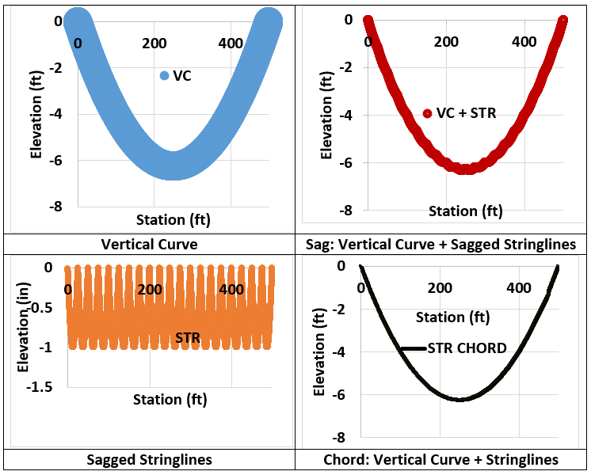
Derived Profiles

Slide 11
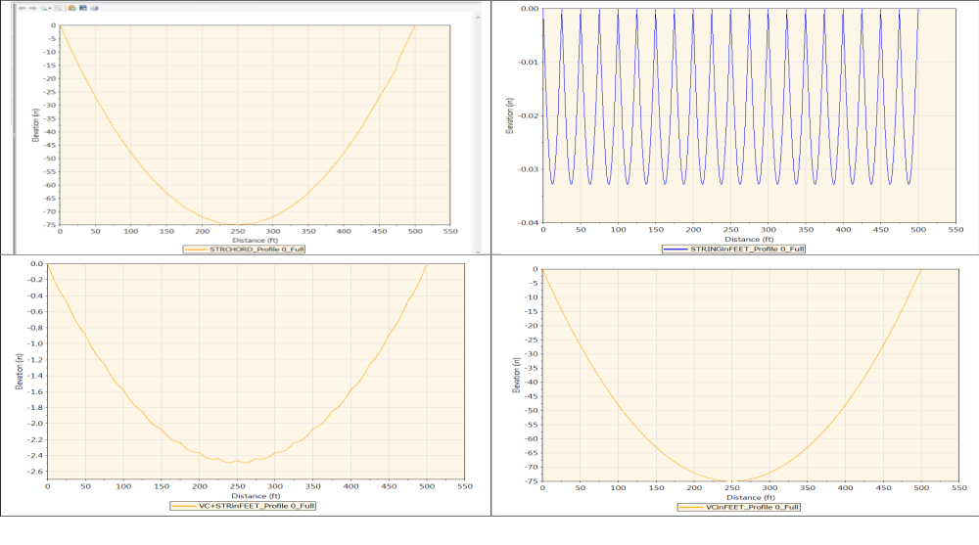
Resulting Profilograms

Slide 12
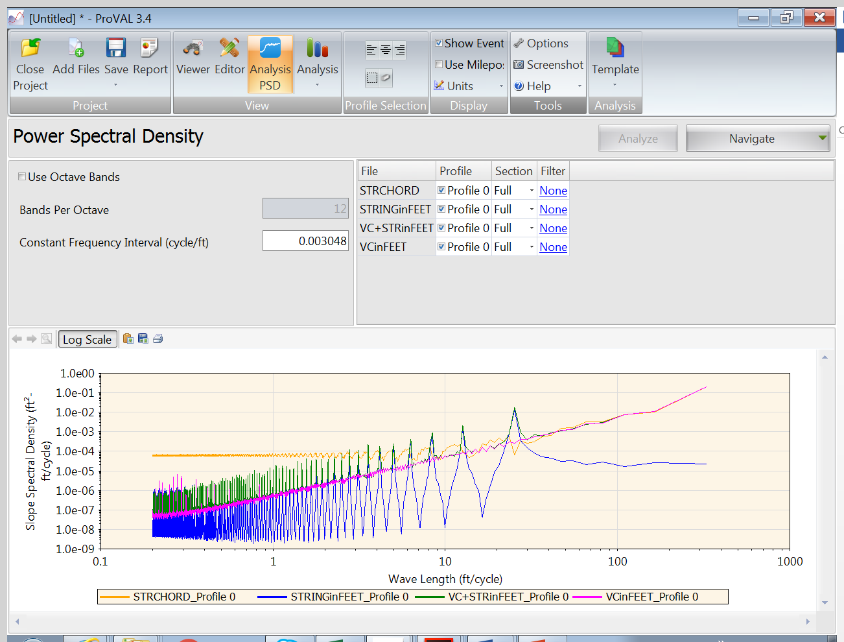
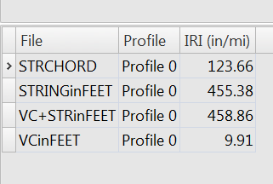
Results of Stringline-Induced IRI
Preponderant 25 Ft Waveform In Chord & Sag Effects
Stringline error contribution to IRI = 455 in/Mile
For 1/2 of the stringlines sagged to ½ inch= 114 in/mile
Profilogram additions are algebraic but not arithmetic unless
causative factors are similar.

Slide 13
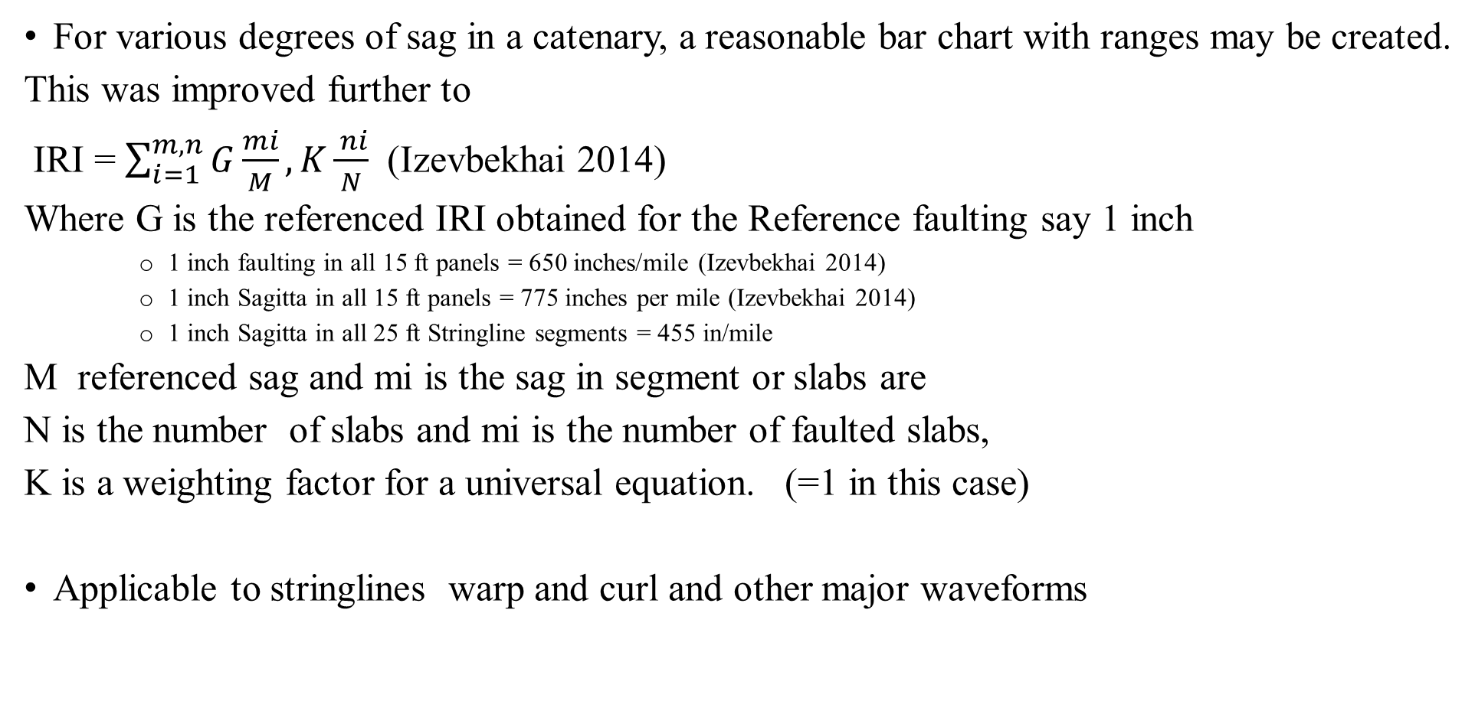
Agglomeration & Superposition of Similar Features
For various degrees of sag in a catenary, a reasonable bar chart with ranges may be created.
This was improved further to
IRI = $\sum_{i=1}^{m,n}{G\frac{mi}{M}},K\frac{ ni}{N}$ (Izevbekhai 2014)
Where G is the referenced IRI obtained for the Reference faulting say 1 inch
    1 inch faulting in all 15 ft panels = 650 inches/mile (Izevbekhai 2014)
    1 inch Sagitta in all 15 ft panels = 775 inches per mile (Izevbekhai 2014)
    1 inch Sagitta in all 25 ft Stringline segments = 455 in/mile
M referenced sag and mi is the sag in segment or slabs are
N is the number of slabs and mi is the number of faulted slabs,
K is a weighting factor for a universal equation. (=1 in this case)
Applicable to stringlines warp and curl and other major waveforms

Slide 14
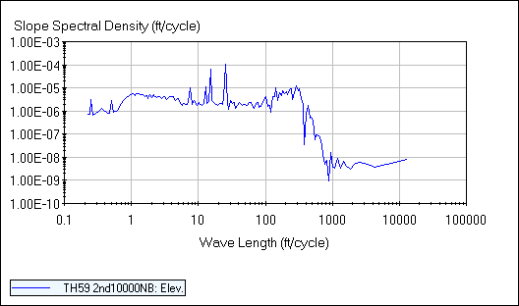
Case Study TH 59 Morris
Chatter Phenomena :Pattern Similar to a 25-foot wavelength.
Spectral analysis indicated preponderant 25 ft waveform
“Chatter” may have been caused by a discrepancy in the paving operation that occurred at an approximate interval of 25-ft.
Did the contractors struggle with loose string lines or loose pins during the operation.
That was the case.

Slide 15
Conclusion
Stringline effects are real and Significant but warp and curl as well are faulting are Individually and synergistically more Significant.
Stringless Paving does not correct existing errors but will facilitate correction of subsequent anomalies
Benefit /Cost of Stringless Paving will be more obvious with increased usage.
Innovation tries hard but tradition dies hard. The Street of Whatever leads to a destination of Never.
Choose Innovation: Choose Stringless Paving.

Slide 16

Acknowledgements
Glenn Engstrom & Jeff Brunner (MnDOT)
Joe Meade Doug Schwartz & Joe Thomas (MnDOT Rtd.)
Tom Nordstrom & Dave Janisch (MnDOT)
Matt Zeller (CPAM)

Slide 17
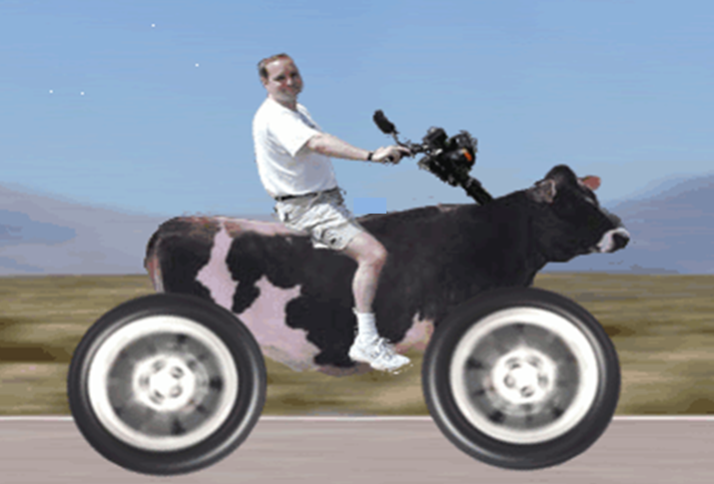


What is Sustainability ?
A process where no animals (or Humans including future generations) are / were harmed!!

Slide 18
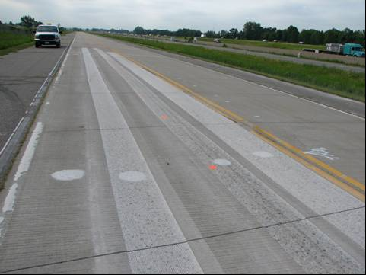

QUESTIONS
THE ENDLESS ROAD OF RESEARCH

