Slide 1

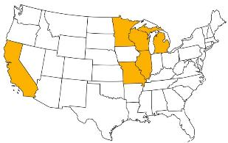
2018 Pavement Workshop
May 23-24, 2018
Roadway Applications Using TDA
Joaquin Wright
Senior Project Manager, TDA specialist
+ 46 Associate Members

Slide 2
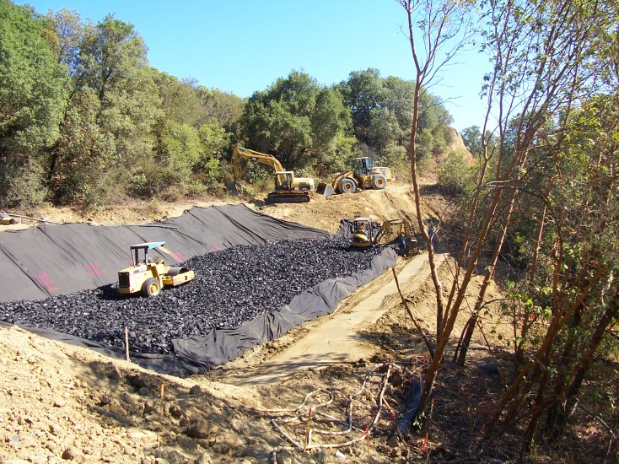
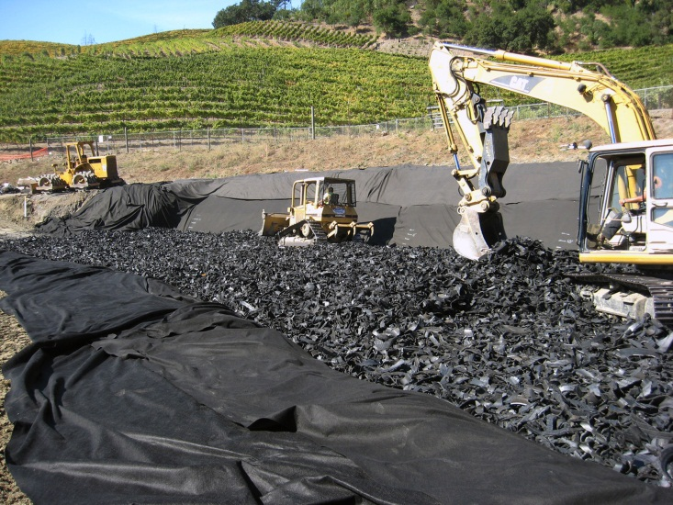
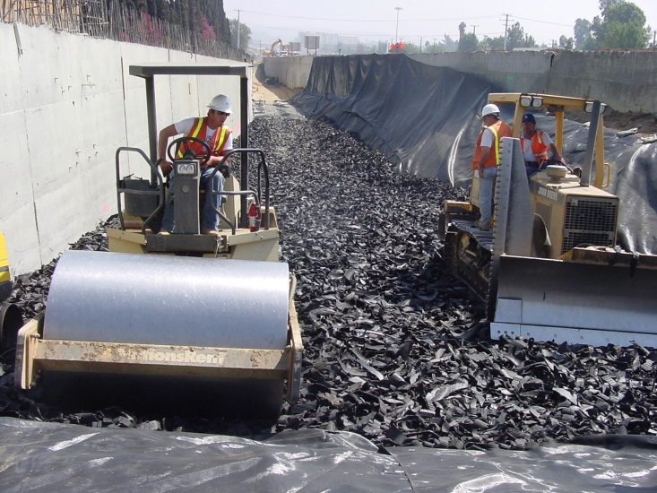
ROADWAY APPLICATIONS USING TDA
PRESENTED BY:
Joaquin Wright, GHD Inc.
TO:
NRRA
5/23/18

Slide 3
Todays Presentation
Introduction to TDA in California Video
Roadway Applications in California

Slide 4
CalRecycle’ s Objective is to promote the use of TDA in Civil Engineering Applications
Educate Local Public Works, CALTRANS, Private Consulting Civil Engineers and State and Local Environmental Agencies on the benefits of TDA
  Engaged with National Scrap Tire Work Group
Research – Develop Sustainable, Environmental Beneficial and Cost Effective Civil Engineering Reuses for Waste Tires
Coordinate and Assist Waste Tire Processors to assure there is adequate TDA to meet future demand.

Slide 5
Beneficial Properties of Tire Derived Aggregate (TDA) in Civil Engineering Applications
Tire Derived Aggregate (TDA) has properties that civil engineers, public works directors & contractors need
  Lightweight
  Free Draining/High Permeability
  Low earth pressure
  Good thermal insulation, .2 Cal/m-hr C
    >5x better then soil
    Does not hold moisture or “wick”, therefore no decreased performance due to water
  Durable
  Compressible
  May be cheapest solution
  Helps the environment when used in sustainable infrastructure
  Conserve natural aggregate resources

Slide 6
TDA ASTM Guidelines D6270 -2017
  Construction practices
    Design and Construction guidelines
      Geotextile separator
      10 ft lifts
      Compacted dry density of ~50lbs/cf
      min. 10 tons vibratory steel wheel compactor, six passes
  Material Specifications
    Type A, 2-4 inch nominal
    Type B, 6-12 inch nominal
  Leachate
    TDA can be placed Above and Below water table with negligible effects on water quality.

Slide 7
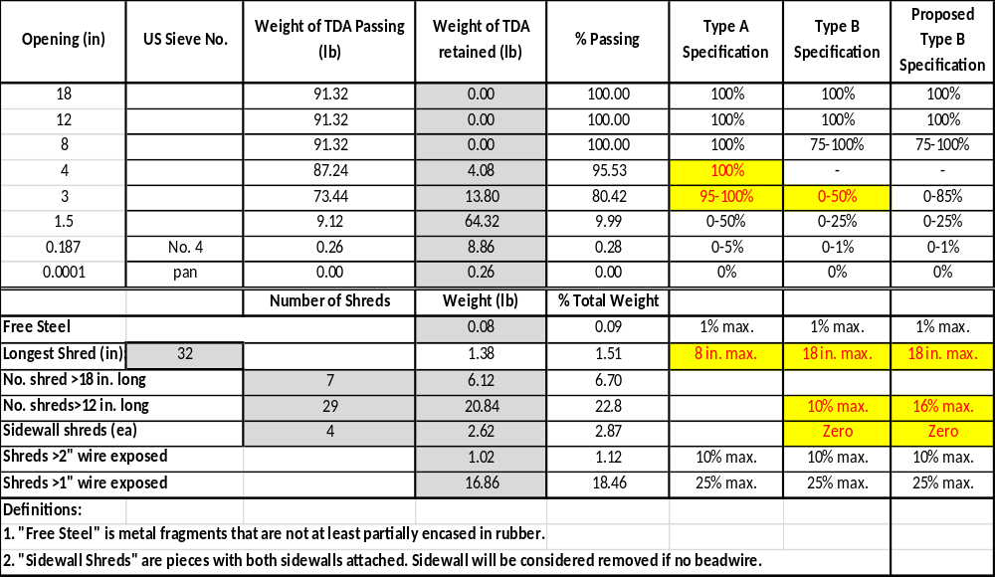
TDA Gradation Specification
Sample Gradation of TDA

Slide 8
Roadway Uses for Tire Derived Aggregate
Lightweight fill for Road Embankments
Lightweight fill for Road Slide Repair
TDA in Low Impact Development (LID) Roadway Storm-Water infiltration galleries

Slide 9
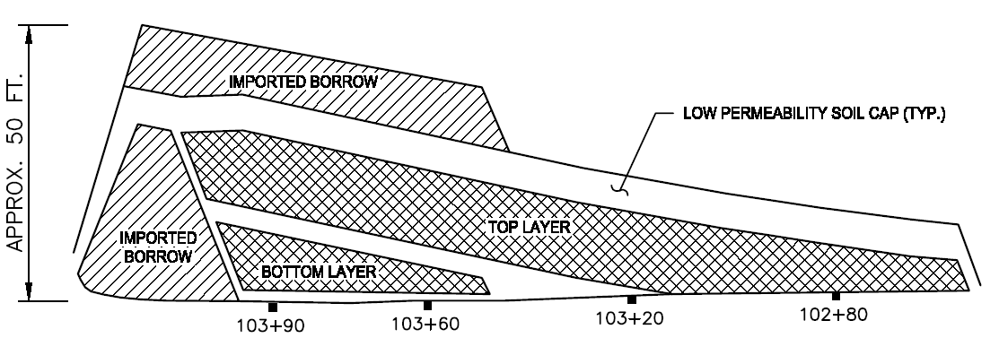
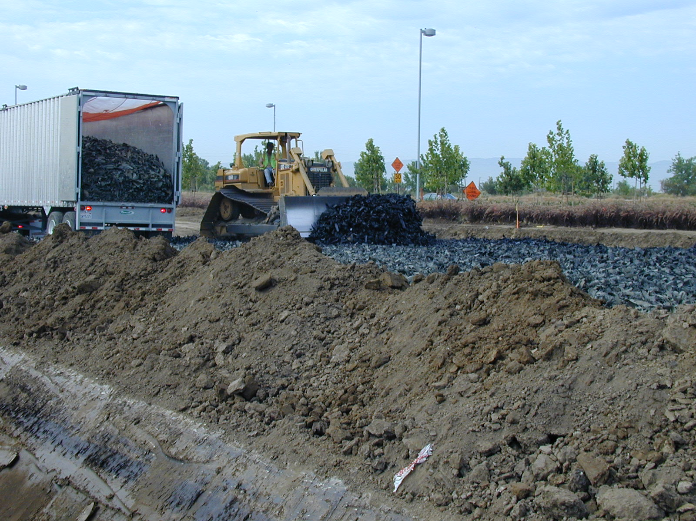
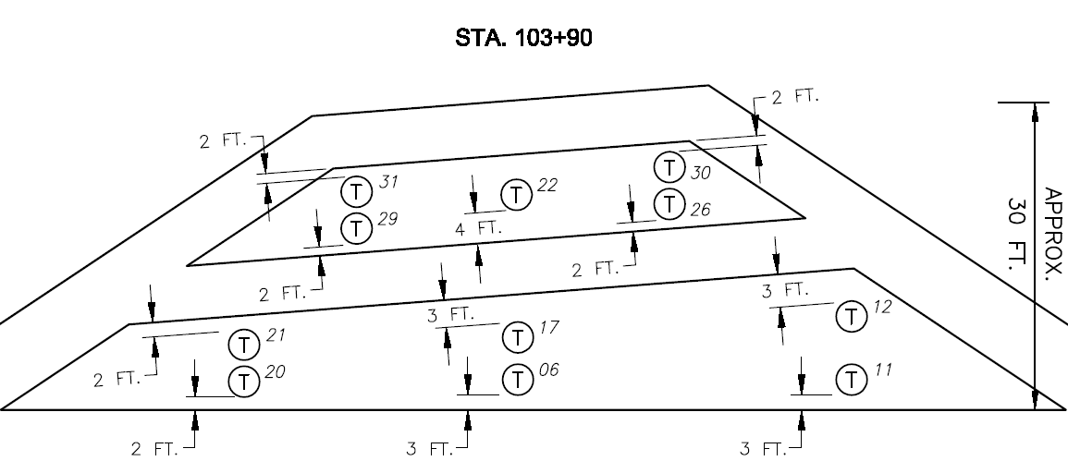
Embankment Projects
Dixon Landing/HWY 880 Interchange Project

Slide 10
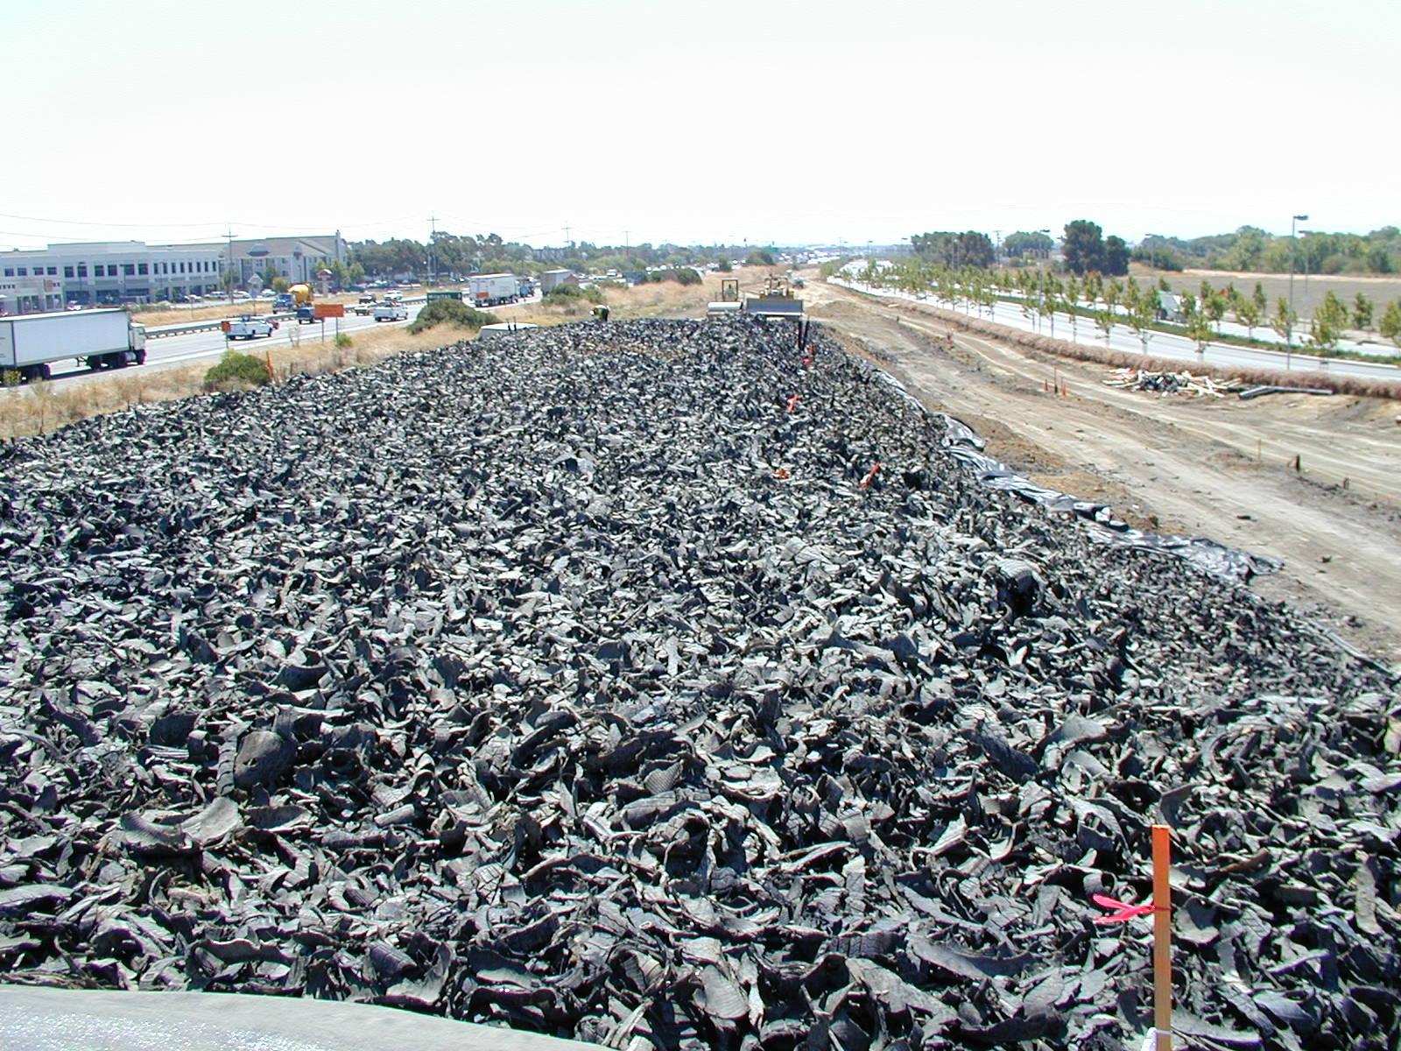
660,000 Tires
TYPE B TDA
DIXON LANDING

Slide 11
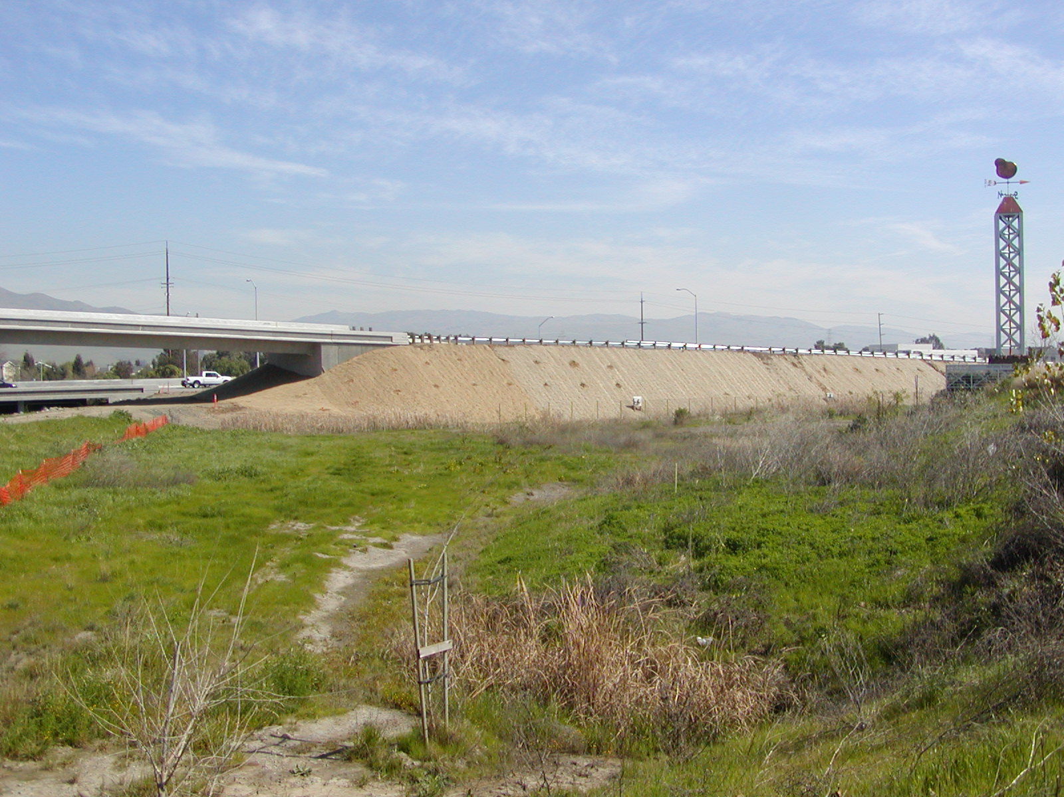

Slide 12
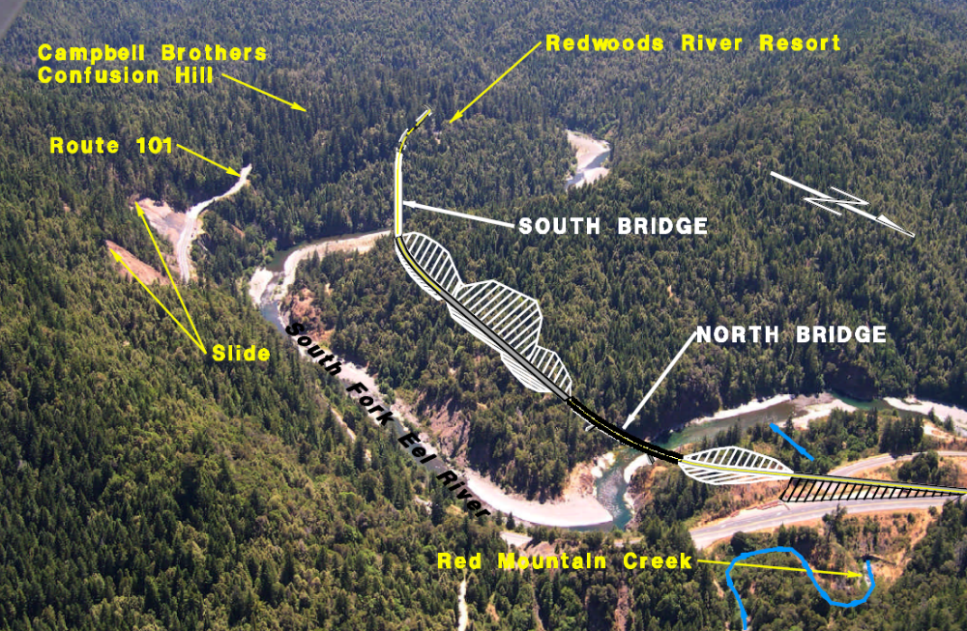
Confusion Hill Embankment Project

Slide 13
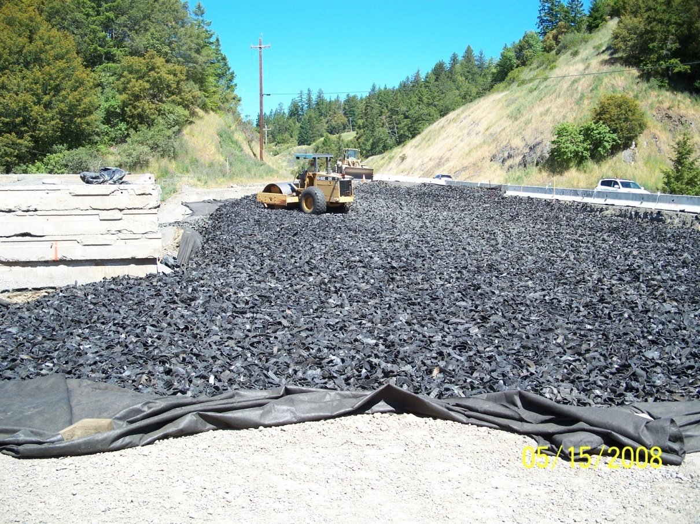
Confusion Hill - Lightweight TDA Embankment Project 2008
270,000 Tires
TYPE B TDA
Notes:
This project started in this summer and is being constructed in 4 phases. Placement of all the TDA will be completed next year.
This project will use 270,000 PTE’s of TDA and will save the State of California approximately $320,000.

Slide 14
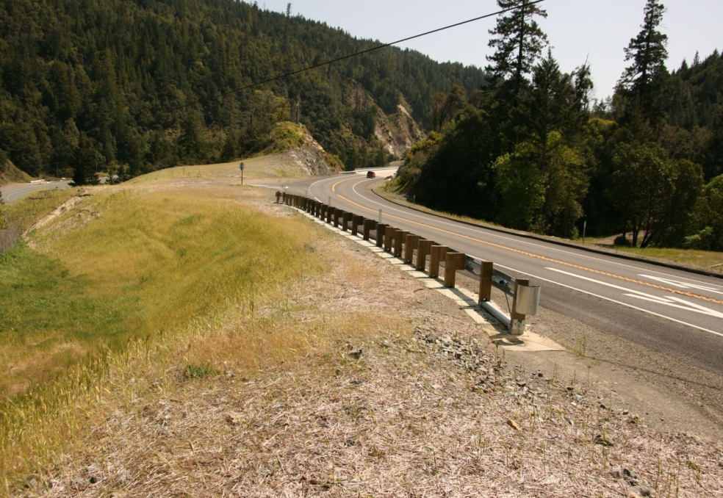
Confusion Hill
Final Project

Slide 15
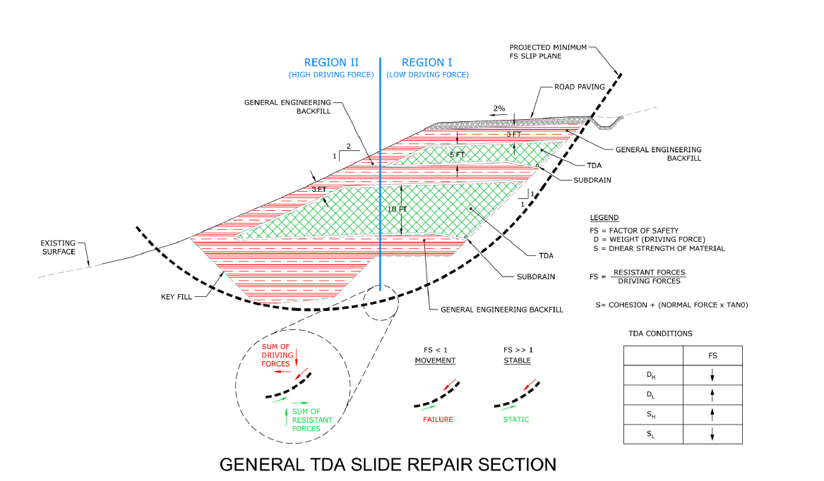

Slide Repair Projects
2007 – Marina Drive, Mendocino Co. Landslide Repair
2008 - Sonoma Co. Geysers Rd. Landslide Repair Project
2009 - Sonoma Mtn. Road , Landslide Repair Project
2012 – Santa Barbara, Palomino Road

Slide 16
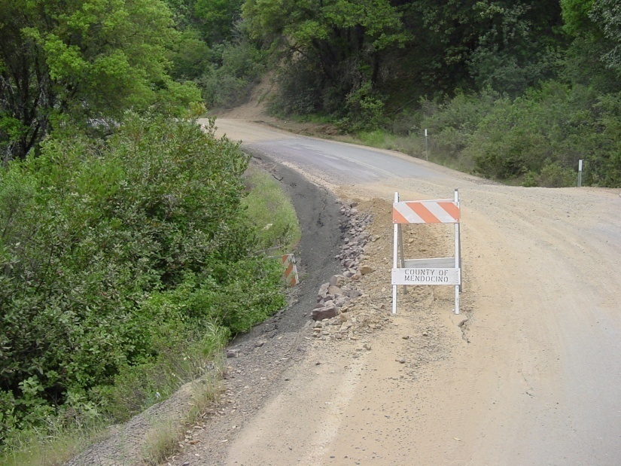
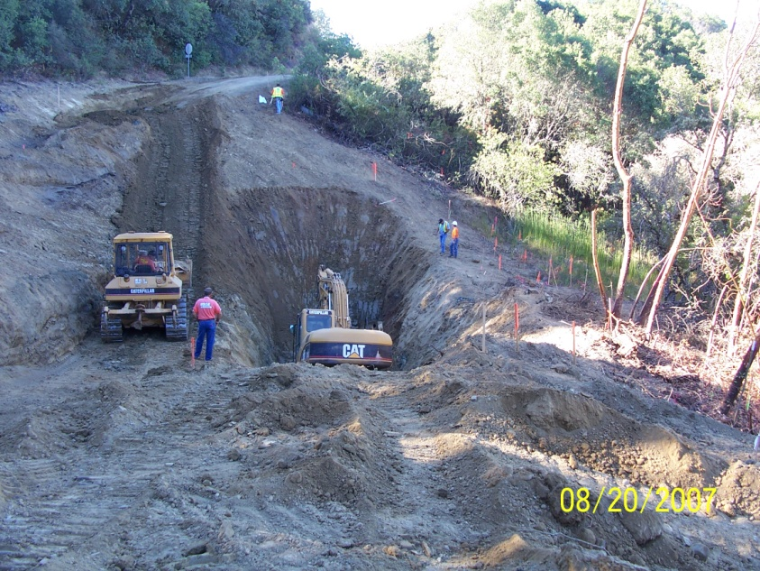
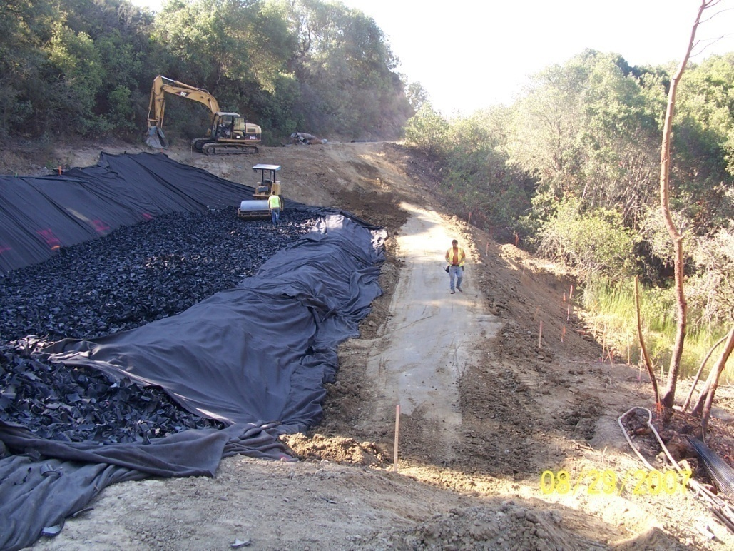
Marina Drive Slide Repair

Slide 17
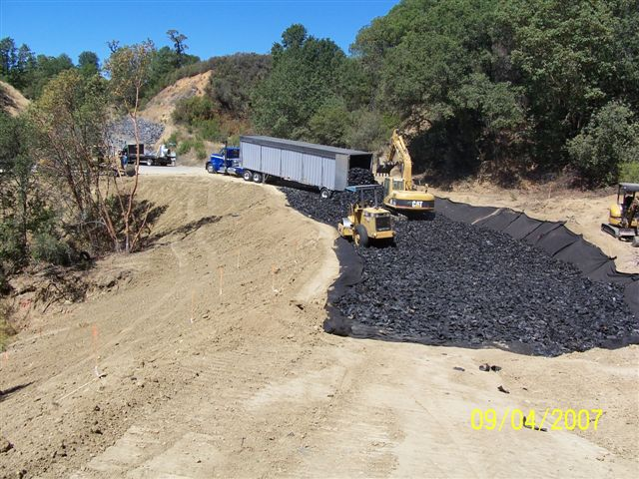
Mendocino County, Marina Dr.
133,000 Tires
TYPE B TDA

Slide 18
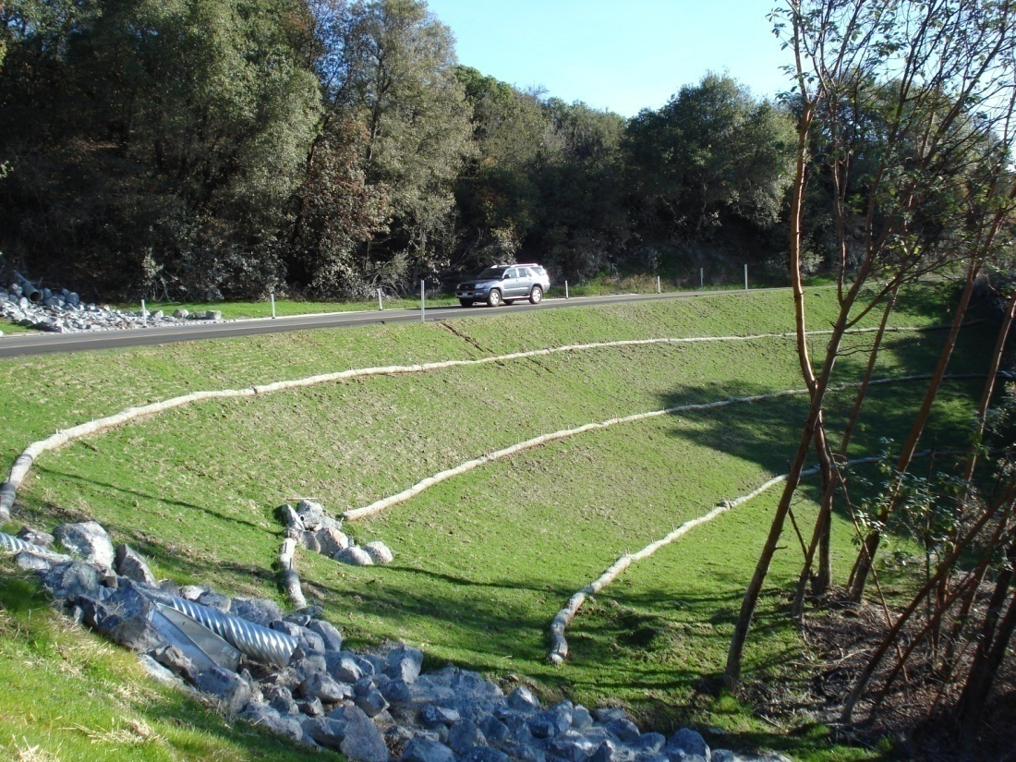
Marina Drive Slide Repair
Savings to the County $90,000

Slide 19
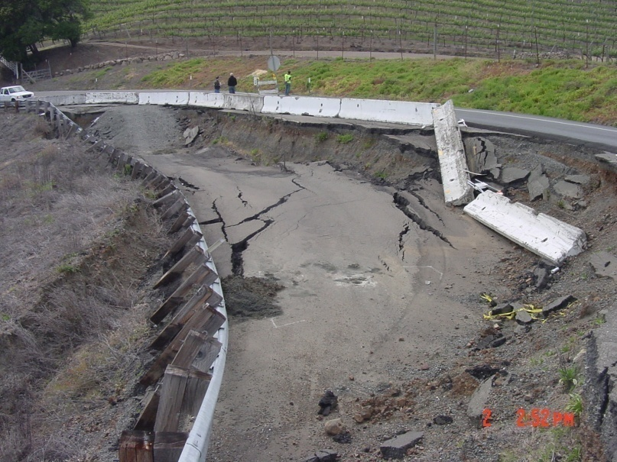
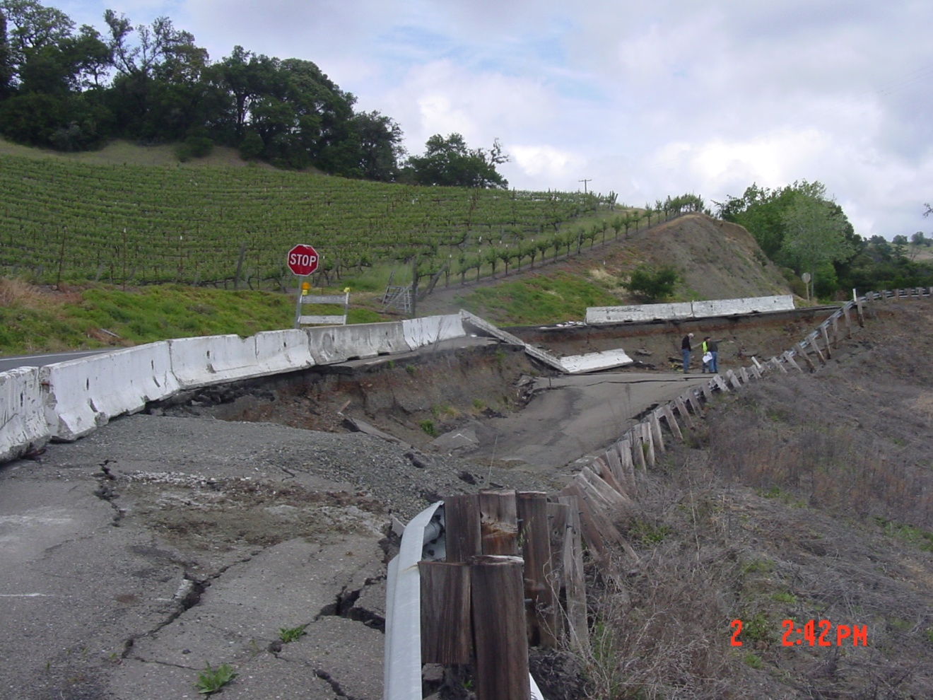
Geysers Road Slide

Slide 20
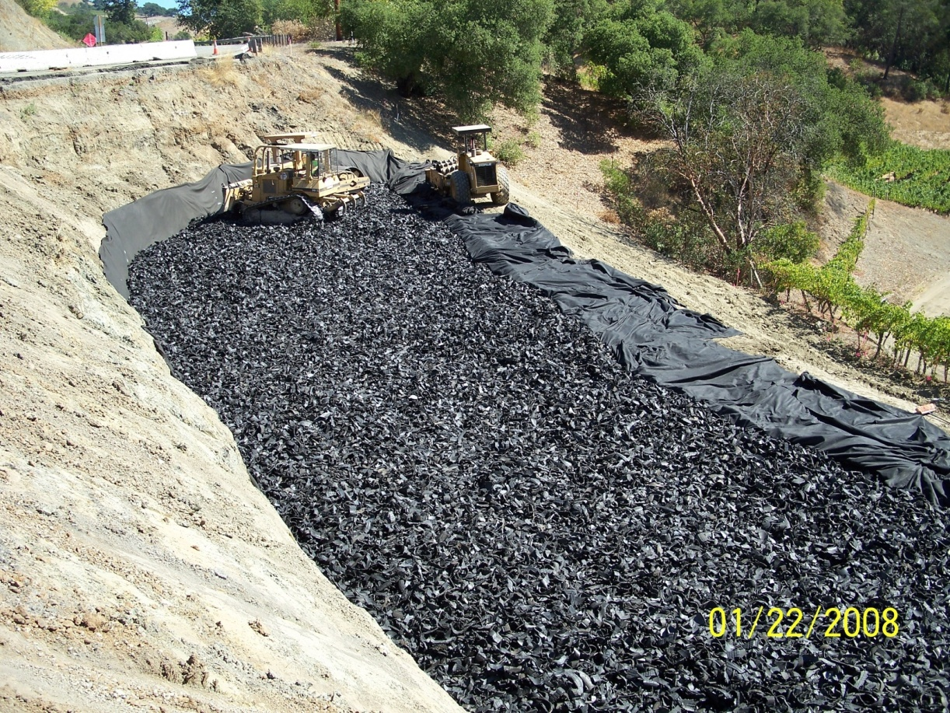
Geysers Road Slide Repair
150,000 Tires
TYPE B TDA
Notes:
PROJCT OVERVIEW

Slide 21
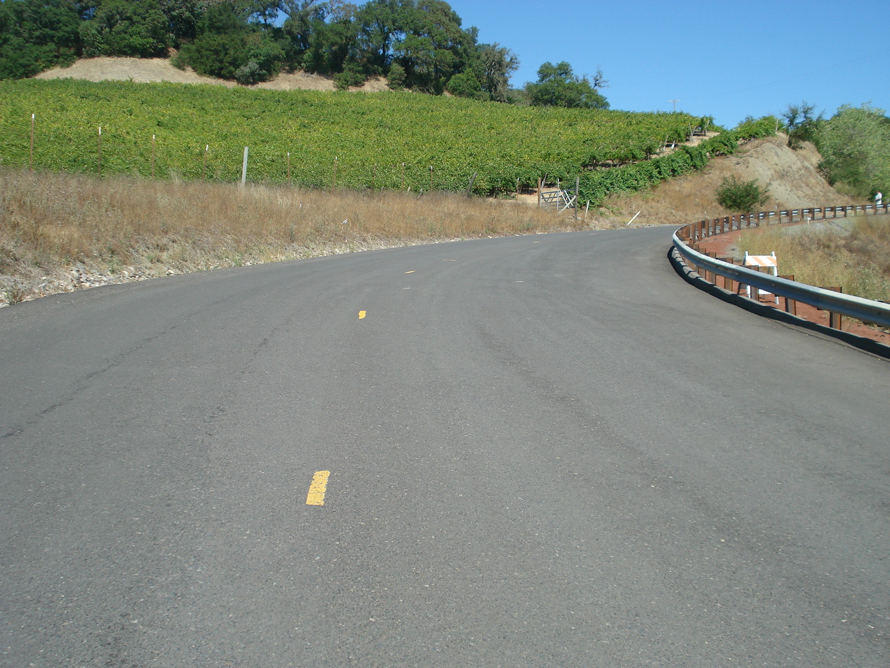
Geysers Road
Savings to County $128,000
Before
After

Slide 22
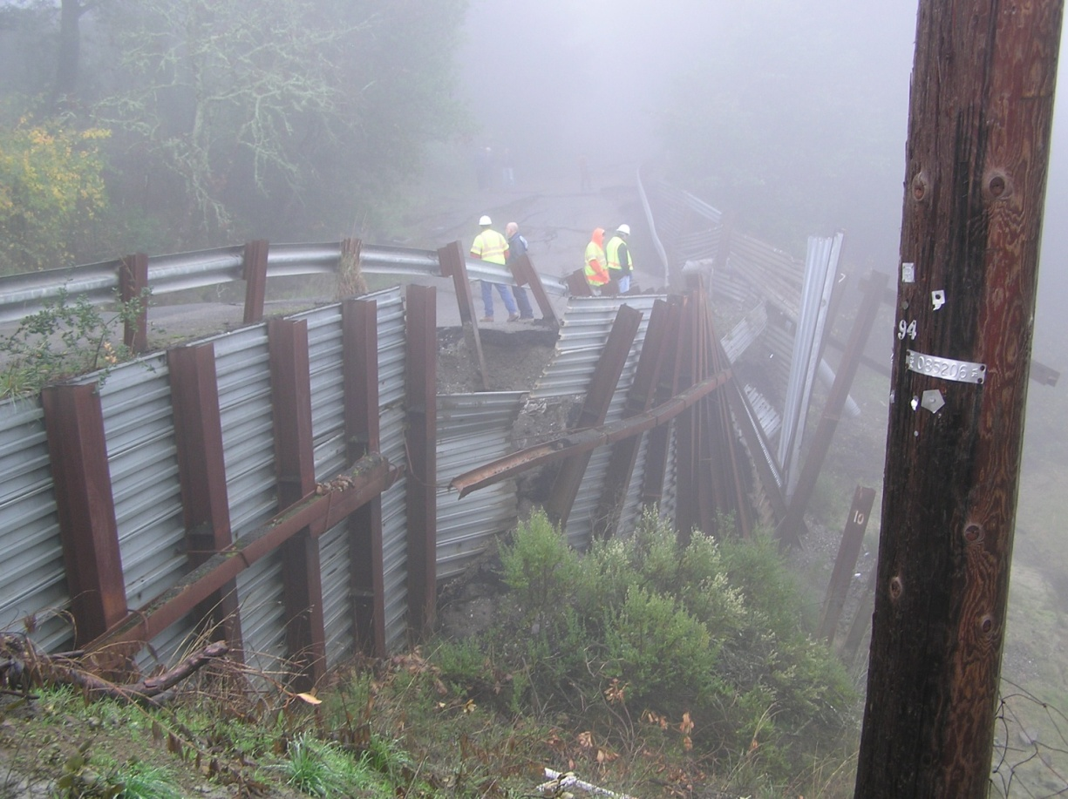
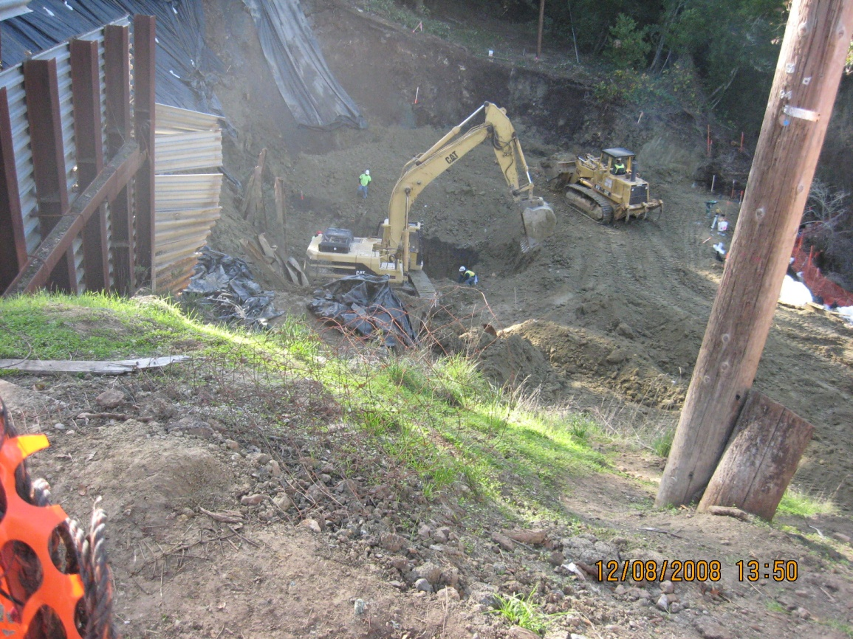
Sonoma Mtn. Road, Sonoma County
Notes:
The Sonoma Mountain Road in Glen Ellen is also a slide repair project in Sonoma county that is currently under construction.
Sonoma Mountain Road failed back in 2006 and has been completely closed since then.
After agreeing to work with the county on the Geysers Road slide project the County came for the Board with this project. They had hoped it to would be a good candidate for a TDA project. In an effort to get the county to more comfortable with using TDA on their own the CIWMB agreed to supply the TDA material for the project and provide construction oversight for the TDA placement.
The county is responsible for the design and implementation of the construction.

Slide 23
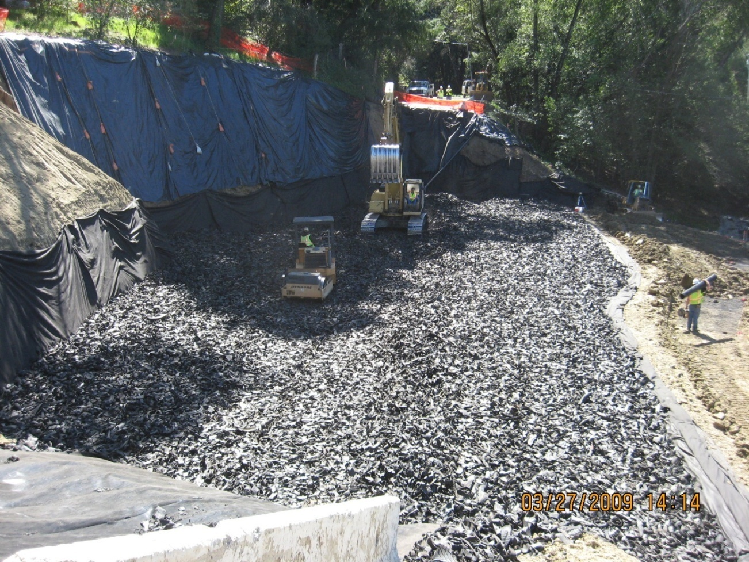
Sonoma Mountain Road
330,000 TIRES
TYPE B TDA

Slide 24
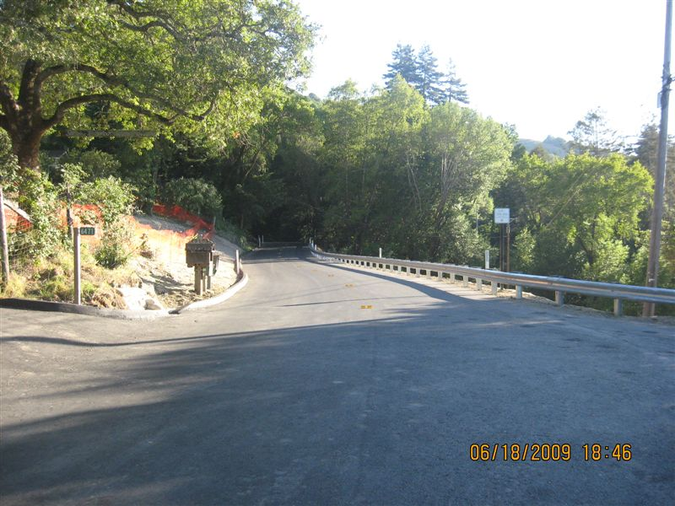
Sonoma Mtn. Road, Sonoma County
Savings to County $590,000

Slide 25
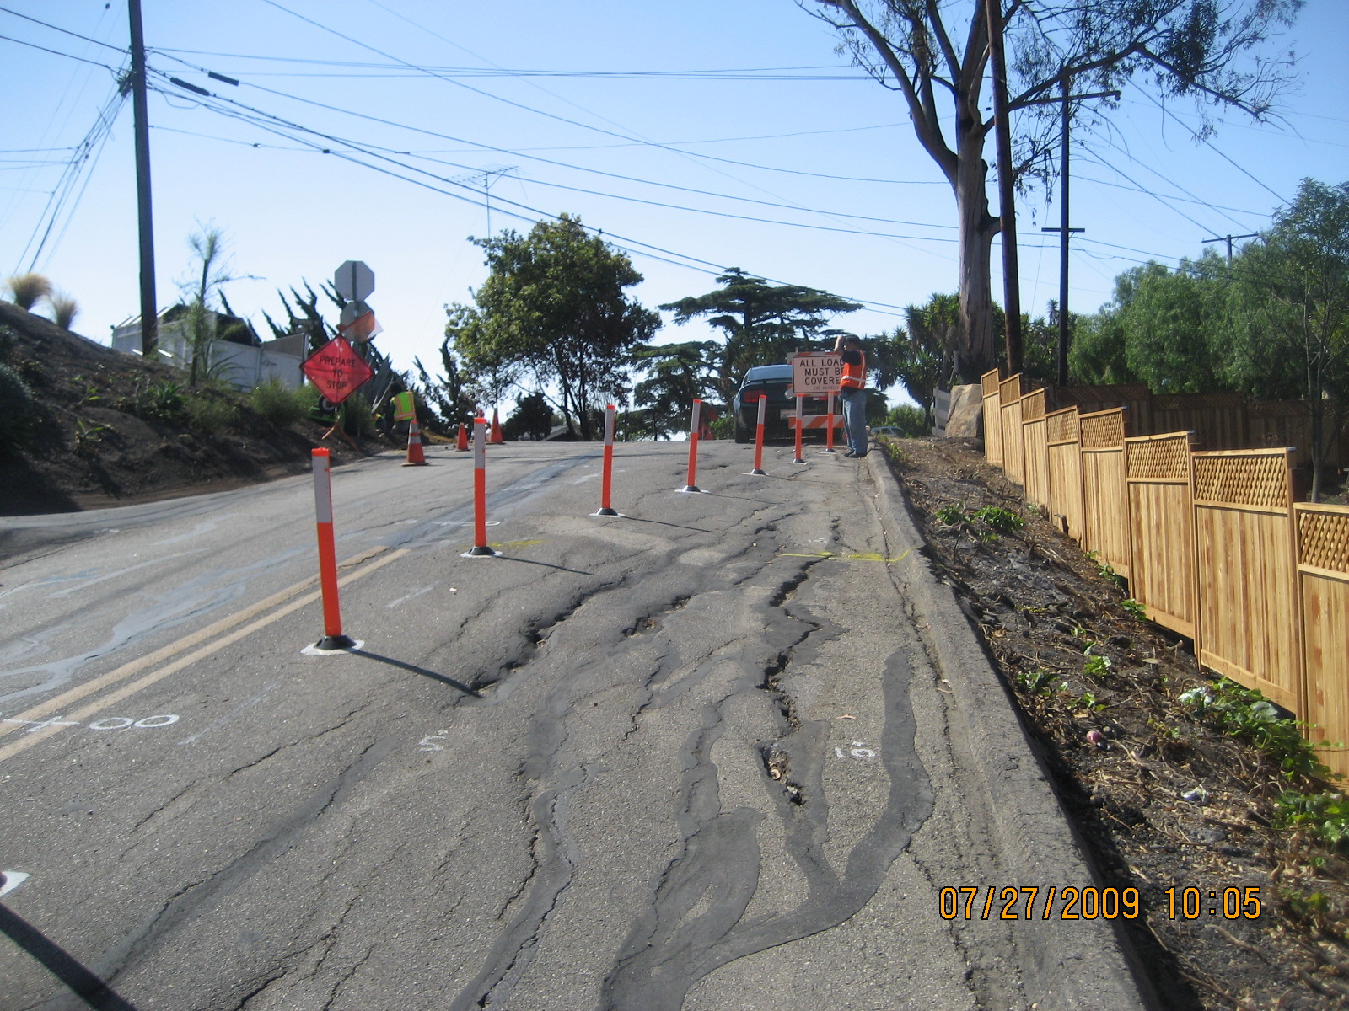
Palomino Road, Santa Barbara County Slide Repair

Slide 26
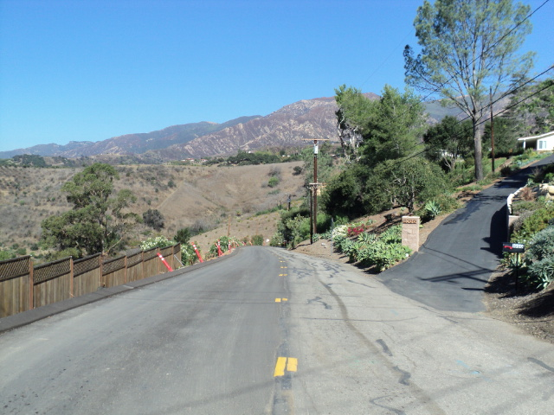
Palomino Road, Slide Repair
Savings to County $90,000

Slide 27
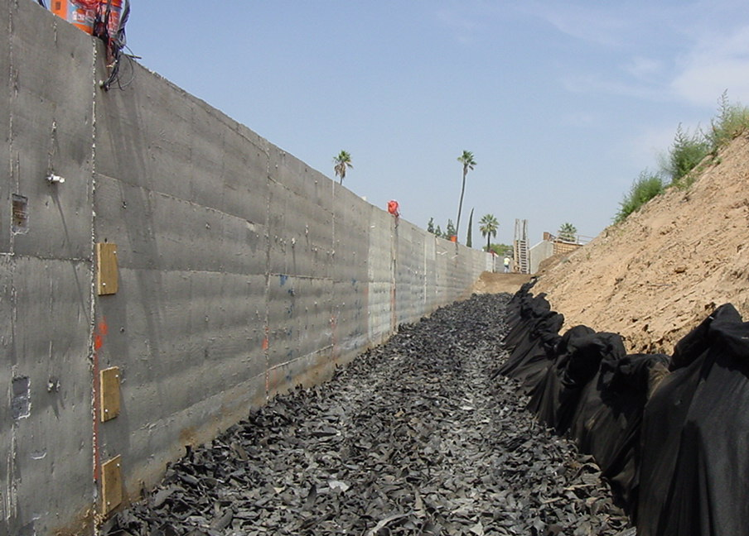
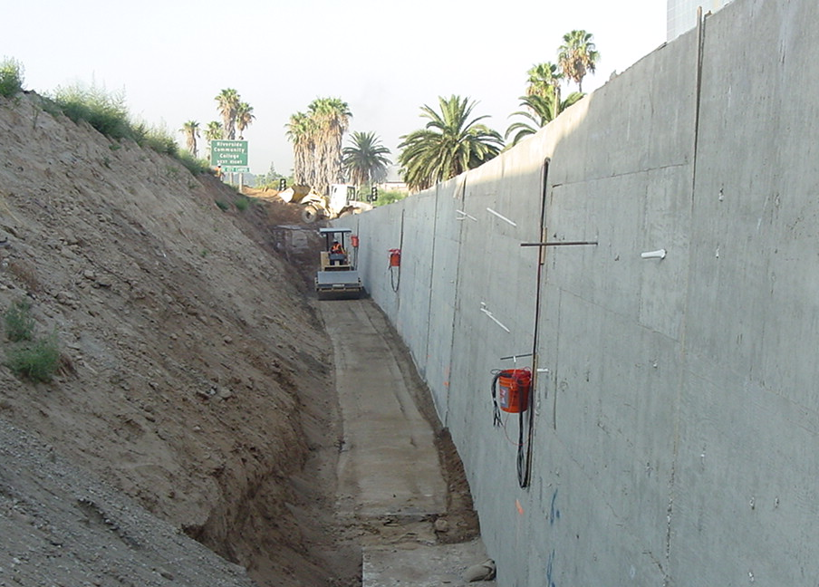
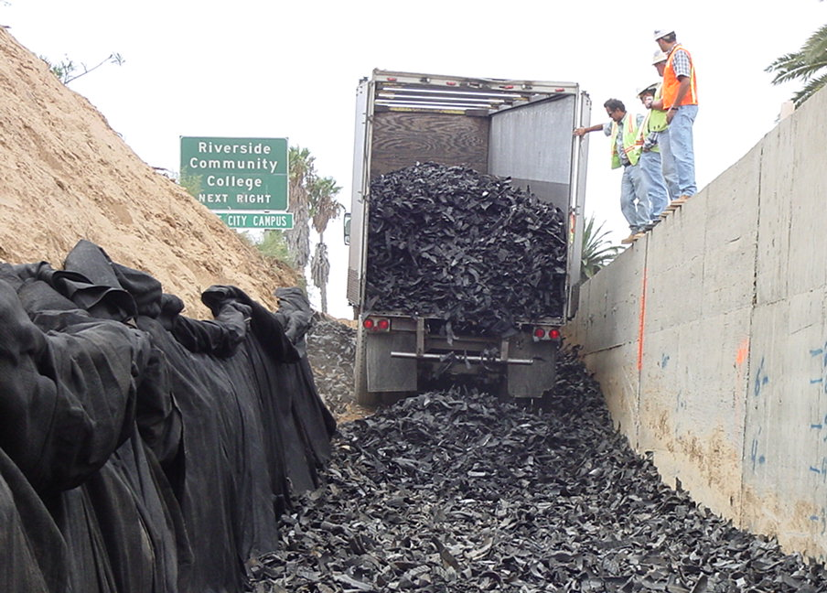
Light Weight Backfill Behind Retaining Walls
TYPE B TDA

Slide 28
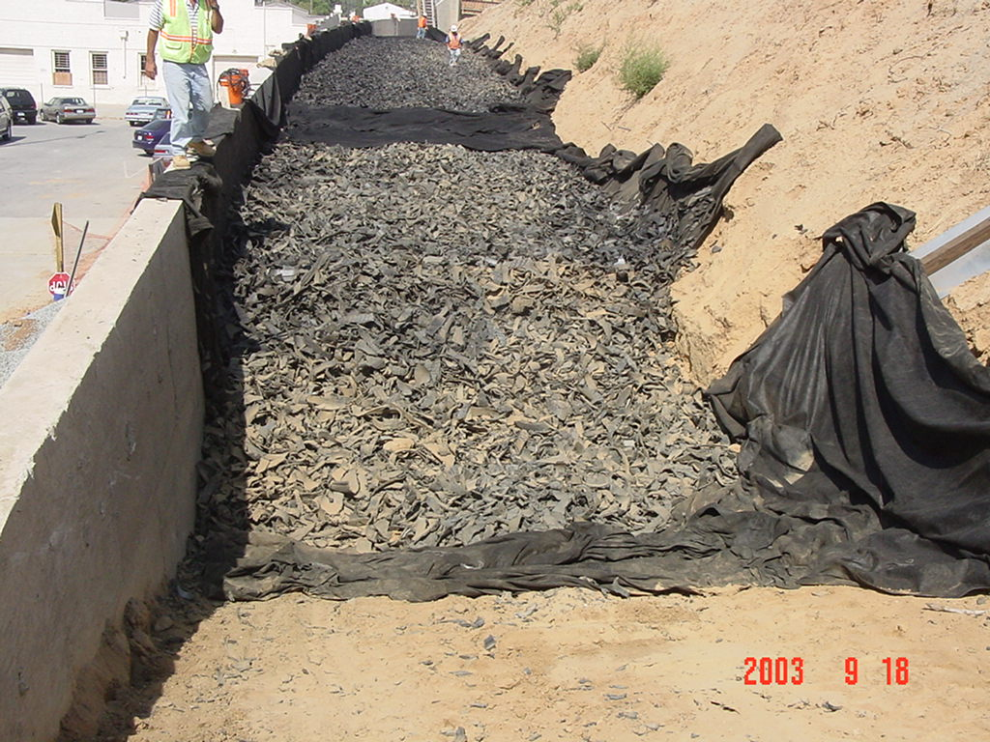
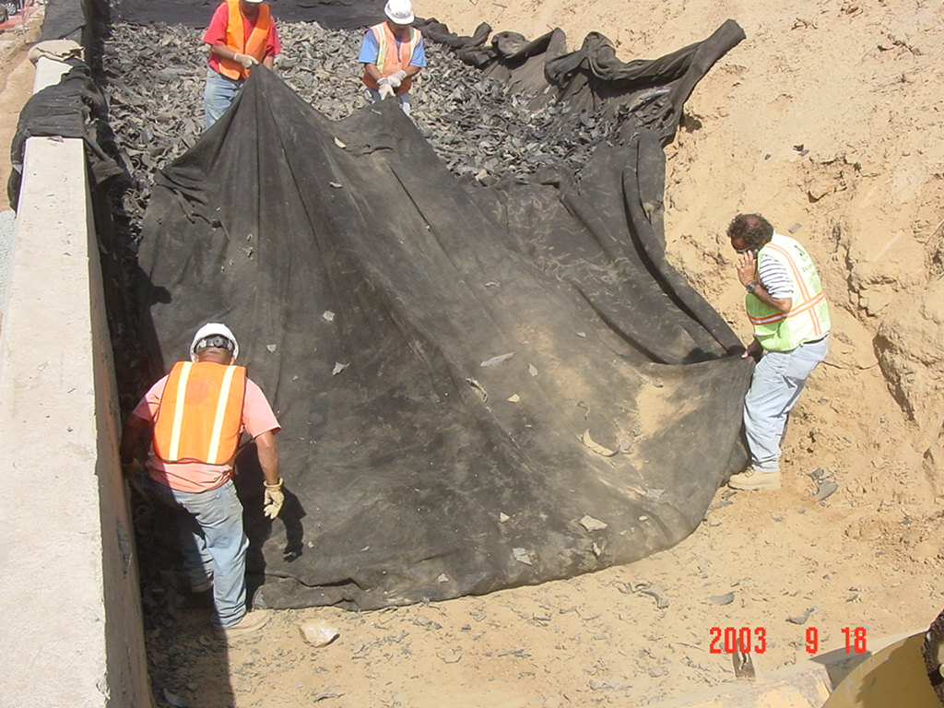
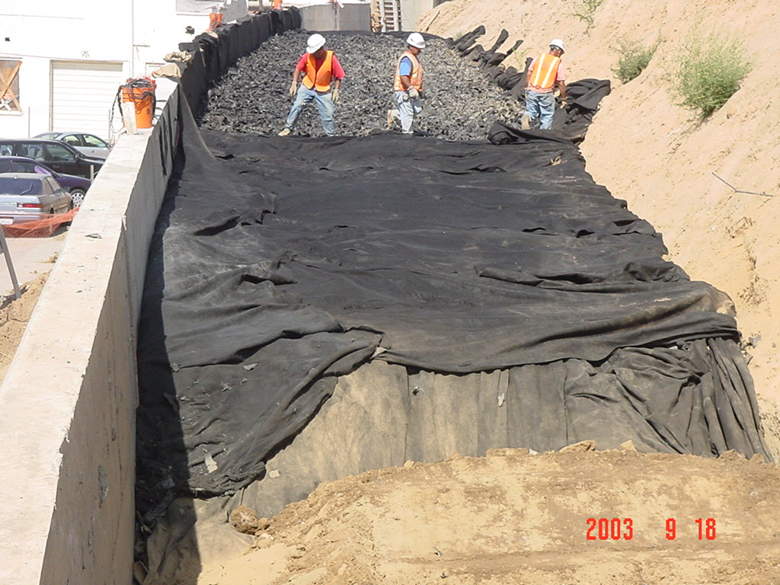
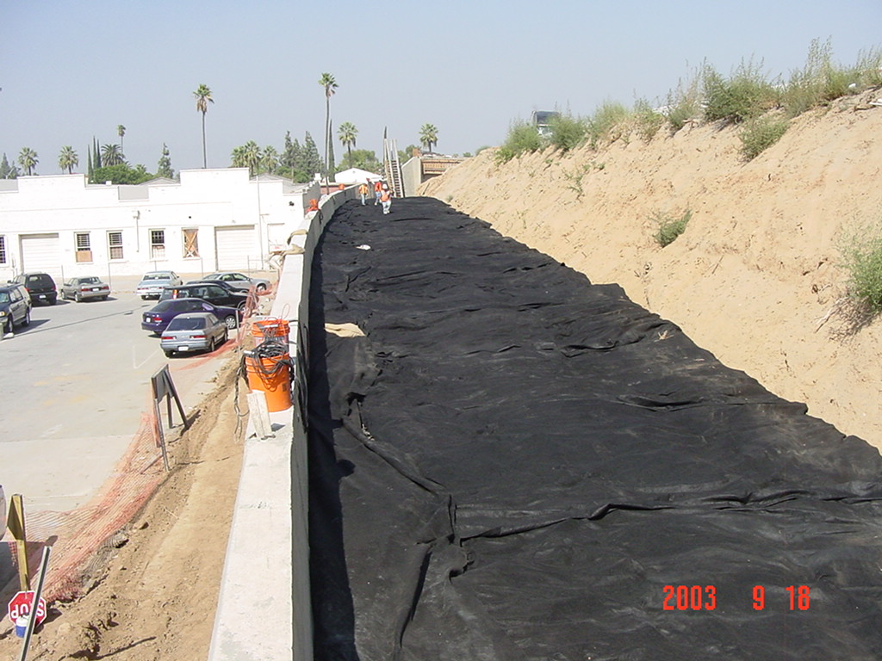
Riverside, CA
Final geo-textile wrap

Slide 29
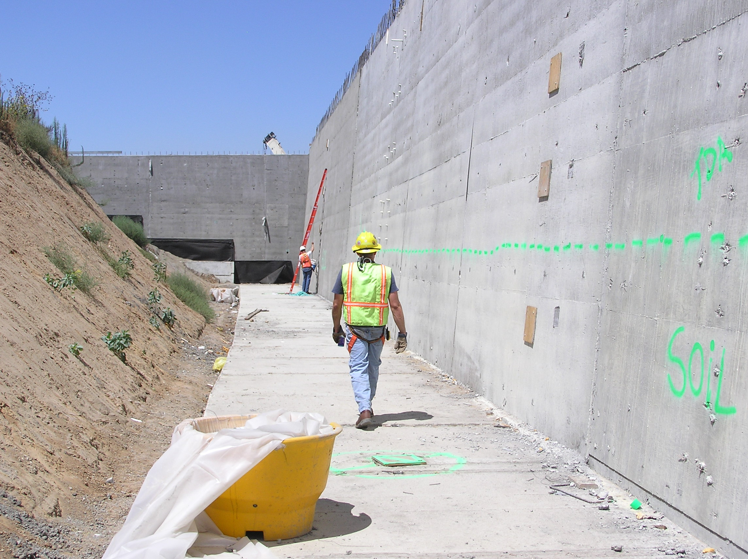
Type 1 T Retaining Walls
Estimated Savings on Future Walls - $200/ lineal foot

Slide 30
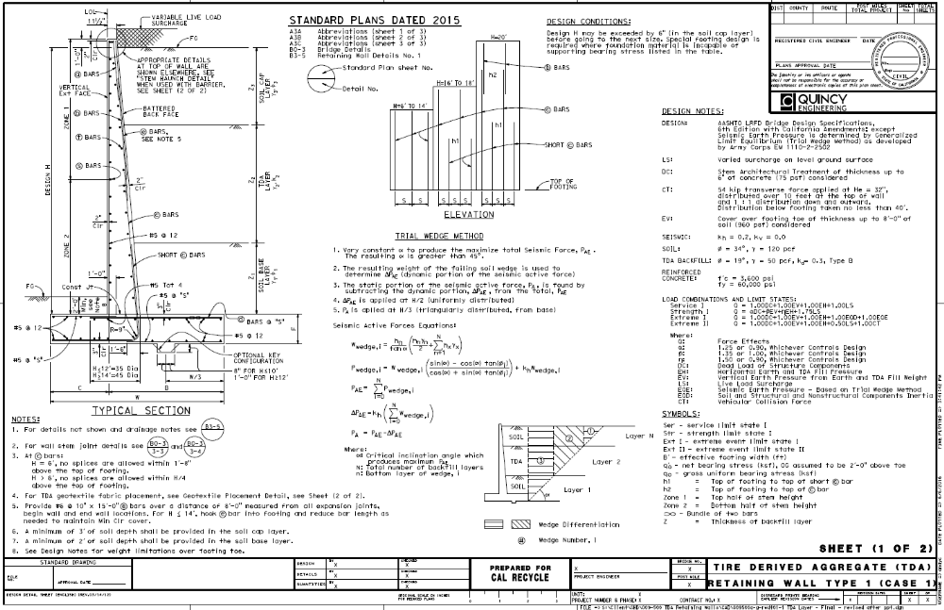
Type 1 T Retaining Walls
Estimated Savings on Future Walls - $200/ lineal foot

Slide 31
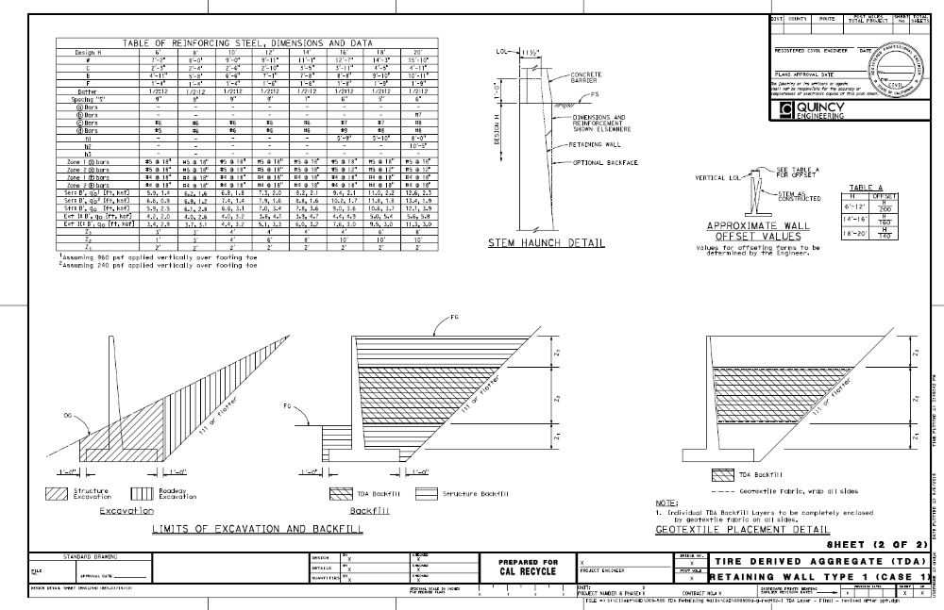
Type 1 T Retaining Walls
Estimated Savings on Future Walls - $200/ lineal foot

Slide 32
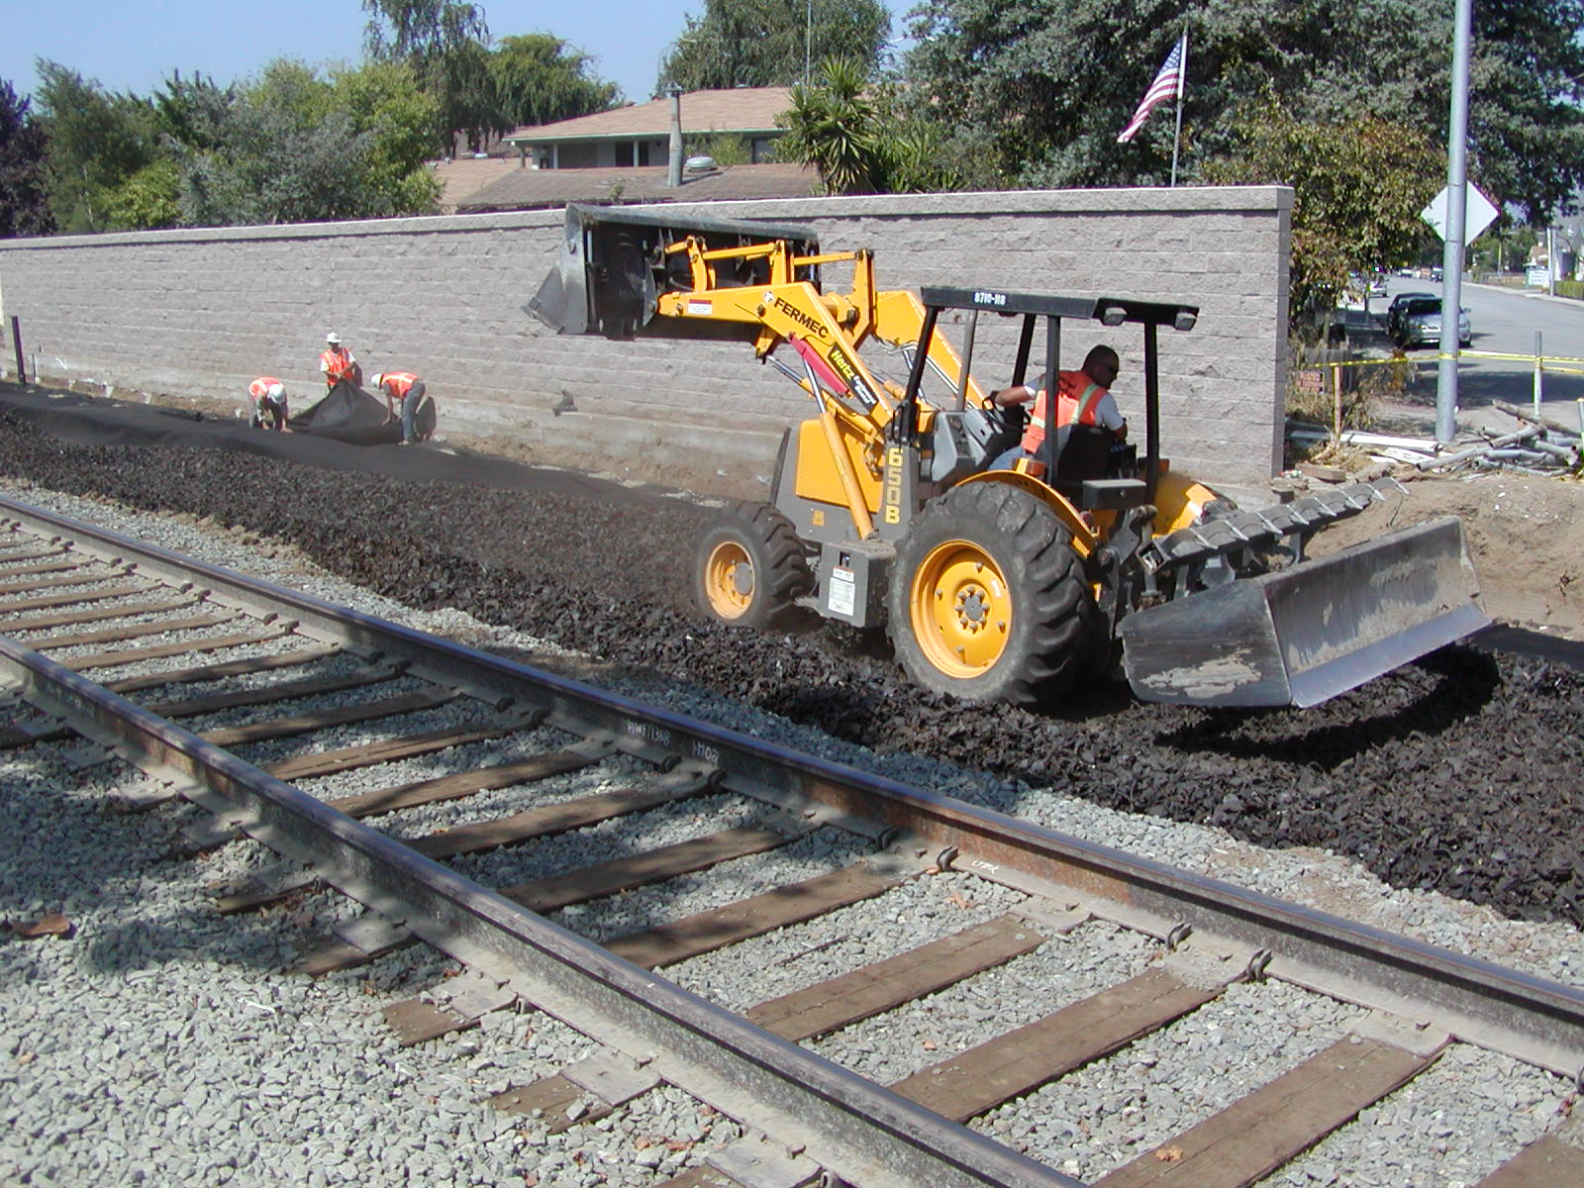
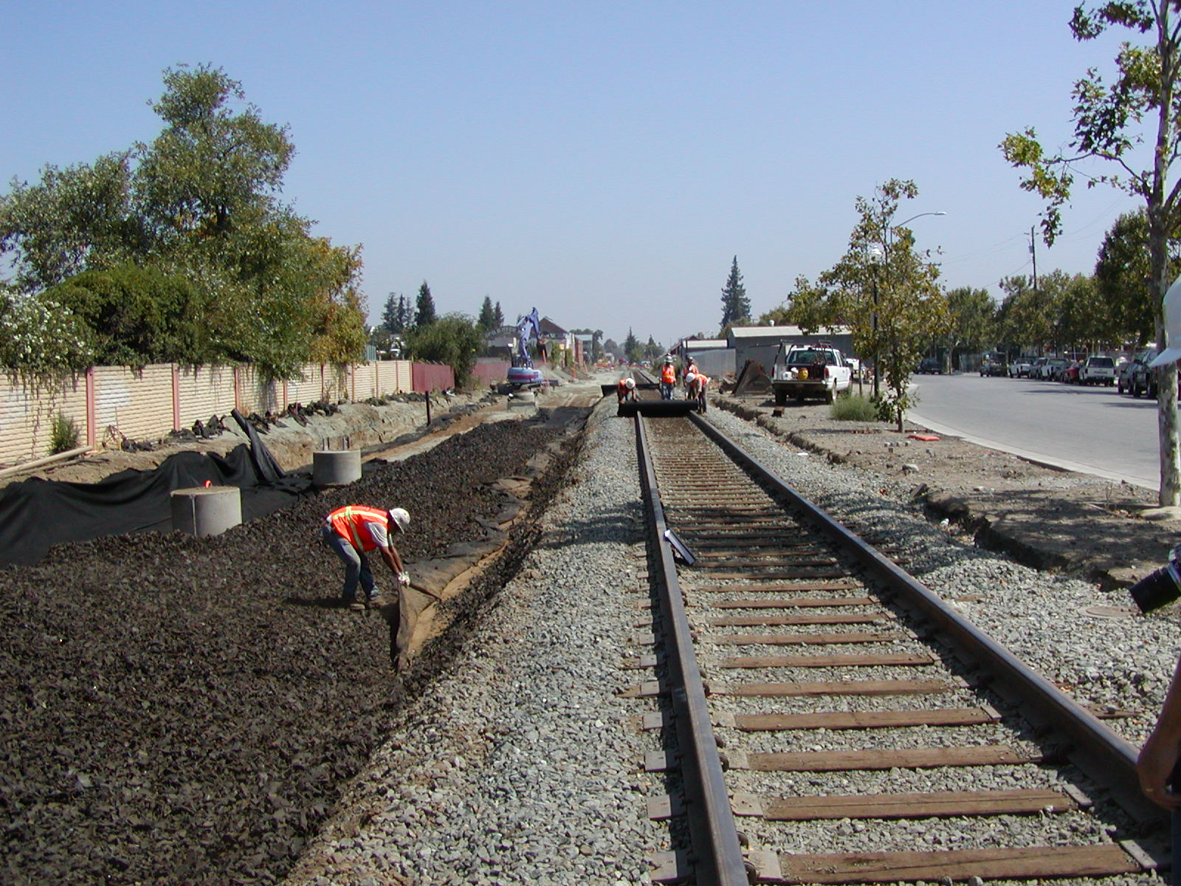
TDA In Light Rail Vibration Mitigation

Slide 33
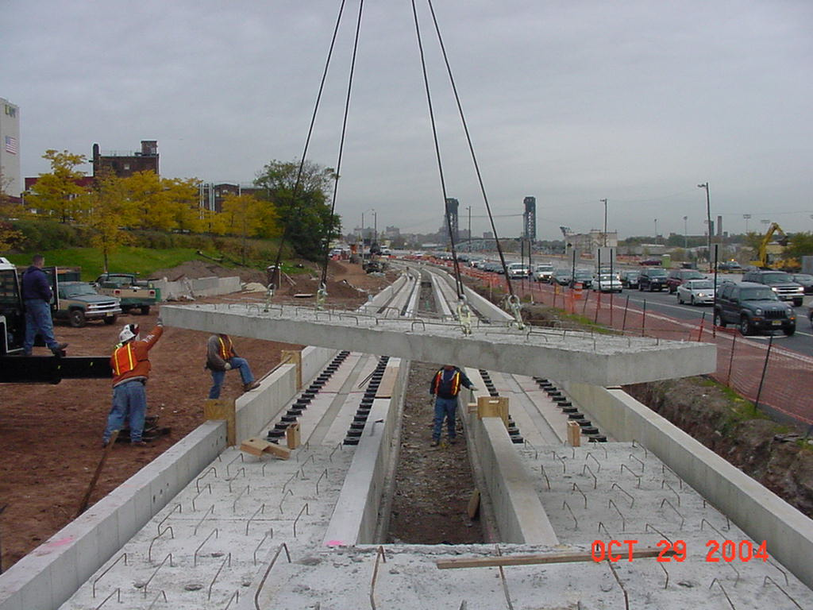
Conventional Vibration Mitigation Technology $800+/ft

Slide 34
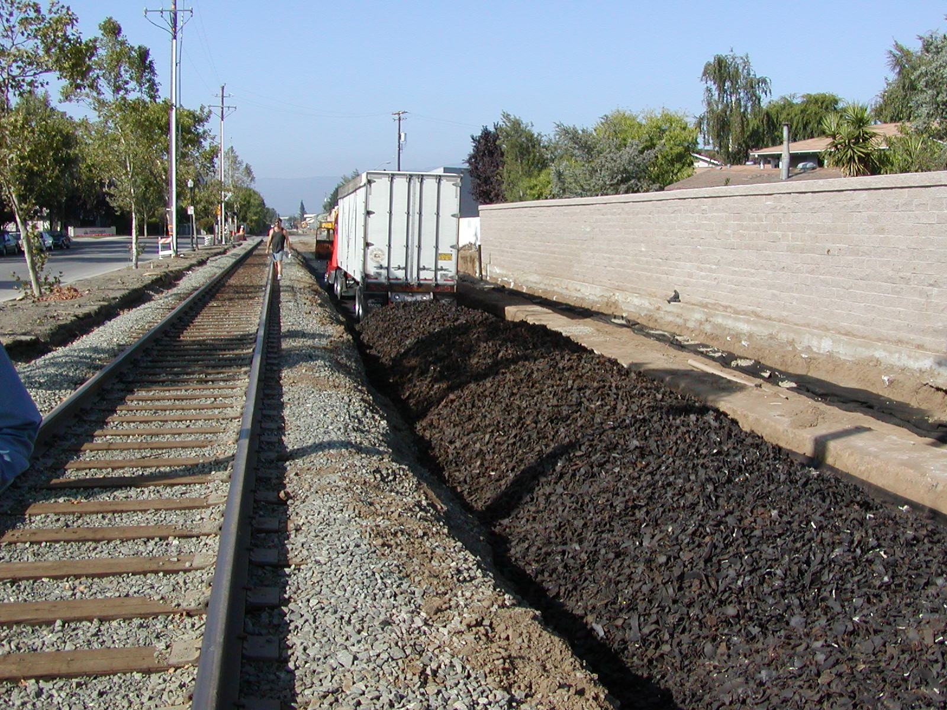
TDA Vibration Mitigation $150/ft

Slide 35
TDA LID Designs
Butte Regional Transit Operations Center (BRTOC), Chico, CA
Fleet and Materials Lab Building, Santa Rosa, CA
Transportation Improvements for Redwood Business Park, Ukiah, CA
  In Construction now

Slide 36
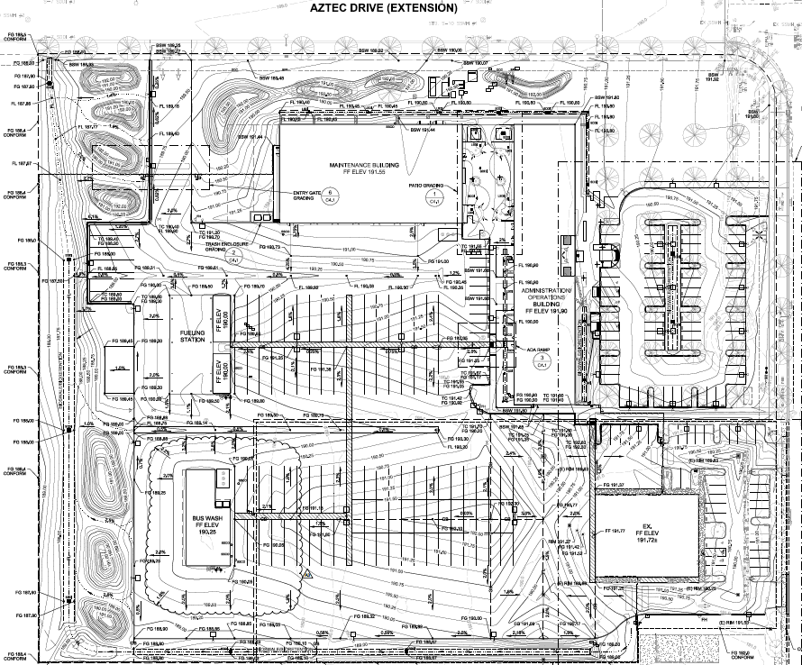
BRTOC Project Site Plan

Slide 37
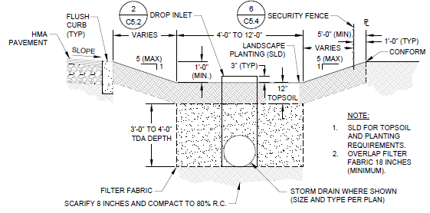
Bioretention Swale Typical Section

Slide 38
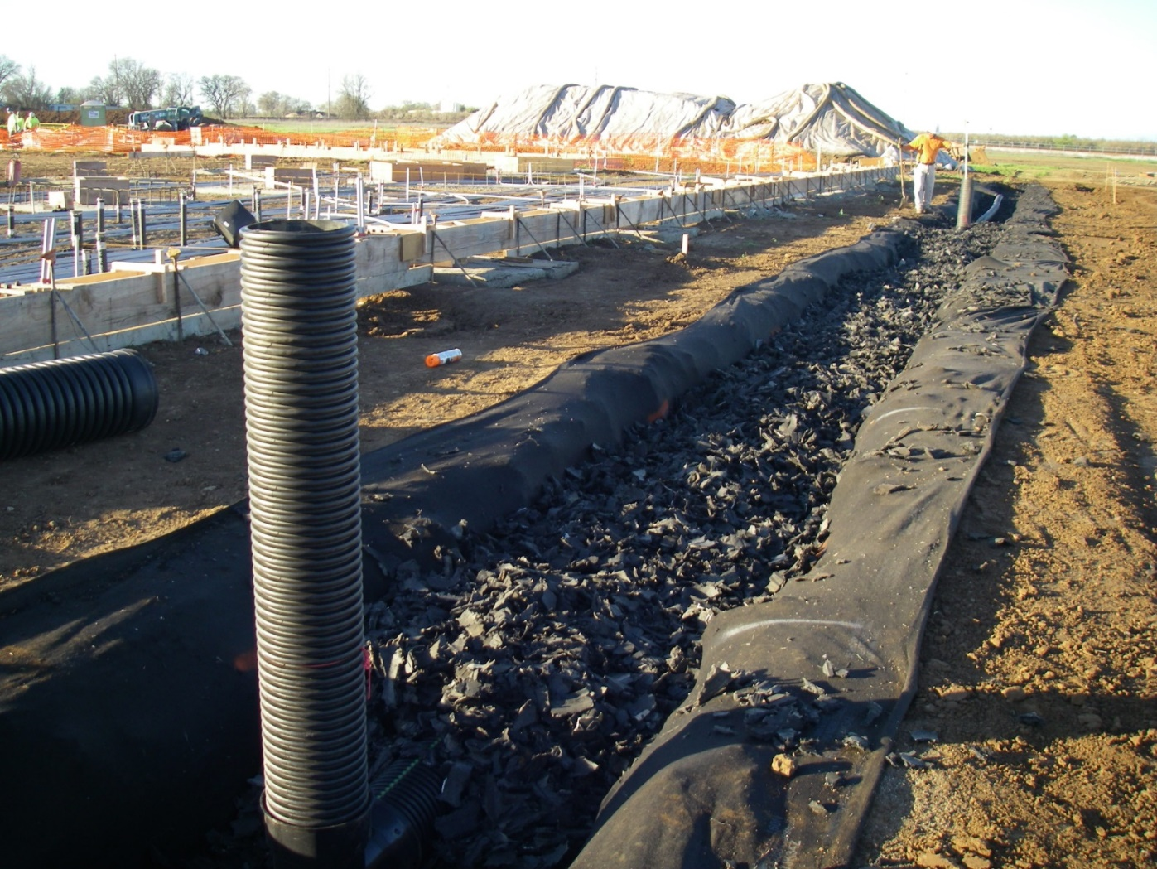
BRTOC Construction Photos

Slide 39
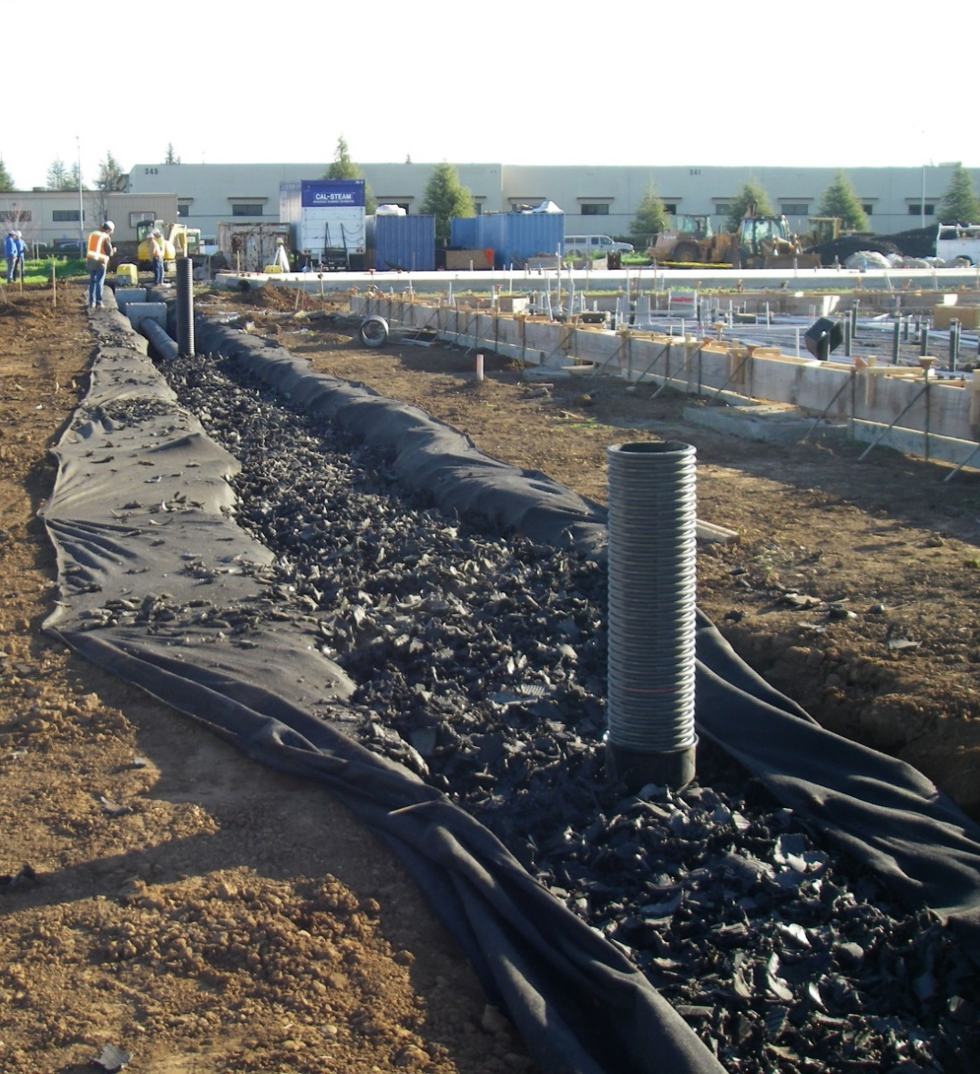
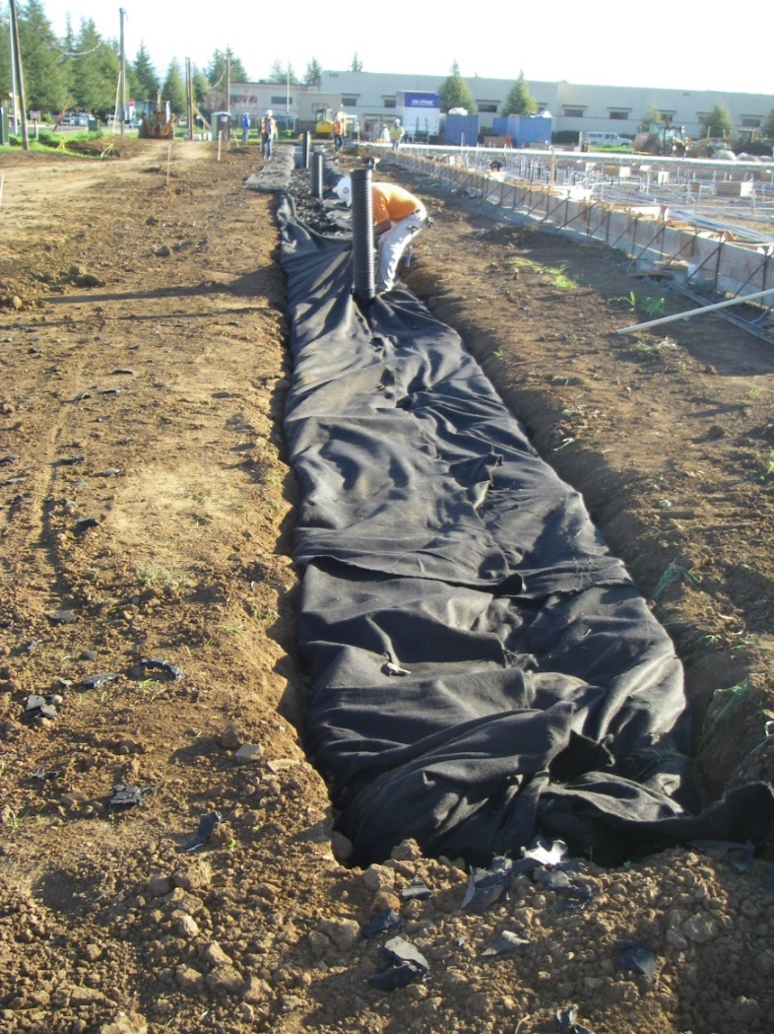
BRTOC Construction Photos

Slide 40
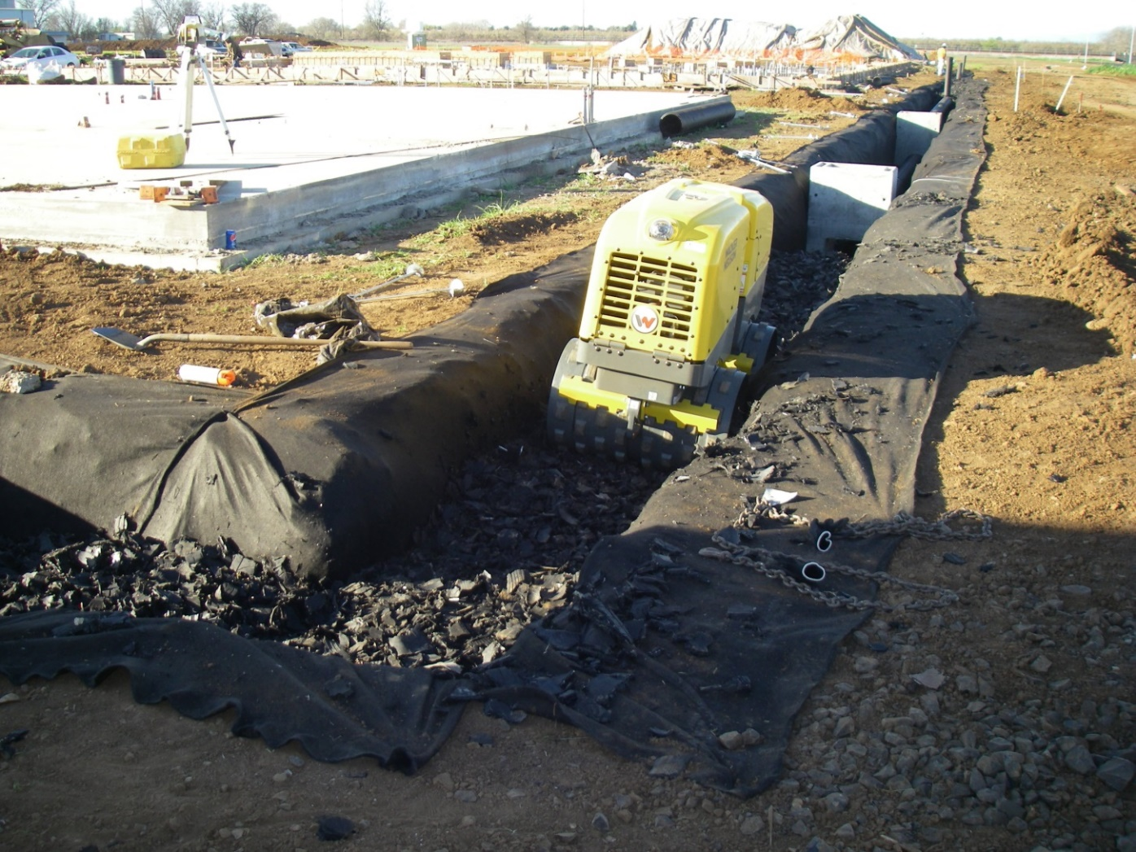
BRTOC Construction Photos

Slide 41
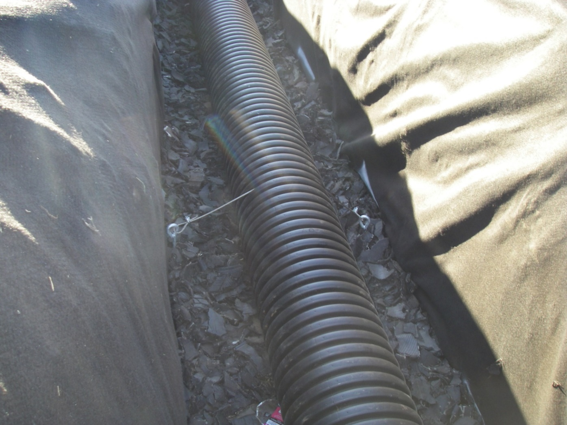

BRTOC Construction Photos
Helical Soil Anchor

Slide 42

BRTOC Construction Photos

Slide 43

BRTOC Construction Photos

Slide 44

BRTOC Construction Photos

Slide 45


BRTOC Construction Photos

Slide 46

Sonoma County Fleet Facility Site Plan

Slide 47

Bioretention Swale Typical Section

Slide 48

Fleet Facility Site Construction Photos

Slide 49

Fleet Facility Site Construction Photos

Slide 50

Fleet Facility Site Construction Photos

Slide 51

Fleet Facility Site Construction Photos

Slide 52


Fleet Facility Site Construction Photos

Slide 53

City of Ukiah Redwood Business Park
Typical Road Reconstruction & LID Plan

Slide 54

TDA Infiltration gallery cross section view
BIORETENTION TDA AREA

Slide 55

Typical Infiltration Gallery (Pre-Construction)
Cleanout
Perf Pipe
Bioretention TDA Area
Catch Basin

Slide 56



Typical Infiltration Gallery (excavation & fill)

Slide 57



Typical Infiltration Gallery

Slide 58
?

Slide 59


















































Thank You

